Slide 1
Project Presentation Integrated Project
On
Crave Cart
Nishtha, Pragti Gupta, Prerana Thakur, Priya Gupta
2210991992, 2210992056, 2210992085, 2210992096
Supervised By
Mr. Rahul
Department of Computer Science and Engineering,
Chitkara University, Punjab

Slide 2
Content
Introduction
Problem Statement
Proposed Design
Tech Stack
Features
Limitations
Conclusion
Future Scope

Slide 3
Introduction
Crave Cart is a comprehensive e-commerce platform built using the MERN stack, designed to provide a seamless online shopping experience. The platform includes essential features such as product uploads, an intuitive admin panel, and efficient category and subcategory management. To ensure secure user authentication, it implements access and refresh tokens, along with OTP-based email verification and password recovery. Crave Cart also integrates a robust payment system using Stripe and supports media uploads via Cloudinary. The frontend is developed with React, Vite, and Tailwind CSS, ensuring a responsive and visually appealing user interface. Additionally, the application leverages Redux Toolkit for state management, Postman for API testing, and Sweet Alert for interactive notifications. This project serves as an excellent opportunity to enhance skills in MongoDB, Express.js, React.js, and Node.js while developing a scalable and secure e-commerce solution.

Slide 4
Problem Statement
In today's digital era, online shopping platforms often face challenges related to security, scalability, and user experience, leading to inefficiencies for both customers and administrators. Many existing e-commerce solutions struggle with secure authentication, complex product management, and seamless payment integration. Additionally, the lack of a well-structured admin panel and an intuitive user interface can hinder smooth operations. To address these issues, Crave Cart is designed as a comprehensive e-commerce platform that ensures secure user authentication through access and refresh tokens, OTP-based email verification, and password recovery. It provides an efficient admin panel for product uploads and category management while integrating Cloudinary for media uploads and Stripe for secure transactions. By leveraging modern web technologies like React, Vite, and Tailwind CSS for a responsive UI and Redux Toolkit for state management, Crave Cart aims to create a scalable, high-performance, and user-friendly online shopping experience.

Slide 5
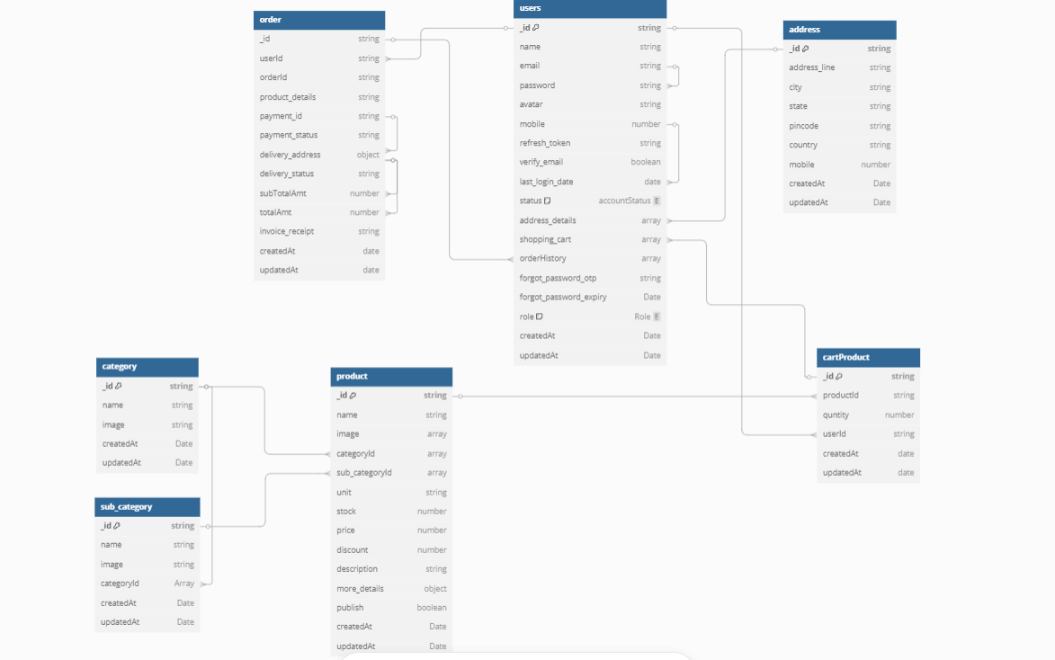
Proposed Design

Slide 6
Tech Stack
The Crave Cart platform is built using the MERN Stack along with additional technologies to enhance user experience.
Backend:
Node.js – For server-side logic and API development
Express.js – For handling backend routing and middleware
Mongoose – For interacting with the MongoDB database
Json Web Token (JWT) – For secure authentication using access and refresh tokens
Dot env – For environment variable management
Frontend:
React.js – For building the user interface
Vite – For fast development and optimized builds

Slide 7
Tailwind CSS – For responsive and modern styling
Redux Toolkit – For efficient state management
React Router – For client-side routing
Database:
MongoDB – For storing user, product, and transaction data
Authentication & Security:
OTP-based email verification – Implemented using Resend
Password recovery system – Securely manages password reset requests
Access & refresh tokens – Ensures secure user authentication

Slide 8
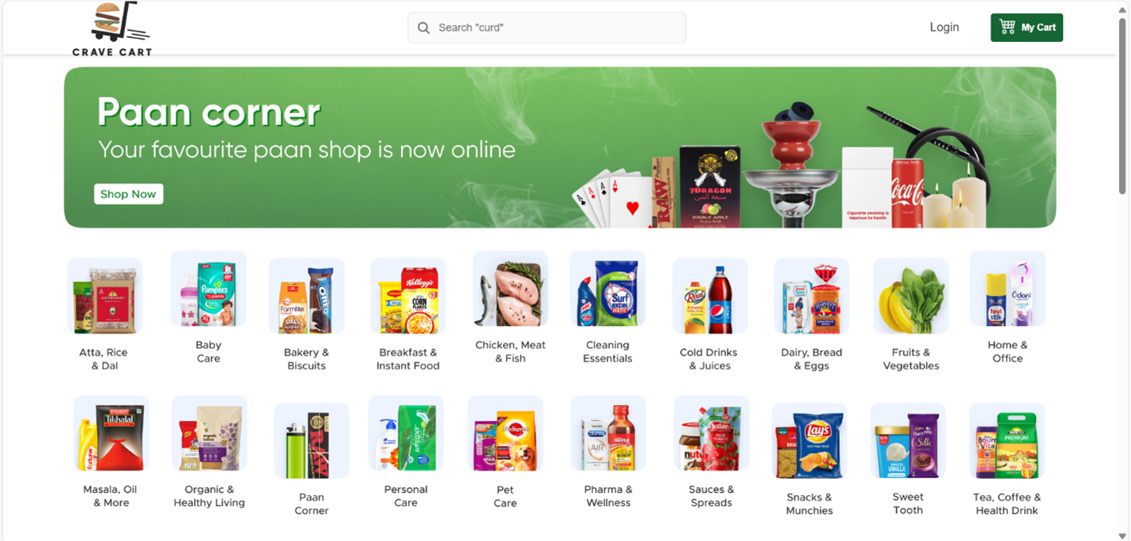

Slide 9
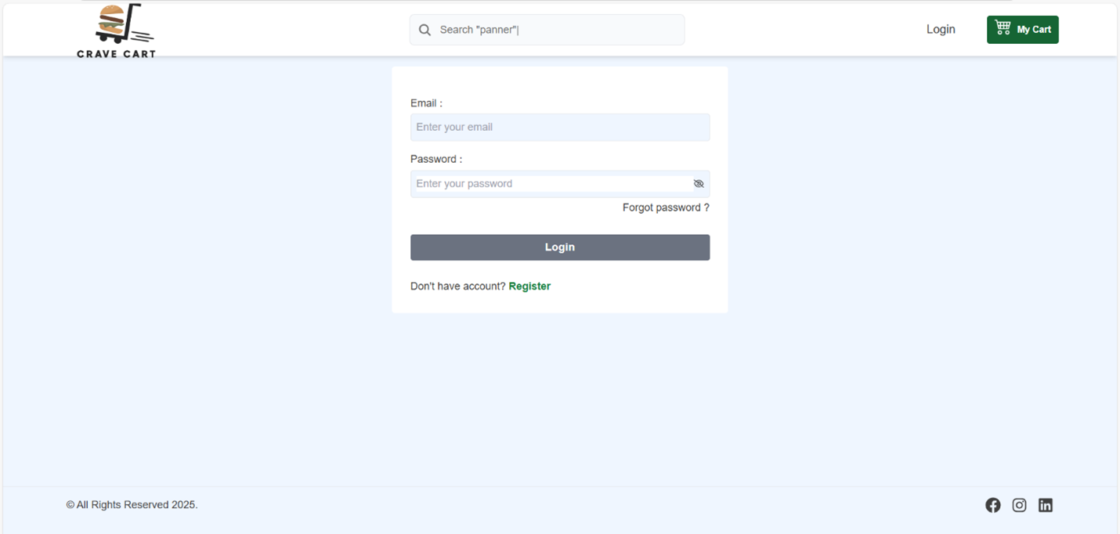

Slide 10
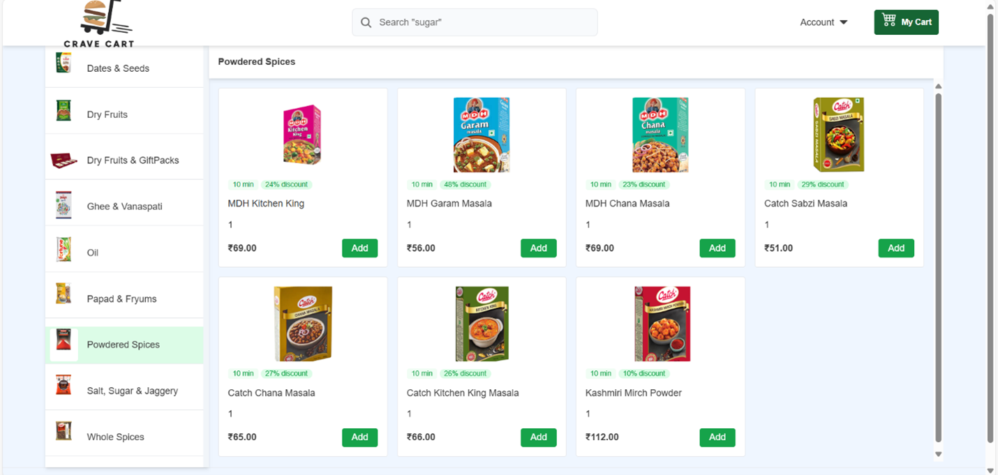

Slide 11
Features
User-Centric Features:
Secure User Authentication – Access & refresh tokens.
Personalized User Dashboard – View order history, manage addresses, track shipments.
Product Search & Filtering – Efficient product discovery with category-based search and filters.
Secure Checkout with Stripe – Seamless online transactions with multiple payment options.
Admin-Focused Features:
Admin Dashboard – Intuitive panel for managing products, categories, orders and users.
Product & Inventory Management – Upload, edit, categorize and track stock levels.
Order Processing & Status Updates – Admins can update order status.

Slide 12
Limitations
No Native Mobile App Support – The platform is currently web-based; a dedicated mobile app could enhance accessibility.
Limited Scalability for High Traffic – As traffic grows, performance optimization and server scaling are required.
No AI-Powered Recommendations – Product suggestions are static; integrating AI-based recommendations could improve personalization.
Possible Cyber Threats – Even with strong security, there is always a risk of hacking and fraud.
No Multilingual Support – The platform currently supports only one language, making it less accessible for global users.

Slide 13
Conclusion
Crave Cart is a robust and scalable e-commerce platform designed to provide a secure and user-friendly shopping experience. By integrating modern technologies like React, Vite, Tailwind CSS, Redux Toolkit, Stripe, and Cloudinary, it ensures smooth performance, efficient product management, and secure transactions.
While the platform has strong features, it also has some limitations, such as the lack of a mobile app, direct shipping integration, and AI-based recommendations. However, with further improvements, Crave Cart has the potential to become an even more powerful and scalable solution in the
e-commerce industry.

Slide 14
Future Scope
Mobile App Development – Expanding Crave Cart into a mobile application for Android and iOS to enhance accessibility and user engagement
AI-Powered Recommendations – Implementing AI-based product recommendations and personalized shopping experiences to improve customer satisfaction.
Multi-Language & Multi-Currency Support – Expanding to global markets by offering language translations and local currency support.
Marketing & Customer Engagement Tools – Adding email campaigns, SMS notifications, push notifications, and discount management to boost sales.

Slide 15

15

