Slide 1
Setup Hadoop Core components

Slide 2
Agenda
Overview
HDFS Architecture
Setup HDFS
Map Reduce
MRv1 Architecture
Setup MRv1 or Classic
Challenges with MRv1
YARN Architecture
Setup MRv2 or YARN
Running jobs

Slide 3
Overview
In this session we will set up Hadoop Core Components using Cloudera Distribution of Hadoop eco system. We will use Cloudera Manager to set up cluster and both HDFS and Map Reduce will be explained in detail.

Slide 4
6 node cluster
Three Servers (Masters)
Three Servers (Slaves)
Client
Namenode
Datanode
Datanode
Secondary Namenode
Datanode

Slide 5
6 node cluster
Three Servers (Masters)
Three Servers (Slaves)
Monitoring Database
Monitoring Server
Monitoring Agent
Monitoring Agent
yum repository server/client
yum client
HDFS
HDFS

Slide 6
HDFS Architecture
HDFS – Hadoop Distributed File System (Storage)
Daemon Processes
Slaves: Datanodes
Masters: Namenode(s) and Secondary Namenode
Parameter Files
core-site.xml
hdfs-site.xml
Apache Web Interfaces
Namenode WUI
Datanode WUI
Log Files

Slide 7
Setup HDFS on Cloudera Manager
Login to Cloudera Manager(http://<ipaddress>:7180)
Default user/password: admin/admin
Click on add service
Install binaries
Configure Namenode, Secondary Namenode, Datanodes as well as client
HDFS will be ready!!!
Validate by copying a file from client/gateway node (master01)

Slide 8
HDFS
What is HDFS?
Hadoop Distributed File System
It is all about storage
Logical file system
Distributed
Resilient
Fault Tolerant

Slide 9
Setup HDFS
Configure Slaves and Masters
Datanodes
Namenode(s) and/or Secondary Namenode
Configuration Files
core-site.xml
hdfs-site.xml
hadoop-env.sh
log4j.properties
Validation
Files and Blocks (block size)
Fault tolerance and Rack awareness (replication factor)
Verify logs and browse the file system
Understand Hadoop command line interface
Understand HDFS Web Interfaces

Slide 10
Configure Slaves and Masters
Datanode
Map Reduce
Namenode
Datanode
Map Reduce
Secondary Namenode
Datanode
Map Reduce
Map Reduce

Slide 11
Configure Slaves and Masters
Slaves
Datanodes for storage
Most of the nodes in Hadoop cluster are slaves and they will have datanodes running
Masters
Namenode
Secondary Namenode
Heartbeat
Datanodes sends heartbeat to Namenode at frequent and regular intervals.
As part of heartbeat additional information about available storage will be sent to Namenode

Slide 12
Configuration files
hadoop-env.sh is for environment variables
core-site.xml will have parameters that are used by HDFS and Map Reduce
hdfs-site.xml will have parameters that are used by HDFS
Modifying parameters
Understanding Final

Slide 13
Validation
Using WI (Namenode and Datanode)
Using OS commands
Using Ambari/Cloudera Manager
Verify logs

Slide 14
Files and Blocks
File abstraction using blocks
File abstraction means a file can be larger than any one hard disk in the cluster
It can be achieved by Network file system as well as HDFS
HDFS and other distributed file systems typically uses local file system over network file system
Files are distributed on HDFS based on dfs.blocksize

Slide 15
Files and Blocks
Fault tolerance – HDFS is fault tolerant
HDFS does not use RAID (RAID only solves Hard disk failure, mirroring is expensive and striping is slow)
HDFS uses mirroring and dfs.replication controls how many copies should be made (default 3).
HDFS mirroring/replication solves
Disk failure as well as any other hardware failure (except network failures)
Network failures are addressed using multiple racks with multiple switches

Slide 16
Files and Blocks
Files are divided into blocks based up on dfs.blocksize (default 128 MB)
Each block will have multiple copies and stored in the servers designated as datanodes. It is controlled by parameter called dfs.replication (default 3)
What is file metadata?
HDFS file is logical
Each block will have block id and multiple copies
Each copy will be stored in separate data node
Mapping between file, block and block location is metadata of a file
Also file permissions, directories etc
All these will be stored in in-memory of Namenode

Slide 17
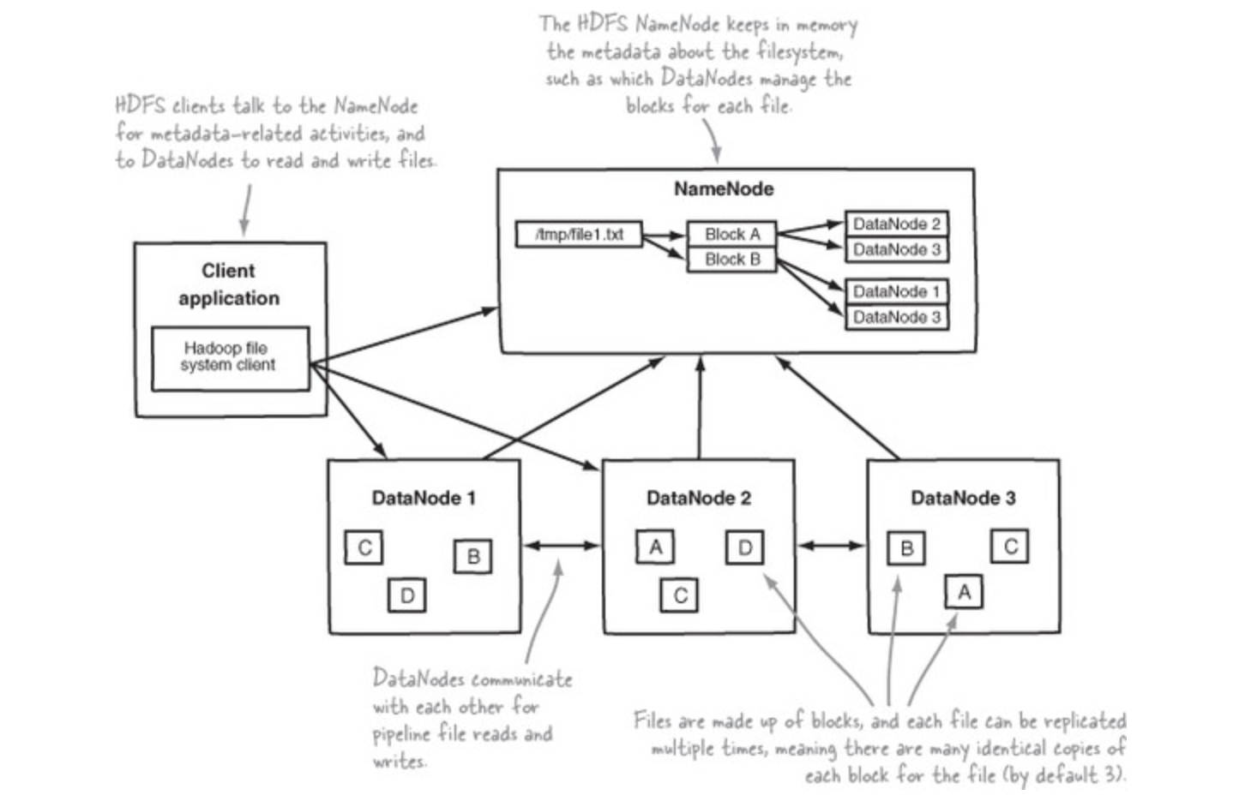
Determine how HDFS stores, reads, and writes files.

Slide 18
Rack Awareness
HDFS mirroring/replication solves
Disk failure as any other hardware failure (except network failures)
Network failures are addressed using multiple racks with multiple switches
HDFS is rack aware, at least one copy will be made in each of the racks in a 2 rack hadoop cluster

Slide 19
Namenode Recovery and Secondary Namenode
Editlogs
FSImage
It only contains files and blocks (to reduce the size of the FSImage and improve restore time – which is serial in nature)
It does not contain block locations
Secondary Namenode
A helper process which merges latest edit log with last snapshot of FSImage and create new one
Recovery process
Namenode starts in safemode
Restores latest FSImage
Recovers using latest edit log
Namenode will do a roll call to datanode to determine the locations of the blocks

Slide 20
Important Configuration Parameters
Namenode IP
Block Size
Replication Factor
Namenode directories for fsimage and editlogs
Datanode directories
Namenode WI and Datanode WI IPs and Ports
Overriding parameter values at run time

Slide 21
HDFS - Important parameters (Hadoop cluster with one name node)
File Name | Parameter Name | Parameter value | Description
core-site.xml | fs.defaultFS/fs.default.name | hdfs://<namenode_ip>:8020 | Namenode ip address or nameservice (HA config)
hdfs-site.xml | dfs.block.size, dfs.blocksize | 128 MB | Block size at which files will be stored physically.
hdfs-site.xml | dfs.replication | 3 | Number of copies per block of a file for fault tolerance
hdfs-site.xml | dfs.namenode.http-address | 0.0.0.0:50070 | Namenode Web UI. By default it might use ip address of namenode.
hdfs-site.xml | dfs.datanode.http.address | 0.0.0.0:50075 | Datanode Web UI
hdfs-site.xml | dfs.name.dir, dfs.namenode.name.dir | <directory_location> | Directory location for FS Image and edit logs on name node
hdfs-site.xml | dfs.data.dir, dfs.datanode.data.dir | <directory_location> | Directory location for storing blocks on data nodes
hdfs-site.xml | fs.checkpoint.dir, dfs.namenode.checkpoint.dir | <directory_location> | Directory location which will be used by secondary namenode for checkpoint.
hdfs-site.xml | fs.checkpoint.period, dfs.namenode.checkpoint.period | 1 hour | Checkpoint (merging edit logs with current fs image to create new fs image) interval.
hdfs-site.xml | dfs.namenode.checkpoint.txns | 1000000 | Checkpoint (merging edit logs with current fs image to create new fs image) transactions.

Slide 22
Verify logs and browse file system
hdfs fsck command
Map HDFS file with blocks and locations using hdfs fsck command
Understand how files are distributed PHYSICALLY?

Slide 23
Understand Hadoop command line interface
hadoop fs
hdfs dfs
Important commands
-mkdir
-copyFromLocal
-put
-copyToLocal
-get
-mv
-cat
-tail
Many more

Slide 24
Understand HDFS Web Interface
It can be accessed using http://<namenode_ipaddress>:50070

Slide 25
Identify components and daemons of an HDFS HA-Quorum cluster
Namenode recovery and secondary namenode
Editlogs
FSImage
It only contains files and blocks (to reduce the size of the FSImage and improve restore time – which is serial in nature)
It does not contain block locations
Editlogs are merged into FSImage at regular intervals (checkpointing)
Secondary Namenode
A helper process which merges latest edit log with last snapshot of FSImage and create new one
Recovery process
Namenode starts in safemode
Restores latest FSImage
Recovers using latest edit log
Namenode will do a roll call to datanode to determine the locations of the blocks

Slide 26
Identify components and daemon of an HDFS HA-Quorum cluster
Namenode recovery and secondary namenode (limitations)
Checkpointing is resource intensive
If ip address is changed, then failover might not be transparent
Recovery is time consuming
Above all Namenode is single point of failure

Slide 27
Identify components and daemon of an HDFS HA-Quorum cluster
HDFS HA – Quorum cluster components
Active (one) and Standby (one) Namenodes
Journal Nodes (Journal directories – at least 3 or more in odd number)
Zookeeper (quorum)
zkfccontroller
HDFS HA – Quorum cluster scenarios
High Availability
Transparent Failover

Slide 28
Identify components and daemon of an HDFS HA-Quorum cluster
HDFS HA – Quorum cluster components
Active and Standby Namenodes
HA is different than Secondary namenode or Federation
Only one node will be active
Standby node will get edit logs at regular intervals from journal nodes (journal nodes get edit logs from active nodes)
Shared edits
Shared Storage
Uses NFS to store edit logs in shared location by both Namenodes (Active and Passive)
Active Namenode writes to shared edit logs
Passive Namenode reads from shared edit logs and apply
Journal Nodes (Journal directories)
Typically 3 (when greater than 3 it needs to be odd number)
Active namenode will write edit logs to majority of the configured journal nodes
Standby namenode will read edit logs from any of the surviving journal node
Zookeeper (quorum)
It will be running on typically 3 or 5 nodes (proc_zkfc)
As proc_zkfc is lightweight it can be deployed on both Namenodes and ResourceManager

Slide 29
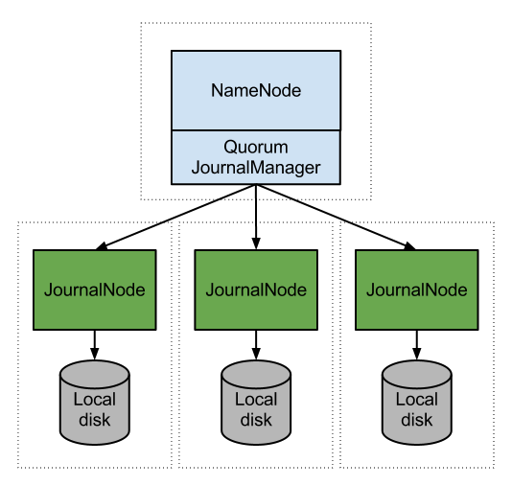
Identify components and daemon of an HDFS HA-Quorum cluster

Slide 30
Setup HDFS HA
Configure HDFS HA using Journal nodes
Make sure zookeeper is added
Go to Actions on Namenode and Enable High Availability
Configure Journal nodes
Review important parameters

Slide 31
Exercise
Understand daemon processes (Namenode, Secondary Namenode, Datanode)
Commands to stop and start HDFS daemons
Copying data back and forth to HDFS
Understand parameter files and data files
Restore and recovery of Namenode
Important parameters and their defaults (dfs.blocksize, dfs.replication)
Namenode Web UI

Slide 32
Interview questions
What are different Hadoop, HDFS and Map Reduce daemons?
How data can be copied in and out of HDFS?
What is Namenode Web UI and what is default port number?
How do you restore and recover namenode?
What happens when Namenode goes down?
What is Namenode HA or Active Passive configuration?
What is fault tolerance and how it is taken care with respect to HDFS?
What is Heartbeat?
How is security handled while setting up Hadoop cluster? (Kerberos and ACLs)

Slide 33
Map Reduce
Map Reduce is misleading term.
Programming: Map and Reduce function
Execution: Mapper and Reducer tasks
It is used in the context of Resource, Job Management as well as development. In this we will only talk about Resource and job management (Execution).
There are 2 ways for job management
MRv1/"Classic" (legacy and default till before Hadoop 2.0)
MRv2/YARN
MRv1 is being decommisioned and not supported by HDP 2.0 out of the box
YARN and MRv2 is default in Hadoop 2.x in all distributions

Slide 34
Map Reduce
What exactly is Map and Reduce in programming context?
White board to explain the concept
Map
Reads data from HDFS
Applies record level transformation, filtering etc
Converts records into key and value tuples
Reduce
Reads output of mapper in the form of key and array of values
Used for aggregations, joins etc
Writes data back to HDFS
Shuffle and Sort
Intermediate stage between Map and Reduce
As the phrase suggests data will be shuffled and sorted (partitioned by key, group by key and sort by key)

Slide 35
6 node cluster
Three Servers (Masters)
Three Servers (Slaves)
Client
Job Tracker
Task tracker
Task tracker
Task tracker

Slide 36
6 node cluster
Three Servers (Masters)
Three Servers (Slaves)
Monitoring Database
Monitoring Server
Monitoring Agent
Monitoring Agent
yum repository server/client
yum client
HDFS
MRv1
HDFS
MRv1

Slide 37
MRv1 Architecture
MRv1 or Classic
A job management tool which do not keep track of resources used by "non map reduce" based tools.
Daemon Processes
Master -> Job Tracker
Slave(s) -> Task tracker
Parameter Files
mapred-site.xml
Apache Web Interfaces
Job Tracker WI
Log files

Slide 38
Setup MRv1 or Classic
MRv1 or Classic is being decommissioned. Hence HDP does not provide as part of typical services. So, demo will be done using Cloudera VM
Configure Slaves and Master
Parameter files
Understand important parameters
Validation
Verify logs
Understand WI
mapreduce CLI

Slide 39
Configure Slaves and Master
Slaves
Task Trackers
Master
Job Tracker
Heartbeat
Task Trackers send frequent heartbeats to Job Tracker.
Task Tracker also sends the information about resources and usage to Job Tracker as part of Heartbeat

Slide 40
Parameter files
mapred-site.xml

Slide 41
Important Parameters in MRv1/Classic
File Name | Parameter Name | Parameter value | Description
mapred-site.xml | mapred.job.tracker | <ip_address>:8021 | Job Tracker ip address and port number
mapred-site.xml | mapred.job.tracker.http.address | <ip_address>:50030 | Job tracker web UI ip address and port number
mapred-site.xml | mapred.system.dir |  | HDFS directory to store Map Reduce control files
mapred-site.xml | mapred.local.dir |  | Local directory to store intermediate data files (map output)
mapred-site.xml | mapred.jobtracker.taskScheduler |  | Default is FIFO – Fair and Capacity are the viable options for production deployments
mapred-site.xml | mapred.queue.names | default | Can provide multiple queue names to set priorities while submitting the jobs
mapred-site.xml | mapred.tasktracker.map.tasks.maximum |  | Maximum Map slots per task tracker
mapred-site.xml | mapred.tasktracker.reduce.tasks.maximum |  | Maximum Reduce slots per task tracker
mapred-site.xml | mapred.reduce.tasks |  | Reduce tasks per job
mapred-site.xml

Slide 42
Validation
Using WI (Job Tracker)
Using OS commands
Using Cloudera Manager
Verify logs

Slide 43
Verify logs
Understand log files
Configuring log4j

Slide 44
Understand WI
Job Tracker WI
Monitor jobs while running
Troubleshooting issues
Understanding task level logs

Slide 45
Mapreduce CLI
mapred
Monitor jobs
Kill jobs
Check status of task trackers
etc

Slide 46
Heartbeat
Task trackers send heartbeat to Job tracker at regular intervals. It helps jobtracker
To keep track of tasktrackers that are alive
Resource utilization by each of the tasktrackers

Slide 47
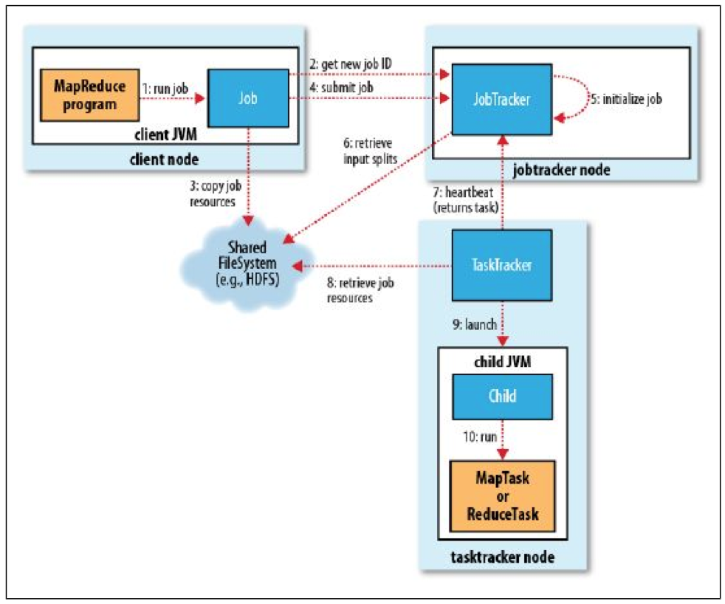
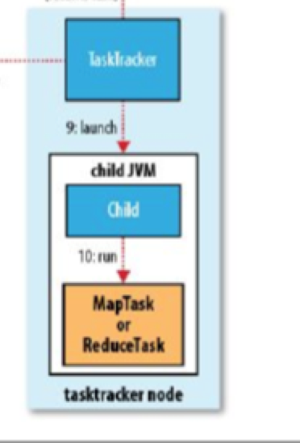
Map Reduce Job Flow (Classic)

Slide 48
MRv1 – Fault Tolerance
MapReduce v1 (MRv1) – Fault Tolerance
Task Failure
Failed due to bug in mapper/reducer code
Bugs in JVM
Hung
Number of task attempts are controlled by mapred.map.max.attempts, mapred.reduce.max.attempts (default 4)
If failures of a job can be ignored then use mapred.*.max.failures.percent (* => map/reduce)
Speculative execution – enabled by default, multiple tasks might process same data in case of slowness due to failures related to hardware (servers, memory, network etc)
Task Tracker Failure
If there are no heartbeats from task tracker to job tracker for 10 minutes, then that task tracker will be removed from the pool
If there are too many failures (default 4) for a task tracker, it will be blacklisted - mapred.max.tracker.blacklists
If there are too many failures (default 4) for a task tracker per job, it will be blacklisted - mapred.max.tracker.failures
Job Tracker Failure
Job Tracker is master for scheduling all jobs.
Job Tracker is single point of failure
No jobs can be run

Slide 49
Speculative Execution
What is it?
Initiating duplicate task for long running one.
A large job is not complete until all its mappers and reducers are complete. So if there is one long running task with out much progress, overall job execution time can be higher
How it is enabled?
mapred.map.tasks.speculative.execution (default true)
mapred.reduce.tasks.speculative.execution (default true)
yarn.app.mapreduce.am.job.speculator.class
yarn.app.mapreduce.am.job.task.estimator.class

Slide 50
Speculative Execution
How it works?
Speculative task will be created (most likely on different node) if a mapper/reducer is taking longer (lets say minute) with out much progress.
If original task finishes first then speculative task will be killed and vice versa.
What is criteria?
By default it is enabled and it is betterment of a particular job.
As there will be multiple processes for the same task, resource usage can be high. It can impact other jobs on the cluster.
If your cluster capacity is under configured, then it is better to disable speculative execution.
What is it for?
It is mainly for infrastructure/hardware issues – eg: Network, i/o or cpu issues
It is not meant for buggy code

Slide 51
Challenges with MRv1
Single point of failure
Tightly coupled with map reduce
Does not keep track of resources used by other Hadoop eco system tools – so not effective when HBase or Impala or Spark are running on the same cluster
Under utilization or contention of resources as mappers and reducers are pre-configured
Log files are scattered across all the nodes in the cluster

Slide 52
Hadoop Cluster – Processing (MRv1)
Mappers
Task Tracker
Reducers
Job Tracker
Mappers
Task Tracker
Reducers

Slide 53
YARN Architecture
YARN – Yet Another Resource Negotiator
A generic job management tool which can share resources between "map reduce" based distributed processing tools as well as "non map reduce" based distributed processing tools.
Daemon Processes
Master -> Resource Manager
Slave(s) -> Node Managers
Apptimeline server (application history)
History server (Map Reduce history)
Per job Application Master
Parameter Files
yarn-site.xml
mapred-site.xml
Apache Web Interfaces
Resource Manager WUI
Application Master WUI
Job History Server
Log files

Slide 54
6 node cluster
Three Servers (Masters)
Three Servers (Slaves)
Client
Resource Manager
Node Manager
Node Manager
Apptimeline Server
History Server
Node Manager

Slide 55
6 node cluster
Three Servers (Masters)
Three Servers (Slaves)
Monitoring Database
Monitoring Server
Monitoring Agent
Monitoring Agent
yum repository server/client
yum client
HDFS
YARN+MR2
HDFS
YARN+MR2

Slide 56
Setup YARN
Configure Slaves, Master and other components
Slaves: Nodemanager on all nodes
Master: Resourcemanager on one of the masters
App timeline server on one of the masters
Historyserver on one of the masters
Parameter files
Understand important parameters
Validation
Verify logs
Understand WI
Understand YARN and mapreduce CLI

Slide 57
Configure Slaves and Masters
Slaves
Nodemanager
Masters
Resourcemanager
App timeline server
History server

Slide 58
Parameter files
yarn-site.xml
Parameters related to YARN
mapred-site.xml
Parameters related to Map Reduce
log4j.properties

Slide 59
Important parameters in MRv2/YARN
File Name | Parameter Name | Parameter value | Description
yarn-site.xml | yarn.resourcemanager.address | <ip_address>:<port> | Resource Manager ip and port
yarn-site.xml | yarn.resourcemanager.webapp.address | <ip_address>:<port> | Resource Manager web UI ip and port
yarn-site.xml | yarn.nodemanager.resource.memory-mb |  | Amount of physical memory, in MB, that can be allocated for containers.
yarn-site.xml | yarn.scheduler.minimum-allocation-mb | 1024 | Minimum total memory for containers on each of the nodes
yarn-site.xml | yarn.scheduler.maximum-allocation-mb | 4096 | Maximum total memory for containers on each of the nodes. Same as yarn.nodemanager.resource.memory.mb
yarn-site.xml | yarn.scheduler.minimum-allocation-vcores | 1 | Minimum number of virtual cores on each of the nodes
yarn-site.xml | yarn.scheduler.maximum-allocation-vcores | 4 | Maximum number of virtual cores on each of the nodes
yarn-site.xml | yarn.resourcemanager.scheduler.class |  | Class which determines scheduler – Fair or capacity
yarn-site.xml
yarn-site.xml

Slide 60
Important parameters in MRv2/YARN
File Name | Parameter Name | Parameter value | Description
mapred-site.xml | mapreduce.framework.name | yarn
mapred-site.xml | mapreduce.jobhistory.webapp.address | <ip_address>:<port> | Job history server Web UI IP address and port number
mapred-site.xml | yarn.app.mapreduce.am.* |  | Parameters related to application master
mapred-site.xml | mapreduce.map.java.opts |  | JVM Heap size for child task of map container
mapred-site.xml | mapreduce.reduce.java.opts |  | JVM Heap size for child task of reduce container
mapred-site.xml | mapreduce.map.memory.mb |  | Size of container for map task
mapred-site.xml | mapreduce.map.cpu.vcores | 1 | Number of virtual cores required to run each map task
mapred-site.xml | mapreduce.reduce.memory.mb |  | Size of container for reduce task
mapred-site.xml | mapreduce.reduce.cpu.vcores | 1 | Number of virtual cores required to run each reduce task
mapred-site.xml | mapreduce.input.fileinputformat.split.minsize | 0

Slide 61
Validation
Run the job
Using WI (Resource Manager, Application Master and Job History Server)
Using OS commands
Using Ambari or Cloudera Manager
Verify logs

Slide 62
Verify logs
While jobs are running
Using Job history server

Slide 63
Understand WI
Resource Manager WI
Job History WI
Per job application master WI
Ambari

Slide 64
YARN and Mapred WI
Run a job
Monitor while job is running
Evaluate results once job is completed (Job History server)
Importance of job.xml for every job

Slide 65
Map Reduce Job Flow (Classic)

Slide 66
Hadoop Cluster – Processing (MRv1/Classic)
Slaves (Datanodes and Tasktrackers)
Two data sets
One with 2 files/blocks
Another with 4 files/blocks
m
Gateway
2 map tasks are created where data is stored (data locality)
Map tasks are created to read data from HDFS and perform row level transformations
1 reduce task is created to aggregate the data
Job Tracker
r
1
m
Request have gone to job tracker
Job submitted and monitored
Job is submitted to process the data

Slide 67
Hadoop Cluster – Processing (MRv1/Classic)
Slaves (Datanodes and Tasktrackers)
m
m
Gateway
r
m
1
2
m
Job tracker will perform both resource management and monitors job management of all jobs
m
One job is running
Second job is submitted
r
m

Slide 68
Hadoop Cluster – Processing (MRv2 + YARN)
Slaves (Datanodes and nodemanagers)
Two data sets
One with 2 files/blocks
Another with 4 files/blocks
m
Gateway
Resource Manager
r
1
m
Request have gone to resource manager
First application master will be created
Application master will determine which nodes map and reduce tasks should be executed in “containers”
Application master will take care of job management (unlike classic where job tracker does job management)
Job is submitted to process the data
a

Slide 69
Hadoop Cluster – Processing (MRv2 + YARN)
Slaves (Datanodes and nodemanagers)
Two data sets
One with 2 files/blocks
Another with 4 files/blocks
a
m
m
Gateway
Resource Manager
r
m
1
2
r
m
m
One job is running
a
m

Slide 70
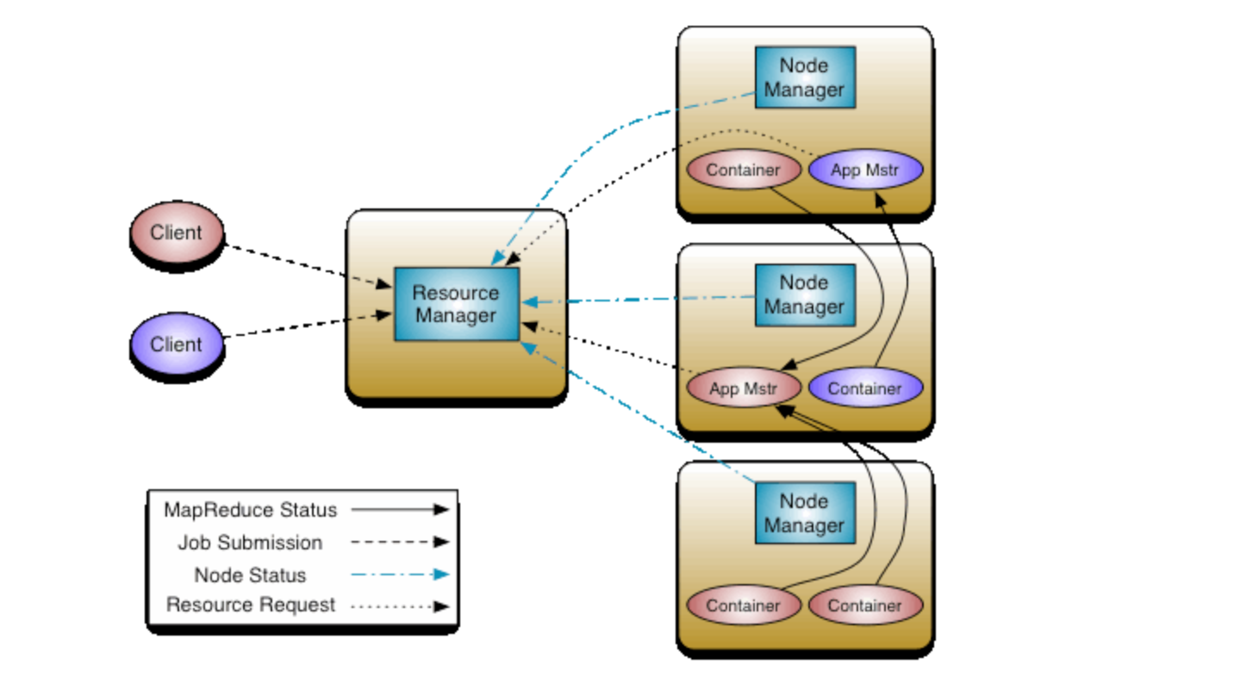
Hadoop Cluster – Processing (MRv2 + YARN)

Slide 71
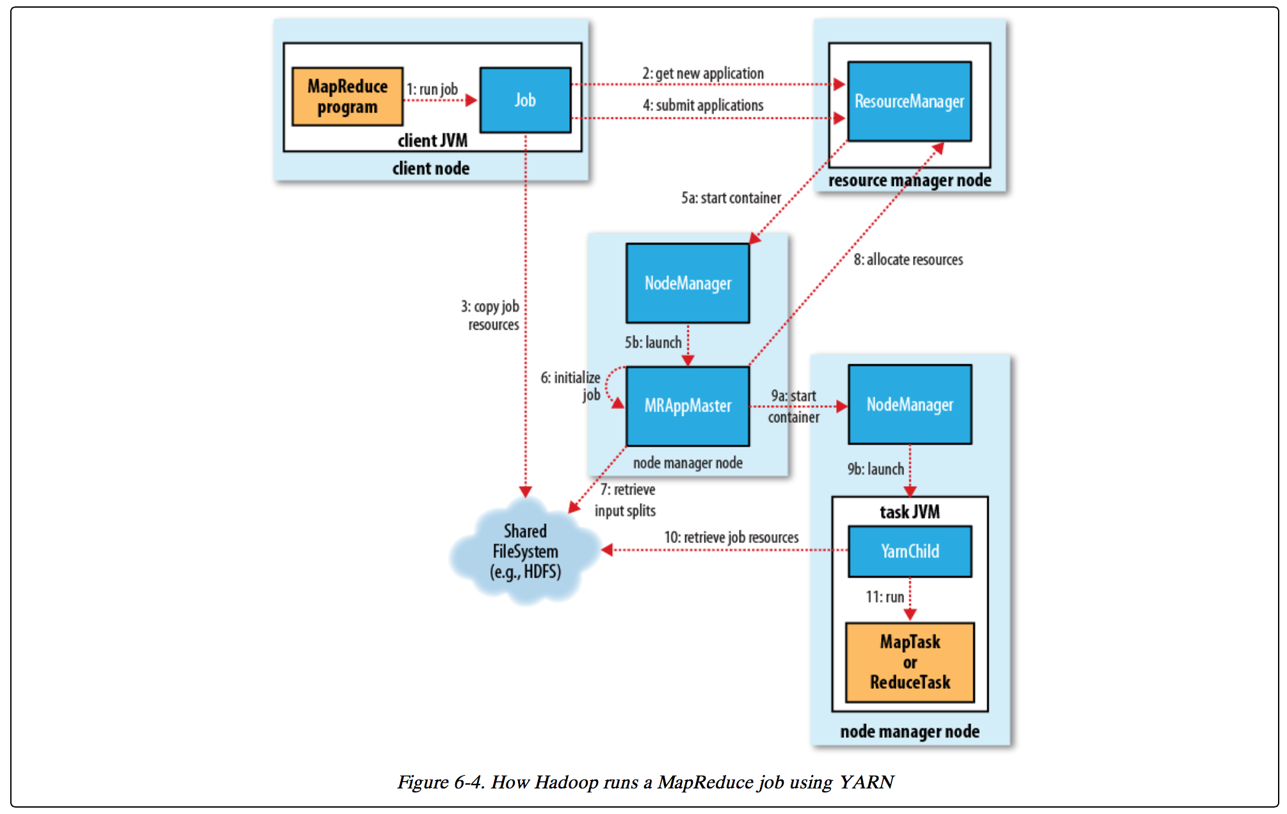
Map Reduce Job Flow (YARN)

Slide 72
YARN – Fault Tolerance
MapReduce v2 (MRv2/YARN) – Fault Tolerance
Task Failure (mostly same as classic/MRv1)
Application Master Failure
If application master is failed that means a job is failed. It can be controlled by yarn.resourcemanager.am.max.retries (default 1)
Node Manager Failure
If there are no heartbeats from Node Manager to Resource Manager for 10 minutes (default), then that Node Manager will be removed from the pool
Resource Manager Failure
Although probability of Resource Manager failure is relatively low, no jobs can be submitted until RM is brought back up and running.
High availability can be configured in YARN which means there will be multiple RM running in the cluster. There is no high availability in MRv1 (only one job tracker)

Slide 73
Hadoop Cluster – Processing (MRv2/YARN)
Containers
Mappers
Reducers
App Master
Node Manager
Resource Manager
Containers
Mappers
Reducers
App Master
Node Manager

Slide 74
Understand basic design strategy for MapReduce v2 (MRv2)
Hadoop 1.0
Hadoop 2.0
MapReduce
(data processing)
Others
(non map reduce based data processing)
MapReduce
(cluster resource management & data processing)
YARN
(cluster resource management)
HDFS
(distributed, redundant and reliable storage)
HDFS2
(distributed, redundant and reliable storage with highly available namenode)

Slide 75
Determine how YARN handles resource allocations
Question: How YARN handles Resource Allocations?
Answer: Using Resource Manager, Node Manager and per job application master (unlike job tracker and task tracker in MRv1/classic). We need to define several parameters for resource allocation (CPU/cores and Memory).
yarn-site.xml will have parameters at node level
mapred-site.xml will have parameters at task level

Slide 76
MRv1 vs. MRv2
 | MRv1 | MRv2/YARN
Master | Job Tracker – handles both resource management as well as job processing. | Resource Manager – only looks after resource management.
Slave on each datanode | Task Tracker | Node Manager
Job | Job Tracker controls life cycle of the job | Per job application master controls life cycle of job. Application master is transient in nature and will be cleaned up after job is completed.
Mappers and reducers | Task tracker will manage the processes that runs tasks (mappers and reducers) | Containers will manage the processes that runs tasks (mappers and reducers). Containers are transient in nature and will be cleaned up when job is completed.
Mappers and reducers | Tasks for mappers and reducers on each node are pre-configured and cannot be changed. It can cause under utilization of resources. | Tasks for mappers and reducers are not pre-configured. Relatively effective utilization of resources.
Scalability | Single point of failure and probability is high as Job Tracker controls each job life cycle as well as resource consumption. Have issues with clusters more than 4000 nodes | Can configure for high availability. Resource Manager is relatively stable than Job tracker.

Slide 77
Running jobs
Understanding split size
Lowest granular at which map task processes data
Typically it is same or greater than blocksize
It can be smaller than blocksize, if combined input formats are used
If the file size is smaller than blocksize/splitsize, typically one mapper will process each file
Controlled by mapreduce.input.fileinputformat.split.minsize, default 0
Impact of replication factor on output being written to HDFS
hadoop jar command
Overriding parameters
Validating parameters in job.xml
Understanding counters

Slide 78
Scheduling Jobs
FIFO Scheduler
Fair Scheduler
Capacity Scheduler

Slide 79
Exercise
Identify daemon processes for MRv1 as well as MRv2+YARN
Identify different parameter files
Difference between MRv1 – "Classic" and MRv2 - YARN
Understand important parameters and relevance of the parameters in capacity planning as well as performance tuning

Slide 80
Interview Questions
What are different daemon processes?
What is application master?
What is default port number of Resource Manager UI?
What are different type of schedulers?

Slide 81
Learning Pattern
You can apply this pattern to almost all the tools in Hadoop eco system.
Architecture
Daemon Processes
Parameter files
Log files
Validation

Slide 82
Thank You

