Slide 1
Setup Sqoop

Slide 2
Learning Pattern
You can apply this pattern to almost all the tools in Hadoop eco system.
Architecture
Daemon Processes
Parameter files
Log files
Validation

Slide 3
Learning Pattern
You can apply this pattern to almost all the tools in Hadoop eco system.
Architecture
Daemon Processes – Client only
Parameter files – Not applicable
Log files – Not applicable
Validation

Slide 4
Agenda
Overview
Sqoop Architecture
Setup Sqoop using 3rd party wizards
Sqoop parameter files
Sqoop log files
Sqoop demo

Slide 5
Overview
Sqoop is a map reduce based tool that can be used to copy data from relational databases to Hadoop and vice versa.
Written in Java and Open Source
Uses JDBC for DB connectivity
Uses Map Reduce framework

Slide 6
Hadoop eco system
Hadoop Components
Hadoop eco system
Oozie
Pig
Impala
HBase
Flume
Mahout
Spark
Hive
Sqoop
Presto
Map Reduce
Non Map Reduce
Distributed File System (HDFS)
Hadoop Core Components

Slide 7
6 node cluster
Three Servers (Masters)
Three Servers (Slaves)
Monitoring Database
Monitoring Server
Monitoring Agent
Monitoring Agent
yum repository server/client
yum client
HDFS
MR+YARN
HDFS
MR+YARN
Hive
Pig
Metastore Database
Sqoop

Slide 8
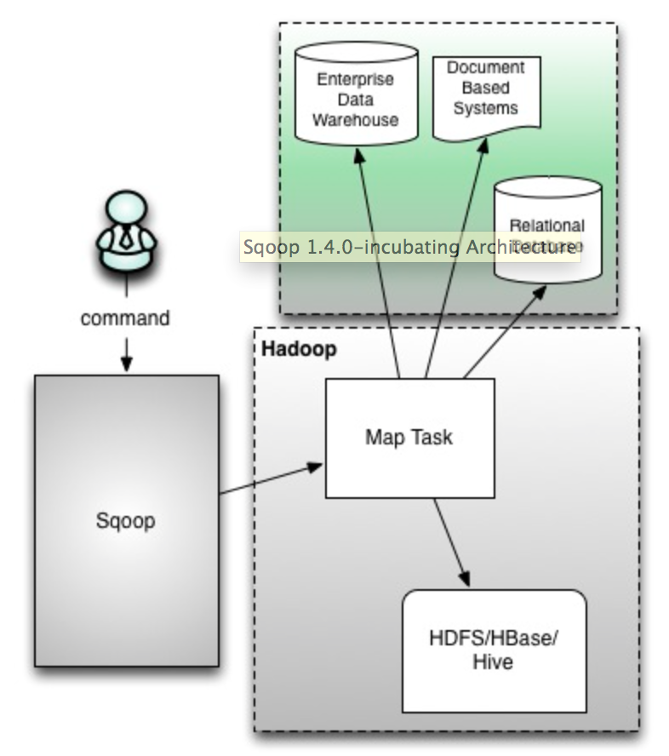
Sqoop Architecture

Slide 9
Sqoop Architecture
Map only
Command line (only)
Not secure
No client-server
If one have access to sqoop command, he will have access to all JDBC jars
Not easily extensible and no separation of duties
Both read from source and write to target is done by mapper

Slide 10
Sqoop Import
DSS
Document based
Operational
Sqoop import
Map Task
HDFS/HBase/Hive

Slide 11
Sqoop import
Sqoop import is to get data from conventional databases and NoSql/Document based databases into Hadoop eco system.
It uses map/reduce framework to load data in parallel. Default is 4.
Execution steps
Generates custom DBWritable class reading metadata of table.
Connect to database – default 4 concurrent connections
Read and split the data using custom DBWritable class
Load data into HDFS

Slide 12
Sqoop Import
Split logic
Uses primary key or unique key
Get minimum and maximum value
Compute ranges based on number of map tasks (default 4)
Process mutually exclusive data in parallel
Without primary/unique keys import process only uses one map task

Slide 13
Sqoop incremental load
Argument | Description
--check-column (col) | Specifies the column to be examined when determining which rows to import.
--incremental (mode) | Specifies how Sqoop determines which rows are new. Legal values for mode include append and lastmodified.
--last-value (value) | Specifies the maximum value of the check column from the previous import.

Slide 14
Sqoop Export
DSS
Document based
Operational
Sqoop export
Map Task
HDFS/HBase/Hive

Slide 15
Sqoop Export
Sqoop export is to get data out of Hadoop based systems into conventional databases/NoSql data stores.
It also uses Map/Reduce framework.
At this time it only understands HDFS directories not Hive tables (HCatalog)
It also splits data (but uses HDFS splittable logic)

Slide 16
Sqoop Considerations
Generic
Need to customize to leverage strengths of underlying source or target conventional databases.
Determining number of mappers and outliers
Working with binary data (using Sequence Files)
Might not be able to read HCatalog (Incremental exports cannot use HiveQL embedded in Sqoop commands)
Compression (needs to be splittable or file size should not be greater than split size)

Slide 17
Setup Sqoop using 3rd party wizards
Sqoop is client only

Slide 18
Sqoop parameter files
Not that important.
As it is map reduce based tool, it uses xml files created for hdfs and mapreduce/yarn

Slide 19
Sqoop log files
Sqoop does not store log files any where
You need to redirect output of the command using Linux redirect process

Slide 20
Sqoop demo
Install mysql connector
Copy connector jar to sqoop lib
Sqoop Import and Sqoop Export

