Slide 1
Setup HBase

Slide 2
Learning Pattern
You can apply this pattern to almost all the tools in Hadoop eco system.
Architecture
Daemon Processes
Parameter files
Log files
Validation

Slide 3
Learning Pattern
You can apply this pattern to almost all the tools in Hadoop eco system.
Architecture
Daemon Processes
Masters – 3 HMasters (highly desired)
Slaves – HRegionServer on each of the slave nodes
Parameter files –
hbase-site.xml
Log files
Validation

Slide 4
Agenda
Overview
HBase Architecture
Setup Zookeeper using 3rd party tools
Setup HBase using 3rd party tools
HBase parameter files
HBase log files
HBase demo

Slide 5
Overview
HBase is a NoSQL Datastore which uses HDFS as storage and can be used for applications that are operational in nature.
It might not be good solution where transactions are important.
It addresses scalability and can complement both operational as well as decision support applications

Slide 6
HBase Architecture
HMASTER
Responsible for Admin operations
Manage and monitor cluster
Controls load balancing and failover
HRegionServer
HRegionServer
HRegion
HRegion
HDFS

Slide 7
HDFS+MR vs. HBase
HDFS+MR | HBase
Distributed file system | Uses HDFS for storage, but sorts data based on keys
Batch Processing | Suitable for low latency operations
Individual records cannot be updated as operations are done at file level. No random reads/writes. | Individual records can be inserted, updated, deleted or read. Supports random reads/writes.
Writes are done to files directly via buffers. No logging. | Writes are done to memory and write ahead log (WAL) before written to HDFS

Slide 8
HBase vs. RDBMS
HBase | RDBMS
Column oriented | Row-oriented (mostly)
Flexible schema, columns can be added on the fly | Fixed schema
Designed to store Denormalized data | Designed to store Normalized data
Good with sparse tables | Not optimized for sparse tables
Joins using MapReduce which is not optimized | Optimized for joins
Tight integration with MapReduce | No integration with MapReduce
Linear scalability using auto sharding– just add hardware | Hard to shard and scale
Good for semi-structured data as well as structured data | Good for structured data
Does not follow codd’s rules (not suitable for transactional based systems) | Follows codd’s rules (transactional based systems)

Slide 9
Oracle Architecture
Database Servers
Storage
Network Switch
(interconnect)
Network Switch

Slide 10
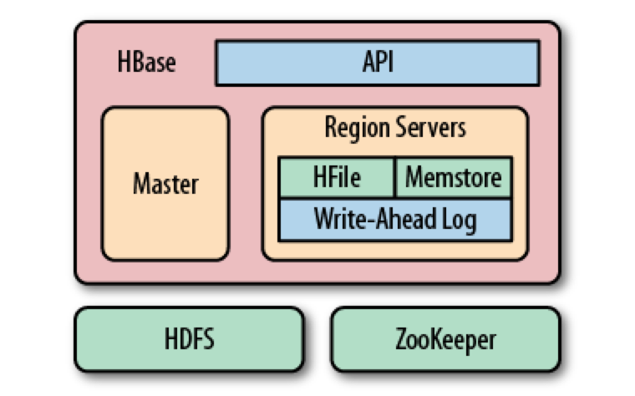
HBase Architecture

Slide 11
Hadoop eco system
Hadoop Components
Hadoop eco system
Oozie
Pig
Impala
HBase
Flume
Mahout
Spark
Hive
Sqoop
Presto
Map Reduce
Non Map Reduce
Distributed File System (HDFS)
Hadoop Core Components

Slide 12
6 node cluster
Three Servers (Masters)
Three Servers (Slaves)
Client
HMaster
HRegion Server
HRegion Server
HMaster
HMaster
HRegion Server

Slide 13
6 node cluster
Three Servers (Masters)
Three Servers (Slaves)
Monitoring Database
Monitoring Server
Monitoring Agent
Monitoring Agent
yum repository server/client
yum client
HDFS
MR+YARN
HDFS
MR+YARN
Hive
Tez
Pig
Metastore Database
Sqoop
HBase
HBase

Slide 14
Setup Zookeeper using 3rd party tools
Need to set up Zookeeper on at least 3 nodes in the cluster

Slide 15
Setup HBase using 3rd party tools
Configure HMaster on servers that are running zoo keeper
Configure Region Server on servers that are running HDFS and/or YARN

Slide 16
HBase parameter files
hbase-site.xml

Slide 17
Important Parameters
File Name | Parameter Name | Parameter value | Description
hbase-site.xml | hbase.rootdir | hdfs://vm03host07:8020/hbase | HDFS root directory for HBase
hbase-site.xml | hbase.master.info.port | 60010 | HMaster web ui port
hbase-site.xml | hbase.zookeeper.quorum
hbase-site.xml | hbase.zookeeper.property.clientPort | 2181
hbase-site.xml | hbase.regionserver.info.port | 60030 | Region Server web ui port
hbase-site.xml | hbase.zookeeper.* |  | Parameters related to zookeeper
hbase-site.xml | hbase.master.* |  | Parameters related to HMaster
hbase-site.xml | hbase.client.* |  | Parameters related to HBase client
hbase-site.xml | hbase.regionserver.* |  | Parameters related to RegionServer
hbase-site.xml | hbase.hregion.* |  | Parameters related to HRegion controlled by Region Servers
hbase-site.xml | hbase.hstore.* |  | Parameters related to mem store

Slide 18
HBase log files
Logs on Master
Logs on Region Servers

Slide 19
HBase demo
Launching HBase Shell
Creating namespaces and HBase tables
Put operation
Get/Scan operation
Count
Filters

