Slide 1
Setup Oozie

Slide 2
Agenda
Overview
Oozie Architecture
Setup Oozie using 3rd party tools
Oozie parameter files
Oozie log files
Oozie demo

Slide 3
Learning Pattern
You can apply this pattern to almost all the tools in Hadoop eco system.
Architecture
Daemon Processes
Parameter files
Log files
Validation

Slide 4
Learning Pattern
You can apply this pattern to almost all the tools in Hadoop eco system.
Architecture
Daemon Processes
Masters – Oozie Server
Parameter files
oozie-site.xml
Log files
Validation

Slide 5
Overview
Oozie is map reduce based work flow tool.
It facilitates you to define work flows for related jobs.
A workflow is DAG (Directed Acyclic Graph)
Workflow is stored as hPDL (XML)
It runs the entire work flow using one or more map reduce jobs. In larger clusters, Gateway nodes can become bottlenecks and Oozie can mitigate that issue as jobs are run in the cluster in the form of map reduce programs
Integrated with most of the hadoop eco system tools

Slide 6
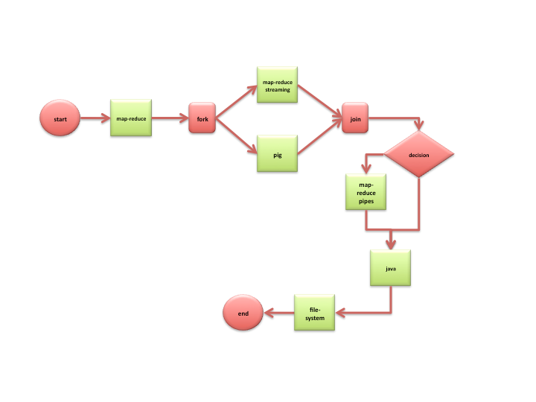
Oozie Workflow

Slide 7
Oozie Architecture
Client
Oozie DB
Eco System - Masters
CLI
MR JT/RM
HDFS Namenode
WI (Hue)
Oozie Server
Slave
Slave
Slave
Eco System Slaves
Eco System Slaves
Eco System Slaves
MR TT/NM
MR TT/NM
MR TT/NM
HDFS Datanode
HDFS Datanode
HDFS Datanode

Slide 8
Oozie Architecture
Oozie repository
Database to store workflow definitions and details
Oozie Server
Oozie Client

Slide 9
Hadoop eco system
Hadoop Components
Hadoop eco system
Oozie
Pig
Impala
HBase
Flume
Mahout
Spark
Hive
Sqoop
Presto
Map Reduce
Non Map Reduce
Distributed File System (HDFS)
Hadoop Core Components

Slide 10
6 node cluster
Three Servers (Masters)
Three Servers (Slaves)
Monitoring Database
Monitoring Server
Monitoring Agent
Monitoring Agent
yum repository server/client
yum client
HDFS
MR+YARN
HDFS
MR+YARN
Hive
Tez
Pig
Metastore Database
Sqoop
Oozie
HBase
HBase
Oozie Repository

Slide 11
Setup Oozie using 3rd party tools
Setup mysql database
Create database for oozie
Create user and grant permissions
Setup by configuring Oozie Server alone

Slide 12
Setup Oozie using Cloudera Manager
Customizing Oozie repository with MySQL database
Go to the host on which oozie server is running
Install mysql connector
Go to mysql database and create database with name oozie
Using cloudera manager click on Oozie service and click on Configuration (View and Edit)
Make necessary changes to parameters under Database category
Also enable create database by adding a parameter using Safety Valve for oozie-site.xml
Start the service

Slide 13
Setup Oozie using Ambari
Customizing Oozie repository with MySQL database
Go to the host on which oozie server is running
Install mysql connector
Go to mysql database and create database with name oozie
Run sudo ambari-server setup --jdbc-db=mysql --jdbc-driver=/usr/share/java/mysql-connector-java.jar
Make necessary changes to parameters under Database category
Start the service

Slide 14
Oozie parameter files
oozie-site.xml

Slide 15
Important Parameters
File Name | Parameter Name | Parameter value | Description
oozie-site.xml | oozie.base.url | http://<hostname>:11000/oozie
oozie-site.xml | oozie.db.schema.name | oozie
oozie-site.xml | oozie.service.JPAService.create.db.schema | false | Change it to true, if you want to create database schema and tables at the time of installation
oozie-site.xml | oozie.service.JPAService.jdbc.driver |  | Provide proper driver class
oozie-site.xml | oozie.service.JPAService.jdbc.url |  | JDBC URL
oozie-site.xml | oozie.service.JPAService.jdbc.username |  | Username to the repository database
oozie-site.xml | oozie.service.JPAService.jdbc.password |  | Password to the repository database
oozie-site.xml | oozie.service.HadoopAccessorService.jobTracker.whitelist
oozie-site.xml | oozie.service.HadoopAccessorService.nameNode.whitelist

Slide 16
Oozie log files
Oozie logs will be under /var/log/oozie
As jobs are submitted as map reduce using YARN/Classic, one needs to go through respective logs while troubleshooting the issues

Slide 17
Oozie demo
Get examples
Understand job.properties, workflow.xml and other dependencies
Make necessary changes to job.properties and workflow.xml to the templates in examples
Run the job
Monitor and troubleshoot the job

