Slide 1
EDW - Hadoop

Slide 2
Recap
Setting up the environment
VMWare software
Cloudera Quickstart VM
Eclipse (for Java development)

Slide 3
Recap (Important topics)
Hadoop Architecture
Parameter files
Daemon processes
HDFS
Map Reduce
Java Map Reduce
API
Framework
Resource Management
MRv1 or Classic
MRv2 or YARN

Slide 4
Recap (Traditional RDBMS)
Designed on the basis of Codd rules
Transactional as well as Operational
Enforces constraints
Indexing
Not linearly scalable (MPP can be alternative)
Data is structured
Redundancy is bad (typically)

Slide 5
Recap (Hadoop Advantages)
Distributed Storage and Computing
Linearly scalable
Can store both structured and unstructured data
Economical and yet reliable (open source on top of commodity hardware)

Slide 6
Recap (HDFS Challenges/Limitations)
No Transactions
No or minimal constraints on write (Schema on read)
Not for small files
Not for mission critical
No updates
Not for random access

Slide 7
Recap (Map Reduce Challenges/Limitations)
No real time (Batch Batch Batch)
Minimal index support
No updates

Slide 8
Agenda
Create Databases (Hive)
Physical Data Modeling (Hive)
Extract and Load data (Sqoop/Java Map Reduce/Hive)
Transformation (Hive/Pig/Java Map Reduce)
Defining Workflows (Oozie)

Slide 9
Agenda
Hive Architecture
Hive DDL
Sqoop
Java Map Reduce (already covered in detail)
Hive (Data Load Language – similar to DML)
HiveQL
Pig
Oozie

Slide 10
EDW (Current Architecture)
OLTP
EDW/ODS
Visualization/
Reporting
ODS
Reporting
Closed
Main Frames
Data Integration
(ETL/Real Time)
Decision Support
XML
External apps
Data Warehouse
Source(s)

Slide 11
Operational Data Store
Purpose of ODS
Compliance
Data lineage
Data Integration
Real time/Batch
ETL
Minimal transformation
Reporting
Compliance based

Slide 12
EDW (Use Cases)
Data Integration
Real time
Batch
ETL
Reporting
Real time
Batch

Slide 13
Enterprise Data Warehouse (Important Concepts)
Dimensions
Type 1, 2, 3 dimensios
Facts
Rollup tables
Report tables
Fiscal reports
Daily
Weekly
Monthly
Quarter Yearly
Yearly
To date reports
Day to hour
Week to date
Month to date

Slide 14
EDW (Big Data eco system)
OLTP
Visualization/
Reporting
Node
Reporting Database
Node
Reporting
Closed
Main Frames
ETL
Real Time/Batch (No ETL)
Hadoop Cluster
(EDW/ODS)
Decision Support
XML
External apps
Node
Source(s)

Slide 15
EDW (Use Cases)
Data Integration
Real time (HBase)
Batch (Sqoop/Hive/Map Reduce)
ETL (Hive/Pig/Map Reduce)
Reporting
Real time (Impala/Presto/HBase)
Batch (Hive)

Slide 16
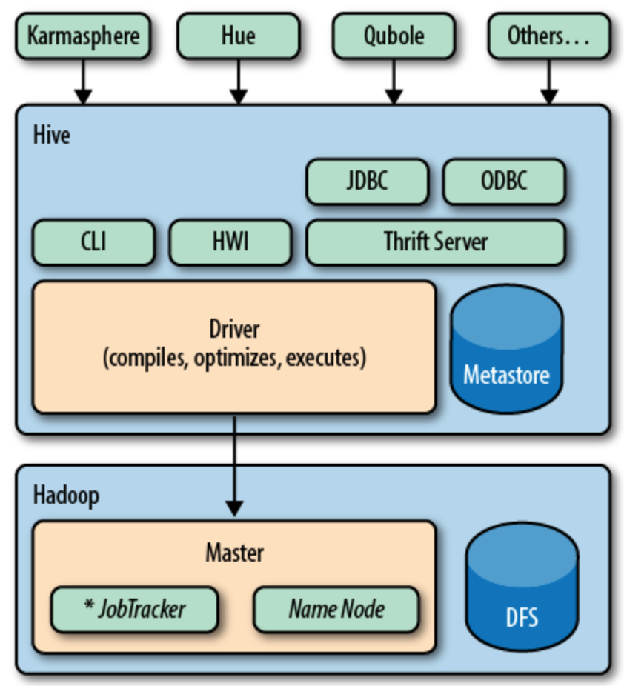
Hive Architecture

Slide 17
Hive Architecture
Hive Metastore
Hive Configuration
hive-site.xml
.hiverc
Run time configuration (using set operator)
Hive Command line
hive (launches command line)
hive -e (to execute individual command w/o launching command line)
hive -f (to execute hive script which contains series of hive commands w/o launching command line)
Hive log files
By default hive logs are written to /tmp directory

Slide 18
Hive log files
By default uses /tmp/${user}
Override it using (-hiveconf or set)
hive.log.dir
hive.log.file
hive.querylog.location

Slide 19
Data Definition Language (DDL)
Major differences with Relational
No support for real time indexes
No packages or procedures or functions
No Triggers
No range partitioning
Limited data types (only numeric and string)
Strings do not have precision
No data type for date

Slide 20
Hive DDL
Create Databases
Creating and managing tables
Physical Data Modeling

Slide 21
Create Databases
Create one or more databases for staging
Create one database for ODS
Create one or more databases for EDW

Slide 22
Data Definition Language (DDL)
Data types
Numeric (int, smallint, bigint, float, double, decimal etc – same as most of traditional databases)
Character (string vs. char, varchar, varchar2, clob etc)
Binary (binary vs. blob)
Complex (array, struct, map etc)
Create/drop/truncate tables
Field and line delimiters
File formats
External vs. Managed tables
Non-partitioned tables
CTAS (Create table as select)
Add/drop/truncate partitions/buckets
Partitioning (List Partitioning)
Bucketing (Hash Partitioning)
Describe tables
Describe
Describe extended
Describe formatted (most recommended)
Views

Slide 23
Physical Data Modeling
File formats (Recap)
Convert data types
Determine delimiter (Field and line delimiters)
Determine formats for null values
Redundancy
Determine partitioning/bucketing strategy
Too much partitioning vs. too little partitioning

Slide 24
Physical Data Modeling (EDW)
Fact
Dimensions
Type 1, 2, 3 dimensions
Star schemas
Snowflake schemas
Rollup tables
Report tables

Slide 25
Extract and Load
Source types
Relational
Closed (Mainframes)
External (XML, JSON etc)
Extract and Load considerations
Push
Pull
Filter as much as possible and as early as possible

Slide 26
Extract and Load data into EDW
Sqoop
To extract and load data from relational databases
Hive
To load data (already extracted) from flat files into HDFS
Java Map Reduce
To extend the capabilities of load process
Flume (out of scope)
To extract and load data from web logs

Slide 27
Sqoop
Architecture
Sqoop CLI
Sqoop commands
sqoop import
sqoop export
sqoop eval
sqoop list-*

Slide 28
Sqoop
Sqoop Architecture
Sqoop2 Architecture
Sqoop Import
Sqoop Export
Sqoop Considerations

Slide 29
Sqoop
Data load tool (both in and out)
Written in Java and Open Source
Uses JDBC for DB connectivity
Uses Map Reduce framework

Slide 30
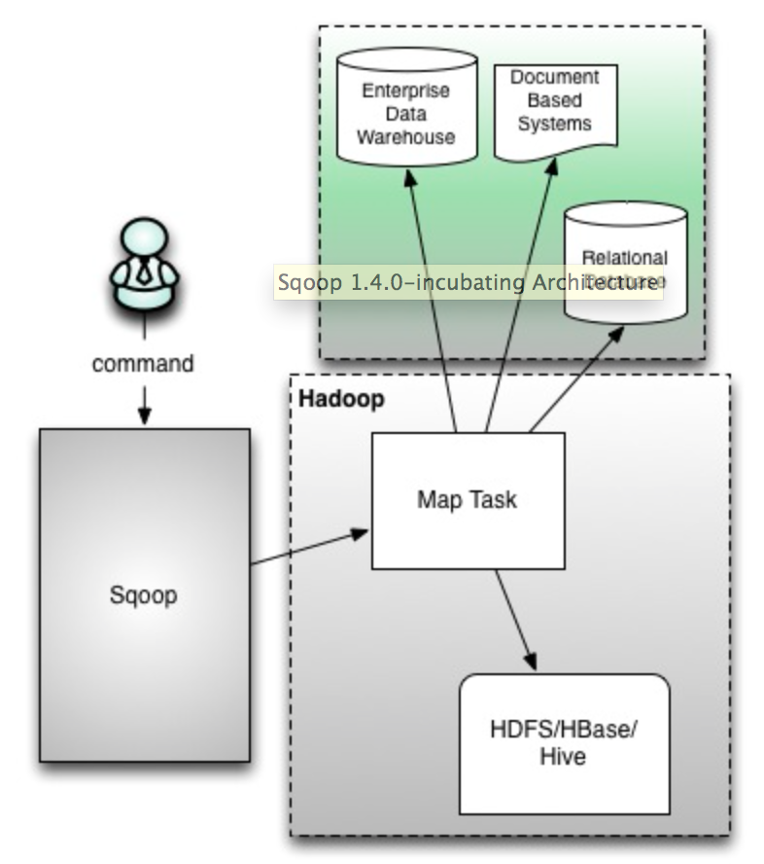
Sqoop Architecture

Slide 31
Sqoop Architecture
Map only
Command line (only)
Not secure
No client-server
If one have access to sqoop command, he will have access to all JDBC jars
Not easily extensible and no separation of duties
Both read from source and write to target is done by mapper

Slide 32
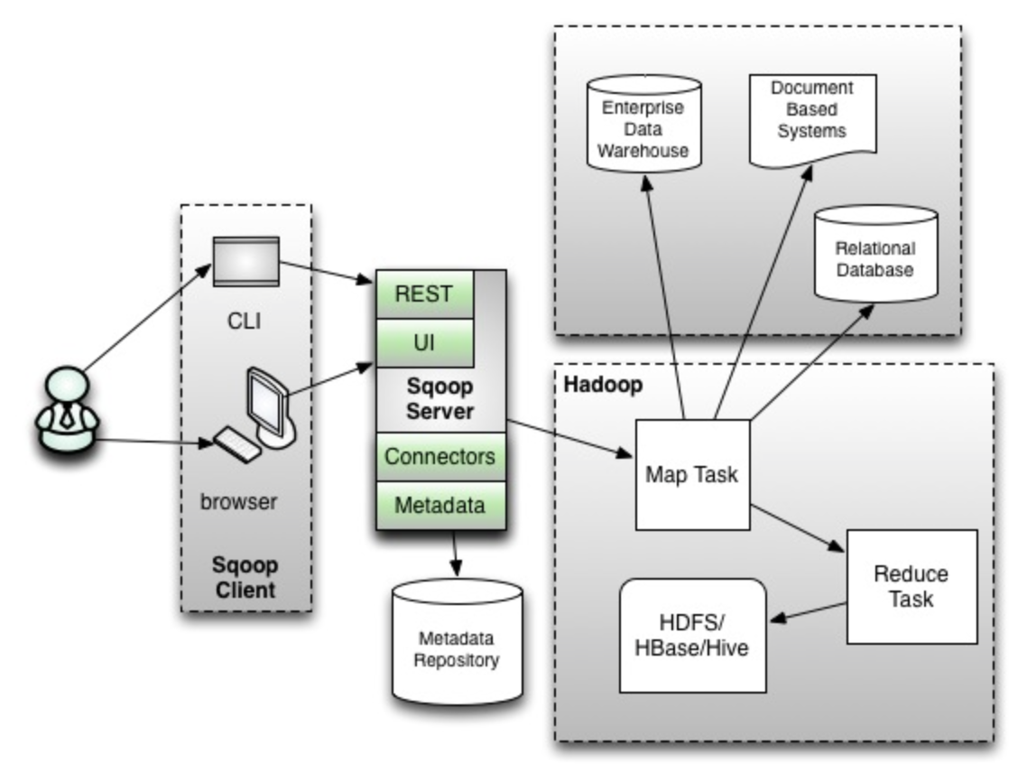
Sqoop2 Architecture

Slide 33
Sqoop2 Architecture
Client/Server architecture
Map and Reduce
Available on web, command line
Extensible and separation of duties
Highly Secure
Developers use clients
Admins set up servers
Jar files will reside on server

Slide 34
Sqoop Import
DSS
Document based
Operational
Sqoop import
Map Task/MR Task
HDFS/HBase/Hive

Slide 35
Sqoop import
Sqoop import is to get data from conventional databases and NoSql/Document based databases into Hadoop eco system.
It uses map/reduce framework to load data in parallel. Default is 4.
Execution steps
Generates custom DBWritable class reading metadata of table.
Connect to database – default 4 concurrent connections
Read and split the data using custom DBWritable class
Load data into HDFS

Slide 36
Sqoop Import
Split logic
Uses primary key or unique key
Get minimum and maximum value
Compute ranges based on number of map tasks (default 4)
Process mutually exclusive data in parallel
Without primary/unique keys import process only uses one map task

Slide 37
Sqoop incremental load
Argument | Description
--check-column (col) | Specifies the column to be examined when determining which rows to import.
--incremental (mode) | Specifies how Sqoop determines which rows are new. Legal values for mode include append and lastmodified.
--last-value (value) | Specifies the maximum value of the check column from the previous import.

Slide 38
Sqoop Export
DSS
Document based
Operational
Sqoop export
Map Task/MR Task
HDFS/HBase/Hive

Slide 39
Sqoop Export
Sqoop export is to get data out of Hadoop based systems into conventional databases/NoSql data stores.
It also uses Map/Reduce framework.
At this time it only understands HDFS directories not Hive tables (HCatalog)
It also splits data (but uses HDFS splittable logic)

Slide 40
Sqoop Considerations
Generic
Need to customize to leverage strengths of underlying source or target conventional databases.
Determining number of mappers and outliers
Working with binary data (using Sequence Files)
Might not be able to read HCatalog (Incremental exports cannot use HiveQL embedded in Sqoop commands)
Compression (needs to be splittable or file size should not be greater than split size)

Slide 41
Sqoop Demo
Preparation
Make sure sqoop is installed and paths are set up
Make sure JDBC jars are available to sqoop
Make sure JDBC connectivity information is available
Import data
Export data
Using other features
sqoop eval
sqoop list-*
Many more

Slide 42
EDW (Big Data eco system)
OLTP
Visualization/
Reporting
Node
Reporting Database
Node
Reporting
Closed
Main Frames
ETL
Real Time/Batch (No ETL)
Hadoop Cluster
(EDW/ODS)
Decision Support
XML
External apps
Node
Source(s)

Slide 43
Data Loading
Pull strategy - Sqoop Import (already covered)
Sqoop will connect to remote database
Runs as Map Reduce job in Hadoop cluster
Copies data from remote database to Hadoop
Push strategy
Source system will push data to file servers
Data needs to be copied into HDFS
Hive can be used to load the data

Slide 44
Data Loading (PUSH Strategy)
Mission critical OLTP databases to target Hadoop based systems
Closed Mainframes systems to target Hadoop based systems in the form of delimited text files
Third party applications to target Hadoop based systems (JSON, XML, delimited text files etc)

Slide 45
Hive (LOAD)
Files needs to be copied should be of same type as table’s storage type specified in STORED AS clause
Text data (STORED AS TEXTFILE)
Sequence file data (STORED AS SEQUENCEFILE).
Field and line delimiters also should be consistent
LOAD will use file system APIs to copy files from local file system/HDFS to HDFS.
LOAD does not use Map Reduce to get data into HDFS
LOAD does not do any transformations or data integrity checks (Garbage In, Garbage Out). It is developer's responsibility that structure of data being loaded is consistent with the structure of table (unlike databases like Oracle, where integrity checks are performed while data is being loaded to the tables)

Slide 46
Hive (LOAD) - Syntax
LOAD DATA [LOCAL] INPATH 'filepath' [OVERWRITE] INTO TABLE tablename [PARTITION (partcol1=val1, partcol2=val2 ...)]
LOCAL – to copy from local file system to HDFS referred by hive table
OVERWRITE – Old data will be lost
PARTITION – copy data to specified partition
Eg: LOAD DATA LOCAL INPATH '/home/cloudera/test.txt' OVERWRITE INTO TABLE test;

Slide 47
Hive (LOAD) - Demo
Hive LOAD command is used to copy data from local files/HDFS into HDFS used by Hive tables
Copying data from local file system to Hive tables
Copying data from HDFS location to Hive tables
Overwrite existing data
Append to existing data

Slide 48
Hive (INSERT)
Insert command is used to select data from one table to another table
To load one table to another table or partition of another table
Apply transformations
Data cleansing
Filtering
etc
To load data from one table with one file format to another table with different table format

Slide 49
Hive (INSERT)
INSERT OVERWRITE
Old files will be deleted
INSERT INTO
Old files will not be deleted
Simulates append
table insert
Inserting into bucketed tables
Inserting into partitions
Dynamic
Static

Slide 50
Dynamic Partition Insert
Configuration property | Default | Note
hive.exec.dynamic.partition | FALSE | Needs to be set to true to enable dynamic partition inserts
hive.exec.dynamic.partition.mode | strict | In strict mode, the user must specify at least one static partition in case the user accidentally overwrites all partitions, in nonstrict mode all partitions are allowed to be dynamic
hive.exec.max.dynamic.partitions.pernode | 100 | Maximum number of dynamic partitions allowed to be created in each mapper/reducer node
hive.exec.max.dynamic.partitions | 1000 | Maximum number of dynamic partitions allowed to be created in total
hive.exec.max.created.files | 100000 | Maximum number of HDFS files created by all mappers/reducers in a MapReduce job
hive.error.on.empty.partition | FALSE | Whether to throw an exception if dynamic partition insert generates empty results

Slide 51
Hive (Data Loading)
Load
Used to copy files from local file system or HDFS to Hive tables (HDFS)
No map reduce jobs
Insert
Used to copy data from one hive table to another table
Runs map reduce jobs
Merge/upsert operation
There is no inbuilt merge or upsert operation.

Slide 52
Hive (LOAD/INSERT)
Major differences with Relational
Cannot specify columns on insert
Does not support update/delete
Schema on Read (No integrity checks on write)
No transactions (so no commit or redo log)
Uses Map Reduce framework
Insert/Load data
Monitoring jobs

Slide 53
Java Map Reduce (Data quality and performance tuning)
Data quality
Performance tuning of complex and slow queries

Slide 54
Transformation and Load data into EDW
Data Modeling
Technologies for transformation and load data
Hive
Pig
Java Map Reduce

Slide 55
Hive (Transformation and Load)
Hive (Transformation and Load)
Use combination of Hive Query language and data load language
Hive Query Language
Hive Data load language

Slide 56
Hive Query Language (Architecture)
Uses Map Reduce framework
Dynamically generates map reduce code and spawns one or more map reduce jobs

Slide 57
Hive Query Language
Major differences with Relational
Uses Map Reduce framework
Most of the SQL features are still evolving (analytics)
Uses ANSI standard for joins (No (+) like Oracle)
Schema on Read (returns null if the data is inconsistent with its data type)
Intended for batch processing
Simple queries
Joins
User defined functions
Hints
Monitoring Jobs

Slide 58
Hive Query Language
Major differences with Relational
Simple queries
No support for exists (in the earlier versions)
No support for correlated sub queries (in the earlier versions)
No support for sub queries in IN clause
No support for scalar subqueries
Joins
Only supports ANSI joins (for outer joins)
Map side joins (uses distributed cache)
Sorting
Sort by
Order by
User defined functions
Need to use Java to define user defined functions
Hints
Monitoring Jobs

Slide 59
Simple Queries (Syntax)
SELECT [ALL | DISTINCT] select_expr, select_expr, ...
FROM table_reference
[WHERE where_condition]
[GROUP BY col_list]
[CLUSTER BY col_list
| [DISTRIBUTE BY col_list] [SORT BY col_list]
]
[LIMIT number]

Slide 60
Simple Queries
FROM
[WHERE]
Conditional filters
Operator filters (IN, EXISTS – not supported)
[GROUP BY]
[HAVING]
SELECT
Columns and functions
No scalar sub-queries (sub-query in select clause)
[ORDER BY]

Slide 61
Joins
Uses ANSII syntax (JOIN, OUTER JOIN etc)
Reduce Side joins
Number of mapper functions = number of tables in join
Join happens in reducer
Map Side joins (Distributed Cache)
Hybrid

Slide 62
Sorting
Order by (Global sort)
eg: Global ranking
Limitations on scalability
Getting company wide metrics
Getting country wide metrics
Getting NYSE wide metrics
Sort by (sorting with in each bucket )
eg: Divisional ranking
Highly scalable (need not be linear)
Getting department wise metrics
Getting state wise metrics
Getting store wise metrics of an enterprise
Getting sector wise metrics of stocks traded in NYSE

Slide 63
CLUSTER BY and DISTRIBUTE BY
DISTRIBUTE BY
Uses Grouping Comparator on the columns specified in DISTRIBUTE BY clause
DISTRIBUTE BY and SORT BY/CLUSTER BY
Both are same
Used to sort depending up on the columns specified by DISTRIBUTE BY

Slide 64
User Defined Functions
UDF – User Defined Functions (Simple)
UDAF – User Defined Aggregate Functions
UDTF – User Defined Tabular Functions

Slide 65
UDF (Simple)
Create java class
Build jar
Register jar in hive
add jar lca_hive.jar
Create temporary function
create temporary function lca_to_date as 'lca.lca_to_date';

Slide 66
Hive Merge operation
Usage: Type 1 dimension
Load delta data from source into source_stage table (Sqoop import)
Copy data from target table into target_stage
Create new table using outer join between table in target_stage with table in source_stage
Delete files from target table
Copy files from new table to target table

Slide 67
Hive Query Language (Performance Tuning)
Too many small files
Split size
Number of reducers
Typically predetermined by Hive QL engine (need not be accurate, as it considers size of the files being processed)
Compression
Columnar Compression (RC/ORC File format)
Partitioning
Map side join
Order vs. Sort
Proper queries

Slide 68
Too many small files
It can be serious issue for the whole Hadoop cluster.
Sqoop import or Hive load or Hive insert will create new files for delta loads. Even though table size is large delta load might be only in few MBs.
This issue will have many side effects.

Slide 69
Too many small files
Steps
Copy files to a staging table using load command (deletes files under source table from where files are loaded)
Insert into target table or partition selecting from the stage table.
Number of files will be equal to number of reducers used in the process

Slide 70
Split size
Using hive-site.xml
Using .hiverc
Using set
set mapreduce.input.fileinputformat.split.maxsize =<IN_BYTES>
Using hiveconf
-mapreduce.input.fileinputformat.split.maxsize=<IN_BYTES>

Slide 71
Number of reducers
Using set
set mapreduce.job.reduces=<NO_OF_REDUCERS>
Using hiveconf
-hiveconf mapreduce.job.reduces=<NO_OF_REDUCERS>

Slide 72
Compression
Compression Types
Splittable vs. non-splittable
Compression Codecs
Compression Configuration
Compressing both map output as well as reduce output
Compression map output/intermediate files
Can use configuration or set methods

Slide 73
Compression (Types)
A summary of compression formats
Compression format | Tool | Algorithm | Filename extension | Splittable?
DEFLATE[a] | N/A | DEFLATE | .deflate | No
gzip | gzip | DEFLATE | .gz | No
bzip2 | bzip2 | bzip2 | .bz2 | Yes
LZO | lzop | LZO | .lzo | No[b]
LZ4 | N/A | LZ4 | .lz4 | No
Snappy | N/A | Snappy | .snappy | No
[a] DEFLATE is a compression algorithm whose standard implementation is zlib. There is no commonly available command-line tool for producing files in DEFLATE format, as gzip is normally used. (Note that the gzip file format is DEFLATE with extra headers and a footer.) The .deflate filename extension is a Hadoop convention.
[b] However, LZO files are splittable if they have been indexed in a preprocessing step. See page .
[c] Splittable - Block of compressed file cannot be splitted

Slide 74
Compression (Codecs)
Compression format | Hadoop CompressionCodec
DEFLATE | org.apache.hadoop.io.compress.DefaultCodec
gzip | org.apache.hadoop.io.compress.GzipCodec
bzip2 | org.apache.hadoop.io.compress.BZip2Codec
LZO | com.hadoop.compression.lzo.LzopCodec
LZ4 | org.apache.hadoop.io.compress.Lz4Codec
Snappy | org.apache.hadoop.io.compress.SnappyCodec
Compression format | Java implementation? | Native implementation?
DEFLATE | Yes | Yes
gzip | Yes | Yes
bzip2 | Yes | No
LZO | No | Yes
LZ4 | No | Yes
Snappy | No | Yes

Slide 75
Compression (Details)
Compressed file will still be divided into blocks as per block size defined in HDFS
If splittable is no in the above diagram, mappers will not be able to split the blocks, if split size is not equal to block size.
Use a container file format such as Sequence File (page ), RCFile (page ), or Avro datafile (page ), all of which support both compression and splitting. A fast compressor such as LZO, LZ4, or Snappy is generally a good choice.
Use a compression format that supports splitting, such as bzip2 (although bzip2 is fairly slow), or one that can be indexed to support splitting, such as LZO.
Split the file into chunks in the application, and compress each chunk separately using any supported compression format (it doesn’t matter whether it is splittable). In this case, you should choose the chunk size so that the compressed chunks are approximately the size of an HDFS block.
Store the files uncompressed.

Slide 76
Compression (Map Reduce configuration)
MapReduce Compression Properties
Property name | Type | Default value | Description
mapred.output.compress | boolean | FALSE | Compress outputs
mapred.output.compression.codec | Class name | org.apache.hadoop.io.compress.DefaultCodec | The compression codec to use for outputs
mapred.output.compression.type | String | RECORD | The type of compression to use for SequenceFile outputs: NONE, RECORD, or BLOCK
Map Output Compression Properties
Property name | Type | Default value | Description
mapred.compress.map. output | boolean | FALSE | Compress map outputs
mapred.map.output.compression.codec | Class | org.apache.hadoop.io.compress.DefaultCodec | The compression codec to use for map outputs

Slide 77
Partitioning
Proper partitioning is key
Consider redundancy depending up on the use case and determine partitioning
Make sure all the large tables in join partitioned on same key and filter on partition key is applied on all the tables that are partitioned on same key

Slide 78
Map Side Join
Hint (/*+ MAPJOIN(b) */)
Key parameters (set or hiveconf)
hive.auto.convert.join = true
hive.mapjoin.smalltable.filesize = 400000000
Not guaranteed
If small table size is bigger than it uses reduce side join

Slide 79
Order vs. Sort
Syntax
order by
sort by
Determine order vs. sort
If sort, then determine proper number of reducers to get desired scalability

Slide 80
Query Writing
Filter as much as possible as early as possible
Determine order of tables
Use partition keys if applicable to filter data on all large tables
Use compression
Understand parameters
Think out of the box as well as trial and error

Slide 81
Pig Introduction
Apache Pig is a platform for analyzing large data sets that consists of a high-level language for expressing data analysis programs, coupled with infrastructure for evaluating these programs. The salient property of Pig programs is that their structure is amenable to substantial parallelization, which in turns enables them to handle very large data sets.
At the present time, Pig's infrastructure layer consists of a compiler that produces sequences of Map-Reduce programs, for which large-scale parallel implementations already exist (e.g., the Hadoop subproject). Pig's language layer currently consists of a textual language called Pig Latin, which has the following key properties:
Ease of programming. It is trivial to achieve parallel execution of simple, "embarrassingly parallel" data analysis tasks. Complex tasks comprised of multiple interrelated data transformations are explicitly encoded as data flow sequences, making them easy to write, understand, and maintain.
Optimization opportunities. The way in which tasks are encoded permits the system to optimize their execution automatically, allowing the user to focus on semantics rather than efficiency.
Extensibility. Users can create their own functions to do special-purpose processing.

Slide 82
Hive vs. Pig
Hive | Pig
Pre-defined structure over data | No pre-defined structure
Uses relational database for hive metastore | No metastore
Uses SQL model | Uses scripting model
Might not be useful for analytics or ETL on top of unstructured/semi-structured data. | Can be used for analytics on unstructured/semi-structured data

Slide 83
Grunt
Grunt is command line interface which can
Run Pig Latin scripts
Run HDFS commands
File system commands
Control Pig
Run pig scripts
Execute pig scripts (Used to test Pig Latin scripts)
Kill MapReduce jobs

Slide 84
Pig Latin
Relational operations
Parameter substitution
Macros

Slide 85
Data Model
Types
Scalar types
int, long, float, double, chararray, bytearray
Complex types
Map
Tuple
Bag

Slide 86
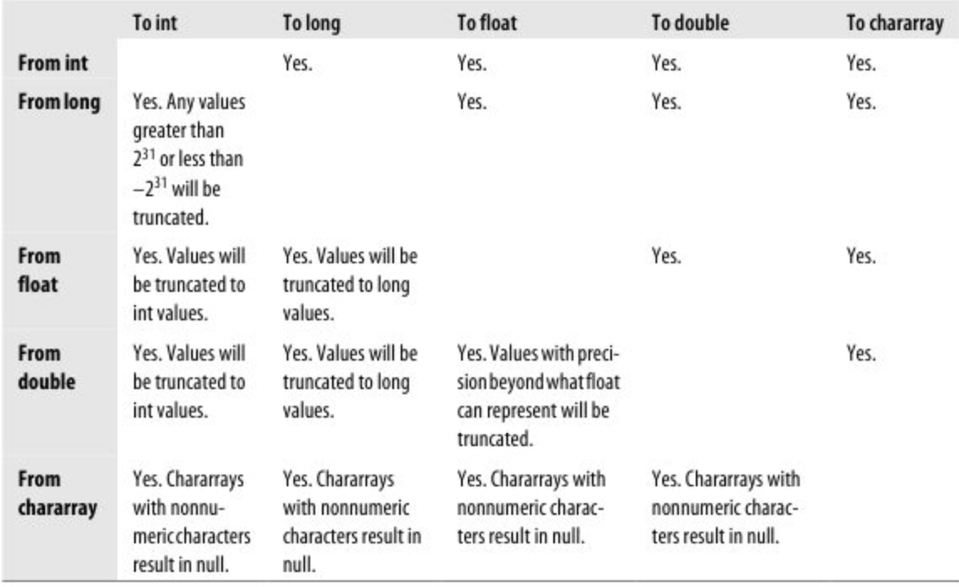
Supported Casts

Slide 87
Sorting, Grouping and Distinct
Fetching
Filtering
Sorting
Grouping
Distinct

Slide 88
Joins
Reduce Side join
Map Side join using distributed cache (replicated)
Map Side join (merge)
Data of all data sets needs to be sorted and partitioned in similar manner
Skewed join

Slide 89
Set operations (relational)
COGROUP (Similar to join)
UNION
INTERSECT
MINUS (There is no built in minus)
CROSS

Slide 90
User Defined Functions
Built-in UDFs
Piggybank
Static Java Functions
Custom functions in Java
Evaluation functions
Algebraic interface
Accumulator interface
Filter functions

Slide 91
Built-in UDFs
Comes with Pig, check online documentation for more details

Slide 92
Piggybank
Piggybank functions are distributed as part of the Pig distribution, but they are not built in. You must register the Piggybank JAR to use them, which you can do in your distribution at contrib/piggybank/java/piggybank.jar.
Register and use

Slide 93
Static Java functions
Any public static Java function that takes no arguments or some combination of int, long, float, double, String, or arrays thereof, and returns int, long, float, double, or String can be invoked in this way.

Slide 94
HCatalog
HCatalog can be used in pig to interact with Hive Metastore
Filters uses partition pruning
HCatLoader can be used to read the data from hive
HCatStorer can be used to write data to hive

Slide 95
Oozie
Workflow
Defines the flow of dependent jobs leveraging Hadoop eco system
Supports
Java
Map Reduce
Hive
Pig
Sqoop
Shell
Coordinator
Schedules the workflows

Slide 96
Oozie Workflow steps
Define workflow.xml
Define job.properties
Place additional jar files under lib
Copy job.properties, workflow.xml and jars (under lib) to HDFS
Run oozie command
oozie job -oozie http://ip-10-0-0-167:11000/oozie -config oozie-sqoop/job.properties -run
Monitor
oozie job -oozie http://ip-10-0-0-167:11000/oozie -info 0000000-140426175505299-oozie-oozi-W

