Slide 1
Setup Tez

Slide 2
Learning Pattern
You can apply this pattern to almost all the tools in Hadoop eco system.
Architecture
Daemon Processes
Parameter files
Log files
Demo and Validation

Slide 3
Learning Pattern - Tez
You can apply this pattern to almost all the tools in Hadoop eco system.
Architecture
Daemon Processes – client only (no daemons)
Parameter files
tez-site.xml
tez-env.sh
Log files – Not applicable
Demo and Validation – Not applicable

Slide 4
Agenda
Overview
Tez Architecture
Setup Tez
Tez parameter files
Tez log files

Slide 5
Overview
Tez is an application framework on top of YARN to allow complex directed acyclic graph (DAG) to process data
Tez can be used to run Apache Hive queries as well as Apache Pig Latin scripts. Hive queries or Pig scripts will be run as Tez jobs
Tez comes out of the box with Hortonworks, but not with other vendors like Cloudera

Slide 6
Tez Architecture
It is client only tool, as it uses YARN but not Map Reduce to process the data
It tries to fine tune Hive or Pig queries which spawns into multiple jobs by eliminating HDFS between dependent map reduce jobs

Slide 7
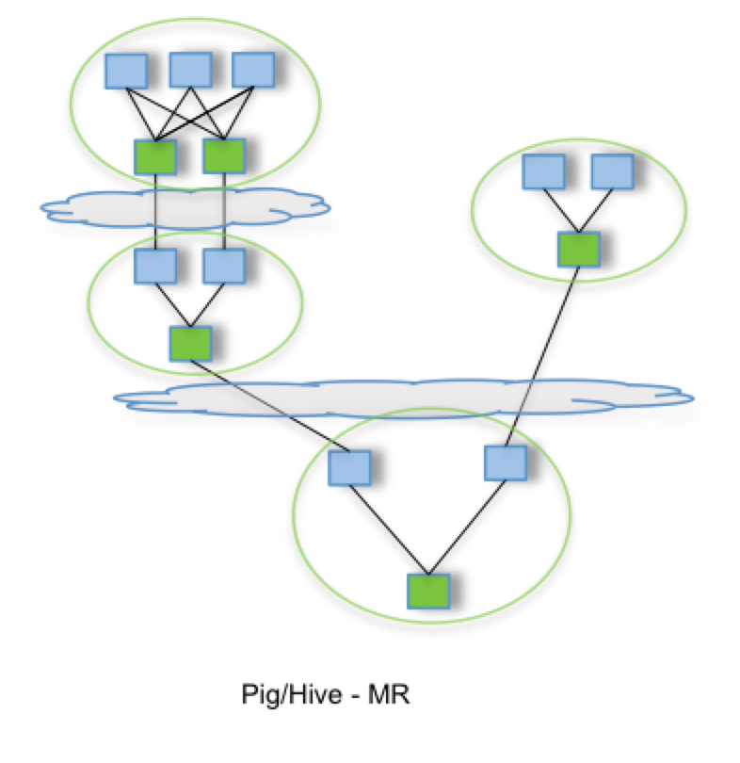
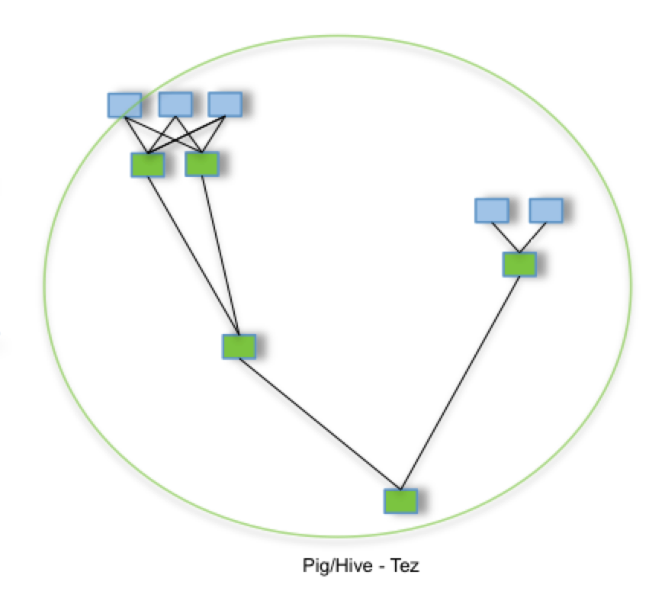
Tez Architecture vs. Map Reduce

Slide 8
Setup Tez
Using Ambari
Add Tez on the gateway or client nodes

Slide 9
6 node cluster
Three Servers (Masters)
Three Servers (Slaves)
Monitoring Database
Monitoring Server
Monitoring Agent
Monitoring Agent
yum repository server/client
yum client
HDFS
MR+YARN
HDFS
MR+YARN
Tez

Slide 10
Tez parameter files
tez-site.xml
tez-env.sh

Slide 11
Tez log files
No log files
Typically jobs will not be run on Tez directly instead they will be run either by using Pig or Hive. Hence one need to look at Pig log files.

