Slide 1
Setup Hive

Slide 2
Learning Pattern
You can apply this pattern to almost all the tools in Hadoop eco system.
Architecture
Daemon Processes
Parameter files
Log files
Validation

Slide 3
Learning Pattern
You can apply this pattern to almost all the tools in Hadoop eco system.
Architecture
Daemon Processes – HiveServer, HiveMetastore etc
Parameter files – hive-site.xml
Log files
Validation

Slide 4
Agenda
Overview
Hive Architecture
Hive Metastore
Setup Hive using 3rd party wizards
Hive parameter files
Hive log files
Hive user defined functions
Hive demo

Slide 5
Overview
Writing Map Reduce jobs can be tedious
Vast array of IT Stakeholders have basic proficiency in SQL
Using hive, we can write queries which will generate map reduce code to process the data.
It will accelerate application development in Hadoop eco system.
It has 3 components
DDL or Physical Modeling
Copying data (LOAD or INSERT)
Querying data (Hive QL)

Slide 6
Hadoop eco system
Hadoop Components
Hadoop eco system
Oozie
Pig
Impala
HBase
Flume
Mahout
Spark
Hive
Sqoop
Presto
Map Reduce
Non Map Reduce
Distributed File System (HDFS)
Hadoop Core Components

Slide 7
Hive Architecture
RDBMS
Hive Metastore
Hive Binaries
Metadata
Data Processing
Data Storage
MR+YARN
HDFS

Slide 8
6 node cluster
Three Servers (Masters)
Three Servers (Slaves)
Monitoring Database
Monitoring Server
Monitoring Agent
Monitoring Agent
yum repository server/client
yum client
HDFS
MR+YARN
HDFS
MR+YARN
Hive
Tez
Pig
Metastore Database

Slide 9
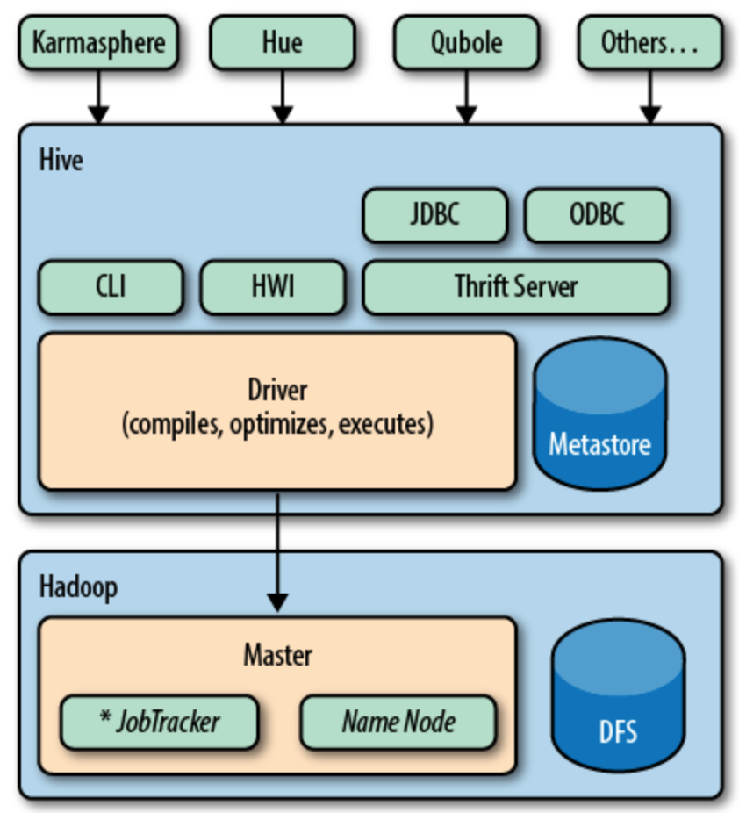
Hive Architecture

Slide 10
Hive Architecture
HDFS
All the data physically stored in HDFS
Map Reduce
Data is processed using map reduce jobs
Metastore
Stores structure of tables
Hive query engine
Generates Java code at run time
Compiles and build jar at run time
Submit as one or more map reduce jobs

Slide 11
Setup Hive using 3rd party wizards
Configure Hive metastore server
Setup Database or use existing database (setup mysql database)
Configure hiveserver2
Configure Gateway

Slide 12
Hive parameter files
hive-site.xml
.hiverc

Slide 13
Important Parameters
File Name | Parameter Name | Parameter value | Description
hive-site.xml | javax.jdo.option.ConnectionURL |  | Connection URL (JDBC URL)
hive-site.xml | javax.jdo.option.* |  | ConnectionDriverName, ConnectionUserName, ConnectionPassword etc. Connection information to Hive Metastore
hive-site.xml | hive.metastore.warehouse.dir | /user/hive/warehouse | Default logical database in Hive
hive-site.xml | mapred.reduce.tasks | -1 | Let's hive engine to determine number of reducers based up on the size of the data
hive-site.xml | hive.zookeeper.quorum |  | Zookeeper quorum information for external java applications to connect to Hive database
hive-site.xml | hive.zookeeper.client.port | 2181
hive-site.xml
hive-site.xml
hive-site.xml
hive-site.xml

Slide 14
Hive log files
Under /tmp

Slide 15
Hive user defined functions
Adding jar files
Creating temporary function
Updating .hiverc file
Supporting development teams

Slide 16
Hive demo
Hive command line
hive -e
hive -f
-hiveconf
set
Creating databases
Creating tables
Managed
External
Copying data to HDFS via Hive tables
Running sample queries
Role of .hiverc
Troubleshooting Map Reduce jobs for hive queries

