Slide 1
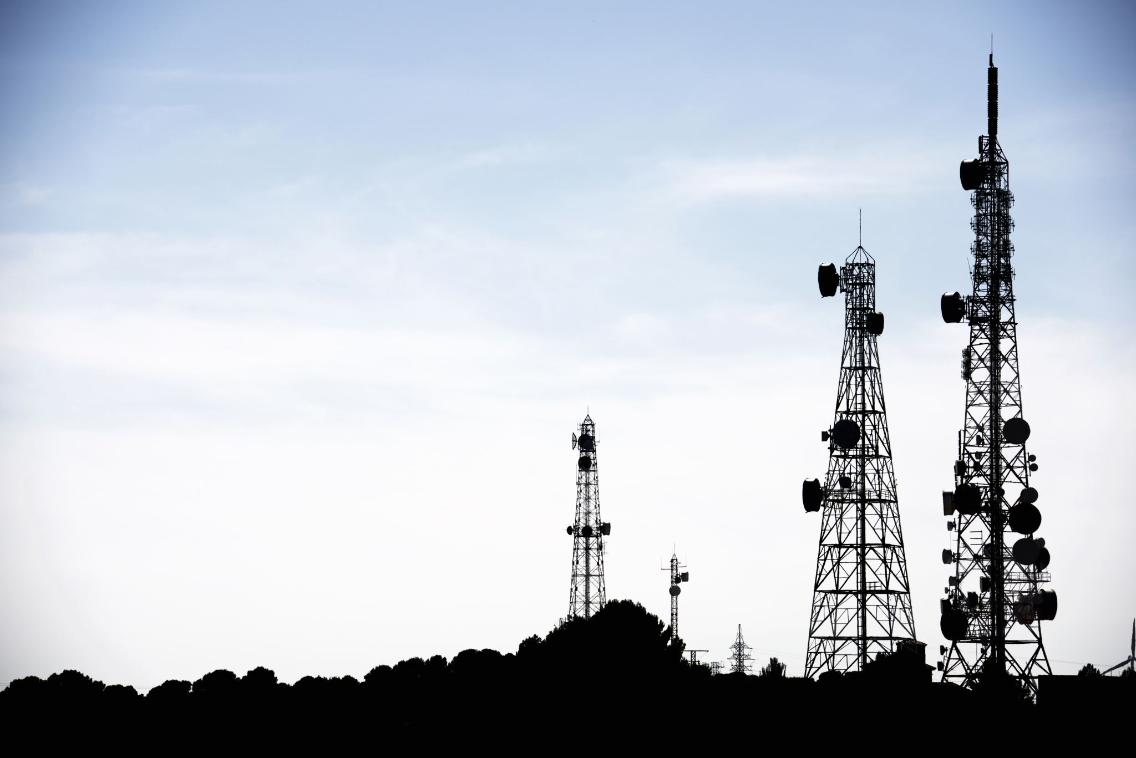
Telecom Customer Churn
Group 18
Swathi Vegiraju (56) sec-01
Pragya Sharma (51) sec-02
Rahul Gamara (10) sec-02

Slide 2
Problem Identification
Customer churn is defined as when customers or subscribers discontinue doing business with a firm or service.
Customers in the telecom industry can choose from a variety of service providers and actively switch from one to the next. The telecommunications business has an annual churn rate of 15-25 percent in this highly competitive market.
Objective
To help companies predict which customers are at high risk of churn.

Slide 3
Collection of Data
Customers who left within the last month – the column is called Churn.
Services that each customer has signed up for – phone, multiple lines, internet, online security, online backup, device protection, tech support, and streaming TV and movies.
Customer account information – how long they’ve been a customer, contract, payment method, paperless billing, monthly charges, and total charges.
Demographic info about customers – gender, age range, and if they have partners and dependents.
https://www.kaggle.com/datasets/blastchar/telco-customer-churn

Slide 4
Data Flow
Exploring the Data
Feature Engineering
Model Building
Hyperparameter Tuning
Model Comparison

Slide 5
ML Pipeline

Slide 6
Classification Models
Logistic :
It is a widely known model when it comes to binary classification. The probability of customer attrition can be easily predicted using various features listed above. This regression technique is simple, efficient and predicts the probability for each class.
2) Random Forest:
It is an ensemble learning method that builds numerous decision trees while training and gives the mode of classes of the individual trees as output. Randomforest models can handle large amounts of data and can efficiently handle complex relationships between the features and the target variable.
3) XGBoost:
It sequentially builds a series of decision trees, where each tree attempts to correct the errors of the previous ones.
This model builds a series of decision trees and each tree corrects the errors of the previous tree. It is a powerful and robust model which is effective in predictive modeling tasks such as customer churn rate.

Slide 7
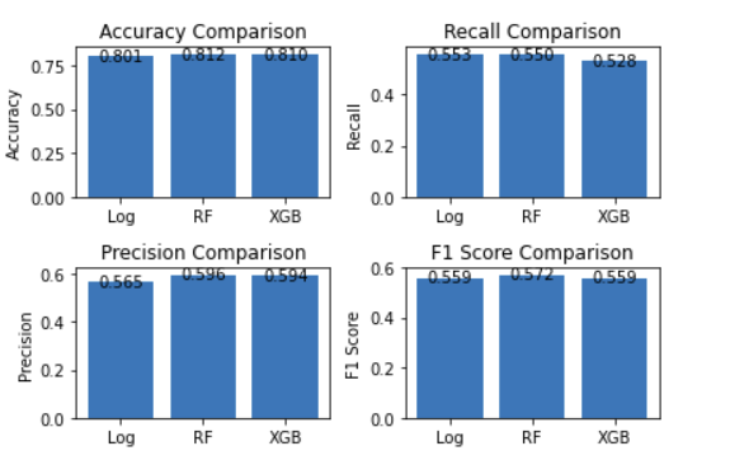
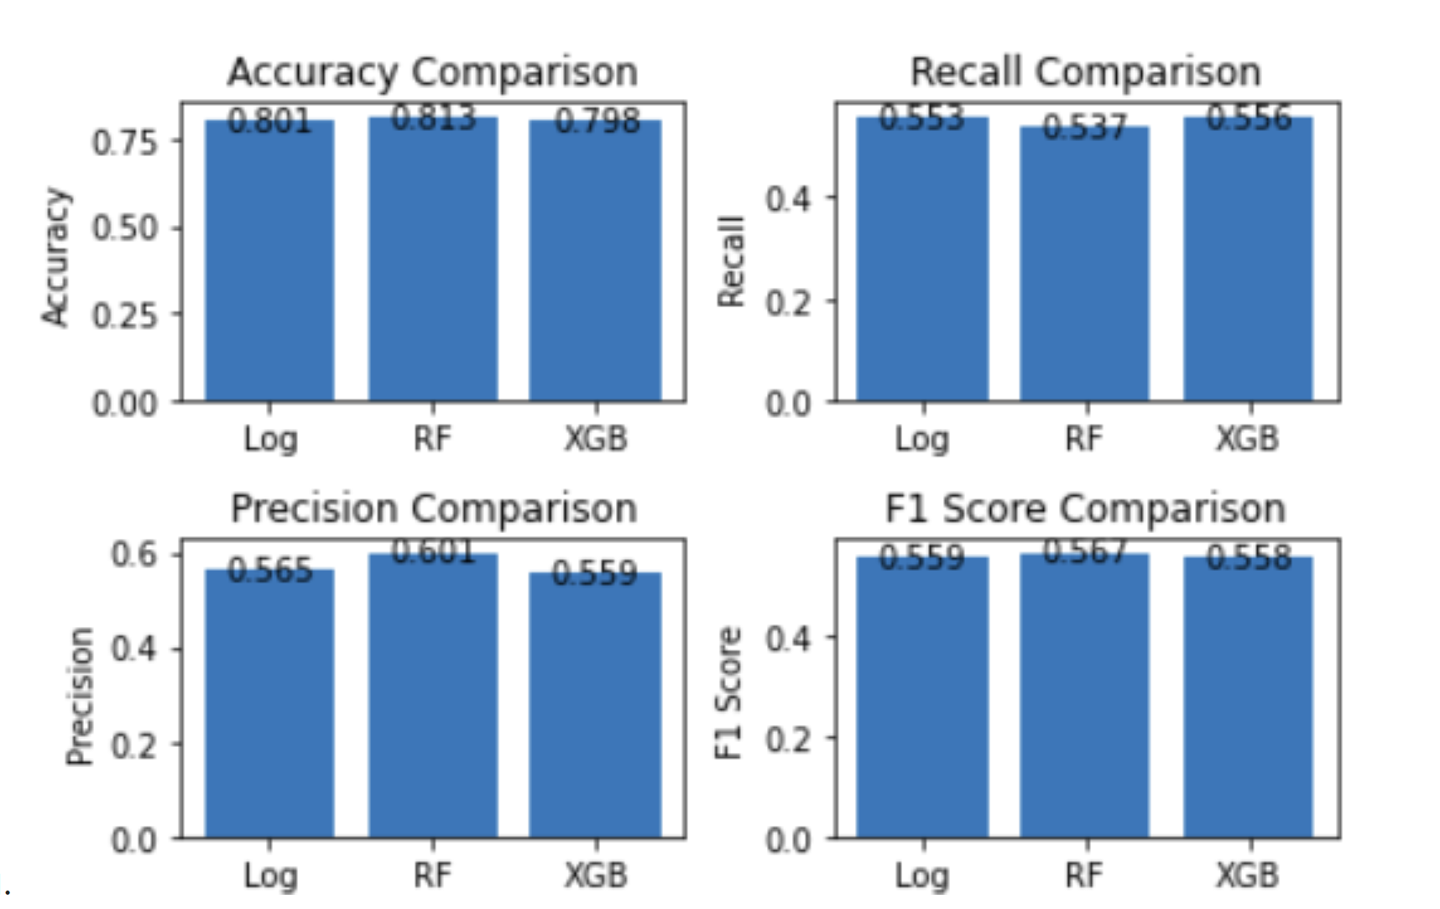
Results
Before Tuning
After Tuning

Slide 8
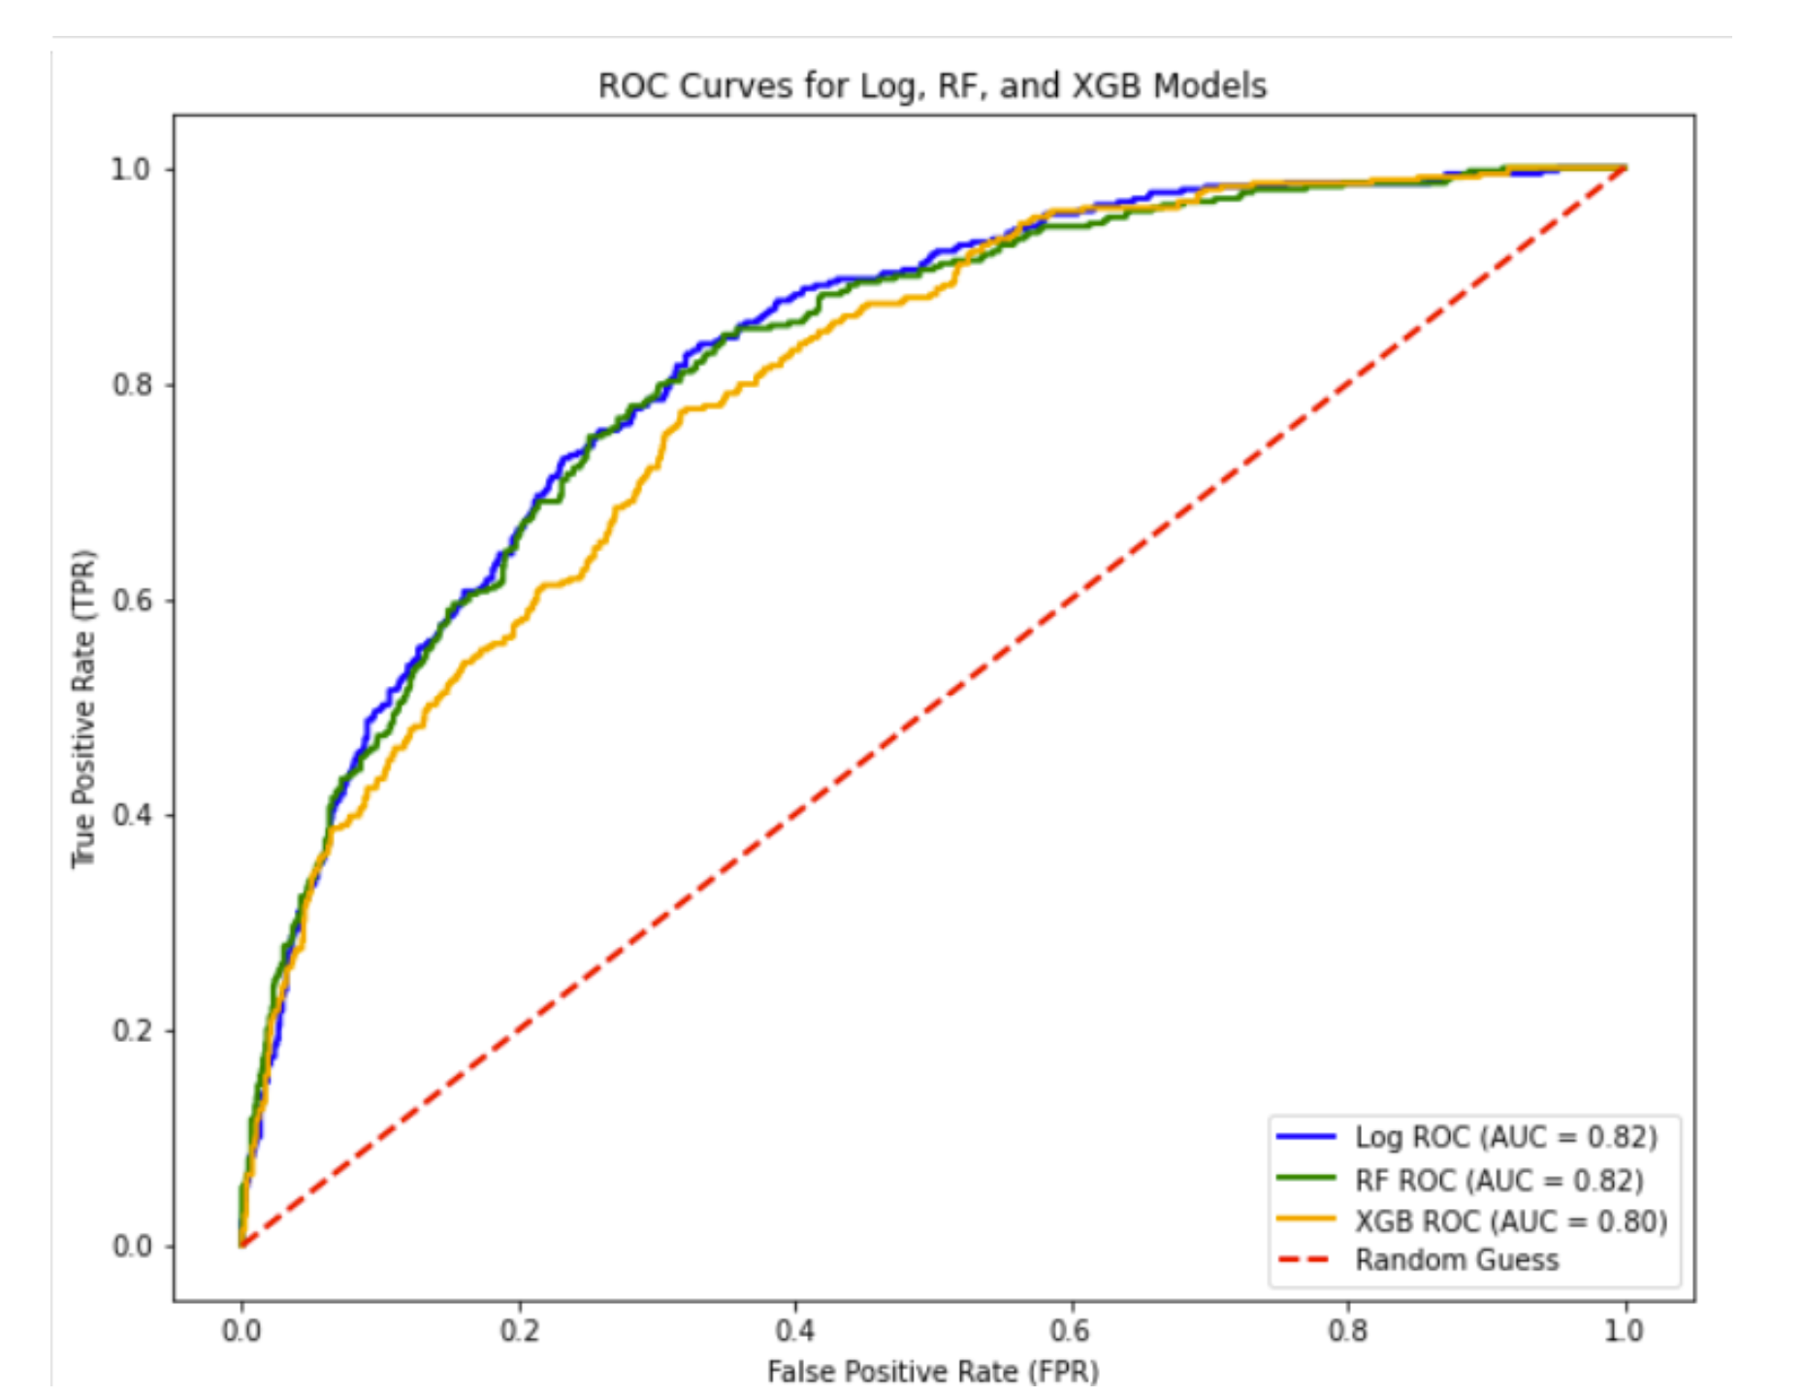
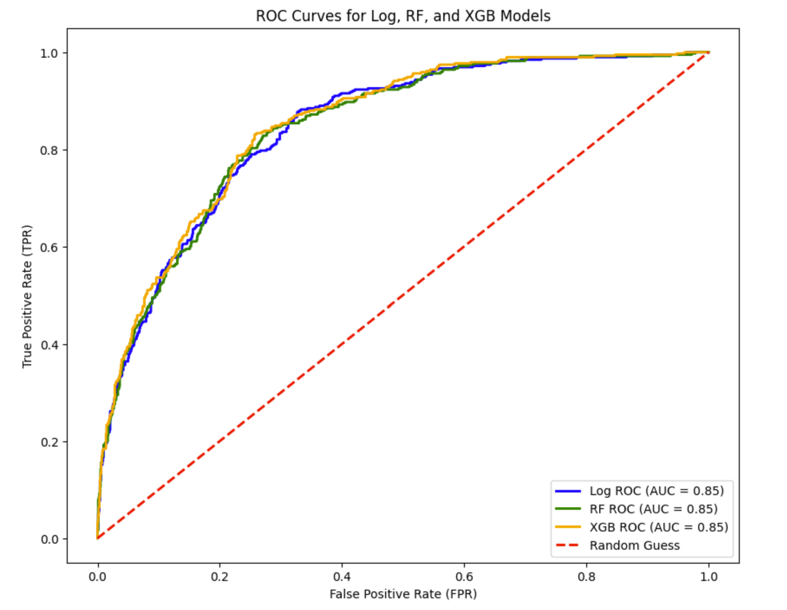
Results
Before Tuning
After Tuning

Slide 9
References:
https://www.kaggle.com/datasets/blastchar/telco-customer-churn
https://www.geeksforgeeks.org/xgboost/
https://www.analyticsvidhya.com/blog/2021/06/understanding-random-forest/

Slide 10
Thank You!

