Slide 1

SMART INDIA HACKATHON 2026
TITLE PAGE
Problem Statement ID – SIH26051
Problem Statement Title – Software Based Model Development for Design of Area Specific Shelter for Thermal Comfort Maintenance
Theme – Miscellaneous
PS Category – Software
Team ID – [team ID]
Team Name (Registered on portal) – ASPIRE

Slide 2
ASPIRE
A climate-specific digital model for designing passive shelters in Ladakh
What the problem statement is asking us to build
Core design principle
• A software model that predicts shelter temperature for a chosen outdoor climate.
• A user can change shelter size, shape, orientation, openings, material and thickness.
• Real weather and solar-radiation data are used instead of fixed assumptions.
• Different designs are compared under the same ambient conditions.
• The final output recommends the combination that maintains comfort with less active heating.
SOLAR GAIN
THERMAL MASS
INSULATION
ORIENTATION
Capture useful winter sunlight
Store heat and release it later
Reduce conductive heat loss
Use site-specific solar exposure
Three required outputs
01
02
03
Why Ladakh?
Indoor temperature
Solar energy
Heat flow
• Large day/night temperature variation.
• Strong solar resource makes passive solar gain useful.
• Heat loss through walls, roofs and openings is significant.
• Thermal mass + insulation can store daytime heat and slow night-time losses.
T_inside(t) for the selected geometry and materials
Heat gained from incident solar radiation
Heat entering/leaving through the envelope over time
@SIH Idea submission- Template
2

Slide 3
Technical Approach
ASPIRE
Fast computational screening + ANSYS validation + interactive visualization
Thermal simulation pipeline
Technology stack
1. CLIMATE INPUT
Engineering
ANSYS Workbench • transient thermal • parametric studies
NASA POWER hourly temperature, solar radiation, wind
2. USER DESIGN
Scientific Python
NumPy • Pandas • RK4 solver • U/R-value • thermal mass • heat balance
Dimensions, orientation, openings, materials
Backend
Flask • Flask-CORS • REST API • JSON simulation endpoints
3. PYTHON MODEL
U-value + thermal mass + solar gain + RK4
Frontend
HTML/CSS/JavaScript • Chart.js • Three.js • OrbitControls
4. ANSYS
Detailed thermal simulation, mesh + boundary conditions
Data layer
NASA POWER hourly data • material-property CSV • optional SQLite/PostgreSQL
5. COMPARISON
Materials, thickness, shape and orientation
Sensors / IoT
ESP32/Arduino • temperature • humidity • solar irradiance • wind
6 RECOMMENDATION
Deployment
Git/GitHub • Docker • cached/offline datasets for remote sites
Best design for comfort and low heat demand
@SIH Idea submission- Template
3

Slide 4
Feasibility And Viability
ASPIRE
Why the solution is practical — and how we will control technical and deployment risk
Technical feasibility
Operational feasibility
Risk & mitigation
What already works
Why it is viable
Main risks
• 1,488 hourly weather records are already available in the supplied dataset.
• Python backend already performs thermal calculations and exposes API routes.
• Material library supports multiple envelope options for comparison.
• Chart.js and Three.js already provide result visualization and 3D interaction.
• Most inputs are numeric and can be entered through a simple form.
• The fast model can screen many designs before expensive simulation.
• The system can work with historical data first and live sensors later.
• The architecture can be reused for other climatic regions.
• Real shelters have infiltration, thermal bridges and workmanship effects.
• Material properties can vary with moisture and temperature.
• ANSYS accuracy depends on geometry, mesh and boundary conditions.
• A single weather point cannot represent every Ladakh micro-climate.
How we mitigate them
Next validation step
Practical deployment
• Create an ANSYS reference geometry.
• Match the same ambient conditions and material properties.
• Compare ANSYS temperature/heat-flux results with the fast Python model.
• Local cached weather data keeps the application usable with weak internet.
• Sensor correction can reduce the gap between satellite data and site reality.
• Saved simulation cases make material/design comparison repeatable.
• Sensitivity analysis across material k, thickness and opening area.
• Field calibration when sensor data becomes available.
• Human-in-the-loop review of shortlisted designs.
• Report uncertainty instead of presenting one number as absolute truth.
FEASIBILITY SCORECARD
Software prototype
READY
Weather data
READY
Material comparison
READY
ANSYS validation
NEXT
Live sensors
FUTURE
@SIH Idea submission- Template
4

Slide 5
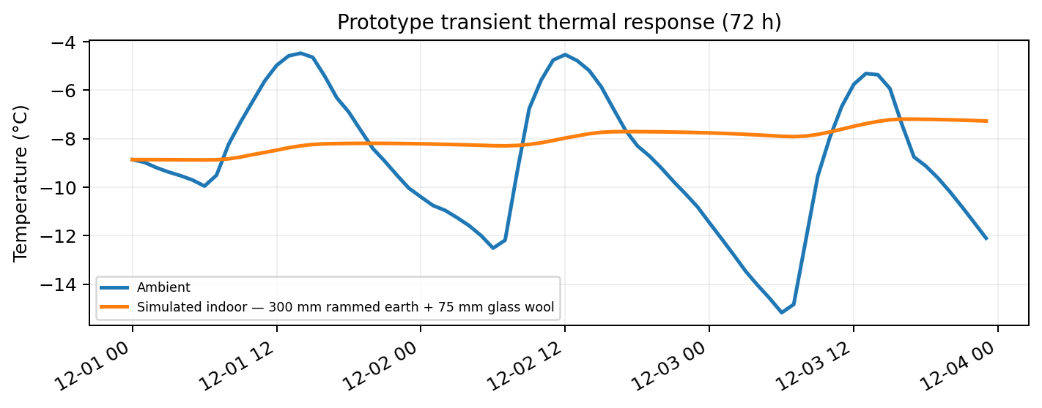
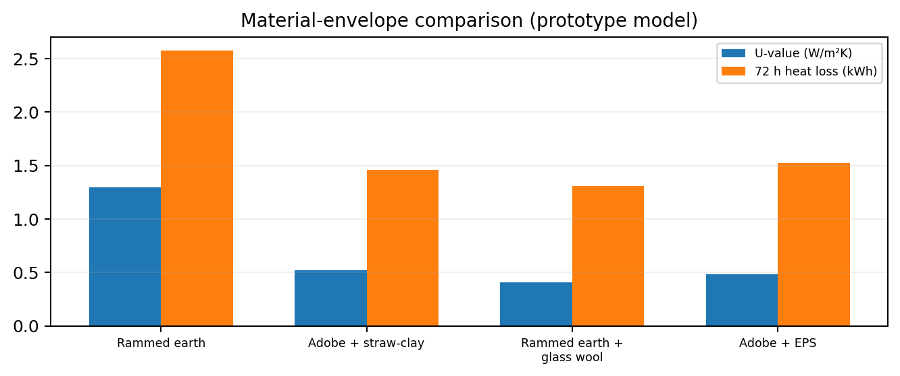
ASPIRE
Impact And Benefits
Turn simulation results into a practical shelter-design decision
Prototype thermal response
Key benefits
Energy
Less dependence on active heating through better passive design.
Design
Compare material, thickness, glazing and orientation before construction.
Cost
Reduce trial-and-error physical prototyping.
Illustrative run using the supplied Ladakh weather data. The fast model is intended for screening; ANSYS and field measurements provide validation.
Field use
Accept local sensor readings and calibrate the model.
Scale
Adapt the same framework to other climatic regions.
SUCCESS = more time in comfort band + less active energy demand
@SIH Idea submission- Template
5

Slide 6
Research & Reference
ASPIRE
Climate data, passive-solar research and engineering-simulation references
NASA POWER
Hourly solar and meteorological data for the selected location.
What we will demonstrate
https://power.larc.nasa.gov/docs/services/api/temporal/hourly/
• User changes shelter geometry and materials.
• Hourly climate data enters the model.
• Python rapidly screens candidate designs.
• ANSYS validates the shortlisted geometry.
• Graphs show indoor temperature, solar gain and heat flow.
• The system ranks designs against thermal-comfort targets.
• Future sensor integration makes the model site-specific.
Thermal simulation and engineering workflow for high-fidelity validation.
ANSYS Workbench
https://www.ansys.com/en-in/products/ansys-workbench
Leh Climatological Data (2011–2024)
Regional temperature and weather records.
chrome-extension://efaidnbmnnnibpcajpcglclefindmkaj/https://mausam.imd.gov.in/leh/mcdata/City.pdf
Research project on passive-solar heated houses in Ladakh.
FHNW — PSH Ladakh
https://www.fhnw.ch/en/engineering-environment/research-services/research/projects/passive-solar-heated-houses-psh-in-ladakh-india
Vernacular Architecture & Climatic Control in Ladakh
Khan (2013)
https://www.researchgate.net/publication/279186605_Vernacular_Architecture_and_Climatic_Control_in_the_extreme_conditions_of_Ladakh_ASPIRE-2013
THERMAL LADAKH
Passive-first • data-driven • region-specific
Mehta, Gajjar & Bhavsar (2024)
Thermal Comfort in Vernacular Ladakhi Dwellings
https://arch.su.ac.th/images/publications/ISVS12/20-Dinal.pdf
External references are linked above.
@SIH Idea submission- Template
6

