Slide 1
Classification of Clothing Items
Final Project
Jalan, Pragya
CSCI E-89 Deep Learning, Spring 2019
Harvard University Extension School
Prof. Zoran B. Djordjević

Slide 2
Objective
To detect and classify images of different types of clothing into their respective classes

Slide 3
Real World Impact
A lot of people have turned to online retailers to browse or buy clothing - therefore there is a huge demand. These retailers need to organise their catalog thereby correctly tagging the labels. It take a lot of man power of correctly classify the clothing into its correct labels.
People put up a lot images on social media, which they want classified.
This classifier will help business correctly classify their images into their respective groups
Notes:
This project has a large real world impace - as a

Slide 4
Dataset
Fashion MNIST dataset
Consists of 70,000 28x28 pixel grey-scale images derived from the online retailer Zalando
Consists of 10 different labels of the fashion items
The dataset promises to the more diverse
This dataset is publicly available to Kaggle and Zalando Fashion MNIST repository on github
The Keras library also includes it as a built in dataset

Slide 5
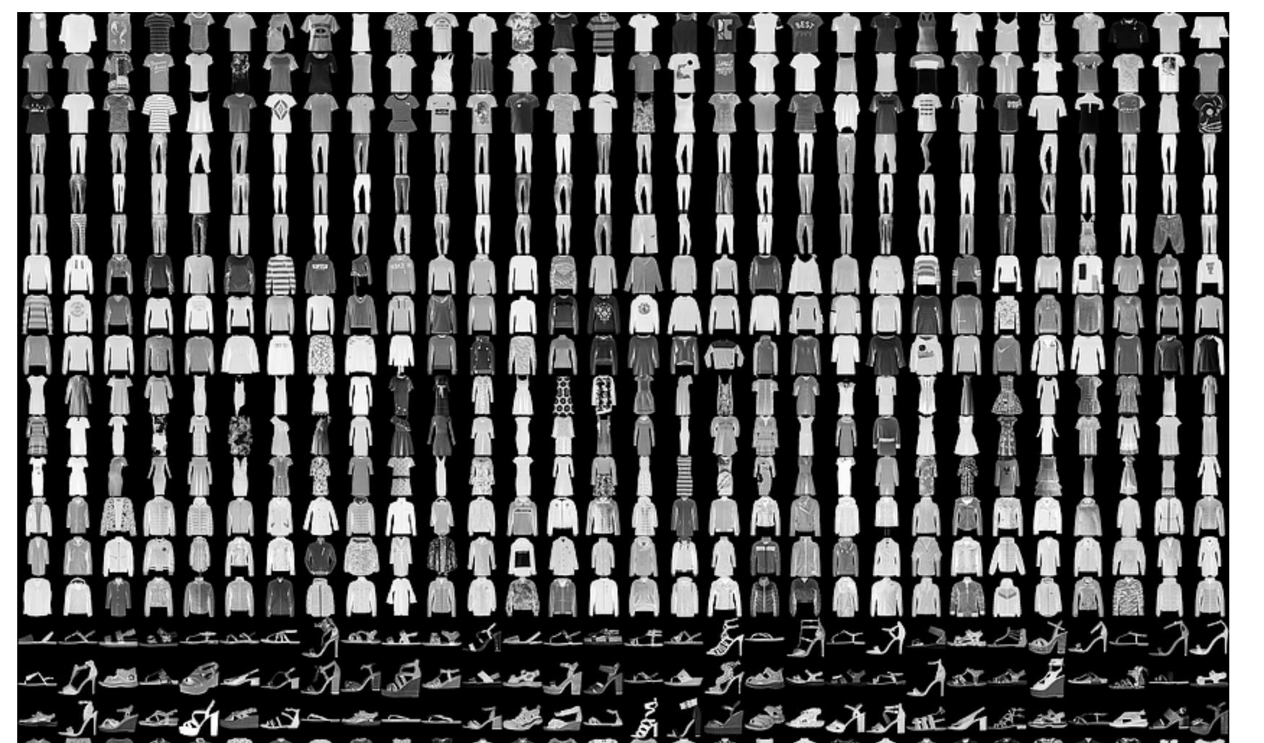
Dataset
Here is an example of how the data looks (each class takes three rows)

Slide 6
Technology
This model is written in Python using Keras
The code was written and run using Jupyter Notebook
The model was run on Google Colab since I could take advantage of the Graphical Processing Unit (GPU)

Slide 7
Model
I used a deep Convolutional Neural Network (CNN) to build this image classifier
I used a pattern of Convolution, Dropout, Convolution and Max Pooling.
This pattern was repeated 3 times with 32, 64, 128 feature maps.
Finally an additional and larger Dense layer was used at the end of the network to translate the large number of feature maps to class values.

Slide 8
Model
Convolutional Layer - this is used to extract features from the input image
Pooling Layer - this reduces the dimensionality of each feature map but retains most of the important information
Dense/Fully Connected Layer - implies that every neuron in the previous layer is connected to every neuron in the next layer
Dropout Layer - here random neurons are dropped during training, therefore other neurons have to step in and handle the representation required to make the prediction. This helps to overcome Overfitting.

Slide 9
Model
The training process:
The network takes a training image as input, goes through the forward propagation step - which is the convolution and pooling operations in the fully connected layer, finds the output probability for each class
It then calculates the total error at the output layer
Finally it uses backpropagation to calculate the gradients of the error with respect to all the weights in the network and use the gradient descent to update all the filter values and parameters values to minimise the output error

Slide 10
Modeling Strategy
The model was run :
with a batch size of 32
for 50 epoches
on a training set of 60,000
on a validation set of 10,000

Slide 11
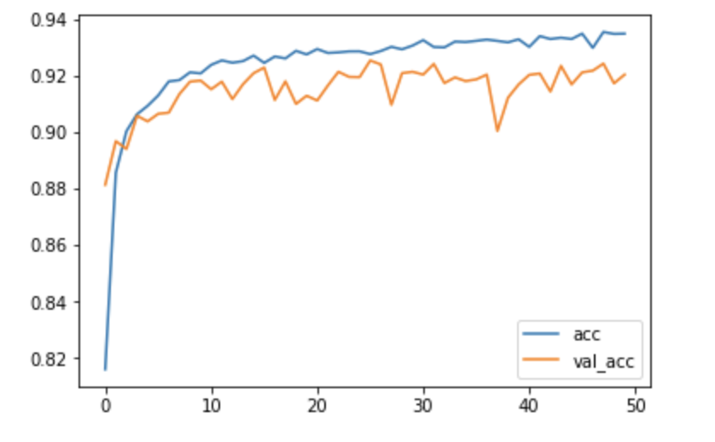
Results
The model gave me an accuracy of ~91%

Slide 12
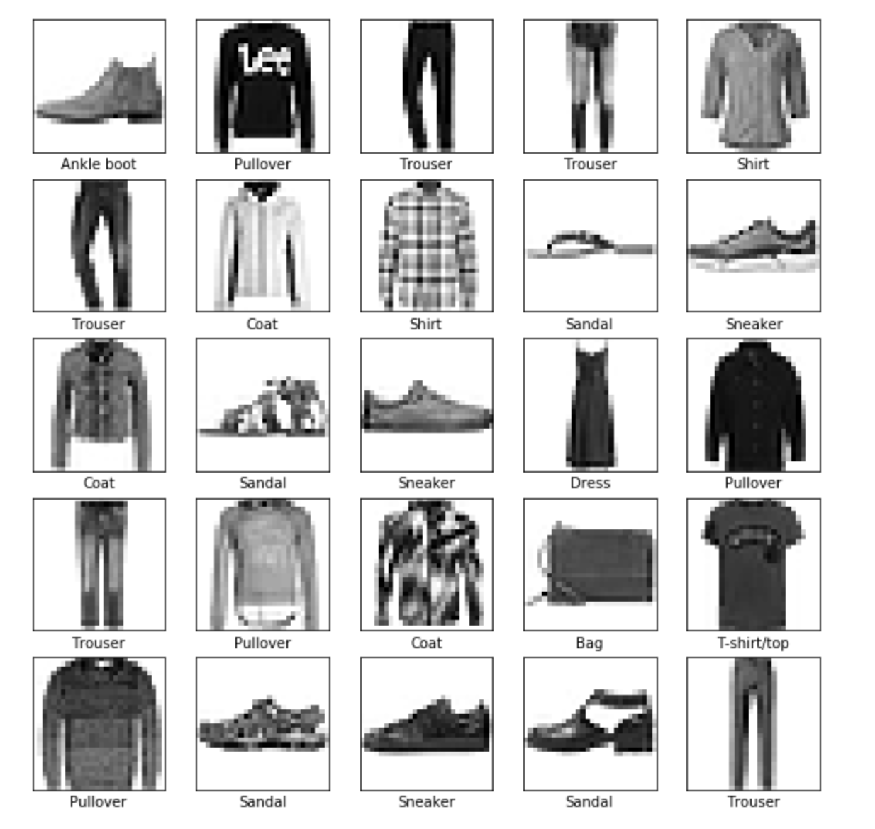
Results
We observe that it correctly identified the 25 images in the test set.

Slide 13
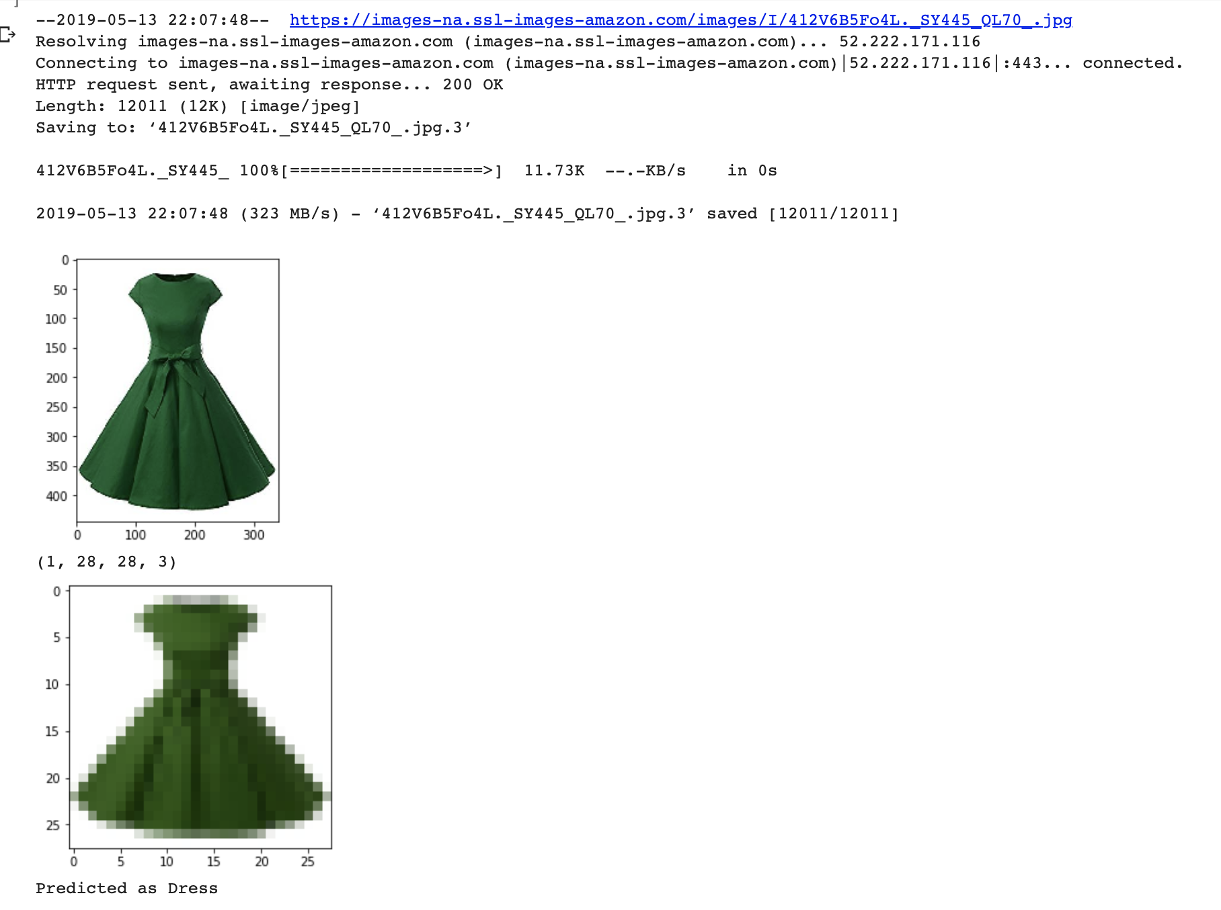
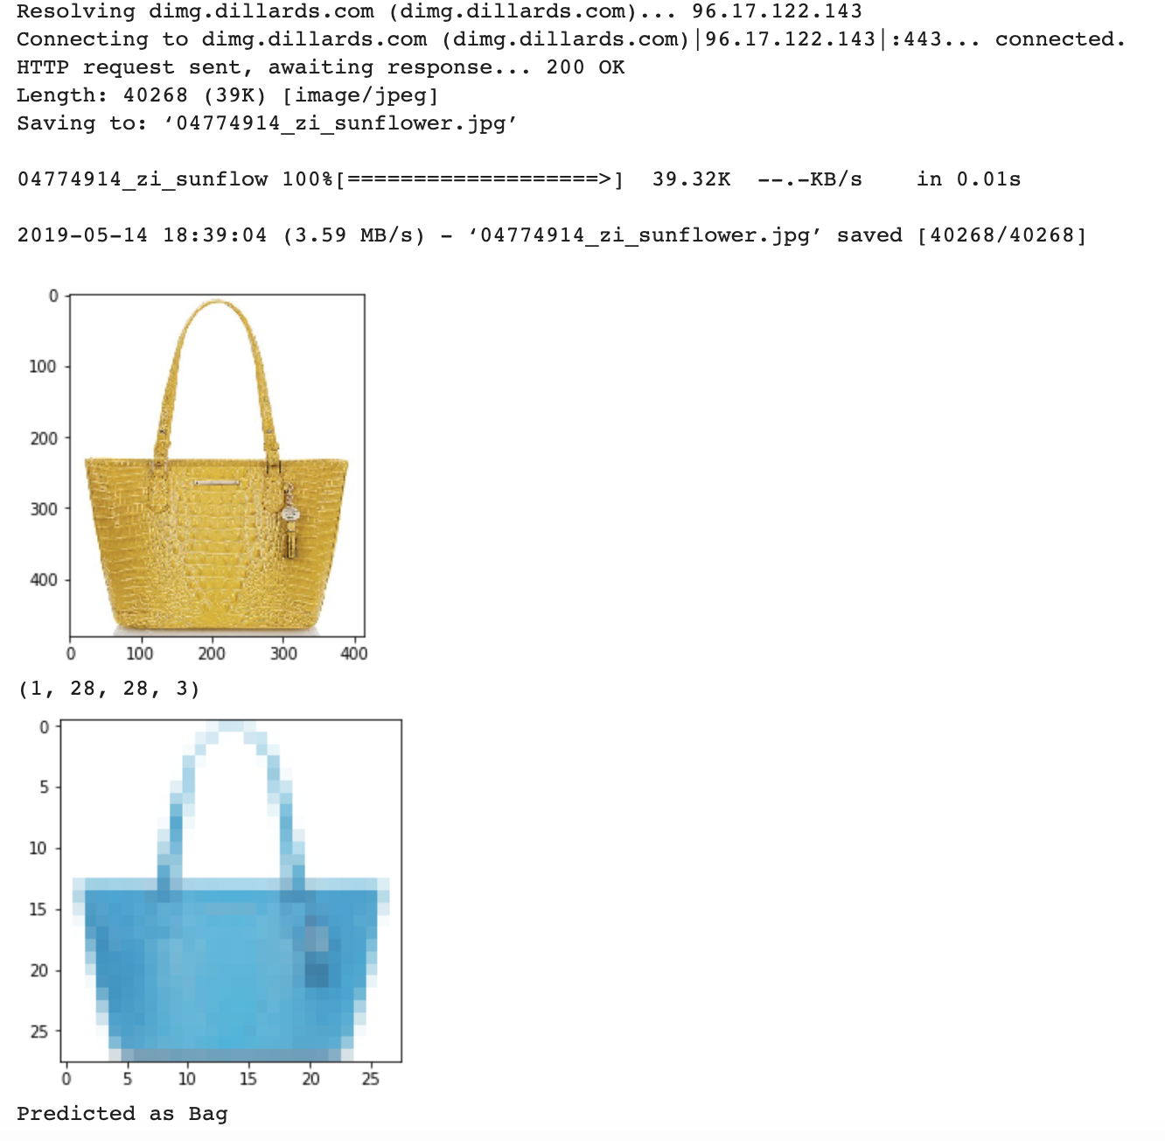
Results
Given an image not it the dataset, it was correctly able to identify its class label

Slide 14
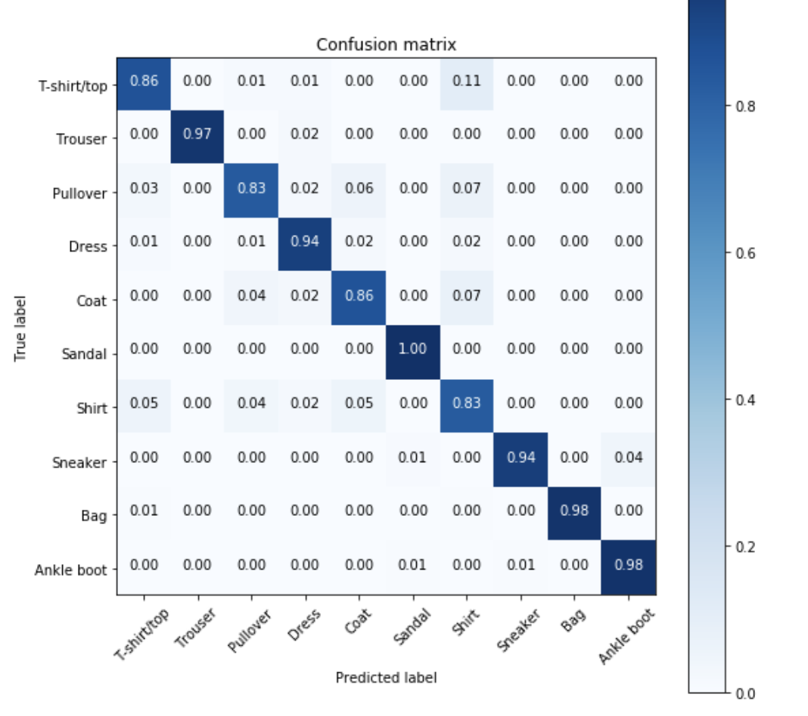
Results
Here we see that most of the miscalculations are happening between 4 of the class labels - T-shirt/top, Pullover, Coat and Shirt which is impacting the performance of the classifier
Notes:
The confusion matrix helps us describe the performance of the classifier visually by plotting the true labels with the predicted labels.

Slide 15
Conclusion
The classifier gave a good accuracy of ~91%
Most of the misclassification was due to the 4 classes - T-shirt/top, Pullover, Shirt and Coat
Since deep learning needs a large number of data to learn, I would collect more samples and give more images, especially from the above 4 classes to help the classifier learn better.
Added to this, I would tweak my model so as to add Regularization and maybe another Dropout Layer to improve overfitting.

Slide 16
Thank you
2-minute video Youtube link: https://youtu.be/gHL2ggJRzm8
15-minute video Youtube link: https://youtu.be/Ii9cFvA-EiQ

