Slide 1

Personalized Healthcare Treatment Using Reinforcement Learning
A Project by Garima Badhan & Pragya Mittal

Slide 2

Overview of the Problem
The healthcare system faces critical challenges in delivering personalized treatments:
Difficulty in dynamically adapting to patient conditions.
Inefficient resource allocation leading to increased costs.
Suboptimal patient outcomes due to static decision-making systems.
Reinforcement learning (RL) addresses these challenges by providing adaptive, patient-specific solutions, optimizing treatment strategies, and improving healthcare efficiency.

Slide 3
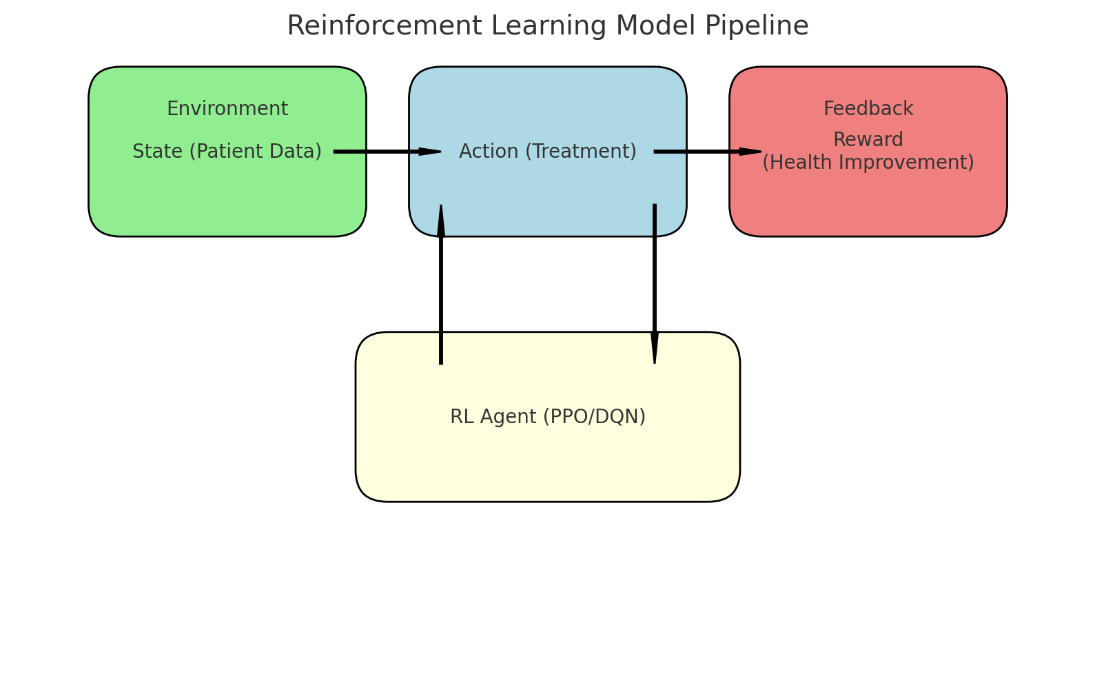
Project Goal and Objectives
Goal: Develop a reinforcement learning system capable of delivering personalized healthcare by optimizing treatment strategies dynamically.
Objectives:
Identify patient-specific treatment needs based on real-time data.
Optimize interventions such as medication, diagnostic testing, and lifestyle changes.
Minimize healthcare costs while improving patient outcomes.
Adapt dynamically to evolving patient conditions for long-term effectiveness.

Slide 4

Dataset and Simulation
The dataset includes:
Patient demographics (e.g., age, gender)
Medical history (e.g., chronic conditions, past treatments)
Real-time vitals and diagnostic results
Data preprocessing involved normalization and handling missing data. A custom OpenAI Gym environment simulates dynamic patient interactions, enabling the RL agent to learn optimal treatment strategies.

Slide 5

Results and Insights
Evaluation Metrics:
Random Policy Average Reward: -502.78
Heuristic Policy Average Reward: -499.15
DQN Agent Average Reward: -500.01
PPO Agent Total Reward: Improved steadily over 100 episodes.
Key Observations:
Random and Heuristic Policies perform inconsistently.
DQN showed moderate performance but struggled in complex environments.
PPO achieved higher stability and reward.
Conclusion:
PPO outperforms other methods, demonstrating its adaptability to dynamic healthcare scenarios

Slide 6

Personalized Recommendations
The model provides actionable recommendations for patient-specific treatments:
Medication Adjustment: Low Adjustment
Diagnostic Testing: Moderate Adjustment
Lifestyle Changes: High Adjustment
These recommendations demonstrate the model's ability to adapt dynamically to individual patient conditions, providing tailored healthcare solutions.

Slide 7
Challenges and Learnings
Challenges:
Hyperparameter tuning for PPO and DQN.
Learnings:
PPO outperforms DQN in dynamic and continuous environments.
Dependence on synthetic data; real-world validation is required.
Computational overhead during training.
Reward design is critical for aligning the model with desired outcomes.

Slide 8
Future Scope
Training PPO and DQN models on larger, diverse datasets and refining recommendations using patient feedback.
Expanding heuristic baselines and exploring advanced RL methods like A3C and SAC
Validating with real-world datasets (e.g., MIMIC-III) and enhancing interpretability using SHAP for clinician adoption.
Optimizing computational efficiency and exploring multi-agent RL systems for collaborative decision-making.

Slide 9
Thank You
For more details:
GitHub Repository:
https://bit.ly/drl_project_github
Feel free to reach out with any questions or collaboration opportunities!

