Slide 1



GTech Enterprises
... A manufacturing solution
Company Address
Gat No. 1652
Patil Nagar, Behind MNGL Pump,
Dehu - Alandi Road,
Chikhali, Pune - 411062,

Slide 2



Gtech Certificates
ISO 14001:2015
ISO 3434-2:2016
ISO 9001:2015
GTech Enterprises

Slide 3
About Us
GTech Enterprises is a forward-thinking, quality-focused manufacturing company specializing in precision machining and manufacturing solutions. Based in Pune, Maharashtra state and established in 2018, we have built a strong reputation for delivering high-performance engineering components and assemblies tailored to meet the diverse needs of industries such as automotive, aerospace, energy, construction, and heavy machinery.
Our manufacturing capabilities span a wide range of processes including sheet metal forming, structural steel fabrication, welding (MIG, TIG, and arc), laser cutting, plasma cutting, bending, rolling, and assembly of complex structures. Whether it's prototyping or full-scale production, our team combines technical expertise with advanced tools and machinery to deliver consistent quality, dimensional accuracy, and durability.
At GTech Enterprises, we are committed to excellence, continuous improvement, and customer satisfaction. We pride ourselves on timely delivery, transparent communication, and fostering long-term partnerships built on trust and performance. As we grow, we continue to invest in technology, talent, and sustainable practices to serve our clients better and contribute to the future of smart manufacturing.
GTech Enterprises

Slide 4
Vision and Mission
Vision Statement:
"To be a leading and innovative manufacturing company delivering world-class machining and manufacturing solutions, committed to excellence, precision, and sustainability in every project we undertake."
GTech Enterprises
Mission Statement:
To provide high-quality, reliable, and cost-effective products and services tailored to customer needs across diverse industries.
To embrace cutting-edge technologies and continuous improvement for enhancing product quality, process efficiency, and customer satisfaction.
To build long-term partnerships with clients through integrity, transparency, and on-time delivery.
To contribute to sustainable manufacturing practices by optimizing resources and reducing waste.

Slide 5
Quality Policy
GTech Enterprises
We at “Gtech Enterprises” are committed to manufacture & supply of Machined Components meeting customer specifications, within stipulated time and cost effectiveness.
We are committed to maintain effective quality management systems through continual improvement of our products, process with enhance customer satisfaction. And We will provide training periodically as per need of our employees.
The objective will be maintained, measured & analyzed periodically to achieve our target.”

Slide 6
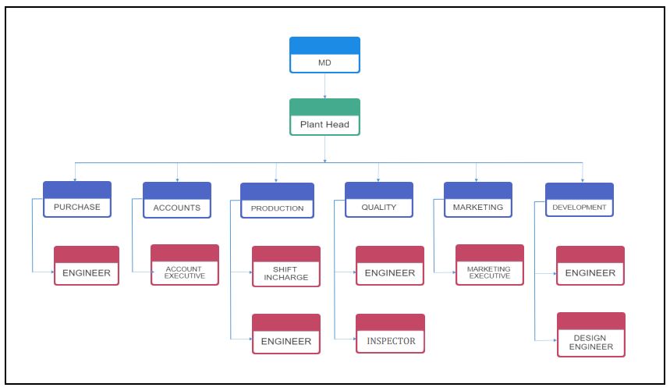
Organization Structure
GTech Enterprises

Slide 7
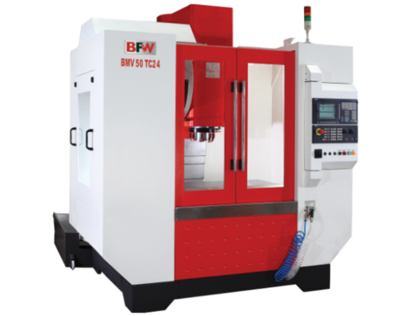
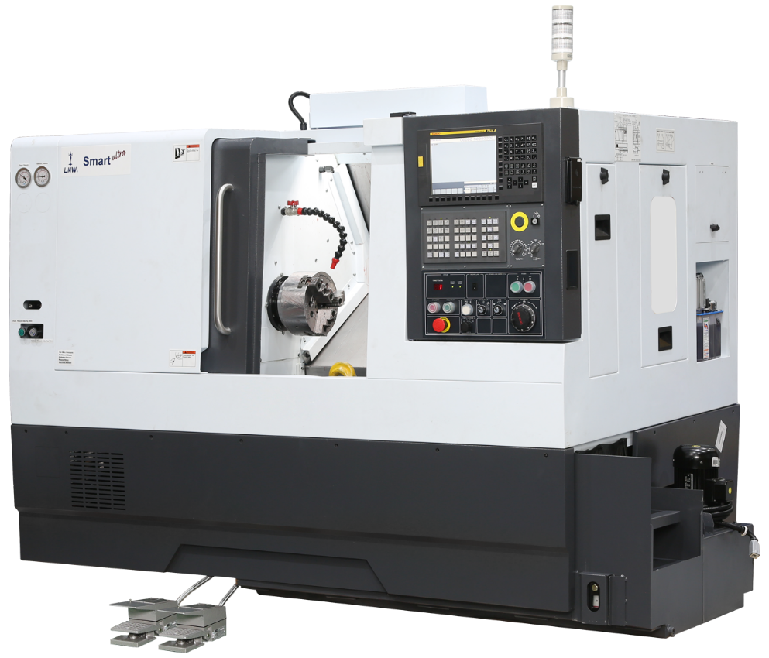
Machining Facilities Available
GTech Enterprises
CAPACITY | UNIT | BMV50 TC24
Head stock travel(Z- axis) | mm | 510
Spindle nose face to table top | mm | 100-610
Increased daylight area with column height block(optional) | mm | 300-810
Distance from floor to table | mm | 950
DESCRIPTION | UNIT | LMW Make
No. of Stations | Nos | 8
Chuck Diameter | mm | 165, 200,300
Maximum Boring Bar Diameter | mm | Ø 32
Turret Indexing | Type | Hydraulic

Slide 8
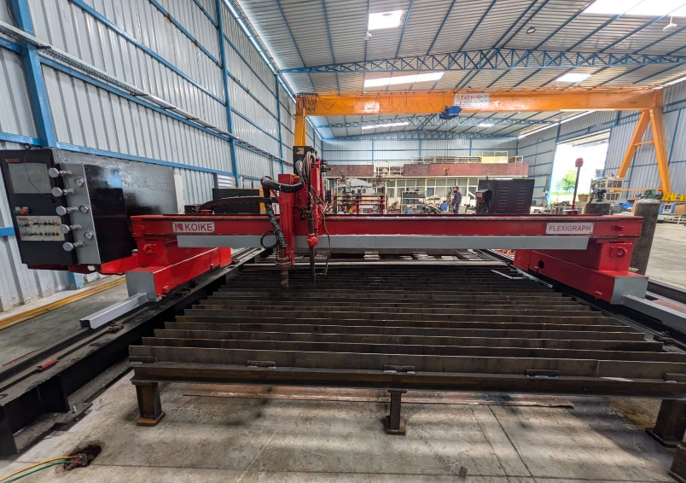
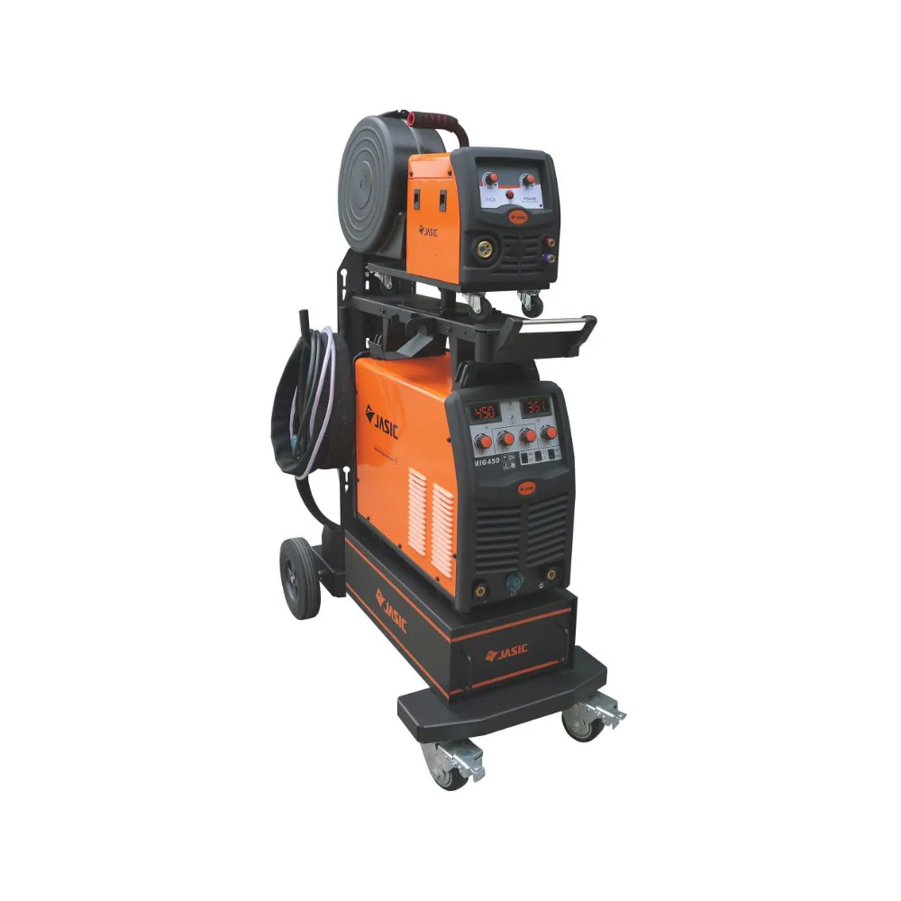
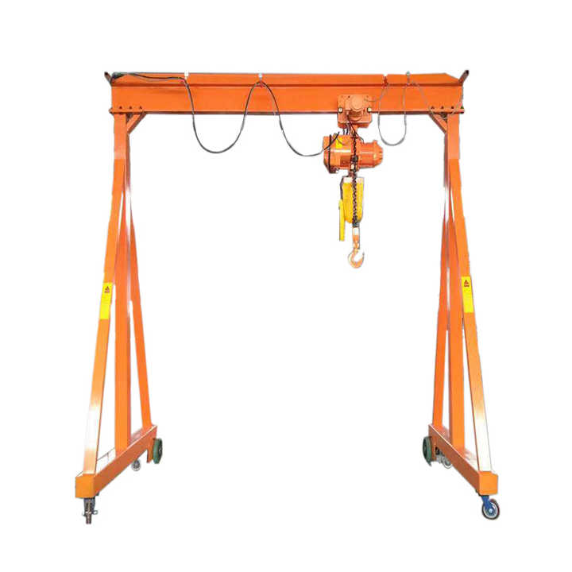
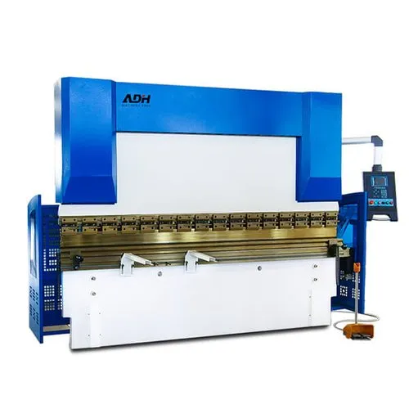

Facilities Available - Fabrication
GTech Enterprises
Plasma Cutting Machine
Welding Machine – 600 Amp
Crane – 5 Ton
Press Break 220 Ton

Slide 9
Machines Available
Sr.No. | MACHINES NAME | MAKE | CAPACITY
1 | CNC Machine | LMW | 300 Dia. x 800L
2 | CNC Machine | LMW | 200Dia x 500L
3 | CNC Machine | LMW Smart Plus | 165Dia x 300L
4 | VMC | BFW | 850x600x600
5 | Press Brake | ADH | 200 tone
6 | Plasma Cutting Machine | Koike | 300 amp, HD, 3mt x 8 mt
7 | RADIAL DRILLING | Rajkot SP | Dia. 1.25”
8 | COLUMN DRILLING | WMW | Dia. 1.5”
9 | PILLER DRILLING | Premier | Dia. 1” (2 No.s)
10 | MILLING M/C | VERNIER | FN 3
11 | LATHE – 1 | SAGAR | Bed – 6 ft.
12 | M1TR | MICROMILL | 1210 X 460 X460
13 | Smart TAPPING MACHINE | ITCO | 25 MM
14 | COMPRESSOR 10HP,7.5 HP,5HP |  | 10 hp
15 | BAND SAW CUTTING | LAXMI INDUSTRIES | 140 DIA CUTTING
GTech Enterprises

Slide 10
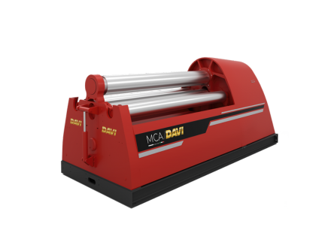
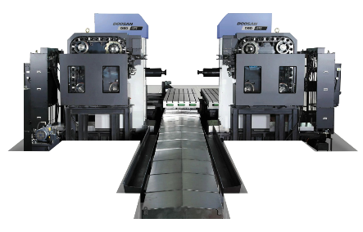
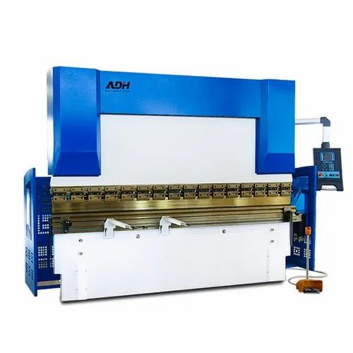
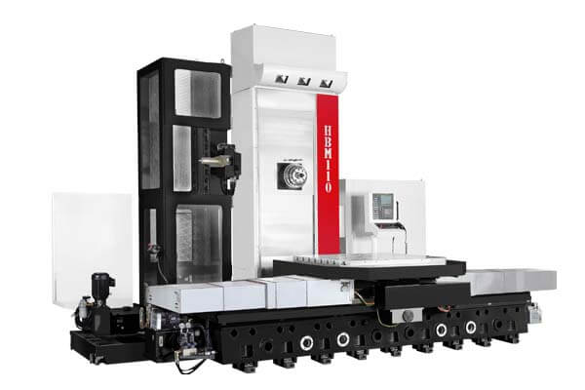
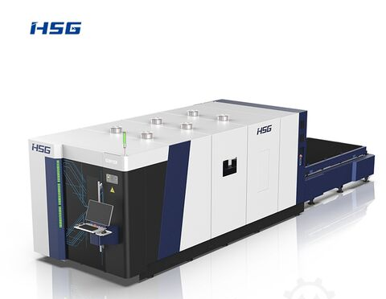
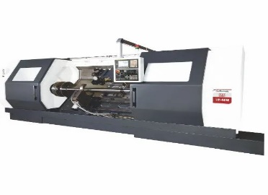
Future Planned Extended Facility
Sr.No. | MACHINES NAME | Details | CAPACITY | Target Date
1 | CNC Machine | Ace Micromatic | 550 Dia. x 1200L | Dec-2026
2 | VMC | With ATC | 2000x1000x1000 | Dec-2026
3 | Duplex Machine | With ATC Dual Spindle | 6200x3600x1000 | Dec -2026
4 | Rolling Machine | 4 – Roller Min Dia-350 | 2500 x 40 mm | Dec -2026
5 | Press Brake | 5 Axis | 200 tone | May -2026
6 | Press Brake | 5 Axis | 400 tone | Dec -2026
7 | HMC | With ATC | 3000x2000x800 | Dec-2026
8 | Laser Cut | HSG 4kw/6 kw | 2500x6500 dual Pallet | July -2026
GTech Enterprises

Slide 11
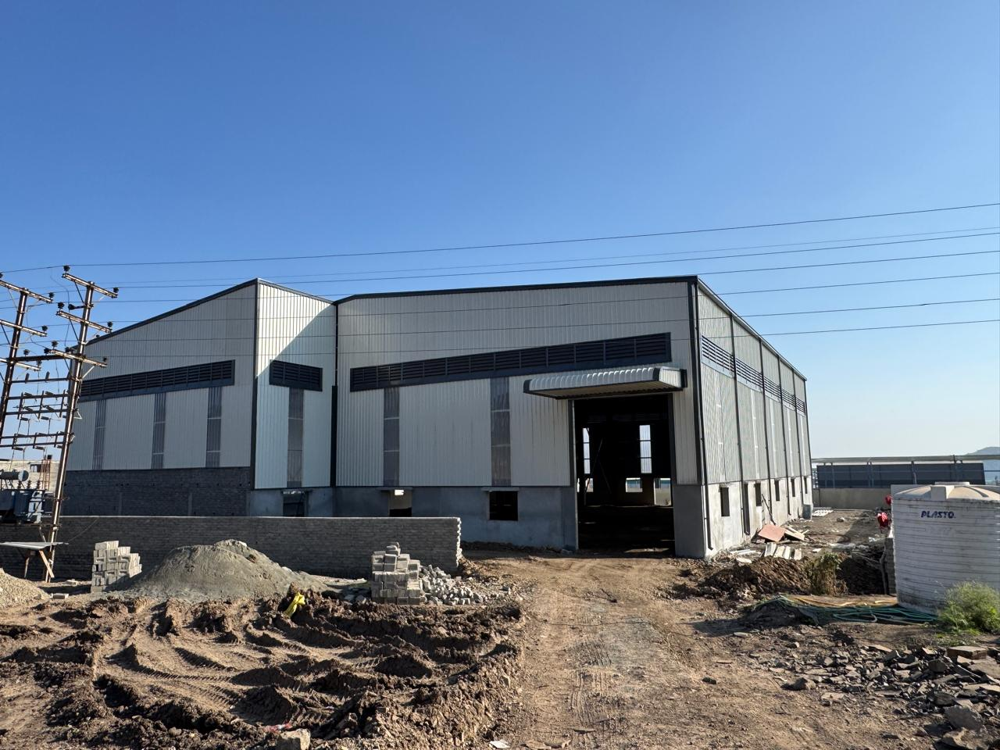
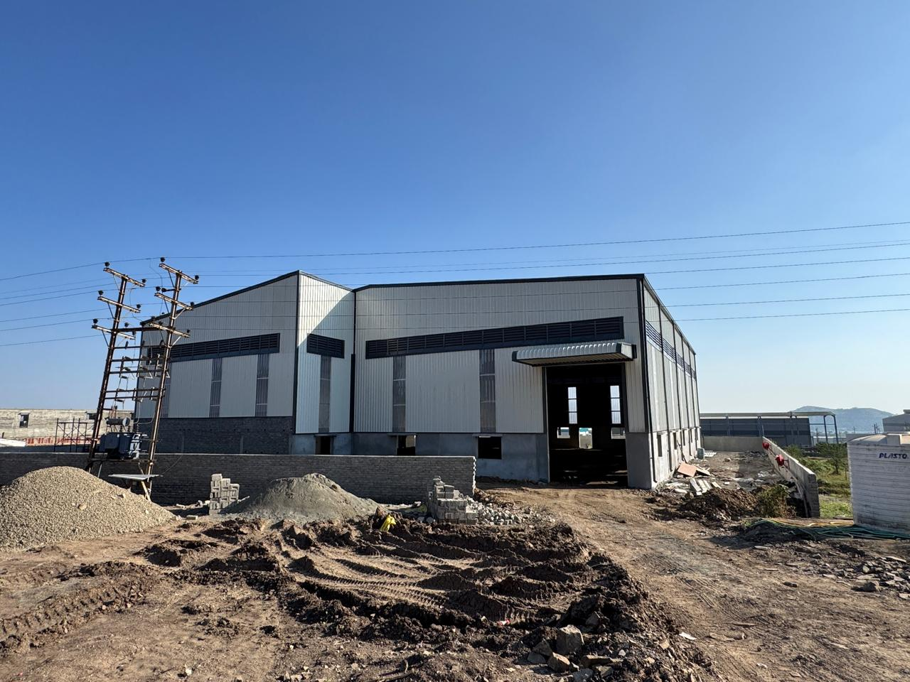
Future Planned Extended Facility Plant Location
Plant Name - | Awani Earthmoving Components
Plant Address | Plot No.PAP-D-11, Talegaon MIDC, Ph. -2,Mawal Pune.
Total Area | 23000 Sq./Ft
Built up Area | 17000 Sq./Ft
GTech Enterprises
Plant Photos

Slide 12
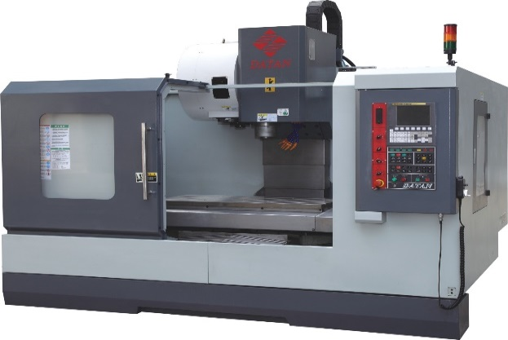

Employee Strength
Sr No | Description ( Technical Staff ) | Nos
1 | Plant Head | 1
2 | Production Engineer | 2
3 | Quality Engineer | 2
4 | Purchase Engineer | 1
5 | Account Executive | 1
 | Total | 7
GTech Enterprises
Sr No | Description (Operator) | Nos
1 | CNC Programmer | 2
2 | CNC Operator | 4
3 | VMC Operator | 4
4 | Drill / Tapping Operator | 9
5 | Skill Welder | 6
6 | Helper | 10
 | Total | 35

Slide 13






Esteemed Customers
GTech Enterprises

Slide 14
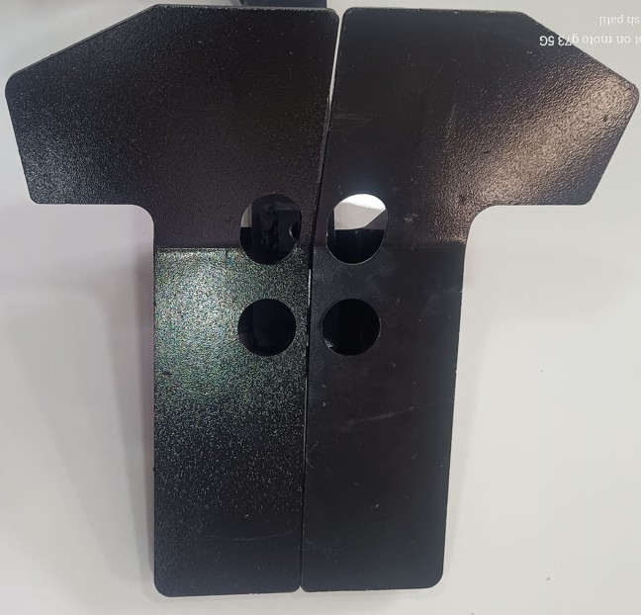
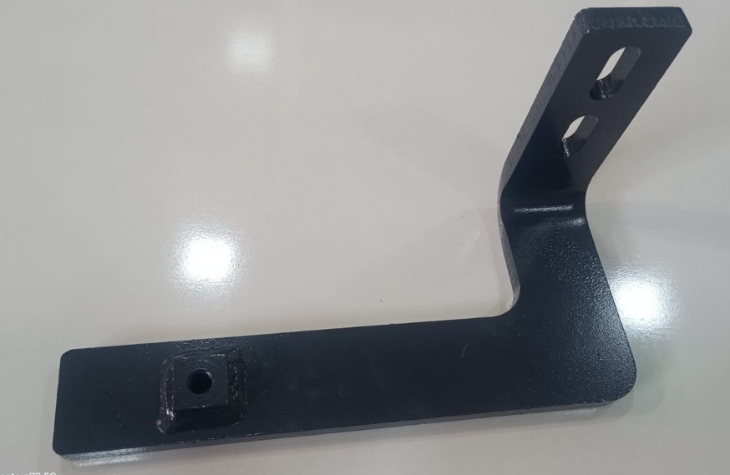
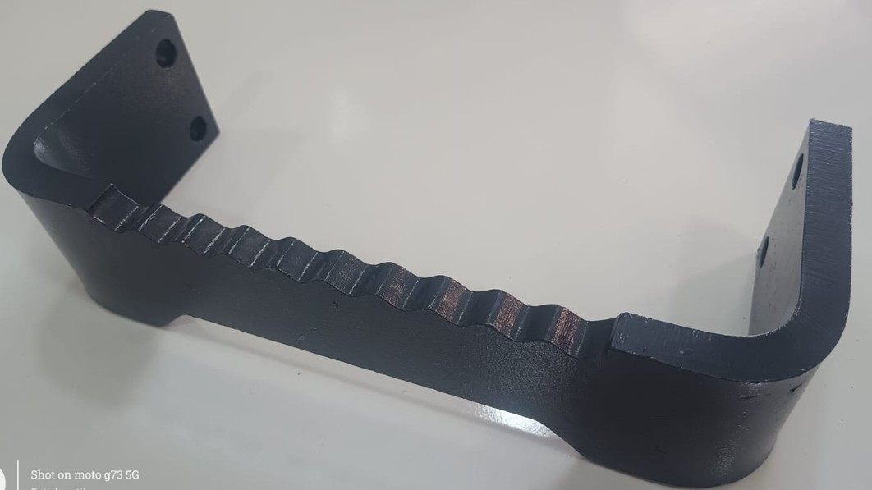
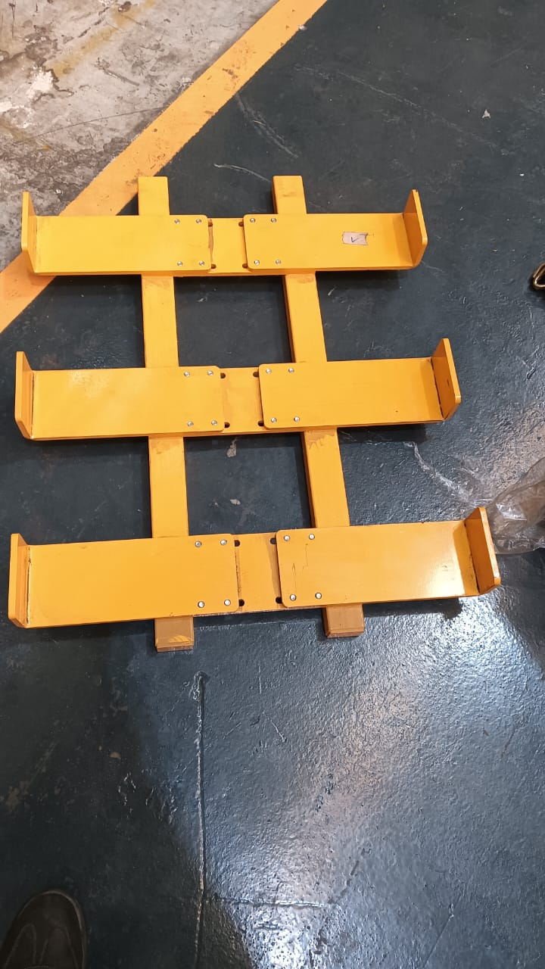
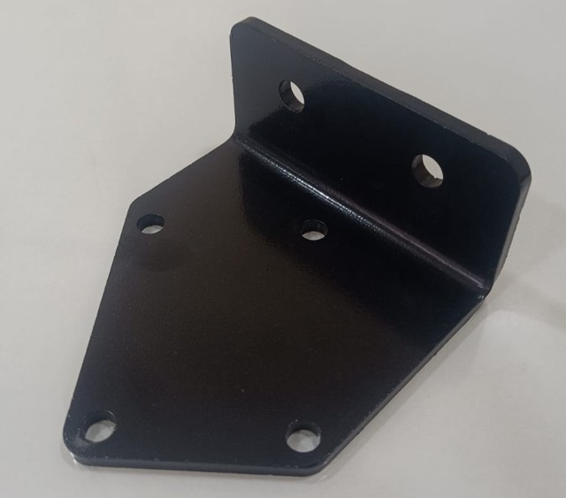
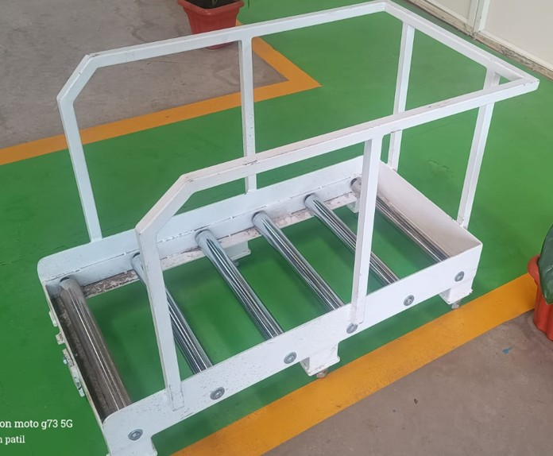
Products Developed
GTech Enterprises

Slide 15
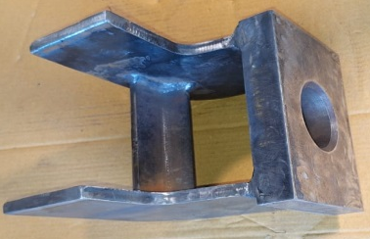
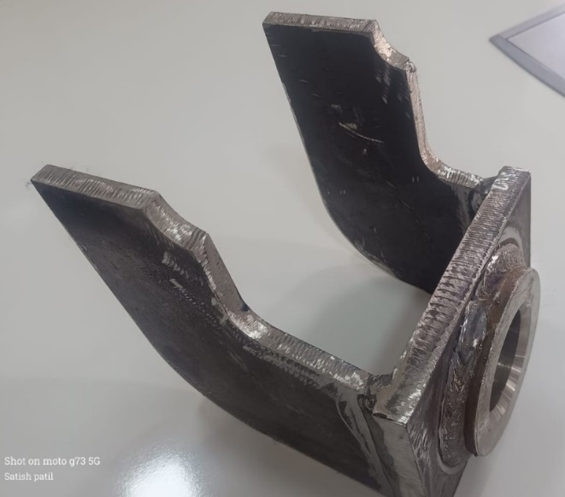
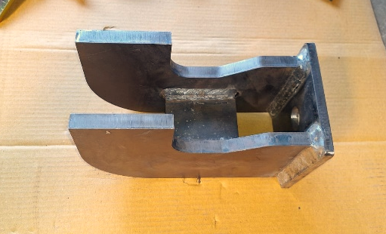
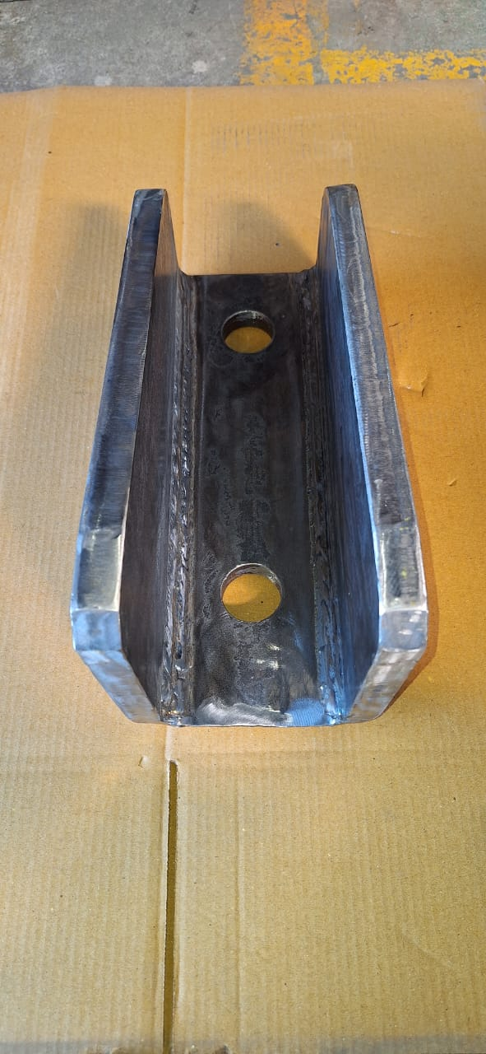
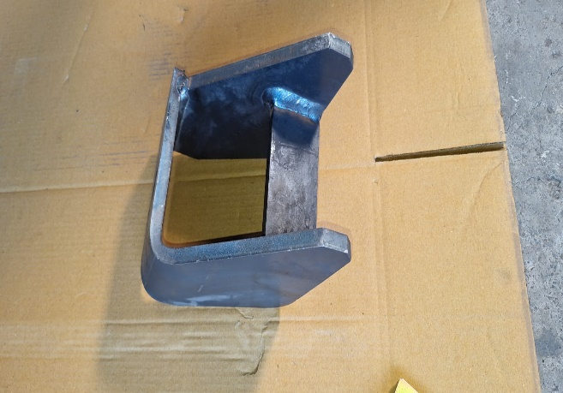
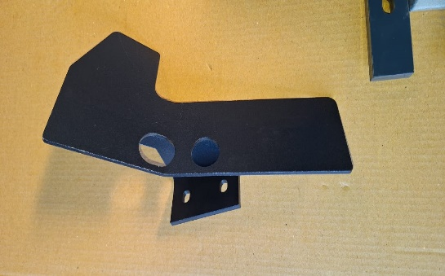
Products Developed
GTech Enterprises

Slide 16
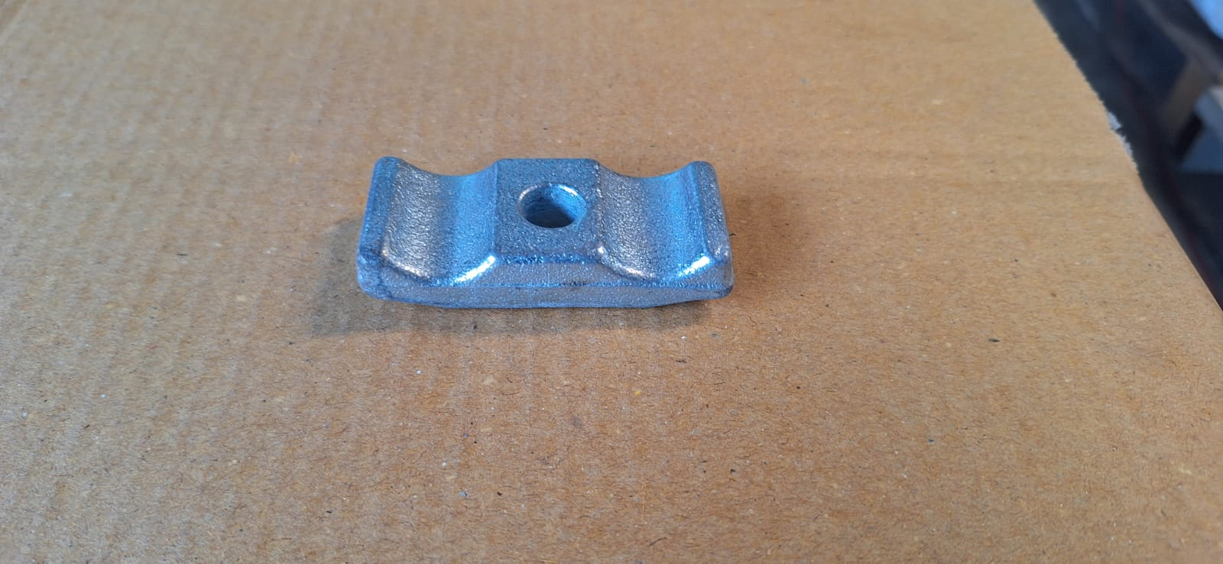
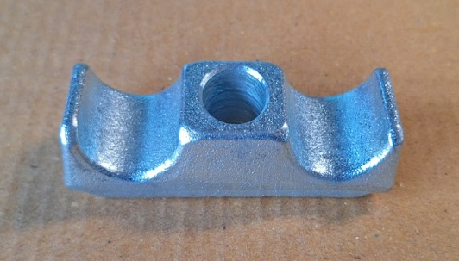
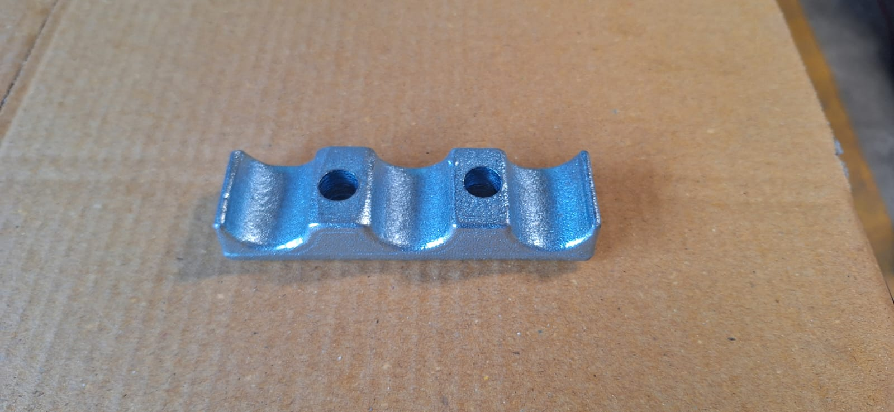
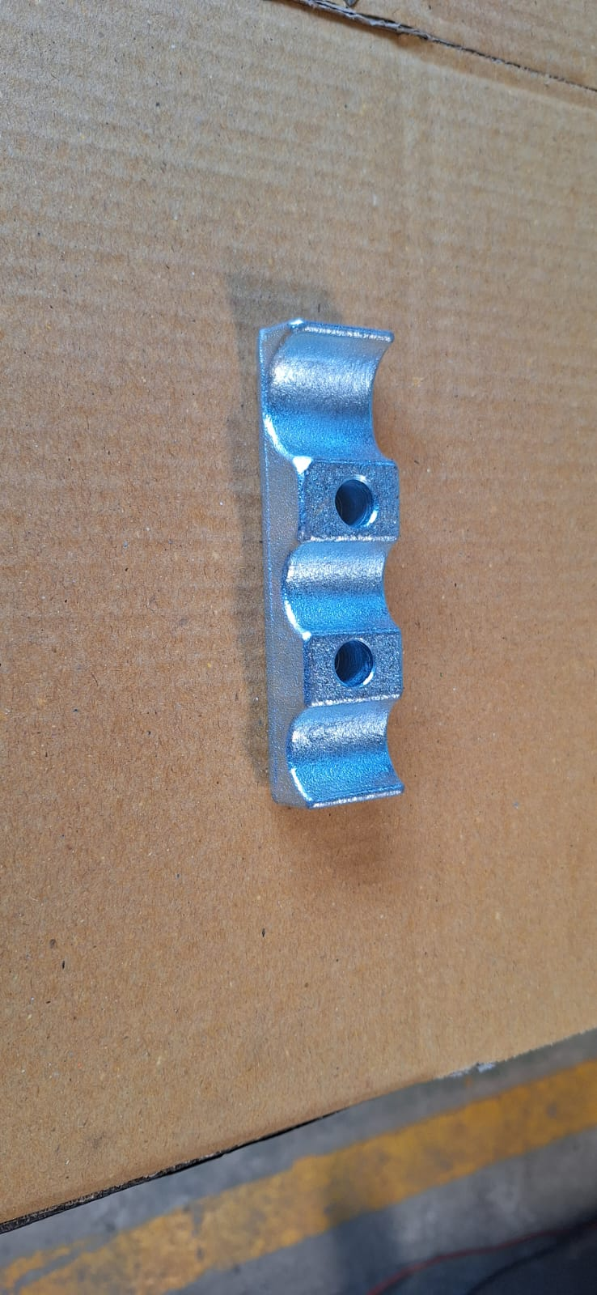
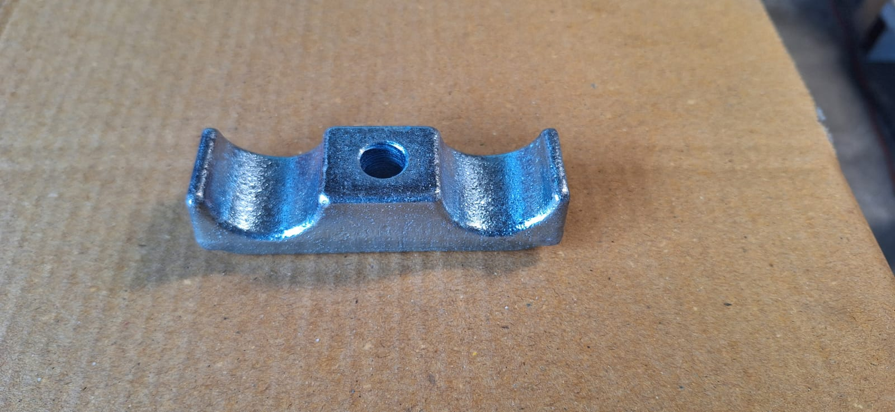
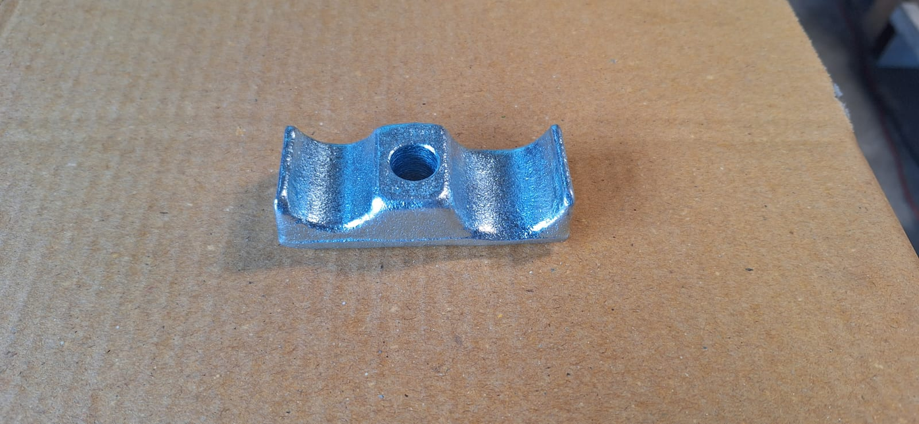
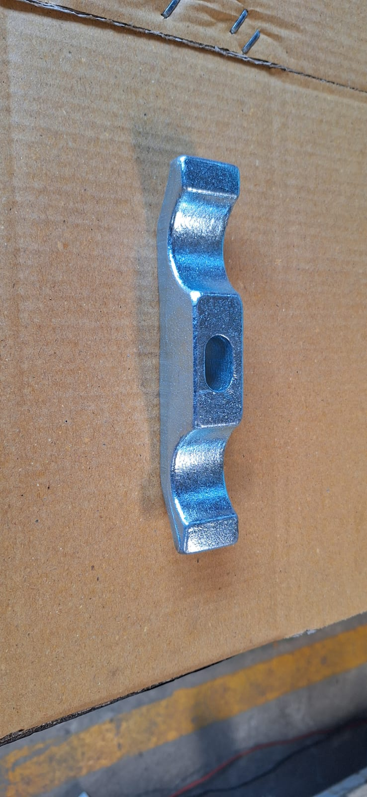
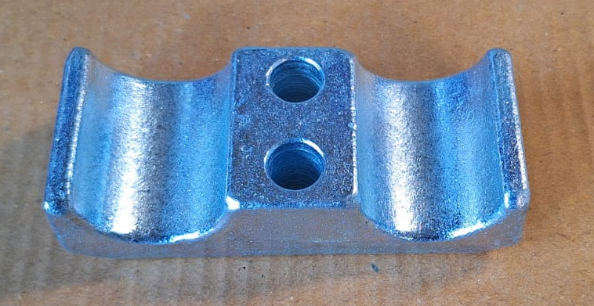
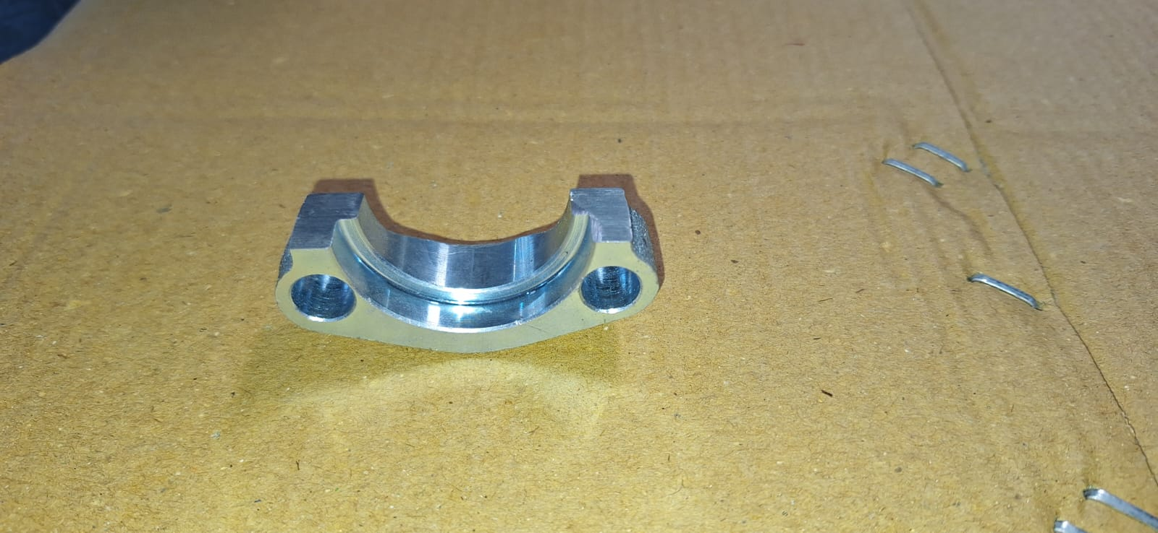
Products Developed – Forged Hydraulic Clamps.
GTech Enterprises

Slide 17
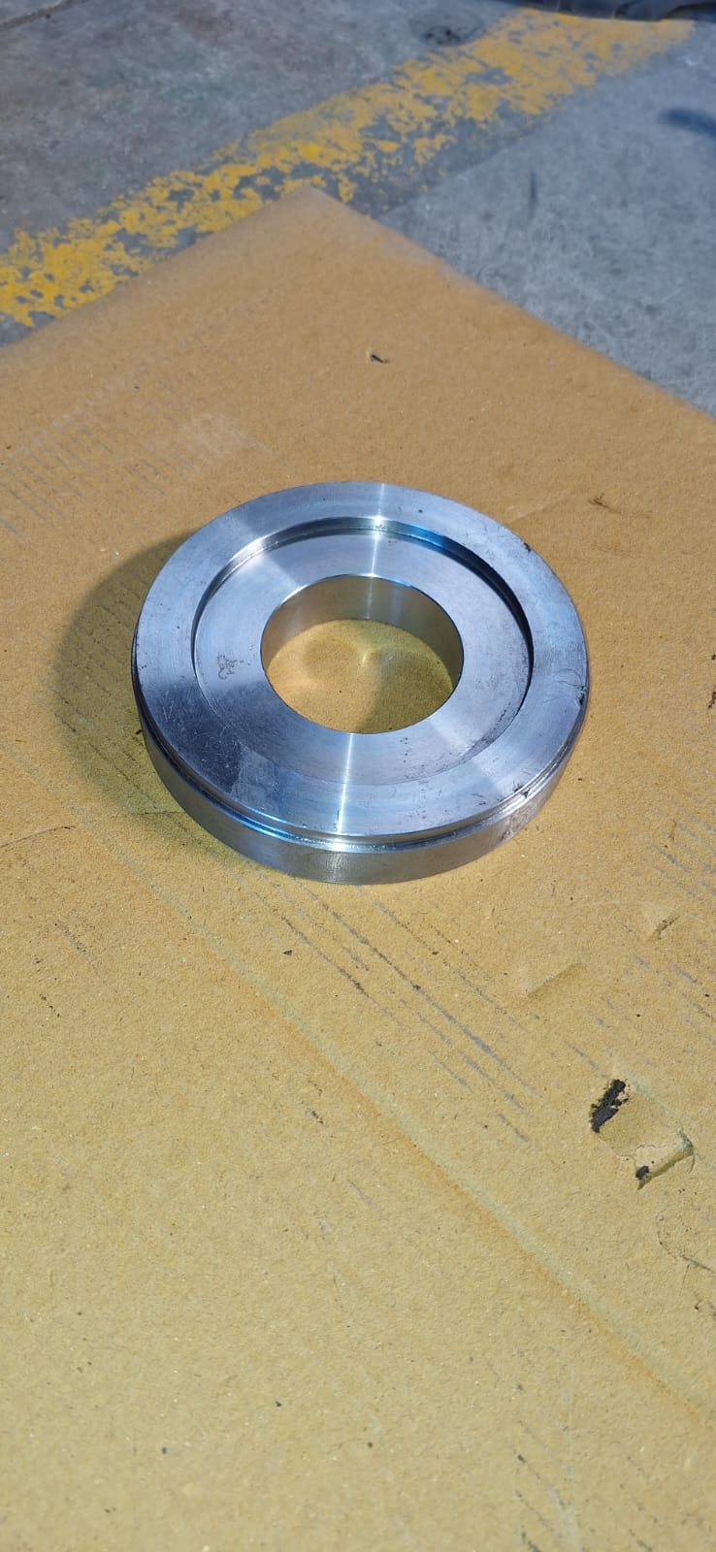
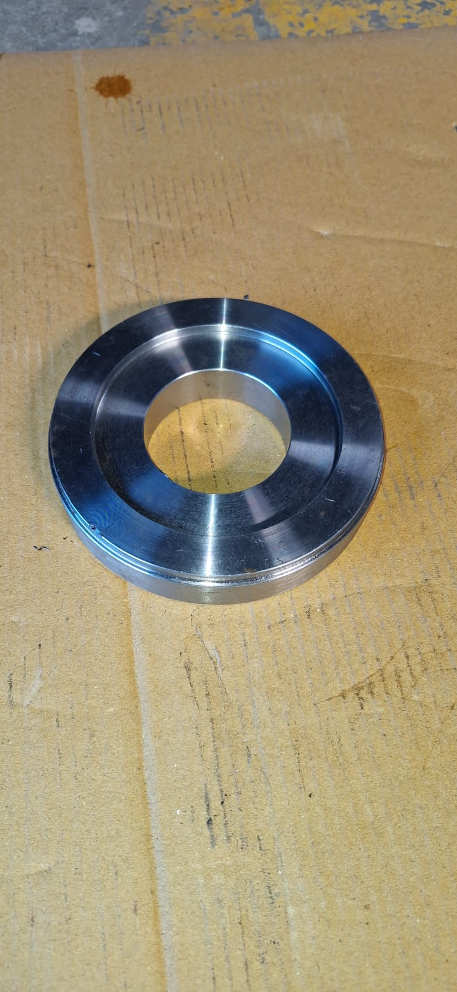
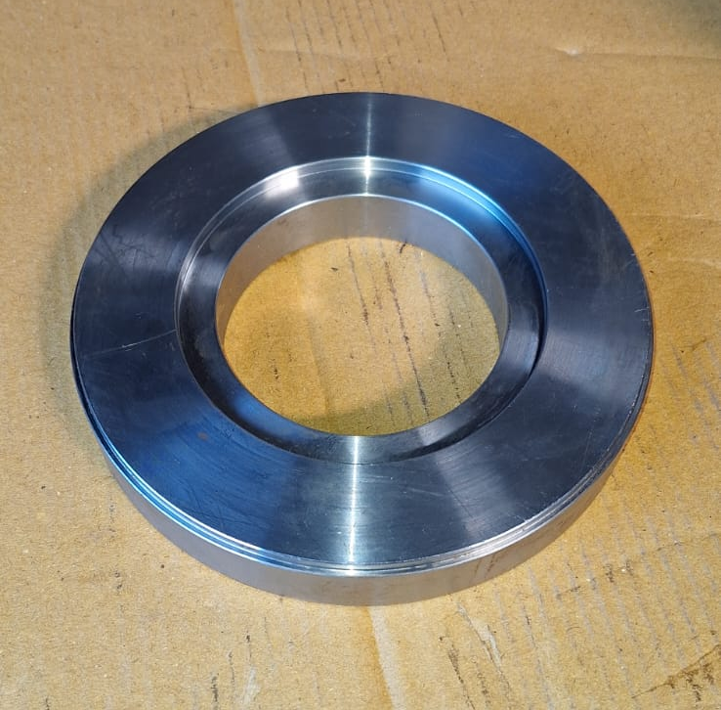
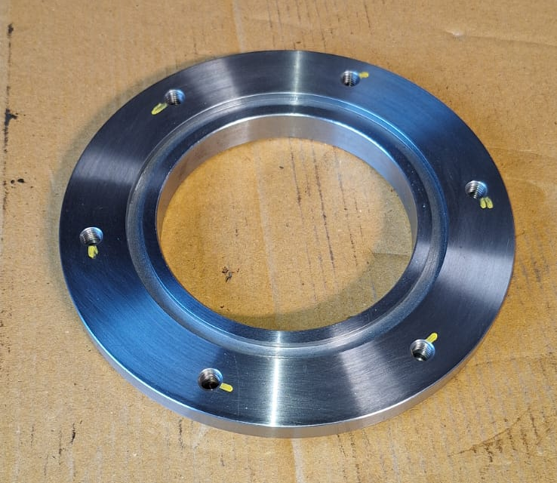
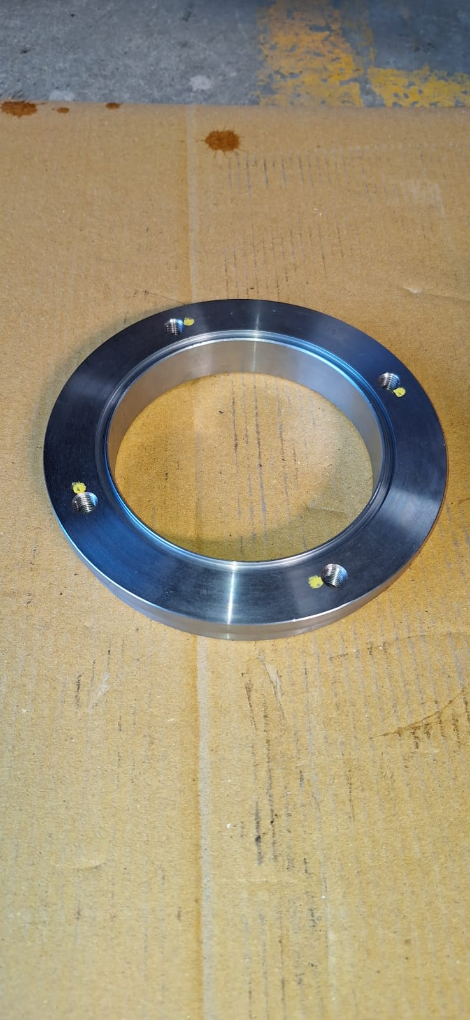
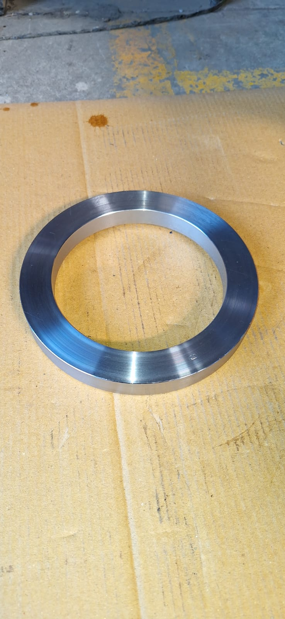
Products Developed
GTech Enterprises

Slide 18
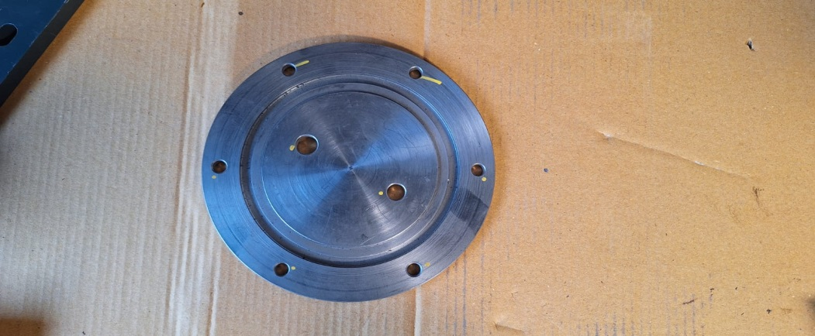
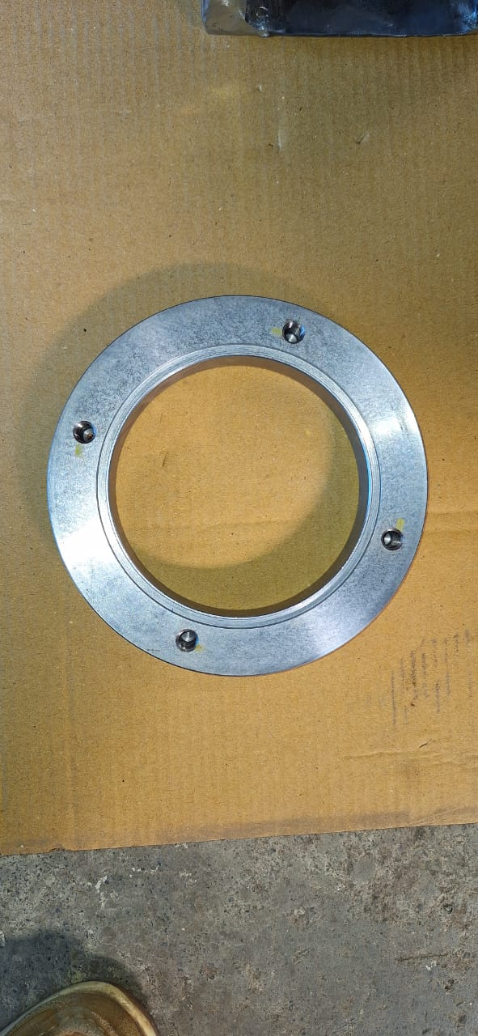
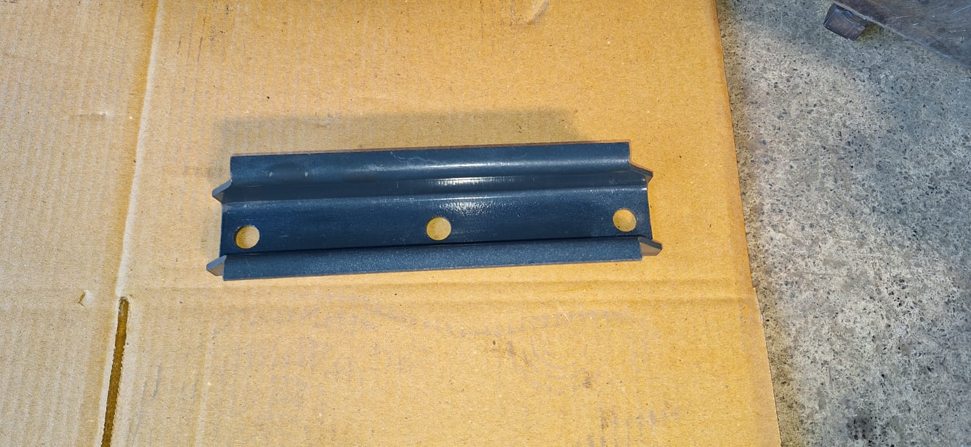
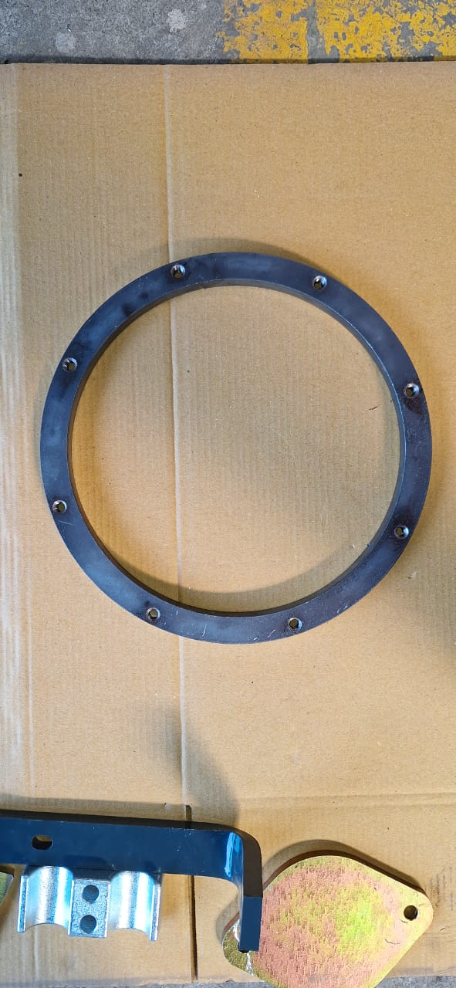
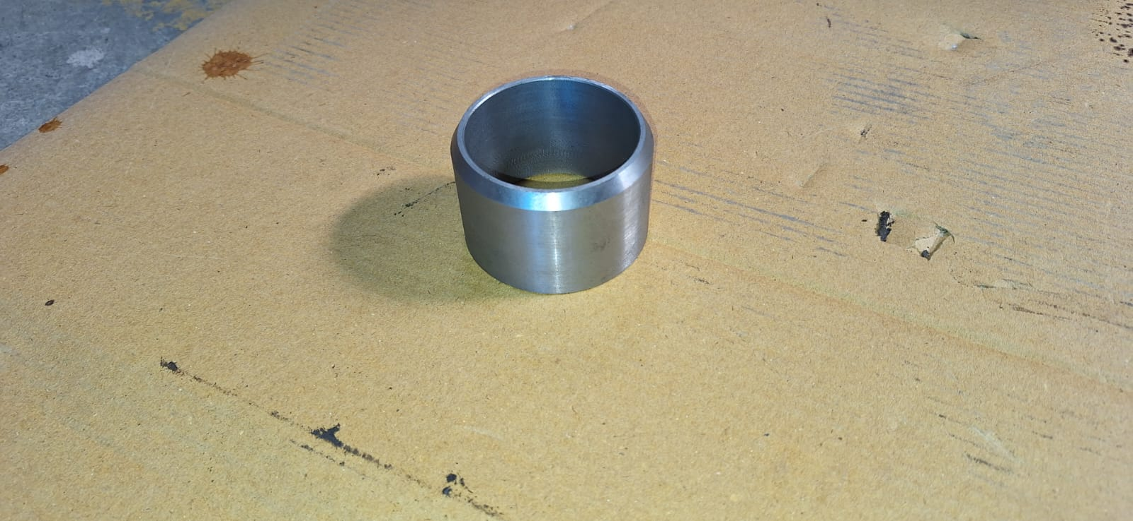
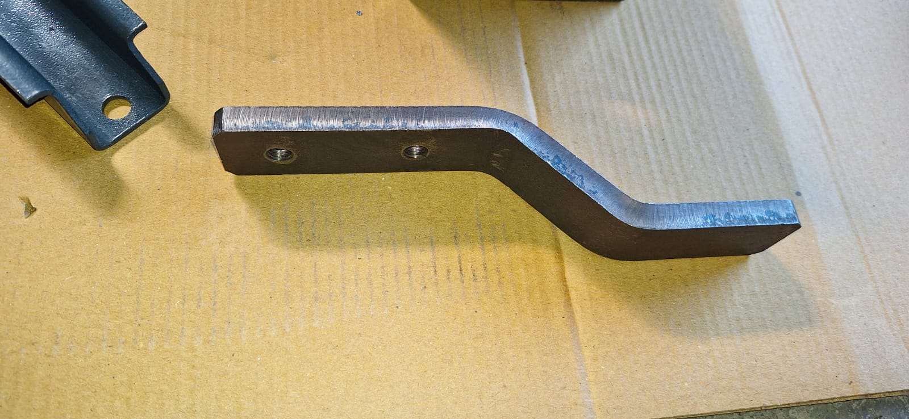
Products Developed
GTech Enterprises

Slide 19
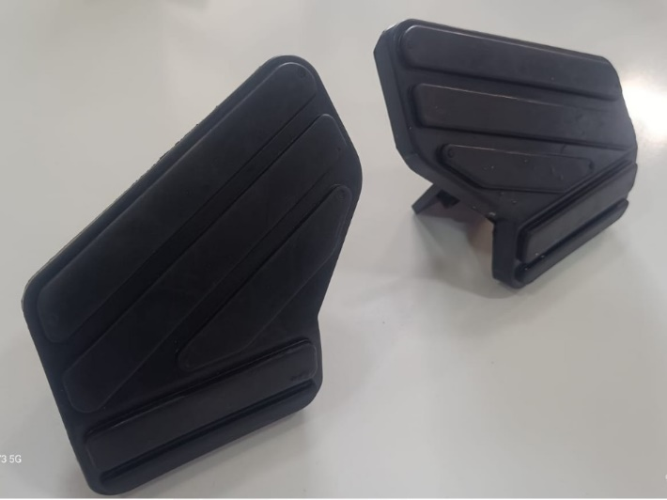




Products Developed – Rubber & Plastic Saddle
GTech Enterprises

Slide 20
Projected Business
GTech Enterprises

Slide 21

GTech Enterprises
GTech Enterprises
Company Address :
Gat No. 1652
Patil Nagar, Behind MNGL Pump,
Dehu - Alandi Road,
Chikhali, Pune - 411062,
India
Gst No. :
27ARAPJ5794R1ZX
development@gtechent.com
gtechenterprises21@gmail.com
Email :
Contact No :
Dr. Ganesh Jadhav - 8087510160
Mr. Parag Patil - 9021774809

