Slide 1
Mini PROJECT – 2- Machine Learning
CREDIT CARD CLIENT DATASET

Slide 2
What is my Data
There are 25 variables:
ID: ID of each client
LIMIT_BAL: Amount of given credit in NT dollars (includes individual and family/supplementary credit
SEX: Gender (1=male, 2=female)
EDUCATION: (1=graduate school, 2=university, 3=high school, 4=others, 5=unknown, 6=unknown)
MARRIAGE: Marital status (1=married, 2=single, 3=others)
AGE: Age in years
PAY_0: Repayment status in September, 2005 (-1=pay duly, 1=payment delay for one month, 2=payment delay for two months, … 8=payment delay for eight months, 9=payment delay for nine months and above)
PAY_2: Repayment status in August, 2005 (scale same as above)
PAY_3: Repayment status in July, 2005 (scale same as above)
PAY_4: Repayment status in June, 2005 (scale same as above)
PAY_5: Repayment status in May, 2005 (scale same as above)
PAY_6: Repayment status in April, 2005 (scale same as above)
BILL_AMT1: Amount of bill statement in September, 2005 (NT dollar)
BILL_AMT2: Amount of bill statement in August, 2005 (NT dollar)
BILL_AMT3: Amount of bill statement in July, 2005 (NT dollar)
BILL_AMT4: Amount of bill statement in June, 2005 (NT dollar)
BILL_AMT5: Amount of bill statement in May, 2005 (NT dollar)
BILL_AMT6: Amount of bill statement in April, 2005 (NT dollar)
PAY_AMT1: Amount of previous payment in September, 2005 (NT dollar)
PAY_AMT2: Amount of previous payment in August, 2005 (NT dollar)
PAY_AMT3: Amount of previous payment in July, 2005 (NT dollar)
PAY_AMT4: Amount of previous payment in June, 2005 (NT dollar)
PAY_AMT5: Amount of previous payment in May, 2005 (NT dollar)
PAY_AMT6: Amount of previous payment in April, 2005 (NT dollar)
default.payment.next.month: Default payment (1=yes, 0=no)

Slide 3
Some Data Info and updates
There are 30000 rows and 25 columns
we can see that all the 25 columns have 30000 count which indicates there is no missing value.
we can see that the repayment status is indicated in columns PAY_0, PAY_2 ... with no PAY_1 column, so we rename PAY_0 to PAY_1 for ease of understanding.
next we check the datatype of each variable of dataset. We see that all the columns are int64 type whereas from previous knowledge we know that SEX, EDUCATION, MARRIAGE, PAY_0, PAY_2, PAY_3, PAY_4, PAY_5, PAY_6, default_payment_next_month are categorical features.
defaulters.isna().sum() # check for missing values for surety – no NULLs

Slide 4
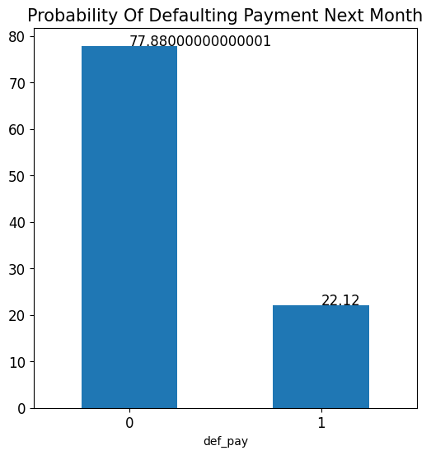
Visualisation – Defaulter Percentage
before moving to visualization we first select some features which we feel would be most correlated to the target variable. From the data provided we see that we want to predict whether a person will default in payment next month or not. This prediction depends mostly on previous repayment history, what is the limiting balance, age, education and marriage. Let's plot these first.
We can see that the dataset consists of 77% clients are not expected to default payment whereas 23% clients are expected to default the payment.
Notes:
Plot.bar()
Xtick
Y ticks

Slide 5
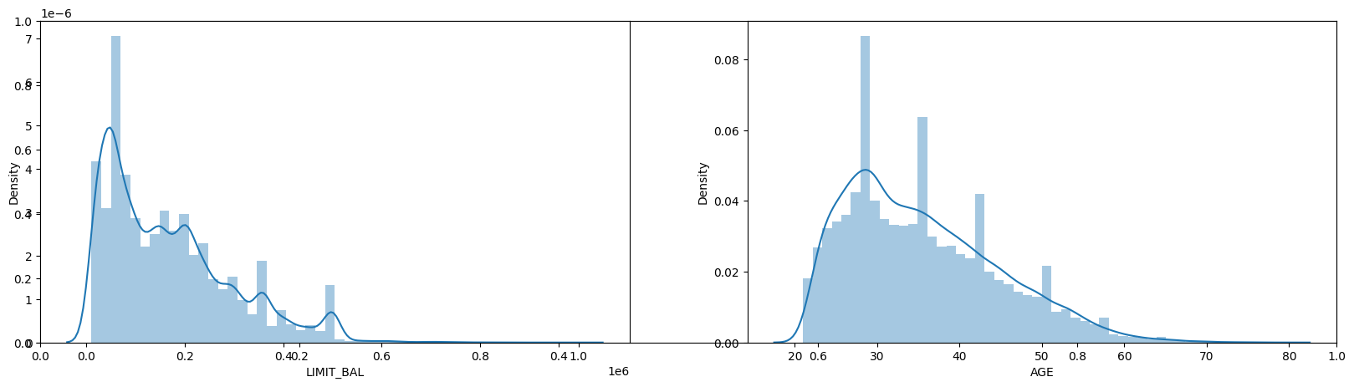
Visualisation – Limit Balance and Age - distribution
By plotting the continuous variables we observe that dataset consists of skewed data of limiting balance and age of clients.
We have more number of clients having limiting balance between 0 to 200000 currency.
We have more number of clients from age bracket of 20 to 40, i.e., clients from mostly young to mid aged groups.
We will observe the effect of variables on target variable below
Notes:
plt.subplot(121)
sns.distplot(defaulters.LIMIT_BAL)
plt.subplot(122)
sns.distplot(defaulters.AGE)

Slide 6
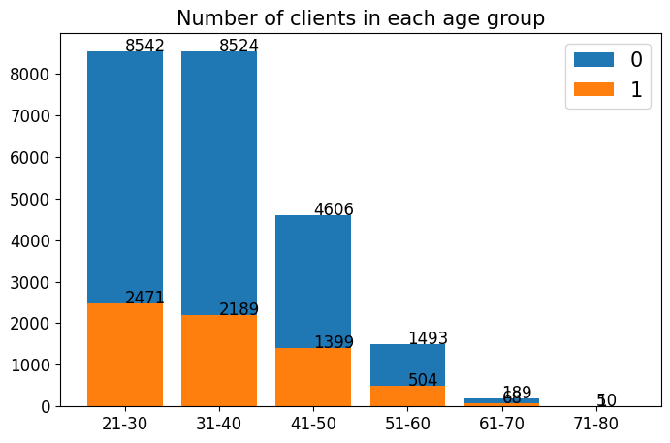
Visualisation – # of clients – age group/default on payment
We have maximum clients from 21-30 age group followed by 31-40. Hence with increasing age group the number of clients that will default the payment next month is decreasing. Hence we can see that Age is important feature to predict the default payment for next month.
Notes:
bins = [20,30,40,50,60,70,80]
names = ['21-30','31-40','41-50','51-60','61-70','71-80']
defaulters['AGE_BIN'] = pd.cut(x=defaulters.AGE, bins=bins, labels=names, right=True)
age_cnt = defaulters.AGE_BIN.value_counts()
age_0 = (defaulters.AGE_BIN[defaulters['def_pay'] == 0].value_counts())
age_1 = (defaulters.AGE_BIN[defaulters['def_pay'] == 1].value_counts())
Barplot and subplot

Slide 7
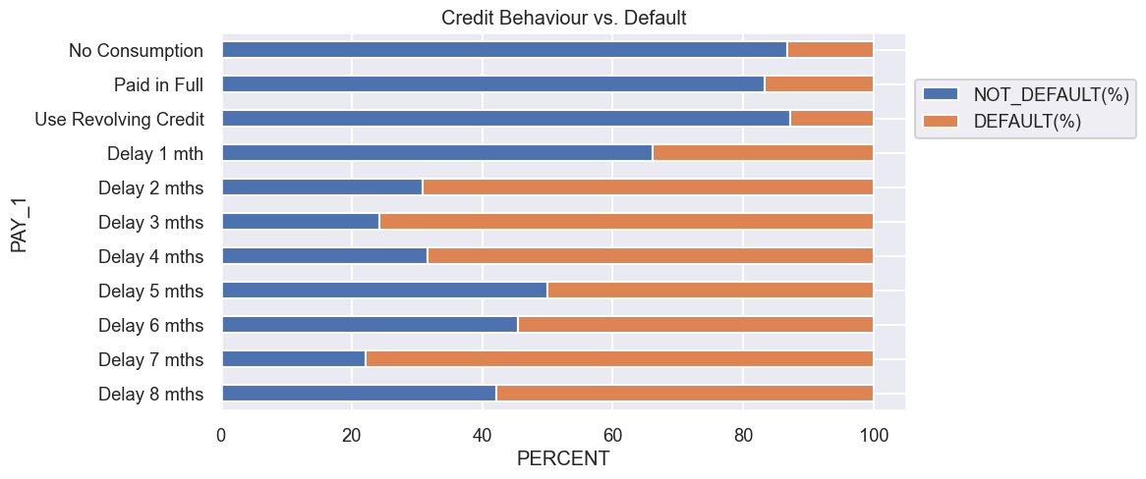
Visualisation – Repayment status vs default payment
Those Using Revolving Credit (paid only minimum) and those delayed for 2 months have the highest Default Count.
When payment is delayed more than 2 months, the chances of default goes higher than 50%.
Notes:
Subplot
Barplot
payment

Slide 8
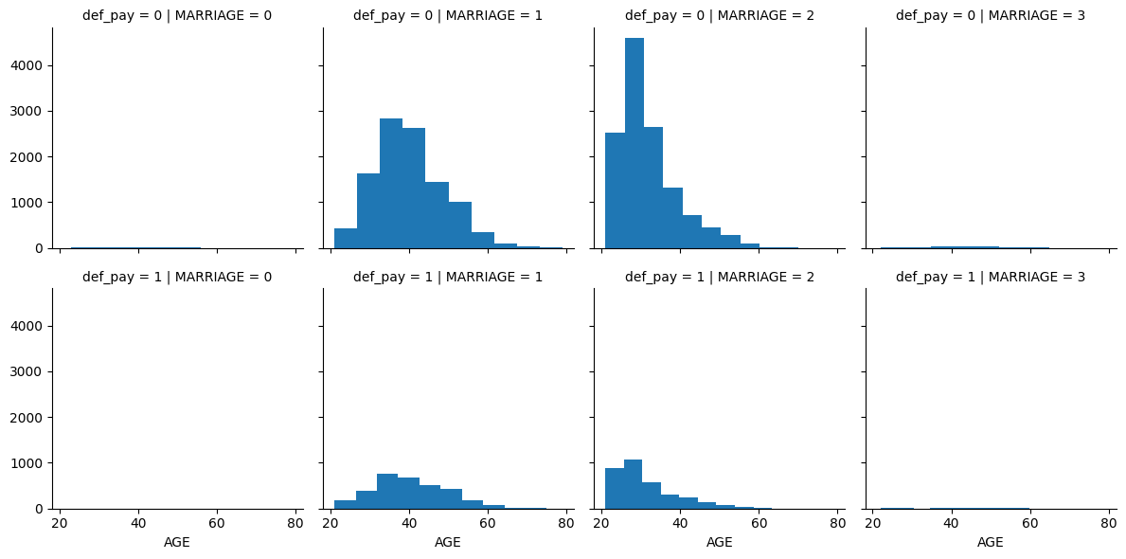
Visualisation – Marriage vs default payment
From this plot we can infer that married people between age bracket of 30 and 50 and unmarried clients of age 20-30 tend to default payment with unmarried clients higher probability to default payment. Hence we can include MARRIAGE feature of clients to find probability of defaulting the payment next month
Notes:
g = sns.FacetGrid(defaulters, row='def_pay', col='MARRIAGE')
g = g.map(plt.hist, 'AGE')
plt.show()

Slide 9
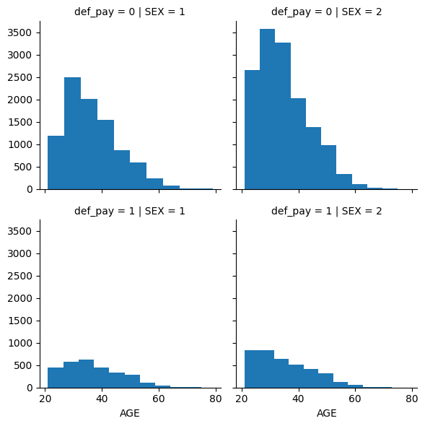
Visualisation – Male/Female vs default payment
It can be seen that females of age group 20-30 have very high tendency to default payment compared to males in all age brackets. Hence we can keep the SEX column of clients to predict probability of defaulting payment.
Notes:
g = sns.FacetGrid(defaulters, row='def_pay', col='SEX')
g = g.map(plt.hist, 'AGE')

Slide 10
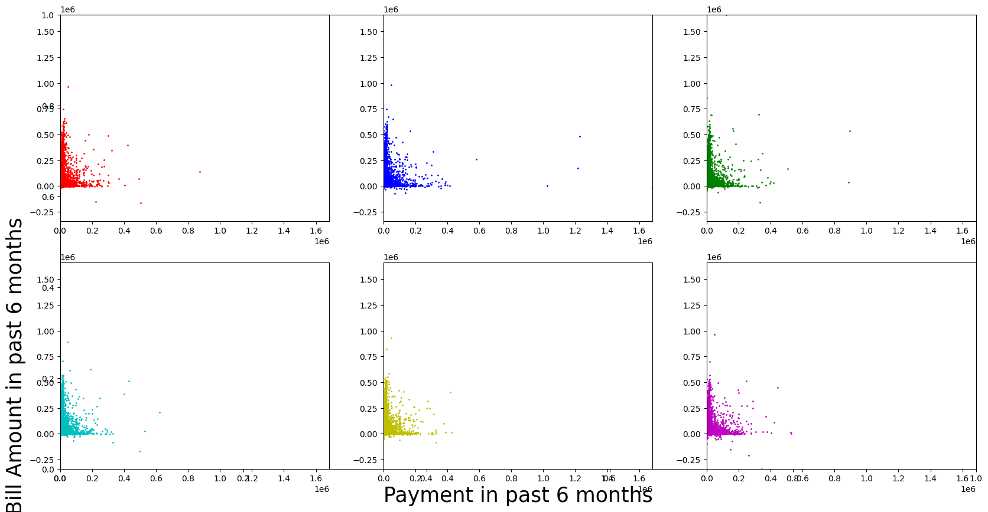
Visualization – Past six months payment vs Default
Above plot indicates that there is higher proportion of clients for whom the bill amount is high but payment done against the same is very low. This we can infer since maximum number of datapoints are closely packed along the Y-axis near to 0 on X-axis
Notes:
plt.scatter(x=defaulters.PAY_AMT1, y=defaulters.BILL_AMT1, c='r', s=1)
Repeat for pay_amt2 and bill_amt-2

Slide 11
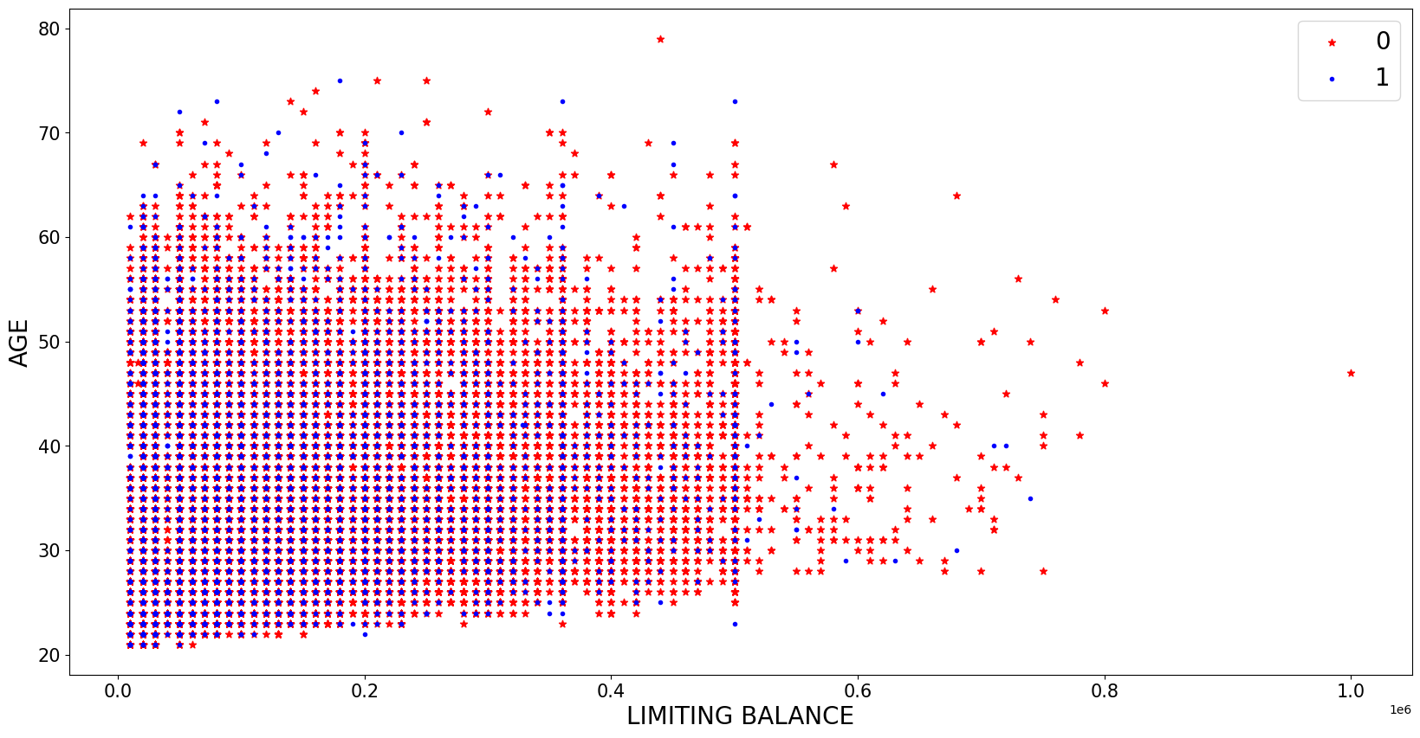
Visualization – Age / Limit Balance vs Default payment
This plot of Age against limiting balance does not provide any accurate information, as there is mixed variation of clients of all age groups and their current month limiting balance.
Notes:
plt.scatter(x=defaulters.PAY_AMT1, y=defaulters.BILL_AMT1, c='r', s=1)
Repeat for pay_amt2 and bill_amt-2

Slide 12
Machine Learning

Slide 13
Problem : Based on the credit card client data set –predict if the person is going to be defaulted next month or not
Data Source : Data from universal data Set as suggested by Laks
Clean and EDA : Mini Project 1
Modelling : Input features are all the columns because I am using gridsearch and hyperparameter tunning. Output variable Def_Pay 0 or 1 , which is Binary , hence used classification Models and used Supervised learning. Ran all the models we know so far and captured the results.
models used = ['LogisticRegression', 'DecisionTree', 'RandomForest', 'KNeighbors’, 'AdaBoost', 'XGBoost', 'Bagging', 'Stacking']
Key questions and steps for ML

Slide 14
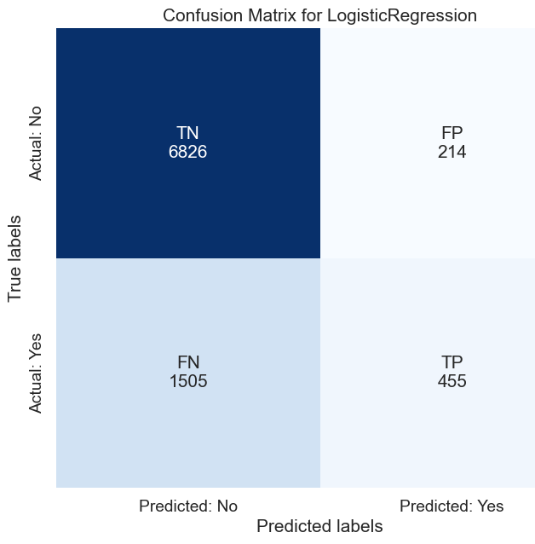
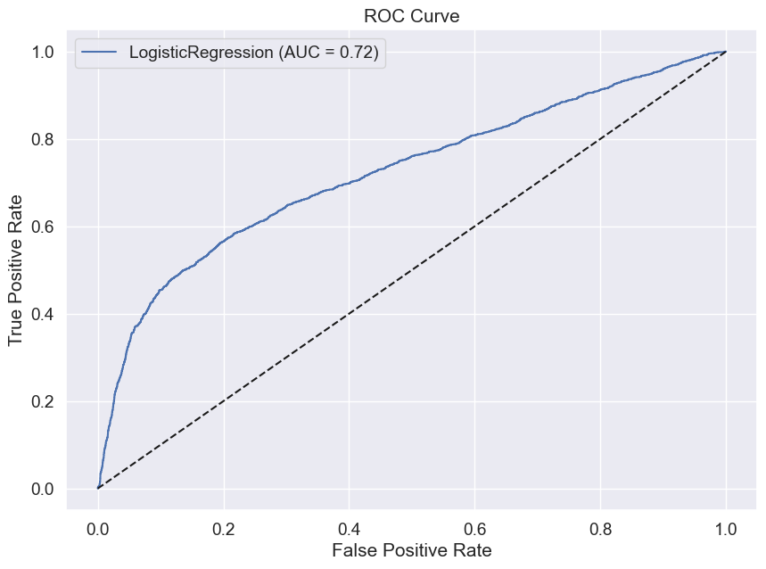
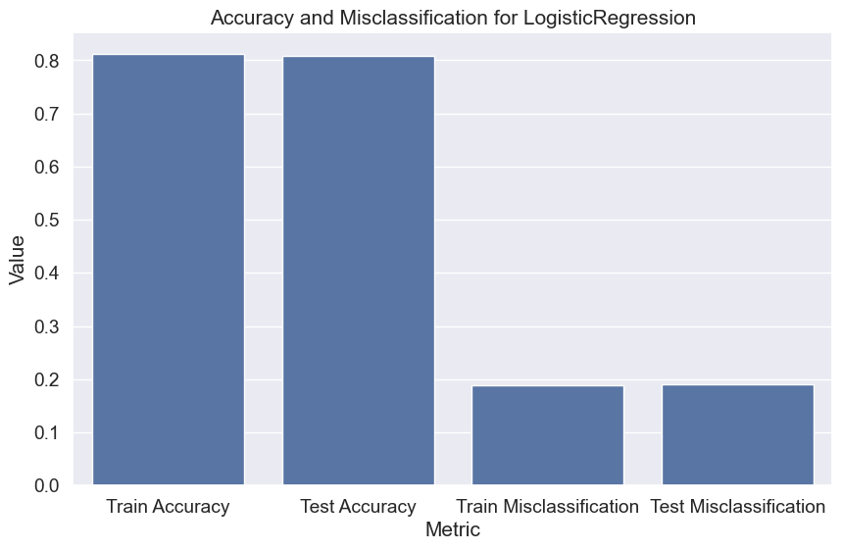
LogisticRegression
Train/Test Accuracy: 0.811/0.809 (Minimal overfitting)
Precision/Recall/F1: The F1 score on test data is 0.346, indicating that the balance between precision and recall isn't great. Precision is moderate, but recall is low.
ROC AUC: 0.723 (Moderate)
Notes:
Model: LogisticRegression
The accuracy on train data is 0.8113809523809524
The accuracy on test data is 0.809
The precision on train data is 0.7208153180975911
The precision on test data is 0.680119581464873
The recall on train data is 0.24957228400342174
The recall on test data is 0.23214285714285715
The f1 on train data is 0.37077045274027004
The f1 on test data is 0.34613921643210344
The roc_auc_score on test data is 0.722860114216141

Slide 15
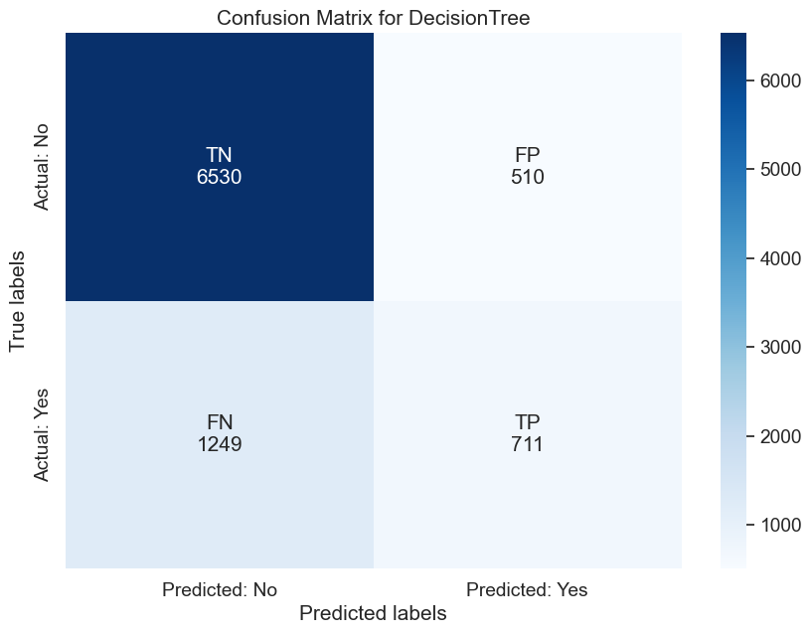
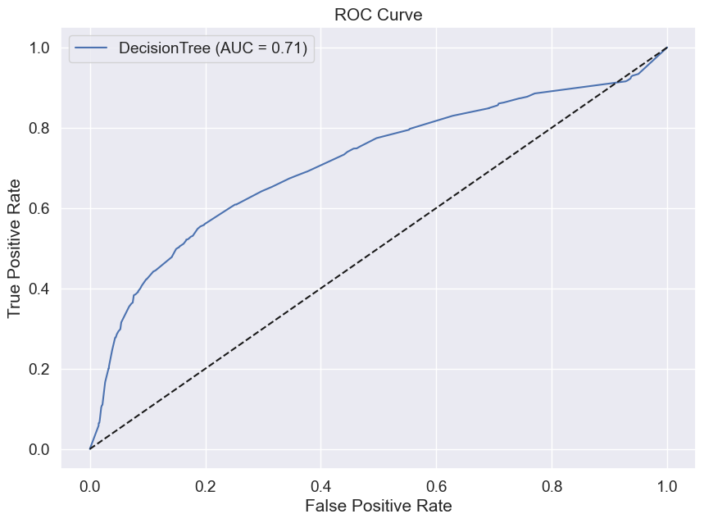
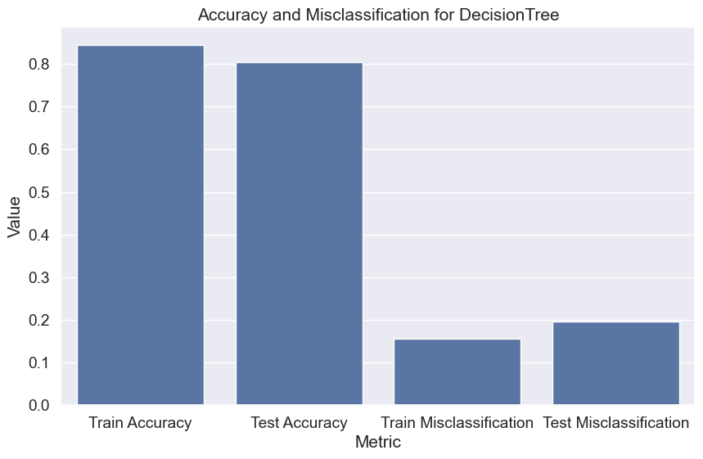
DecisionTree
Train/Test Accuracy: 0.844/0.805 (Some overfitting)
Precision/Recall/F1: The F1 score on test data is 0.450, better than Logistic Regression but still indicating a drop in performance on test data. Precision is moderate, but recall is relatively low.
ROC AUC: 0.713 (Moderate)
Notes:
Model: DecisionTree
The accuracy on train data is 0.8438571428571429
The accuracy on test data is 0.8045555555555556
The precision on train data is 0.7453459782226906
The precision on test data is 0.5823095823095823
The recall on train data is 0.45380667236954664
The recall on test data is 0.36275510204081635
The f1 on train data is 0.5641366476139837
The f1 on test data is 0.4470292360892801
The roc_auc_score on test data is 0.7120746245941558

Slide 16
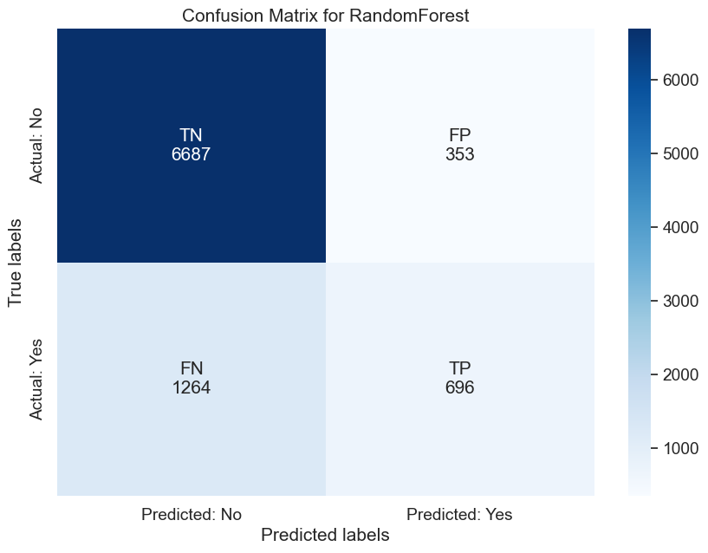
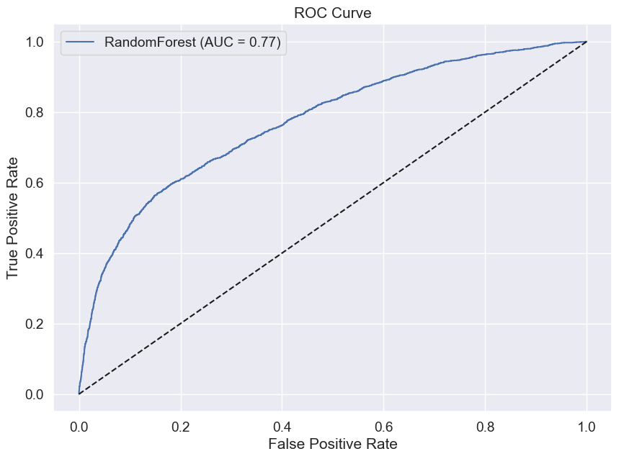
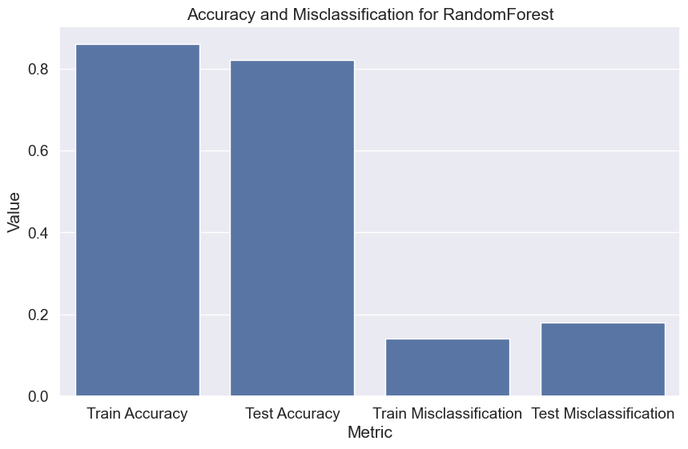
RandomForest
Train/Test Accuracy: 0.859/0.821 (Slight overfitting)
Precision/Recall/F1: The F1 score on test data is 0.468, which is better than Logistic Regression and Decision Tree. Precision is decent, but recall could be better.
ROC AUC: 0.774 (Good)
Notes:
Model: RandomForest
The accuracy on train data is 0.8592857142857143
The accuracy on test data is 0.8203333333333334
The precision on train data is 0.8354775828460039
The precision on test data is 0.663489037178265
The recall on train data is 0.4582976903336185
The recall on test data is 0.3551020408163265
The f1 on train data is 0.591907195138793
The f1 on test data is 0.4626121635094716
The roc_auc_score on test data is 0.7742702777133581

Slide 17
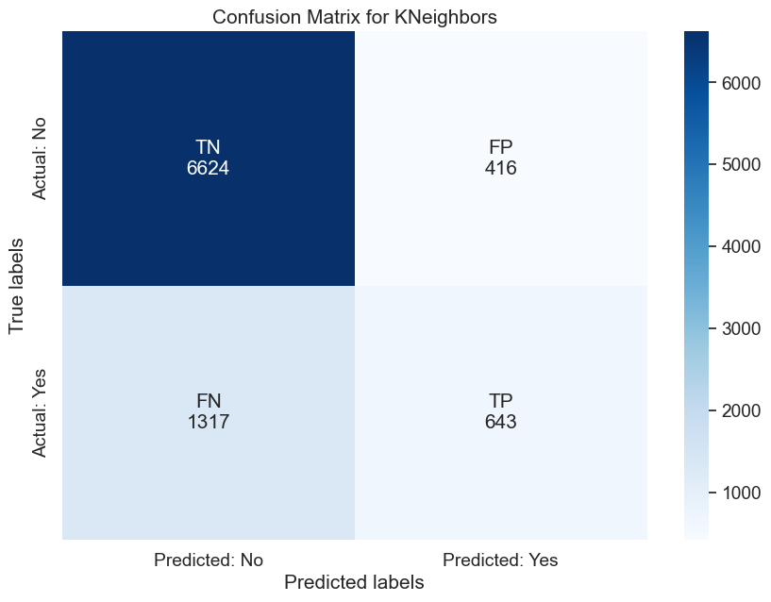

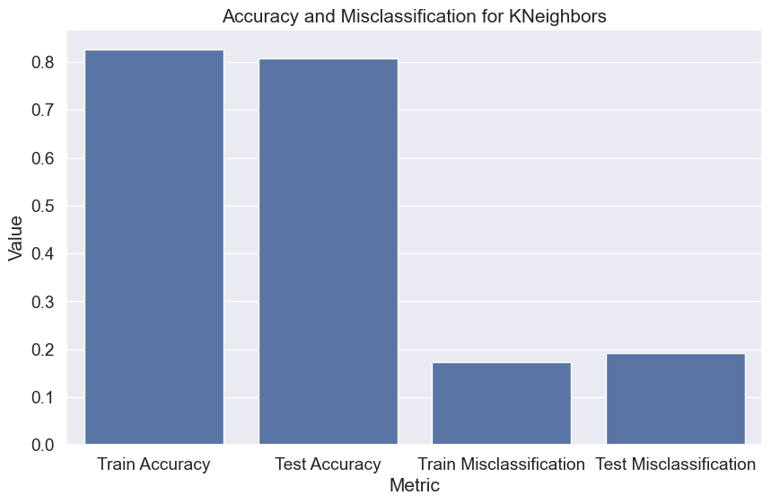
Kneighbours (KNN)
Train/Test Accuracy: 0.826/0.807 (Minimal overfitting)
Precision/Recall/F1: The F1 score on test data is 0.426, indicating moderate performance with consistent precision and recall. It's lower than Random Forest but stable across train and test data.
ROC AUC: 0.724 (Moderate)
Notes:
Model: KNeighbors
The accuracy on train data is 0.8260952380952381
The accuracy on test data is 0.8074444444444444
The precision on train data is 0.6987577639751553
The precision on test data is 0.607176581680831
The recall on train data is 0.3849443969204448
The recall on test data is 0.3280612244897959
The f1 on train data is 0.49641478212906787
The f1 on test data is 0.425968863862206
The roc_auc_score on test data is 0.7239859693877551

Slide 18

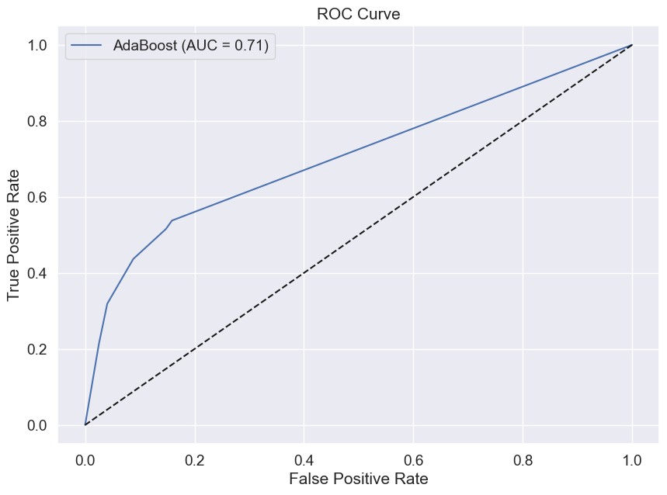
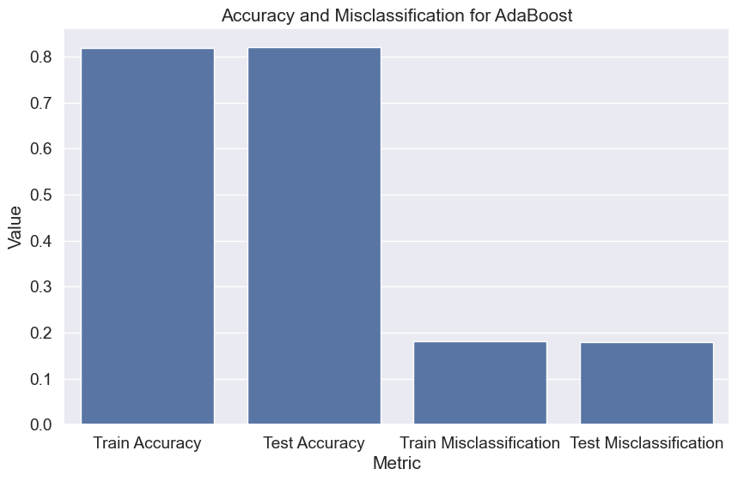
AdaBoost
Train/Test Accuracy: 0.819/0.820 (No overfitting)
Precision/Recall/F1: The F1 score on test data is 0.436, showing a reasonable balance between precision and recall, but it does not outperform Random Forest or XGBoost.
ROC AUC: 0.706 (Moderate)
Notes:
Model: AdaBoost
The accuracy on train data is 0.8194285714285714
The accuracy on test data is 0.82
The precision on train data is 0.6990990990990991
The precision on test data is 0.6868131868131868
The recall on train data is 0.3319076133447391
The recall on test data is 0.31887755102040816
The f1 on train data is 0.45011600928074247
The f1 on test data is 0.4355400696864111
The roc_auc_score on test data is 0.7057428035134509

Slide 19

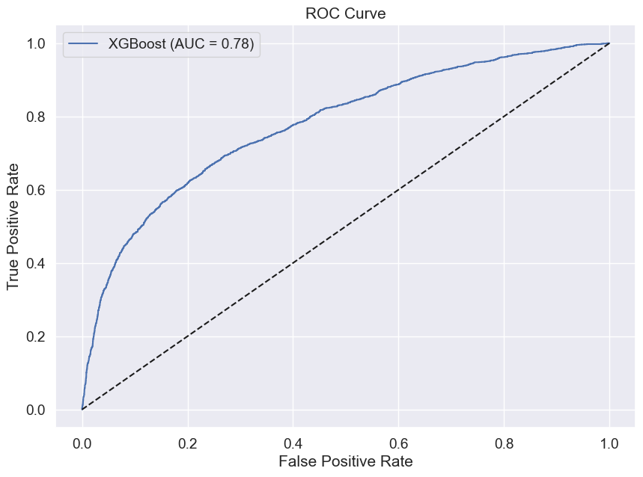

XGBoost
Train/Test Accuracy: 0.827/0.820 (Minimal overfitting)
Precision/Recall/F1: The F1 score on test data is 0.458, comparable to Random Forest. It maintains a strong balance between precision and recall with the highest ROC AUC.
ROC AUC: 0.778 (Good)
Notes:
Model: XGBoost
The accuracy on train data is 0.8265238095238095
The accuracy on test data is 0.8198888888888889
The precision on train data is 0.7042309213127719
The precision on test data is 0.6640851887705711
The recall on train data is 0.38088109495295125
The recall on test data is 0.35
The f1 on train data is 0.4943789035392089
The f1 on test data is 0.4584029401937855
The roc_auc_score on test data is 0.7784536975301485

Slide 20

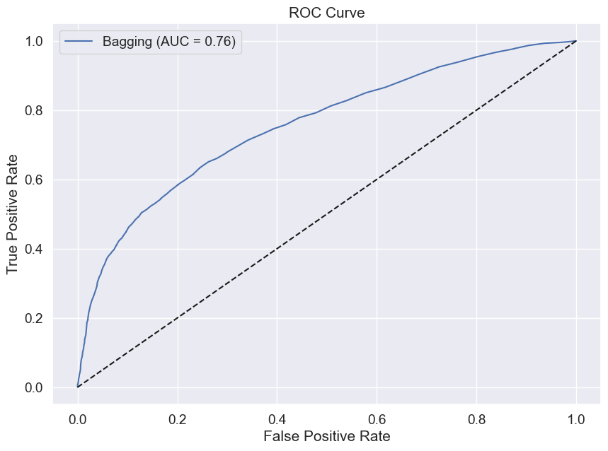
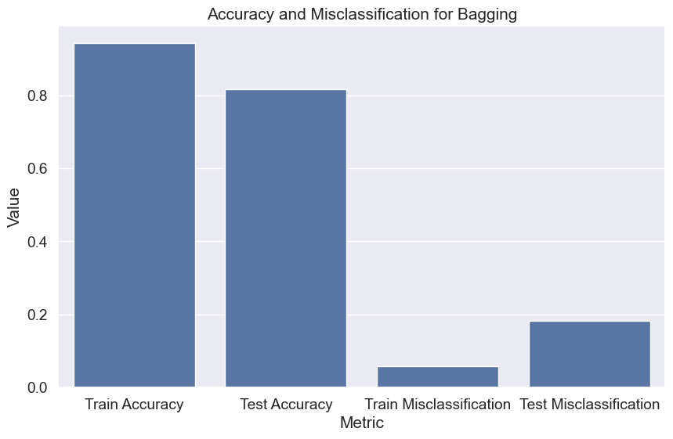
Bagging
Train/Test Accuracy: 0.941/0.816 (Significant overfitting)
Precision/Recall/F1: The F1 score on test data is 0.463, but the model shows significant overfitting, which might indicate an overly complex model that does not generalize well.
ROC AUC: 0.756 (Moderate)
Notes:
Model: Bagging
The accuracy on train data is 0.9420952380952381
The accuracy on test data is 0.8173333333333334
The precision on train data is 0.9742324561403509
The precision on test data is 0.6400709219858156
The recall on train data is 0.7600513259195893
The recall on test data is 0.3683673469387755
The f1 on train data is 0.853916386352715
The f1 on test data is 0.4676165803108808
The roc_auc_score on test data is 0.7571977185760667

Slide 21


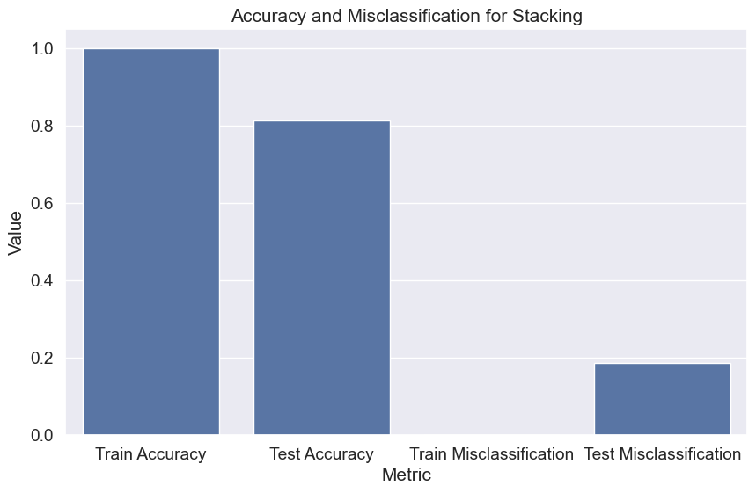
Stacking
Train/Test Accuracy: 0.999/0.815 (Extreme overfitting)
Precision/Recall/F1: The F1 score on test data is 0.441, with very high precision but poor recall, indicating severe overfitting and poor generalization.
ROC AUC: 0.760 (Moderate)
Notes:
Model: Stacking
The accuracy on train data is 0.9993809523809524
The accuracy on test data is 0.8138888888888889
The precision on train data is 0.99978563772776
The precision on test data is 0.646755921730175
The recall on train data is 0.9974337040205303
The recall on test data is 0.32040816326530613
The f1 on train data is 0.998608286050744
The f1 on test data is 0.4285226885022177
The roc_auc_score on test data is 0.7592083502435065

Slide 22



Ensemble
Train/Test Accuracy: 0.853/0.813 (Moderate overfitting)
Precision/Recall/F1: The F1 score on test data is 0.421, showing moderate performance but not surpassing Random Forest or XGBoost in any key metrics.
ROC AUC: 0.757 (Moderate)
Notes:
Model: ensemble_ML
The accuracy on train data is 0.8534285714285714
The accuracy on test data is 0.8126666666666666
The precision on train data is 0.8566964285714286
The precision on test data is 0.6451271186440678
The recall on train data is 0.410393498716852
The recall on test data is 0.3107142857142857
The f1 on train data is 0.554945054945055
The f1 on test data is 0.4194214876033058
The roc_auc_score on test data is 0.7562596387987013

Slide 23
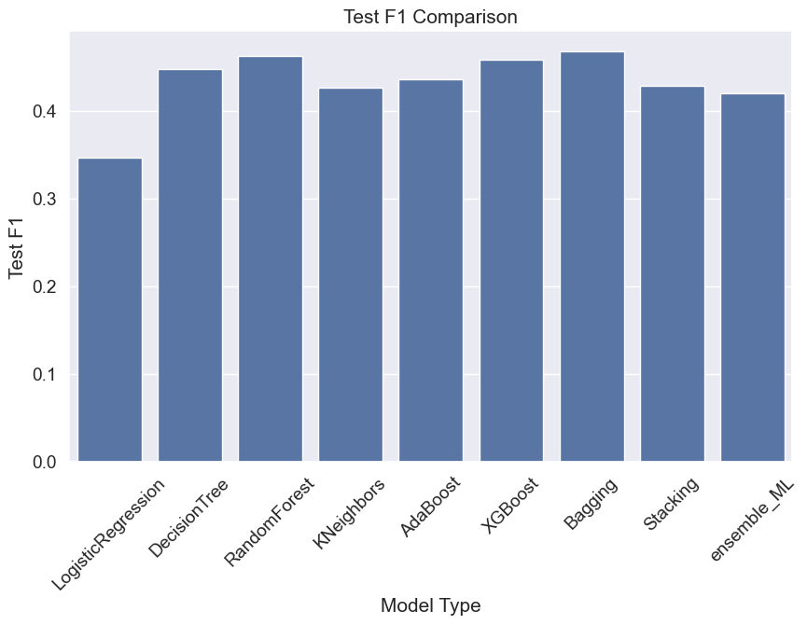
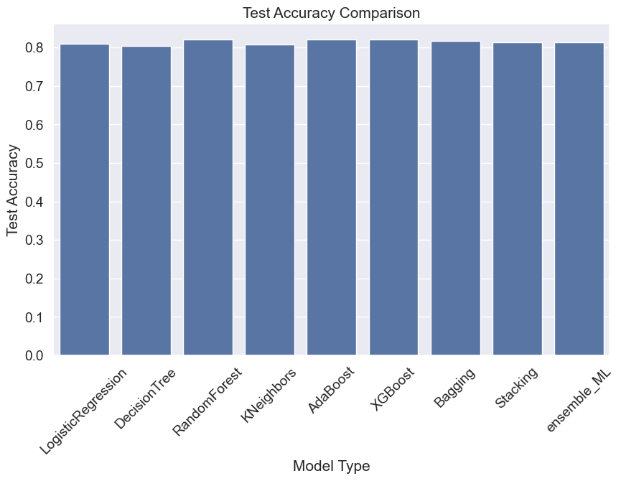
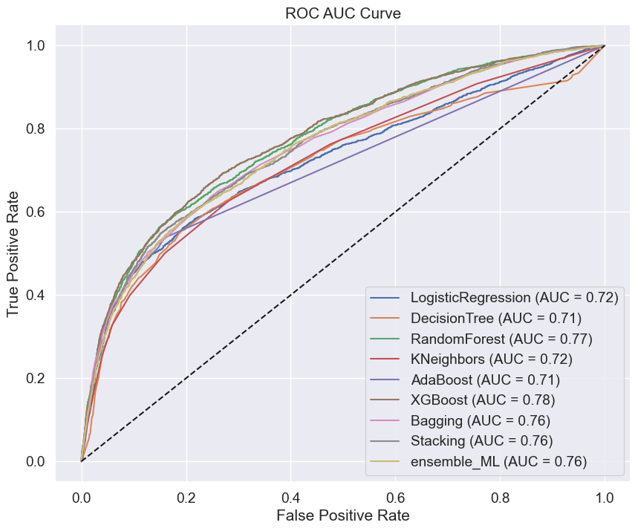
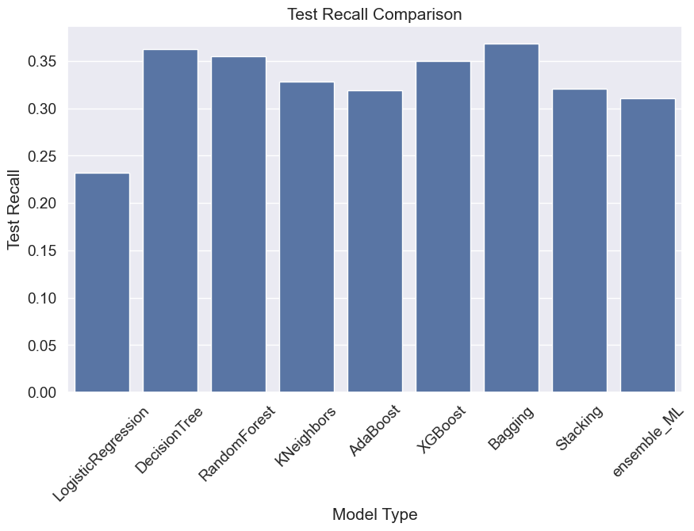
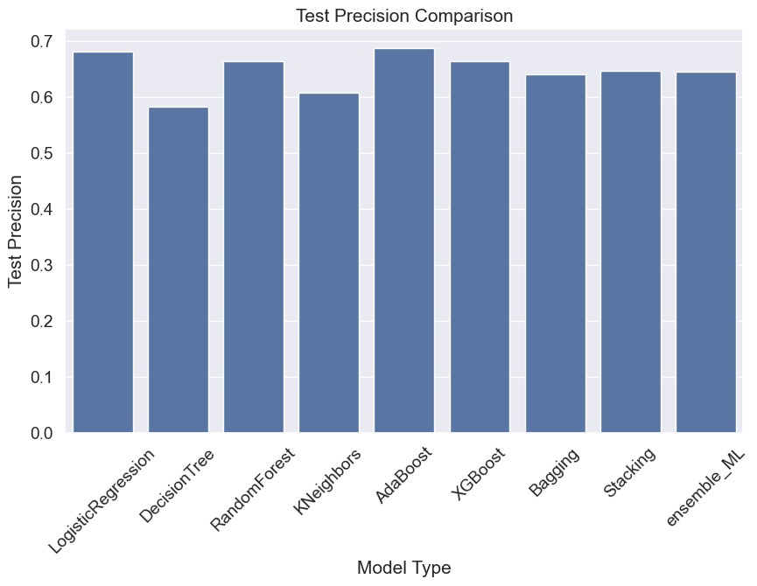
Compare All Models

Slide 24
Recommendation
Based on the analysis, here are the top two recommended models:
Random Forest
Train/Test Accuracy: 0.859/0.821 (Slight overfitting)
Precision/Recall/F1: The F1 score on test data is 0.468, which is better than Logistic Regression and Decision Tree. Precision is decent, but recall could be better.
ROC AUC: 0.774 (Good)
Why Recommend? Random Forest offers a strong balance of accuracy, precision, and recall with minimal overfitting. It provides the best F1 score and a solid ROC AUC, indicating it generalizes well to the test data.
XGBoost
Train/Test Accuracy: 0.827/0.820 (Minimal overfitting)
Precision/Recall/F1: The F1 score on test data is 0.458, which is slightly lower than Random Forest but still strong. It maintains a good balance between precision and recall.
ROC AUC: 0.778 (Good)
Why Recommend? XGBoost is another top-performing model with a strong ROC AUC and minimal overfitting. While its F1 score is slightly lower than that of Random Forest, its high ROC AUC indicates excellent predictive power and robustness.
Final Recommendation:
If you need to choose between these two, Random Forest is slightly preferable for its higher F1 score, making it the top recommendation. However, XGBoost is a close second,

Slide 25
Appendix

Slide 26
