Slide 1
Mini PROJECT – 2- ML
CREDIT CARD CLIENT DATASET

Slide 2
What is my Data
There are 25 variables:
ID: ID of each client
LIMIT_BAL: Amount of given credit in NT dollars (includes individual and family/supplementary credit
SEX: Gender (1=male, 2=female)
EDUCATION: (1=graduate school, 2=university, 3=high school, 4=others, 5=unknown, 6=unknown)
MARRIAGE: Marital status (1=married, 2=single, 3=others)
AGE: Age in years
PAY_0: Repayment status in September, 2005 (-1=pay duly, 1=payment delay for one month, 2=payment delay for two months, … 8=payment delay for eight months, 9=payment delay for nine months and above)
PAY_2: Repayment status in August, 2005 (scale same as above)
PAY_3: Repayment status in July, 2005 (scale same as above)
PAY_4: Repayment status in June, 2005 (scale same as above)
PAY_5: Repayment status in May, 2005 (scale same as above)
PAY_6: Repayment status in April, 2005 (scale same as above)
BILL_AMT1: Amount of bill statement in September, 2005 (NT dollar)
BILL_AMT2: Amount of bill statement in August, 2005 (NT dollar)
BILL_AMT3: Amount of bill statement in July, 2005 (NT dollar)
BILL_AMT4: Amount of bill statement in June, 2005 (NT dollar)
BILL_AMT5: Amount of bill statement in May, 2005 (NT dollar)
BILL_AMT6: Amount of bill statement in April, 2005 (NT dollar)
PAY_AMT1: Amount of previous payment in September, 2005 (NT dollar)
PAY_AMT2: Amount of previous payment in August, 2005 (NT dollar)
PAY_AMT3: Amount of previous payment in July, 2005 (NT dollar)
PAY_AMT4: Amount of previous payment in June, 2005 (NT dollar)
PAY_AMT5: Amount of previous payment in May, 2005 (NT dollar)
PAY_AMT6: Amount of previous payment in April, 2005 (NT dollar)
default.payment.next.month: Default payment (1=yes, 0=no)

Slide 3
Some Data Info and updates
There are 30000 rows and 25 columns
we can see that all the 25 columns have 30000 count which indicates there is no missing value.
we can see that the repayment status is indicated in columns PAY_0, PAY_2 ... with no PAY_1 column, so we rename PAY_0 to PAY_1 for ease of understanding.
next we check the datatype of each variable of dataset. We see that all the columns are int64 type whereas from previous knowledge we know that SEX, EDUCATION, MARRIAGE, PAY_0, PAY_2, PAY_3, PAY_4, PAY_5, PAY_6, default_payment_next_month are categorical features.
defaulters.isna().sum() # check for missing values for surety – no NULLs

Slide 4
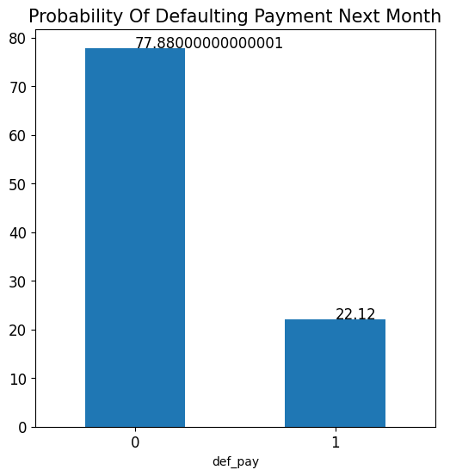
Visualisation – Defaulter Percentage
before moving to visualization we first select some features which we feel would be most correlated to the target variable. From the data provided we see that we want to predict whether a person will default in payment next month or not. This prediction depends mostly on previous repayment history, what is the limiting balance, age, education and marriage. Let's plot these first.
We can see that the dataset consists of 77% clients are not expected to default payment whereas 23% clients are expected to default the payment.
Notes:
Plot.bar()
Xtick
Y ticks

Slide 5
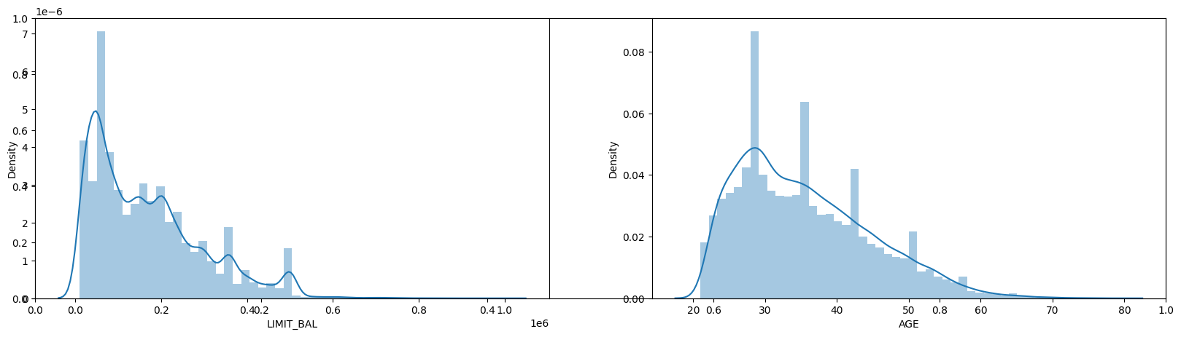
Visualisation – Limit Balance and Age - distribution
By plotting the continuous variables we observe that dataset consists of skewed data of limiting balance and age of clients.
We have more number of clients having limiting balance between 0 to 200000 currency.
We have more number of clients from age bracket of 20 to 40, i.e., clients from mostly young to mid aged groups.
We will observe the effect of variables on target variable below
Notes:
plt.subplot(121)
sns.distplot(defaulters.LIMIT_BAL)
plt.subplot(122)
sns.distplot(defaulters.AGE)

Slide 6
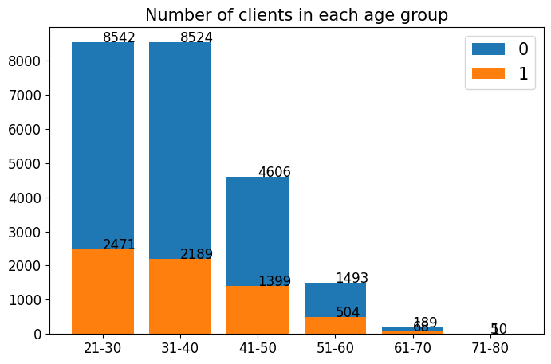
Visualisation – # of clients – age group/default on payment
We have maximum clients from 21-30 age group followed by 31-40. Hence with increasing age group the number of clients that will default the payment next month is decreasing. Hence we can see that Age is important feature to predict the default payment for next month.
Notes:
bins = [20,30,40,50,60,70,80]
names = ['21-30','31-40','41-50','51-60','61-70','71-80']
defaulters['AGE_BIN'] = pd.cut(x=defaulters.AGE, bins=bins, labels=names, right=True)
age_cnt = defaulters.AGE_BIN.value_counts()
age_0 = (defaulters.AGE_BIN[defaulters['def_pay'] == 0].value_counts())
age_1 = (defaulters.AGE_BIN[defaulters['def_pay'] == 1].value_counts())
Barplot and subplot

Slide 7
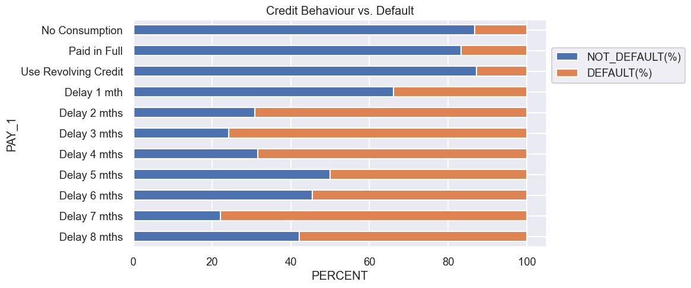
Visualisation – Repayment status vs default payment
Those Using Revolving Credit (paid only minimum) and those delayed for 2 months have the highest Default Count.
When payment is delayed more than 2 months, the chances of default goes higher than 50%.
Notes:
Subplot
Barplot
payment

Slide 8
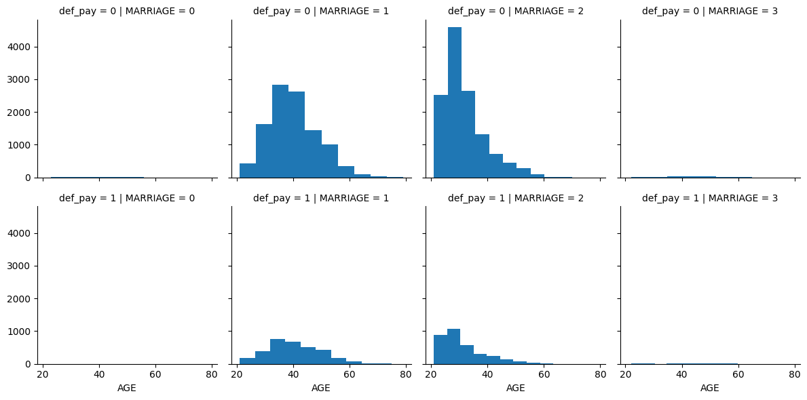
Visualisation – Marriage vs default payment
From this plot we can infer that married people between age bracket of 30 and 50 and unmarried clients of age 20-30 tend to default payment with unmarried clients higher probability to default payment. Hence we can include MARRIAGE feature of clients to find probability of defaulting the payment next month
Notes:
g = sns.FacetGrid(defaulters, row='def_pay', col='MARRIAGE')
g = g.map(plt.hist, 'AGE')
plt.show()

Slide 9
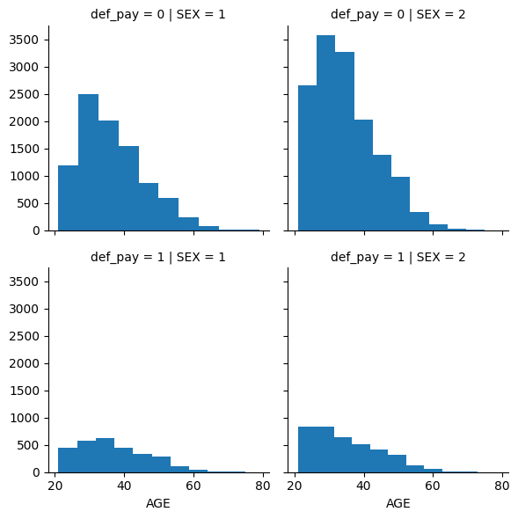
Visualisation – Male/Female vs default payment
It can be seen that females of age group 20-30 have very high tendency to default payment compared to males in all age brackets. Hence we can keep the SEX column of clients to predict probability of defaulting payment.
Notes:
g = sns.FacetGrid(defaulters, row='def_pay', col='SEX')
g = g.map(plt.hist, 'AGE')

Slide 10
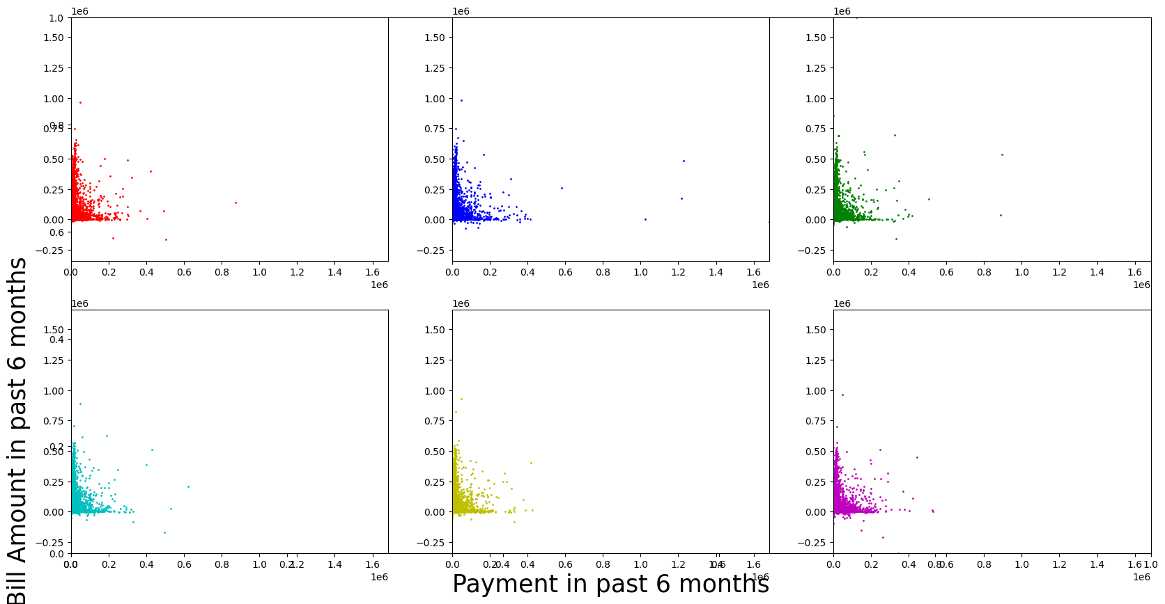
Visualization – Past six months payment vs Default
Above plot indicates that there is higher proportion of clients for whom the bill amount is high but payment done against the same is very low. This we can infer since maximum number of datapoints are closely packed along the Y-axis near to 0 on X-axis
Notes:
plt.scatter(x=defaulters.PAY_AMT1, y=defaulters.BILL_AMT1, c='r', s=1)
Repeat for pay_amt2 and bill_amt-2

Slide 11
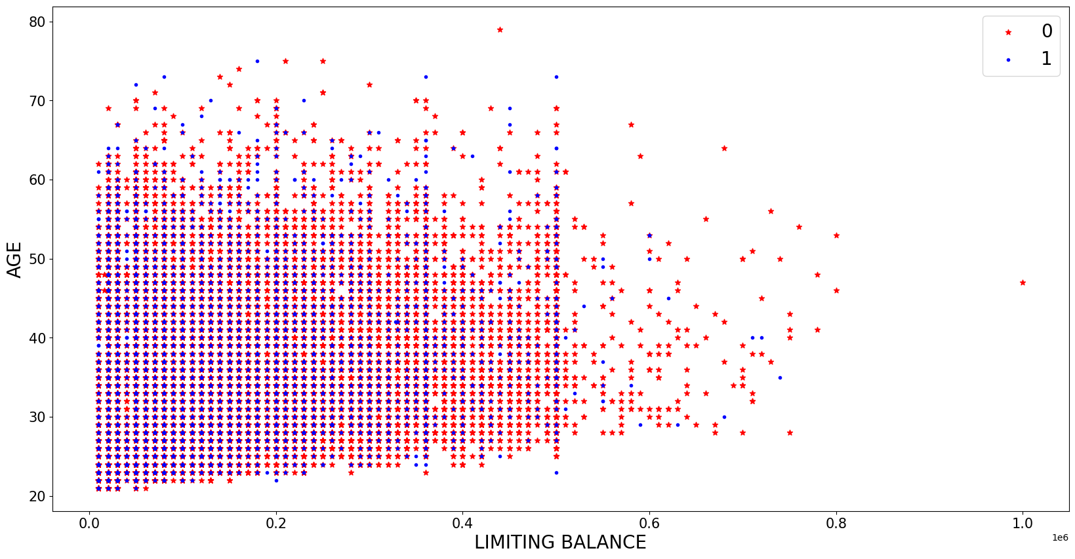
Visualization – Age / Limit Balance vs Default payment
This plot of Age against limiting balance does not provide any accurate information, as there is mixed variation of clients of all age groups and their current month limiting balance.
Notes:
plt.scatter(x=defaulters.PAY_AMT1, y=defaulters.BILL_AMT1, c='r', s=1)
Repeat for pay_amt2 and bill_amt-2

Slide 12
Machine Learning

Slide 13
Key questions and steps for ML
Step 1 : Define the problem or question
Ans 1 : Based on the credit card client data set –predict if the person is going to be defaulted next month or not
Step 2: Find the data
Ans 2 : Data from universal data Set as suggested by Laks
Step 3 & 4 & 5 : Read , clean and EDA + Prepare the data
Ans 3 & 4 & 5 : As per Mini Project 1 and above slides the data
Step 6 : Modelling
Ans 6 : Input features are all the columns because I am using gridsearch and hyperparameter tunning. Output variable Def_Pay 0 or 1 , which is Binary , hence used classification Models and used Supervised learning. Ran all the models we know so far and captured the results.
models = ['LogisticRegression', 'DecisionTree', 'RandomForest', 'KNeighbors’, 'AdaBoost', 'XGBoost', 'Bagging', 'Stacking']

Slide 14
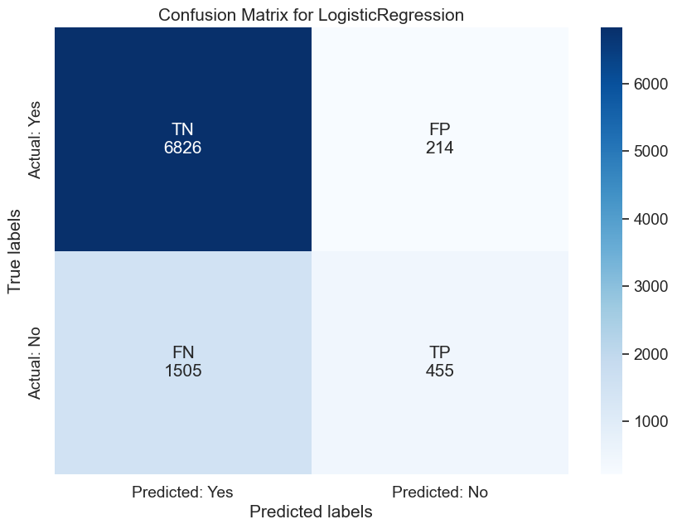
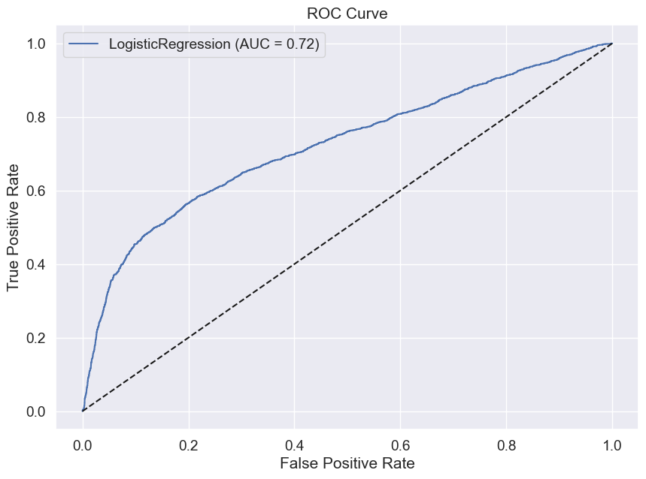
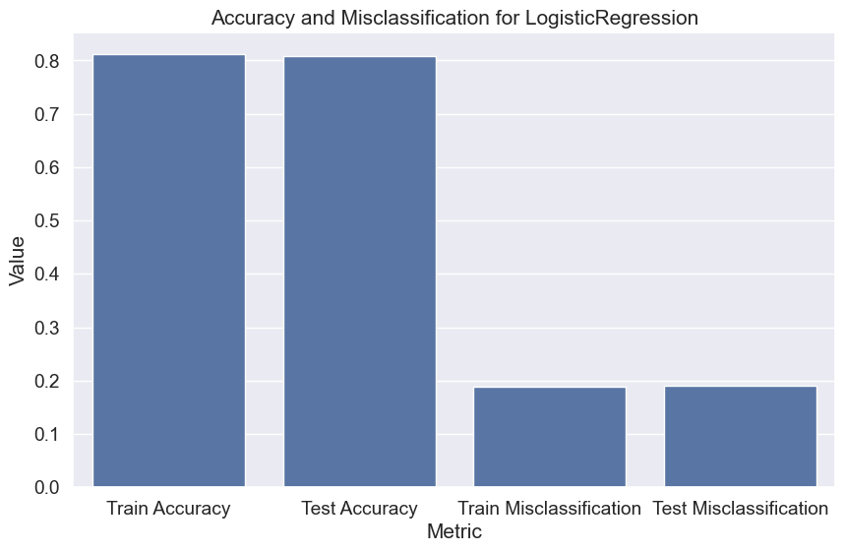
LogisticRegression

