Slide 1
Logistics Optimization for Delivery Routes – FedEx
MySQL Data Analytics Project
Presented by: Pragyan Dixit
Technology: MySQL | SQL | Data Analytics
Project Focus: Shipment Performance
• Route Optimization
• Warehouse Performance
• Delivery Agent Analysis
Course Project

Slide 2
Project Overview
Objective
Build a SQL-driven logistics analytics system to analyze shipment performance, optimize delivery routes, and improve delivery efficiency across the FedEx logistics network.
Key Areas of Analysis
Delivery delay patterns and operational inefficiencies
Route and hub performance
Warehouse performance and utilization
Delivery agent performance
Shipment tracking and bottlenecks
Advanced logistics KPIs
Expected Outcome
Use SQL-based data analysis to identify operational problems and provide actionable recommendations for improving delivery reliability and cost efficiency.

Slide 3
Dataset Description
The project uses five datasets to analyze FedEx logistics operations.
1. Orders Table
Contains order details such as Order ID, Customer ID, Order Date, Route ID, Warehouse ID, Order Amount, Delivery Type and Payment Mode.
2. Routes Table
Contains route information including source and destination cities, countries, distance and average transit time.
3. Warehouses Table
Contains warehouse location, daily capacity and manager information.
4. Delivery Agents Table
Contains agent details including assigned zone, country, experience and average customer rating.
5. Shipment Tracking Table
Contains shipment tracking information including pickup date, delivery date, delivery status, delay hours and customer feedback.
Database Relationships
Orders → Shipments → Routes
Shipments → Warehouses
Shipments → Delivery Agents

Slide 4
Database Structure
Database Name fedex_db
Tables Used
1. fedex_orders.xlsx
Order and customer-related information
2. fedex_routes.xlsx
Route, distance and transit-time information
3. fedex_warehouses.xlsx
Warehouse location and capacity information
4. fedex_delivery_agents.xlsx
Delivery agent experience and rating information
5. fedex_shipments.xlsx
Shipment tracking, delivery status and delay information
Key Relationships
Order_ID → Orders & Shipments
Route_ID → Routes & Shipments
Warehouse_ID → Warehouses & Shipments
Agent_ID → Delivery Agents & Shipments

Slide 5
Task 1 – Data Cleaning & Preparation
Data Quality Checks Performed
• Checked duplicate Order_ID records
• Checked duplicate Shipment_ID records
• Checked missing Delay_Hours values
• Validated Pickup and Delivery dates
• Checked invalid Route_ID and Warehouse_ID references
• Checked orders without corresponding shipment records
Key Results
✓ No duplicate Order_ID records found
✓ No duplicate Shipment_ID records found
✓ No NULL Delay_Hours values found
✓ No invalid Pickup/Delivery date records found
✓ Route_ID and Warehouse_ID references are valid
⚠ 16 orders were found without corresponding shipment records
Conclusion
The dataset is largely clean and consistent, with 16 unmatched orders requiring further investigation.

Slide 6
Task 1 – SQL Queries & Results
Query 1.1 – Duplicate Order_ID
Result: No duplicate Order_ID records found.
Query 1.2 – Duplicate Shipment_ID
Result: No duplicate Shipment_ID records found.
Query 1.3 – NULL Delay_Hours
Result: No NULL Delay_Hours records found.
Query 1.4 – Replace NULL Delay_Hours
Result: No NULL values required replacement.
Query 1.5 – Verify NULL Values
Result: 0 NULL Delay_Hours records.
Query 1.6 – Invalid Delivery Dates
Result: No Delivery_Date before Pickup_Date.
Query 1.7 – Date Validation
Result: Pickup and Delivery dates successfully validated.
Query 1.8 – Orders Without Shipment
Result: 16 unmatched orders identified.
Query 1.9 – Invalid Route_ID
Result: No invalid Route_ID found.
Query 1.10 – Invalid Warehouse_ID
Result: No invalid Warehouse_ID found.

Slide 7
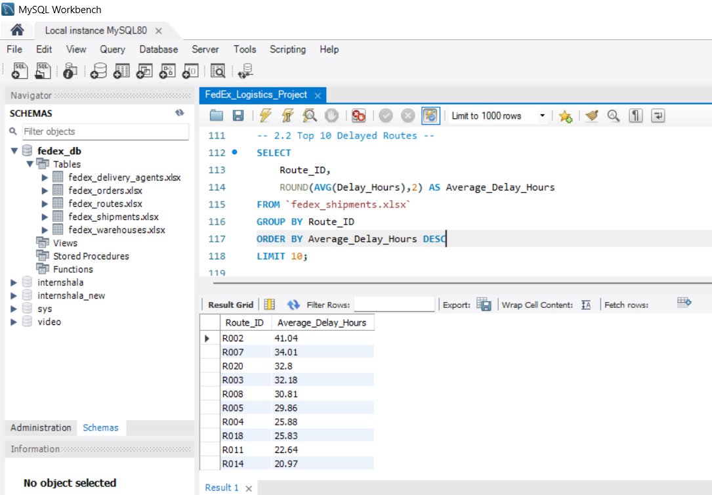
Task 2 – Delivery Delay Analysis
Analysis Performed
• Calculated delivery delay in hours for each shipment
• Identified the Top 10 delayed routes based on average delay
• Ranked shipments by delay within each warehouse using SQL window functions
• Compared average delay between Express and Standard deliveries
Key Metrics
Delivery Delay (Hours)
Delivery Date − Pickup Date
Route Delay
Average delay calculated for each Route_ID
Warehouse Ranking
Shipments ranked by Delay_Hours within each Warehouse_ID
Service-Level Comparison
Express vs Standard average delivery delay

Slide 8
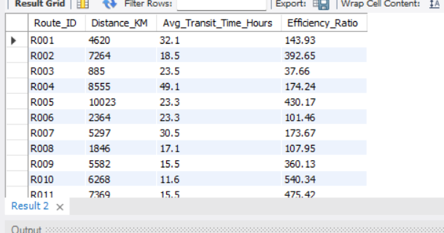
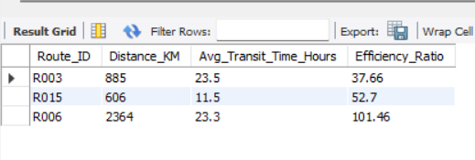
Task 3 – Route Optimization Insights
Analysis Performed
• Calculated average transit time for each route
• Calculated average delivery delay per route
• Calculated the Distance-to-Time Efficiency Ratio
• Identified the 3 routes with the lowest efficiency
• Identified routes where more than 20% of shipments were delayed
• Classified routes for optimization based on average delay
Key Metrics
Average Transit Time
Measures the actual time taken by shipments on each route.
Average Delay
Measures the average additional delay experienced on each route.
Efficiency Ratio
Distance_KM ÷ Avg_Transit_Time_Hours
Business Objective
Identify inefficient and high-delay routes so that FedEx can improve route planning, scheduling and hub utilization.

Slide 9
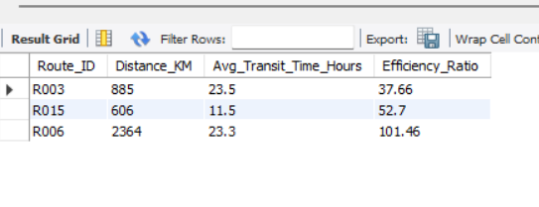
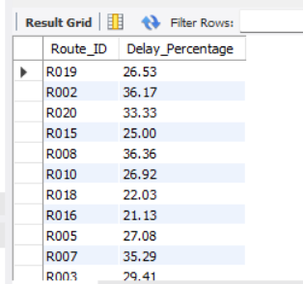
Task 3 – Route Optimization Results
Route Performance Analysis
Query 3.1 – Average Transit Time
Shows the average actual transit time for each route.
Query 3.2 – Average Delay
Identifies routes with higher average delivery delays.
Query 3.3 – Efficiency Ratio
Compares route distance with average transit time.
Query 3.4 – Worst 3 Routes
Identifies the three routes with the lowest efficiency ratio.
Query 3.5 – Delayed Routes
Identifies routes where more than 20% of shipments exceeded the expected transit time.
Query 3.6 – Optimization Classification
Classifies routes as:
• High Priority Optimization
• Needs Monitoring
• Performing Well
Recommendation
High-delay and low-efficiency routes should be reviewed for alternative routing, better scheduling and improved hub coordination.

Slide 10
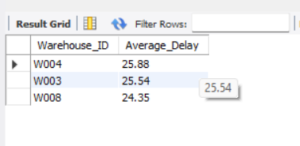
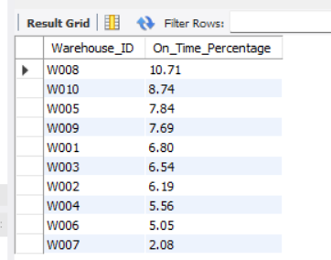
Task 4 – Warehouse Performance
Analysis Performed
• Identified the Top 3 warehouses with the highest average shipment delay
• Compared total shipments with delayed shipments for each warehouse
• Used a CTE to identify warehouses with average delay above the global average
• Ranked warehouses based on On-Time Delivery Percentage
Key Metrics
Average Delay
Measures the average delay of shipments handled by each warehouse.
Delayed Shipments
Counts shipments where delay hours are greater than zero.
On-Time Delivery %
Measures the percentage of shipments delivered without delay.
Business Objective
Identify underperforming warehouses and prioritize them for operational improvements, capacity planning and better shipment handling.

Slide 11
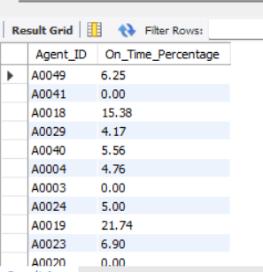
Task 5 – Delivery Agent Performance
Analysis Performed
• Ranked delivery agents based on On-Time Delivery Percentage
• Identified agents with On-Time Delivery below 85%
• Compared the Top 5 and Bottom 5 agents using rating and experience
• Evaluated agents for training and workload-balancing opportunities
Key Metrics
On-Time Delivery %
Measures the percentage of shipments delivered on time by each agent.
Average Rating
Represents customer feedback and service quality.
Experience (Years)
Shows the delivery agent's professional experience.
Business Objective
Identify high-performing agents and support low-performing agents through targeted training and workload balancing.

Slide 12
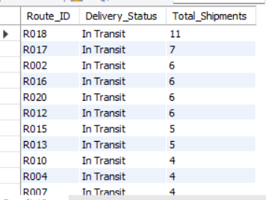
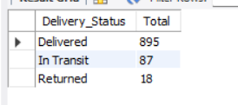
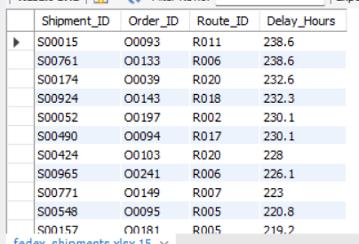
Task 6 – Shipment Tracking Analytics
Analysis Performed
• Displayed shipment status along with the latest delivery date
• Identified routes with In Transit and Returned shipments
• Analyzed the frequency of available shipment statuses
• Identified shipments with exceptionally high delays of more than 120 hours
Key Metrics
Delivery Status
Delivered • In Transit • Returned
Extreme Delay
Shipments with Delay_Hours > 120
Business Objective
Identify shipment bottlenecks, routes with unresolved deliveries and exceptionally delayed shipments that require operational investigation.

Slide 13
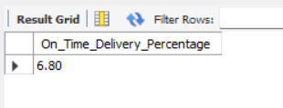
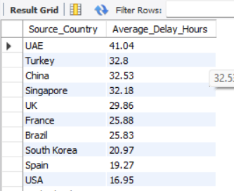
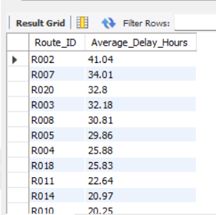
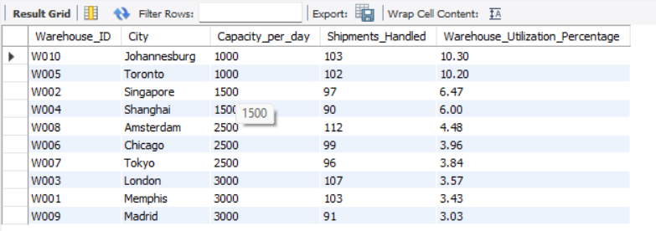
Task 7 – Advanced KPI Reporting
Key Performance Indicators
• Average Delivery Delay per Source Country
Measures the average shipment delay for each source country.
• On-Time Delivery %
Measures the percentage of deliveries completed without delay.
• Average Delay per Route
Identifies routes with higher average delivery delays.
• Warehouse Utilization %
Measures shipment volume handled compared with the warehouse's daily capacity.
SQL Techniques Used
AVG() • SUM() • COUNT() • CASE • GROUP BY • JOIN
Business Objective
Use these KPIs to monitor delivery reliability, route performance and warehouse capacity utilization.

Slide 14
Key Insights
Data Quality
No duplicate Order_ID records were identified.
No duplicate Shipment_ID records were identified.
No NULL Delay_Hours values were found.
No invalid Pickup_Date or Delivery_Date records were identified.
Referential Integrity
Route_ID references were validated successfully.
Warehouse_ID references were validated successfully.
Shipment Mapping
16 orders were identified without a corresponding shipment record.
These unmatched orders should be investigated to understand whether the issue is related to shipment creation, tracking or data recording.
Overall Observation
The dataset is generally clean and consistent, with the main data-quality issue being the 16 unmatched orders.

Slide 15
Business Recommendations
1. Optimize High-Delay Routes
Review routes with high average delays and low distance-to-time efficiency. Evaluate alternate routes, hub combinations and delivery schedules.
2. Improve Warehouse Operations
Prioritize warehouses with high average delays or low on-time delivery performance. Review processing capacity and shipment handling.
3. Train Low-Performing Agents
Delivery agents with On-Time Delivery below 85% should receive targeted training and performance support.
4. Balance Agent Workloads
Redistribute shipments where workload concentration may be affecting delivery performance.
5. Monitor Extreme Delays
Shipments delayed by more than 120 hours should be investigated to identify operational bottlenecks.
6. Use KPI-Based Monitoring
Regularly monitor On-Time Delivery %, Average Delay, Route Efficiency and Warehouse Utilization to support data-driven logistics decisions.

