Slide 1
Customer Segmentation & Order Cancellation Analysis
Pragya Sen
U97864862
pragyas@bu.edu

Slide 2
Outline
Problem Statement
Dataset
Business Problem
Methodology Overview
K-means
PCA
Customer Segmentation
Logistic Regression
Order Cancellation Analysis
Conclusion
Future Work

Slide 3
Problem Statement
Customer Segmentation based on purchasing power
Order Cancellation analysis

Slide 4
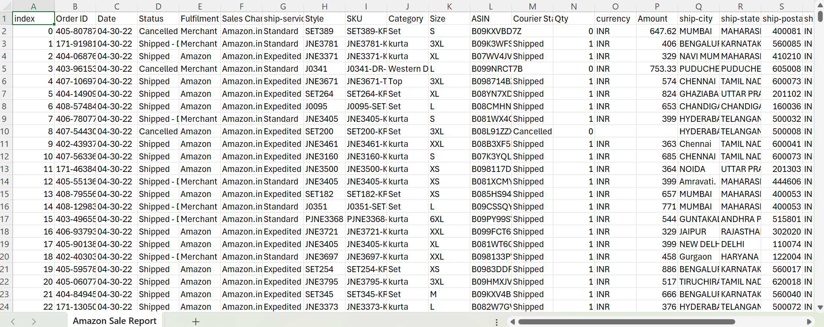
Dataset
Amazon Fashion retail data (Kaggle): 128k records, 23 fields

Slide 5
Business Problem
Why does segmentation matter?
Personalized marketing: It helps target the right products to the right customers, increasing conversion rates.
Inventory optimization: Understanding which customer segments prefer which products helps avoid overstocking or stockouts.
Price sensitivity analysis: Different segments respond differently to price changes—critical for dynamic pricing.
Why are cancellations a concern?
Customer dissatisfaction: Frequent cancellations can indicate supply chain or listing issues.
Seller performance: High cancellation rates can damage seller metrics and visibility on Amazon.
Business impact
Revenue growth: Accurate segmentation leads to better targeting, promotions, and product mix—driving sales.
Cost control: Minimizing cancellations helps reduce shipping, restocking, and customer service costs.

Slide 6
Methodology Overview
Data pre-processing
Customer Segmentation using K-means clustering & PCA (Principal Component Analysis)
Order Cancellation Analysis
Exploratory Analysis
Correlation Analysis
Predictive modelling using Logistic Regression

Slide 7
K-means algorithm
K-means is an unsupervised machine learning algorithm used for clustering. It partitions data into K distinct non-overlapping groups (clusters) based on similarity.
Steps:
Choose the number of clusters (K)
Initialize centroids
Assign points to the nearest centroid
Update centroids
Repeat previous steps till there are no more changes in the Centroids.

Slide 8
PCA Analysis
It is a dimensionality reduction technique used to transform high-dimensional data into fewer dimensions while retaining as much variability as possible.
Key Outputs:
Explained variance ratio: Shows how much information each component retains.
Scree plot: Helps decide how many components to keep.
Transformed dataset: Lower-dimensional data used for K-means or visualization.

Slide 9
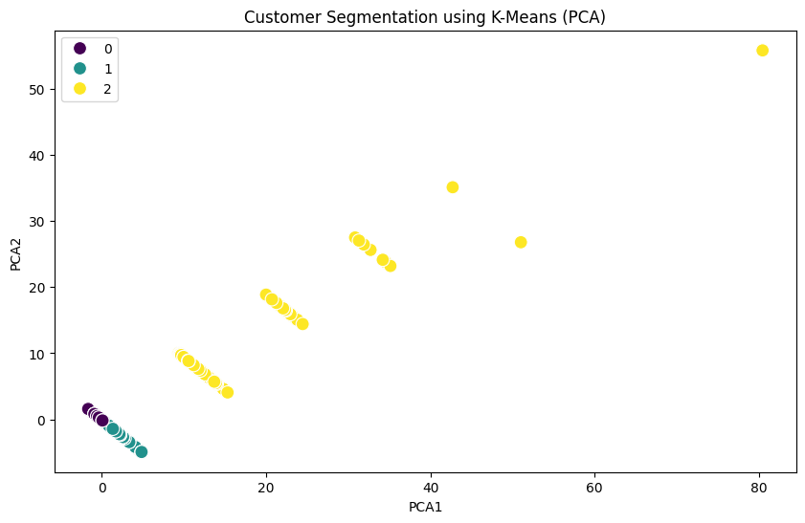
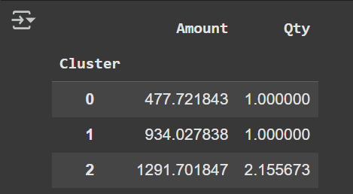
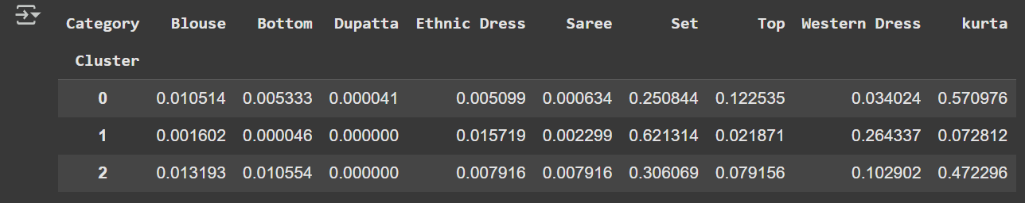
Customer Segmentation
Cluster 0: Budget Shoppers
This cluster has low-spend shoppers who tend to have single-item purchases.
The purchases are dominated by the ‘Kurta’ category (57%).
Cluster 1: Premium Shoppers
This cluster has high-value shoppers but still single-item purchases.
The purchases are dominated by the ‘Set’ category (62%).
Cluster 2: High-end multi-item Shoppers
This cluster has the highest spenders with multi-item purchases.
The purchases are dominated by the ‘Kurta’ (47%) and ‘Set’ (30%) categories.

Slide 10

Logistic Regression
Logistic Regression is a supervised machine learning algorithm used for binary classification.
Uses the logistic (sigmoid) function to map predicted values to probabilities between 0 and 1.
Sigmoid Function:
Returns probability of class 1 (e.g., cancellation).
A threshold (usually 0.5) is applied to convert it to a class label.

Slide 11
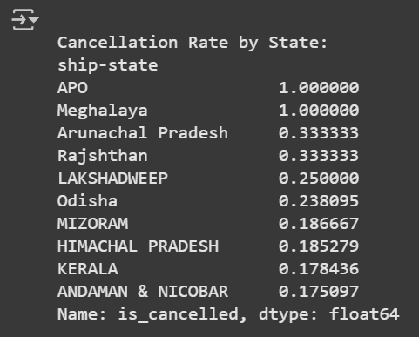
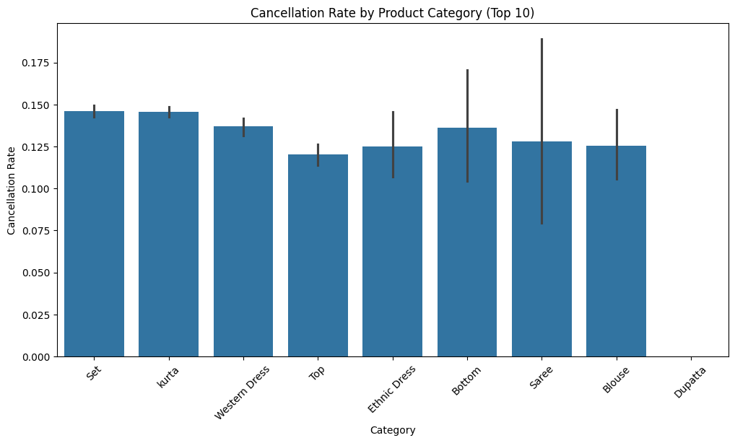
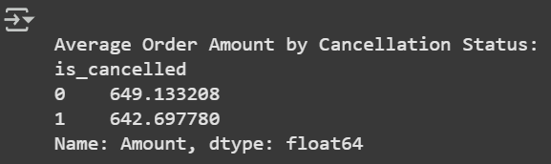
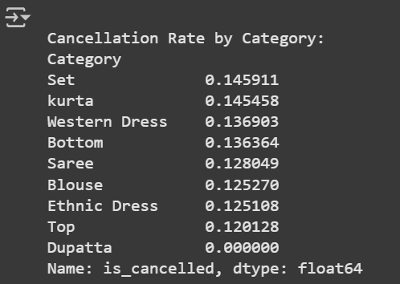
Order Cancellation Analysis
1) Exploratory Analysis
‘Set’ Category has the highest percentage of cancellations.
Meghalaya has the highest cancellation by State.
The average amount for Cancelled orders is Rs. 642.69

Slide 12
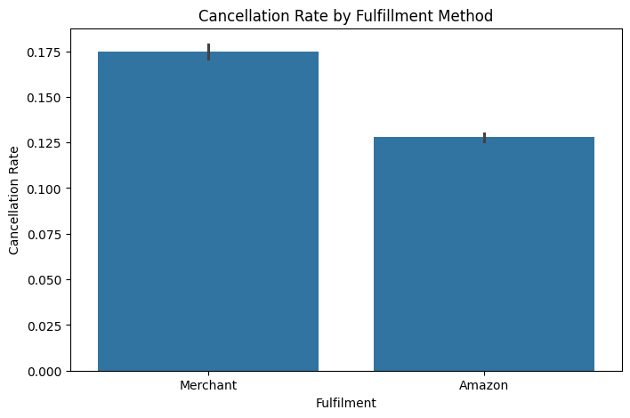
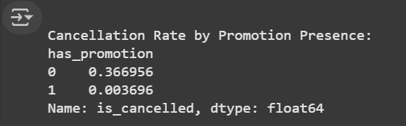
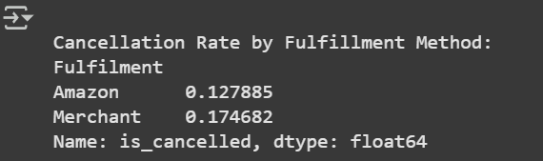
Order Cancellation Analysis
2) Correlation Analysis
Cancellation Rate is significantly higher in items which do not have promotion.
Cancellation Rate is slightly higher for orders from an external Merchant.

Slide 13
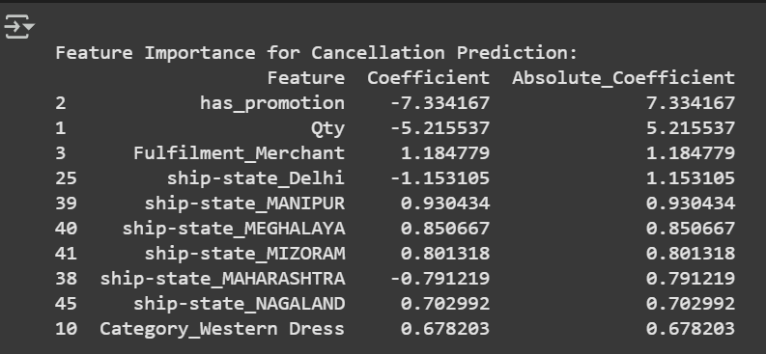
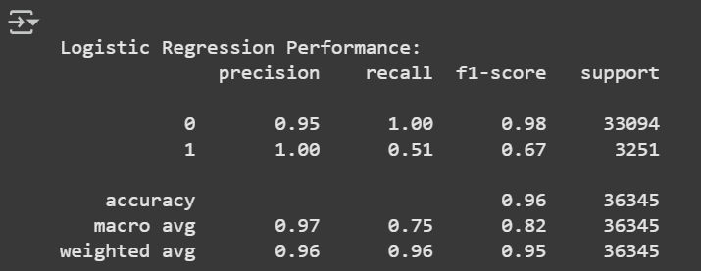
Order Cancellation Analysis
3) Predictive Analysis using Logistic Regression
This model has an Accuracy of 96%.
Whether or not an item has promotion has the highest feature importance and is the strongest predictor of order cancellation.

Slide 14
Conclusion
Customer Segmentation using PCA + K-means revealed clear behavioral clusters, enabling targeted marketing, inventory planning, and customer value maximization.
Order Cancellation Analysis via Logistic Regression identified key drivers such as Promotion presence, Order quantity empowering proactive risk management.

Slide 15
Future Work
Model Refinement & Validation
Incorporate more features (e.g., real-time shipping updates, customer sentiment).
Time-Based Customer Segmentation
Use time series clustering to capture evolving customer behavior over seasons or product launches.
Feedback Loop & Continuous Learning
Use feedback from marketing/cancellation outcomes to retrain models regularly and improve accuracy.

Slide 16

Thank You!

