Slide 1

Red Wine Quality Prediction
Pragya Sen (pragyas@bu.edu)
MET CS 555 Term Project

Slide 2
Problem Statement
Dataset
Determine which chemical features are the best indicators of red wine quality and use the most appropriate method to model the same.
The Red Wine Quality Dataset (https://archive.ics.uci.edu/dataset/186/wine+quality) was used.
1000 samples have been used for this project.
Contains a total of 12 variables where 11 are chemical factors potentially affecting the dependent variable, i.e, the quality

Slide 3
Data Preparation
Statistical Methods Used
Checking the datatype of all the features
Checking for the presence of missing values in the dataset
Summary of the dataset to understand the distribution of data
Checking if data is normally distributed
Splitting Data
Correlation Matrix, Histograms, QQ-plots, Simple Linear Regression, Multiple Linear Regression, Lasso Method (L1 regularization), Random Forest

Slide 4
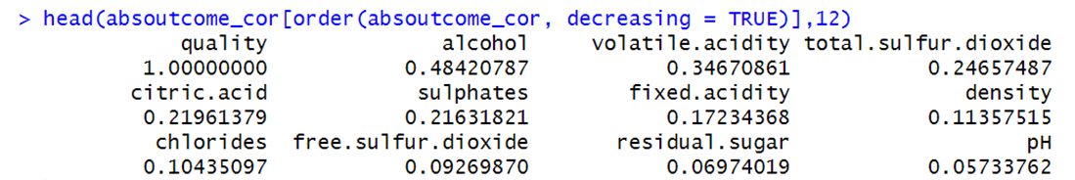
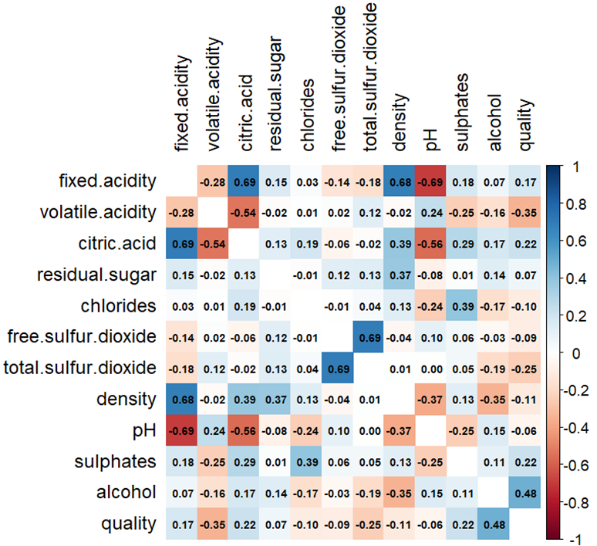
Correlation
Correlation of each factor to quality (in decreasing order)
Top-4 factors: alcohol, volatile.acidity, total.sulphur.dioxide, citric.acid
Correlation matrix of all factors
It was seen that amongst the top-4 variables, only volatile.acidity & citric.acid have a significant magnitude of correlation.
Cor(volatile.acidity, citric.acid) = -0.54

Slide 5
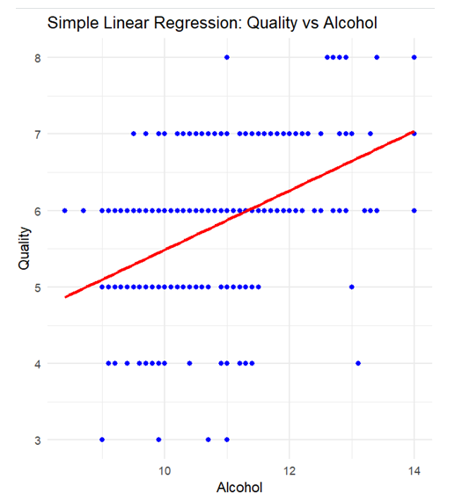
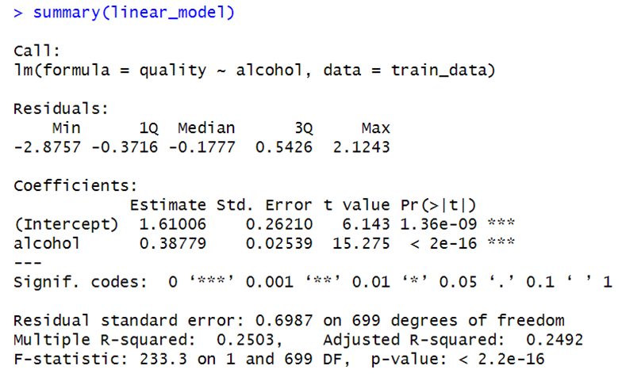
Model 1: Simple Linear Regression (SLR)
Using only 1 predictor variable, i.e, alcohol (highest correlation with quality)

Slide 6
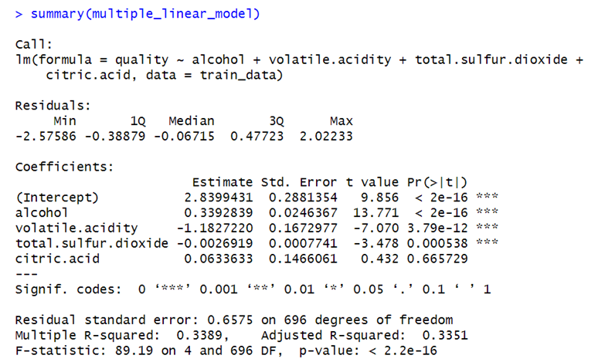
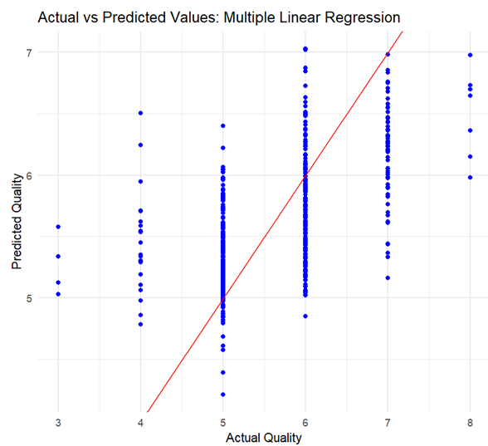
Model 2: Multiple Linear Regression (MLR)
Using the top 4 variables with highest correlation (i.e., alcohol, volatile.acidity, total.sulfur.dioxide, citric.acid) to the quality variable.

Slide 7
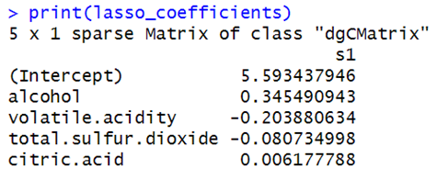
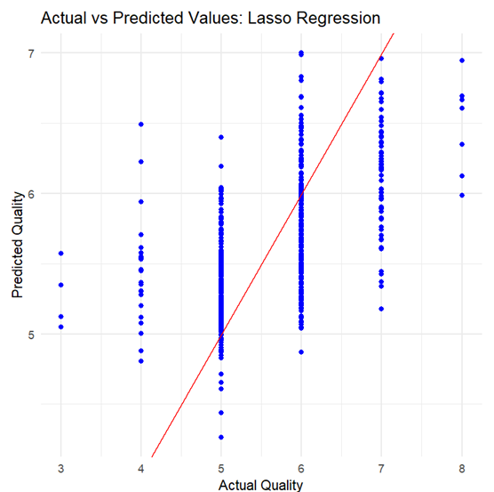
Model 3: MLR with Lasso technique (L1 regularization)
Using the Lasso technique to eliminate the effect of correlation within variables. It aims to shrink coefficients of some features to zero, effectively performing feature selection.
It can be seen that the magnitude of the coefficient for citric.acid is extremely small indicating that it will have minimal impact on the model.

Slide 8
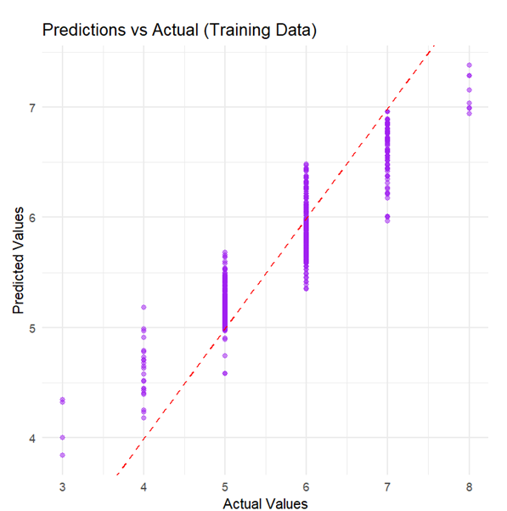
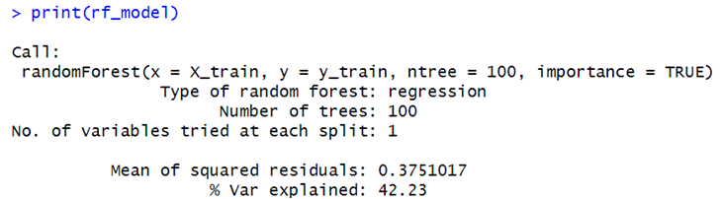
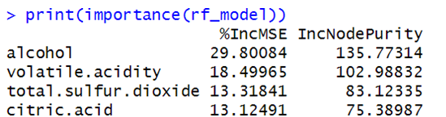
Model 4: Random Forest
Since there is some degree of imbalance in the data, the Random Forest model could be a good fit. It also helps with feature selection which could handle the problem of correlation between 2 predictors.

Slide 9
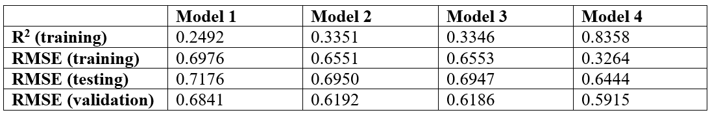
Comparison & Conclusion
Model 4 (i.e., Random Forest) has the highest R² value and the lowest RMSE (Root Mean Squared Error) values for training, testing and validation data. Hence, we can say that the Random Forest model is the best fit for the Red-wine dataset.
The most influential features in predicting red-wine quality are: alcohol, volatile.acidity, total.sulfur.dioxide.
Amongst the top-4 features, citric.acid does not contribute much to the model. This is likely due to the high correlation between volatile.acidity & citric.acid.

Slide 10
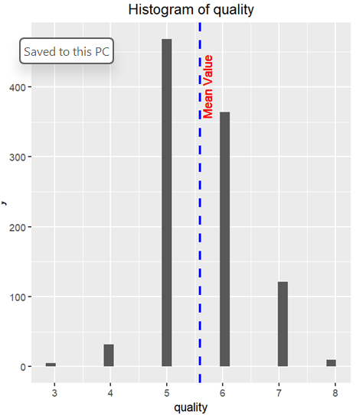
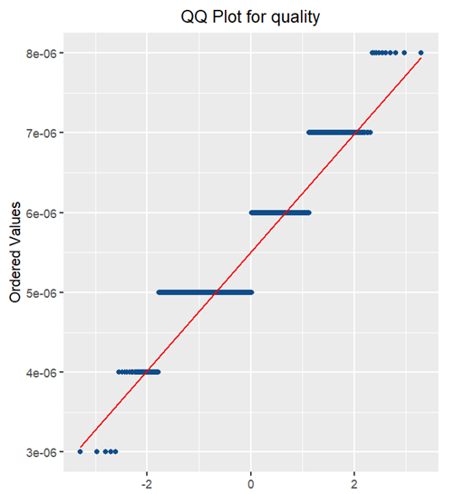
Limitations
One of the limitations of this analysis is that there is some degree of imbalance in the dataset. A majority of the quality values were “regular” (5 and 6), which made no significant contribution to finding an optimal model. These values made it slightly harder to identify each factor's different influence on a "high" or "low" quality of the wine.
Another limitation could be the possibility of overfitting. The Random Forest model was chosen to be the best fit for this dataset. But if looked closely in Table1, it can be seen that the RMSE value of Model 4 for the training data is significantly smaller than the testing data. This could be an indicator of overfitting. Regardless, the Random Forest model appears to be the best choice since the RMSE values, even for testing and validation data, for Model 4 were significantly better than the other models.

Slide 11
Thank you for listening.

