Slide 1
Sentiment Analysis of Restaurant Reviews (Comparative study & Visualization)
Pragya Sen
U97864862
pragyas@bu.edu

Slide 2
Problem Statement
Perform sentiment analysis on restaurant reviews using two different approaches: a traditional machine learning model (Naive Bayes) and a modern deep learning model (BERT).
Provide an interactive visualization using Gradio for end-user interpretation.

Slide 3
Introduction
Sentiment Analysis
A natural language processing (NLP) technique used to determine whether a piece of text expresses a positive, negative, or neutral sentiment.
Naïve Bayesian
A probabilistic machine learning algorithm based on Bayes’ Theorem, used for classification tasks.
BERT (Bidirectional Encoder Representations from Transformers)
A deep-learning model based on the Transformer Architecture.

Slide 4
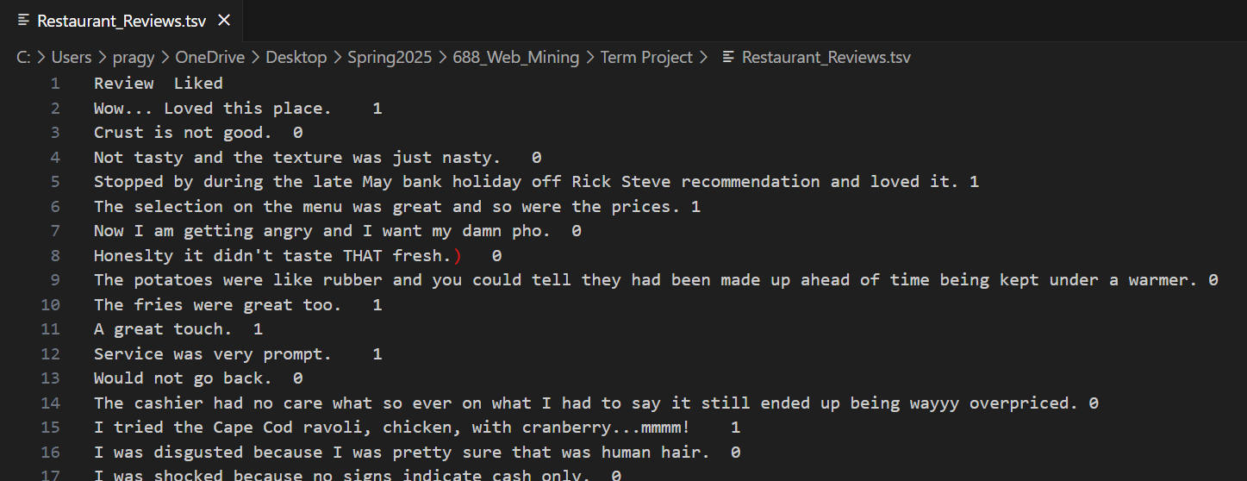
Dataset
A dataset with 1000 restaurant reviews was chosen from Kaggle.
It has 2 fields:
Review: Stores the actual review given by customers.
Liked: Binary field indicating whether the review is positive or negative.

Slide 5
Methodology Overview
Data Pre-processing
Naïve Bayesian model for Sentiment Analysis
BERT model for Sentiment Analysis
Comparison of performance metrics
Gradio for Visual representation

Slide 6
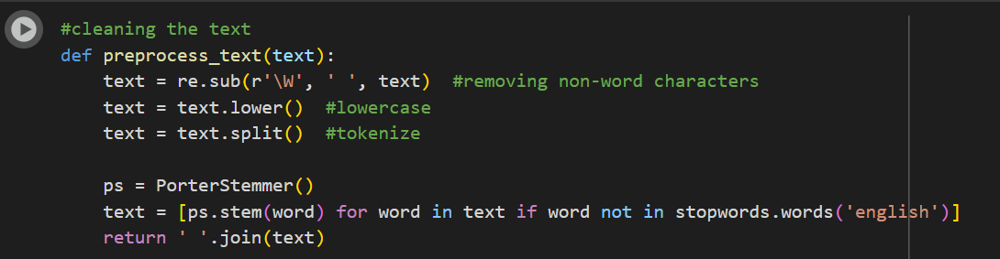
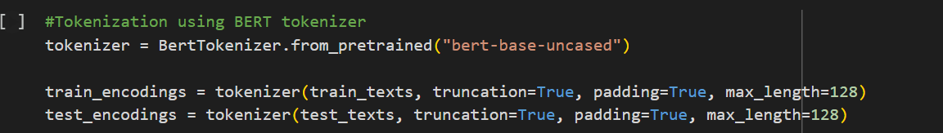
Data Pre-processing
Text Cleaning:
Removing non-word characters & stop-words (Only for the Naïve-Bayesian model)
Converting everything to lower-case (Only for the Naïve-Bayesian model)
Tokenizing
Splitting into Train/Test sets
Train set: 80%
Test set: 20%

Slide 7
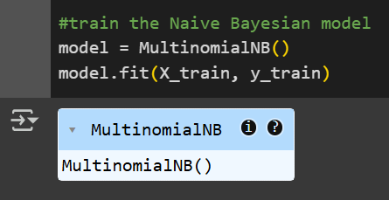
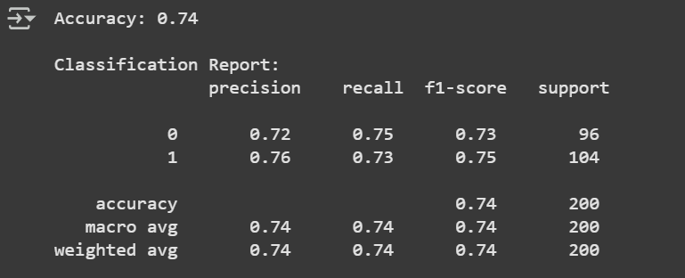
Model 1: Naïve Bayesian
The Naïve Bayesian model is trained on the clean training data.
The trained model is then run on test data and various performance metrics are calculated.

Slide 8
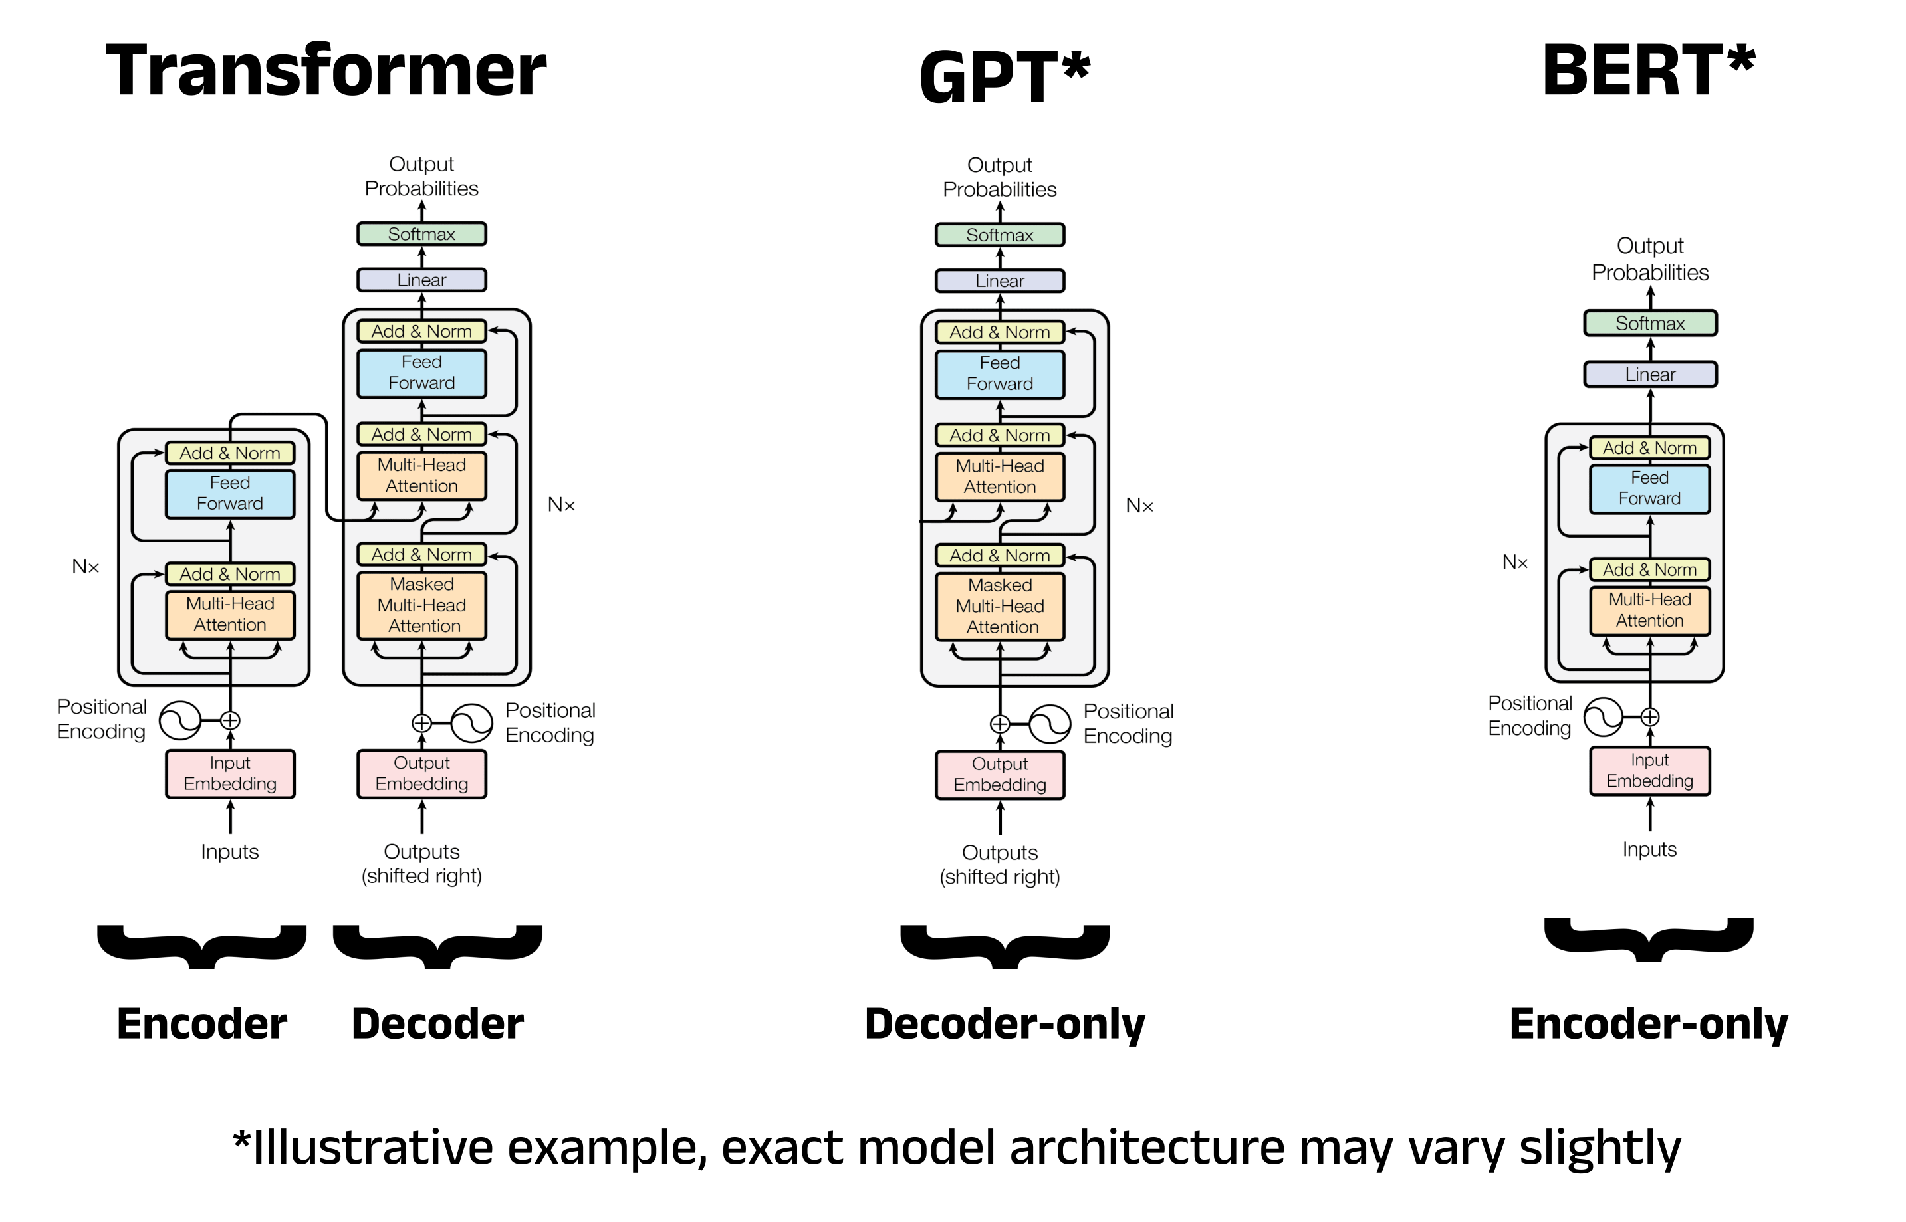
Model 2: BERT (Bidirectional Encoder Representations from Transformers)
What are Transformers?
A deep-learning architecture that uses Attention to weigh the importance of each word in a sentence relative to all other words, regardless of their position.
Decoder-only models: Predict a new output sequence in response to an input sequence.
Encoder-only models: Make predictions about words within an input sequence.

Slide 9
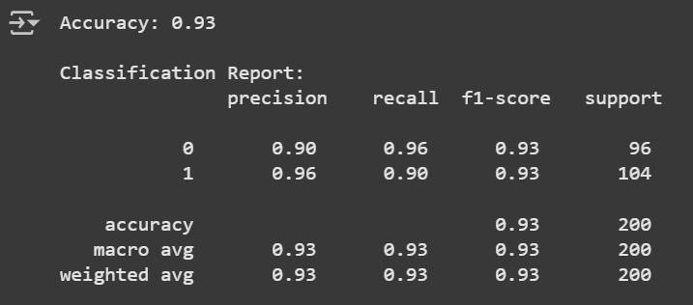
Model 2: BERT
Steps performed during implementation:
Loading the pre-trained BERT model.
Feed tokenized review into BERT model to fine-tune it (2 epochs).
Get sentiment prediction
Evaluate the model

Slide 10
Model Comparison
Metric | Naive Bayesian | BERT
Accuracy | 0.74 | 0.93
Precision (Class 0) | 0.72 | 0.90
Recall (Class 0) | 0.75 | 0.96
F1-Score (Class 0) | 0.73 | 0.93
Precision (Class 1) | 0.76 | 0.96
Recall (Class 1) | 0.73 | 0.90
F1-Score (Class 1) | 0.75 | 0.93
Macro Avg F1 | 0.74 | 0.93
Weighted Avg F1 | 0.74 | 0.93

Slide 11
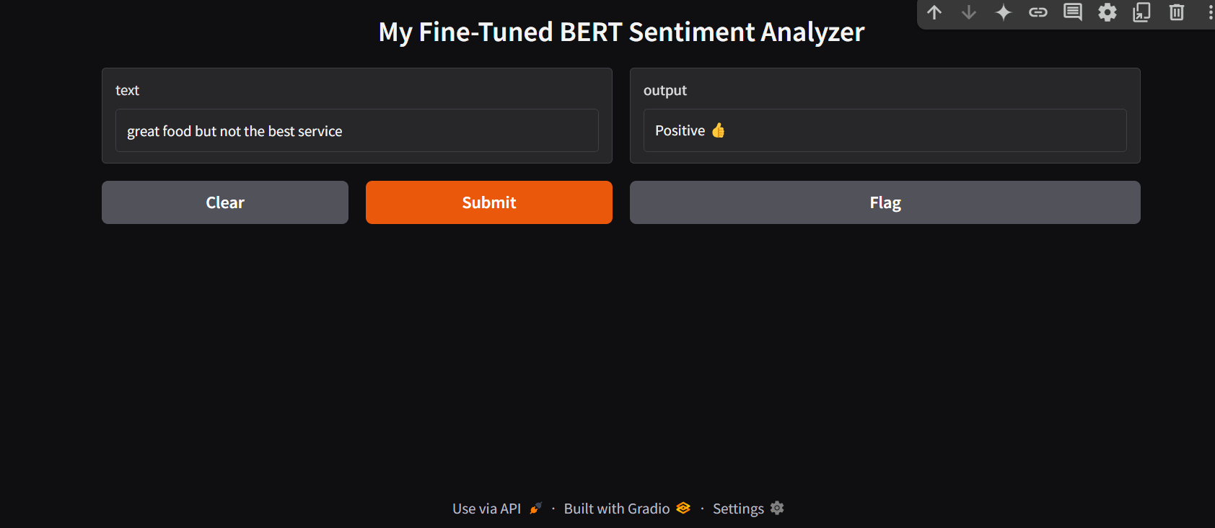
Gradio Visualization
Used Gradio for end-user visualization.
Implemented this for the pre-trained sentiment analysis model from Hugging Face (already fine-tuned on a general dataset like IMDb.)
Implemented this for the model fine-tuned using our training set.

Slide 12
Conclusion
Successfully implemented two sentiment analysis models:
Naive Bayes (classical ML)
BERT (transformer-based deep learning)
BERT outperformed Naive Bayes in terms of accuracy and context understanding, especially in handling nuanced language.
Developed an interactive Gradio app to visualize predictions using both a general pretrained model and our fine-tuned BERT model.

Slide 13
Future Work
Aspect-Based Sentiment Analysis: Identify sentiment toward specific aspects (e.g., food, service, ambience).
Multiclass Classification: Expand from binary (positive/negative) to include neutral or star ratings.
Multilingual Datasets: Improve generalization and cover non-English reviews.
Real-Time Integration: Connect with review platforms or APIs to analyze live customer feedback.

Slide 14

Thank You!

