Slide 1
GUVI HCL HACKATHON 2026 • REVIEW 1
FraudShield AI
Explainable AI-Powered UPI & Digital Payment Fraud Detection Engine
TEAM DETAILS
Team Name: Team Sentinel
Domain: Fintech Security / Web & Core Java
TEAM MEMBERS
• PRAGYA SINGH
• ADITI YADAV
• SMRITI JHA
• PRIYANKA SHARMA

Slide 2
GUVI HCL HACKATHON • REVIEW 1
Problem Statement & Industry Need
THE PROBLEM
• Instant Settlements: UPI & digital transactions settle in milliseconds and are irreversible.
• Behavioral Variance: Fraud looks like anomalous behavior (sudden 10x amount, 3 AM transaction, new device, foreign location).
• The 'Black-Box' Trap: Existing ML solutions give binary labels ('Fraud / Not Fraud') without explainability. Analysts cannot defend why an account was blocked.
OUR OBJECTIVES
• Personalized Baseline: Compare every transaction against the customer's own approved spending history, not rigid global thresholds.
• Hybrid Scoring Engine: Combine 75% Rule-based Behavioral heuristics with 25% Weka J48 Machine Learning probability.
• Explainable Intelligence: Produce transparent 0-100 score + detailed checklist of triggered factors for human analysts to review instantly.

Slide 3
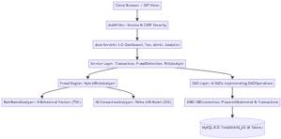
GUVI HCL HACKATHON • REVIEW 1
Multi-Tier System Architecture
LAYERED DESIGN
• Presentation Layer: JSP 2.3 + JSTL 1.2, CSS3 responsive grid (Zero scriptlets).
• Security Filter: AuthFilter for session lifecycle & CSRF token verification.
• Controller Layer: 10+ Java Servlets 4.0 handling HTTP requests, validations.
• Service & Engine: FixedThreadPool async workers & HybridRiskAnalyzer.
• Persistence Layer: 6 DAOs using PreparedStatement & ACID JDBC transactions.
• Database & ML: MySQL 8.0 relational tables & Weka J48 Decision Tree.

Slide 4
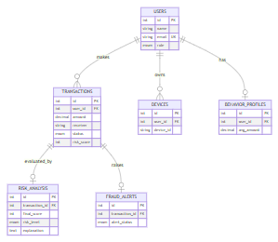
GUVI HCL HACKATHON • REVIEW 1
Relational Database Design (MySQL 8.0)
DATABASE SCHEMA HIGHLIGHTS
• 6 Relational Tables: users, transactions, risk_analysis, fraud_alerts, devices, behavior_profiles.
• Data Integrity: Foreign keys with ON DELETE CASCADE prevent orphaned child records.
• CHECK Constraints: amount > 0 and risk_score BETWEEN 0 AND 100 enforced at DB level.
• Indexed Queries: Compound indexes on (user_id, transaction_time) and status for sub-second retrieval.

Slide 5
GUVI HCL HACKATHON • REVIEW 1
Real-Time Transaction Lifecycle & Workflow
• 1. Transaction Ingestion: User inputs payment. Validated via ValidationUtil (regex for UPI IDs, amounts).
• 2. State 'PENDING': Saved to MySQL with status PENDING to prevent race conditions.
• 3. Concurrency & Lock: Worker thread acquires per-customer lock (ConcurrentHashMap userLocks) ensuring sequential order.
• 4. Hybrid Analysis: RuleBasedAnalyzer computes 6 weighted factors; MLTransactionAnalyzer evaluates Weka tree.
• 5. Atomic Commit: Single JDBC transaction updates transactions, risk_analysis, and fraud_alerts with commit/rollback.

Slide 6
GUVI HCL HACKATHON • REVIEW 1
Core Java & Object-Oriented Principles
Inheritance & Template Method
Abstract TransactionAnalyzer defines final analyze() lifecycle method; RuleBasedAnalyzer & MLTransactionAnalyzer extend it.
Polymorphism & Interfaces
FraudDetector, RiskAnalyzer, and generic DAOOperations<T> interfaces allow modular replacement of detection strategies.
Multithreading & Concurrency
AppExecutors manages a FixedThreadPool (4 workers). Callable/Future return async results; per-customer locking prevents race conditions.
Robust Exception Handling
4 Custom exceptions (InvalidTransaction, Authentication, FraudAnalysis, DatabaseOperation) decouple JDBC from Servlets.

Slide 7
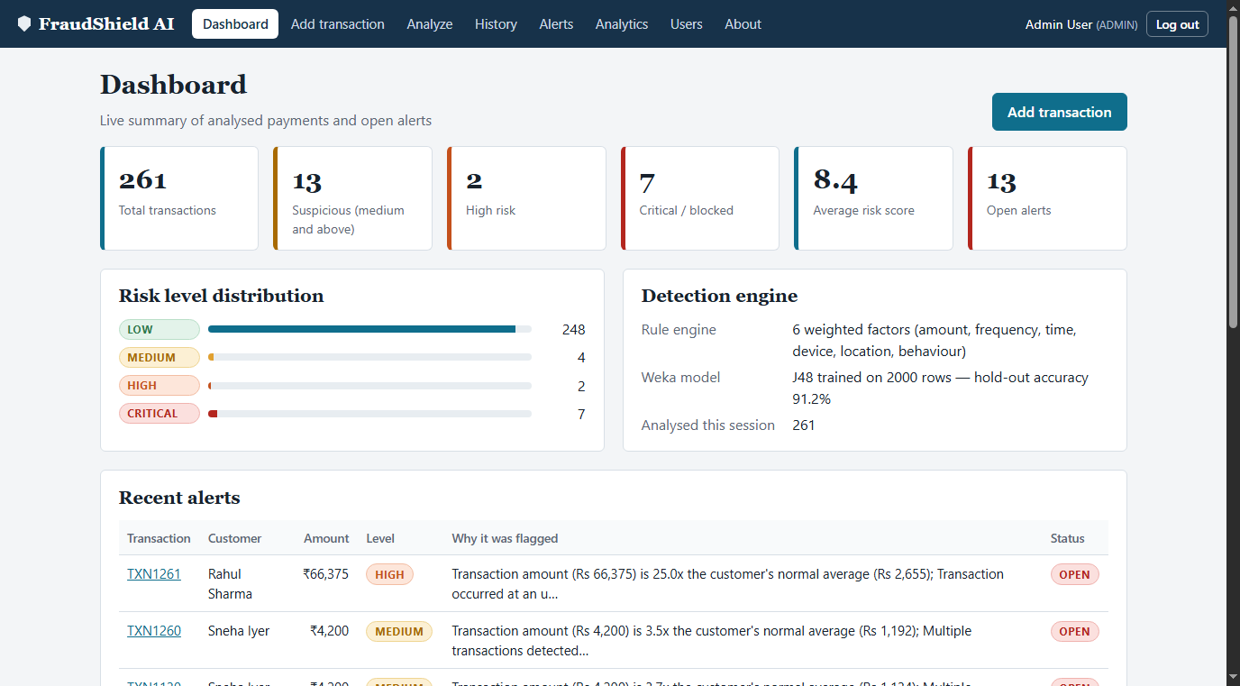
GUVI HCL HACKATHON • REVIEW 1
User Interface & Aesthetics — Console Dashboard
KEY DASHBOARD CAPABILITIES
• KPI Summary Cards: Total transactions (260), Open alerts, Avg risk score, and High/Critical counts.
• Risk Distribution Bar: Visual breakdown of Low, Medium, High, and Critical volume.
• Engine Status Widget: Real-time health indicator of the trained Weka ML model and background worker pool.
• Recent Alerts Queue: Instant access to freshly flagged suspicious events for rapid triage.

Slide 8
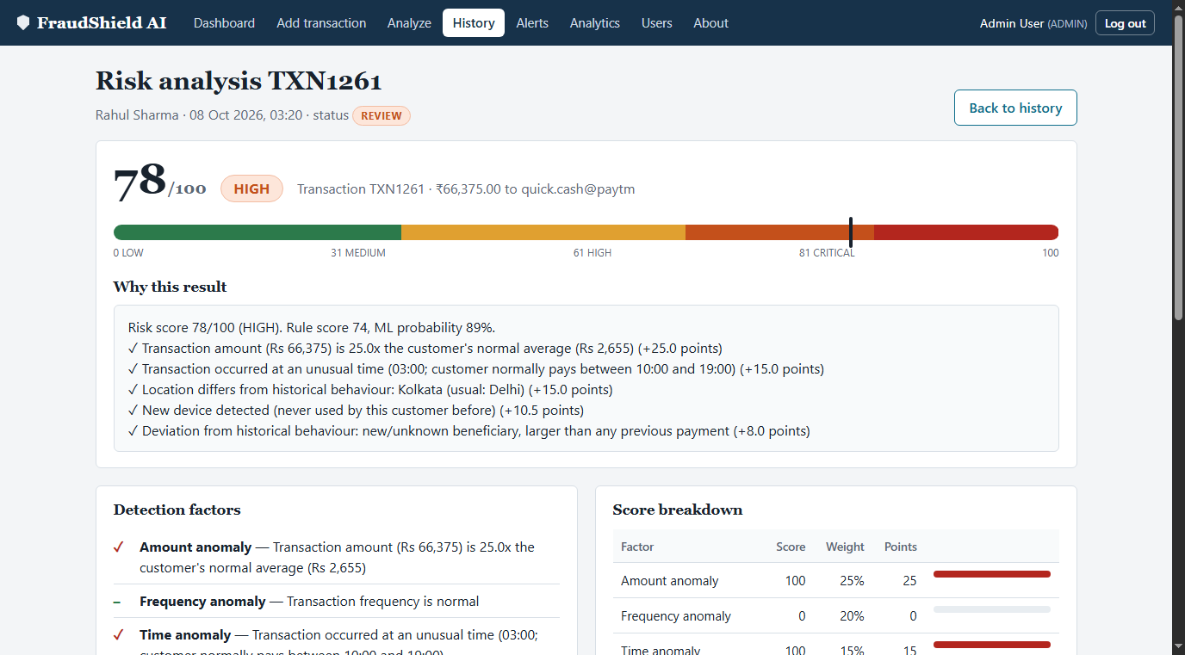
GUVI HCL HACKATHON • REVIEW 1
Explainable Risk Scoring & Decision Breakdown
HOW EXPLAINABILITY WORKS
• 0 - 100 Score Meter: Clear color-coded gauge (Green=Low, Yellow=Medium, Orange=High, Red=Critical).
• Ticked Rule Factors: Exact reasons listed (e.g. Amount 25x above average, payment at 3 AM, foreign city).
• Transparent Weights: Detailed table showing exact points contribution per heuristic.
• Audit-Ready: Includes analysis method, ML probability %, and timestamp for regulatory compliance.

Slide 9
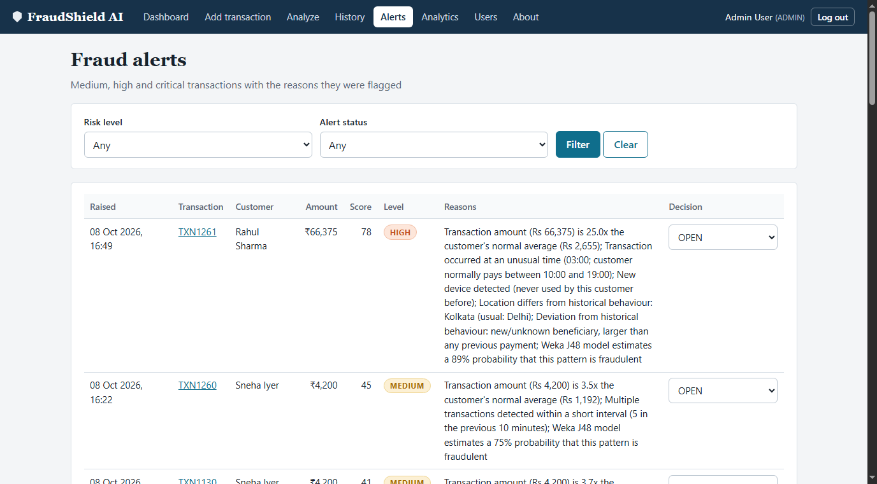
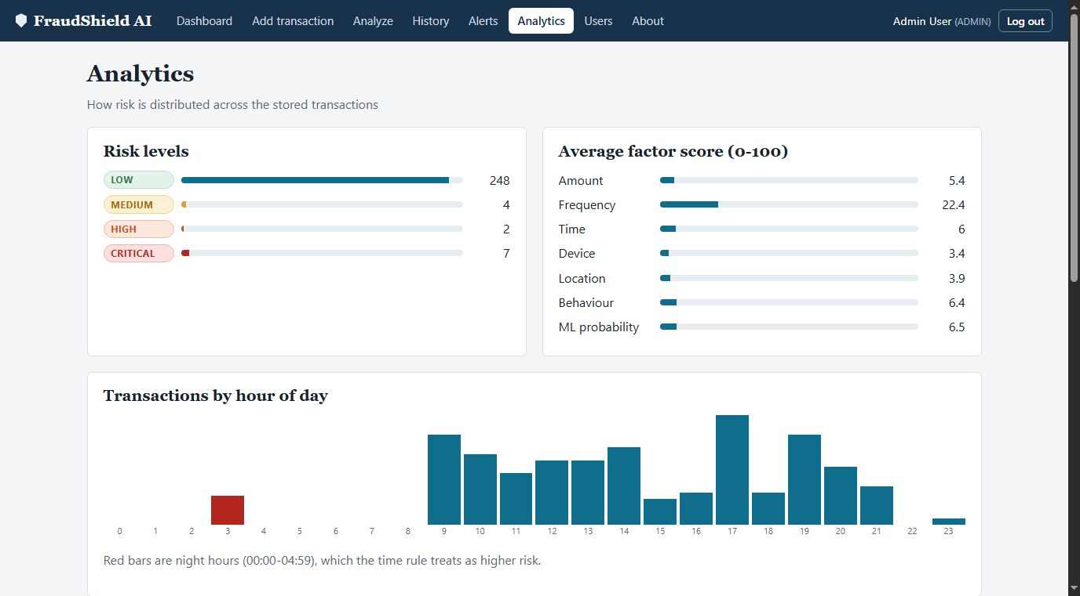
GUVI HCL HACKATHON • REVIEW 1
Alert Workflow & Weka Decision Tree Analytics
FRAUD ALERTS & ANALYST ACTIONS
WEKA J48 DECISION TREE & ACCURACY

Slide 10
GUVI HCL HACKATHON • REVIEW 1
Hackathon Review 1 Evaluation Rubric Mapping
Rubric Criteria | Marks | Implementation in FraudShield AI | Evidence
Problem Understanding & Solution Design | 8 / 8 | Real-time UPI fraud detection comparing payments against historical behavior profiles; explainable 0-100 score. | Risk Page, Architecture Docs
Core Java Concepts & OOP | 10 / 10 | Abstract TransactionAnalyzer, FraudDetector interfaces, Collections, FixedThreadPool concurrency, custom exceptions. | Java Classes, Code Tour
Database Integration (JDBC) | 8 / 8 | 6 DAO classes implementing DAOOperations<T>, PreparedStatement only, ACID commit/rollback, schema with cascades. | MySQL DB, schema.sql
Servlets & Web Integration | 7 / 7 | 11 @WebServlet classes, AuthFilter for sessions/CSRF, JSP/JSTL views with zero scriptlets, web.xml config. | Running Web App, WAR Build

Slide 11
GUVI HCL HACKATHON • REVIEW 1
Review 1 Deliverables & Project Roadmap
REVIEW 1 COMPLETED DELIVERABLES
✔ Project Structure & Setup: WAR packaging, clean 3-tier modular architecture, Java 17 + Maven build.
✔ Database Design & Integration: 6 normalized MySQL tables with foreign keys, CHECK constraints, and 6 JDBC DAOs.
✔ UI Aesthetics & Responsiveness: Modern CSS/HTML analyst console tested across 14 routes with zero JSP errors.
✔ Public GitHub Repository: https://github.com/pragyasingh-12/FraudShield-AI with 900+ lines comprehensive README.
ROADMAP FOR REVIEW 2
➔ Connection Pooling: Integrate HikariCP for high-throughput database connection management.
➔ Automated Unit Testing: Implement JUnit 5 and Mockito tests for RuleBasedAnalyzer and DAOs.
➔ Model Retraining Pipeline: Automatically retrain Weka model using analyst decisions (Confirmed vs False Positive).
➔ SMS & Email Notifications: Integrate alerts dispatch for immediate high-risk payment notifications.

Slide 12
FraudShield AI
Thank You! Questions & Discussion
Team Sentinel • Galgotias University • GUVI HCL Hackathon 2026

