Slide 1
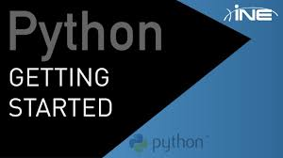

Slide 2
Features of python:
Released in 1991 by G.V. Rossum.
Multi-paradigm-Python is a multi-paradigm programming language. Meaning, it supports different programming approach.One of the popular approach to solve a programming problem is by creating objects. This is known as Object-Oriented Programming (OOP).
Interpreted-Python program runs directly from the source code. Each time Python programs are executed code is required.
Easy to read
Easy to learn

Slide 3
High level language-Python is closer to human languages and further from machine languages.
Dynamically typed-type checking is done at run-time.
Strongly typed-explicit conversion is required.
Extensible-Python is easily extensible with C/C++/Java code, and easily embeddable in applications.

Slide 4
Python has a large and comprehensive standard library.
automatic memory management.
capable of exception handling.

Slide 5
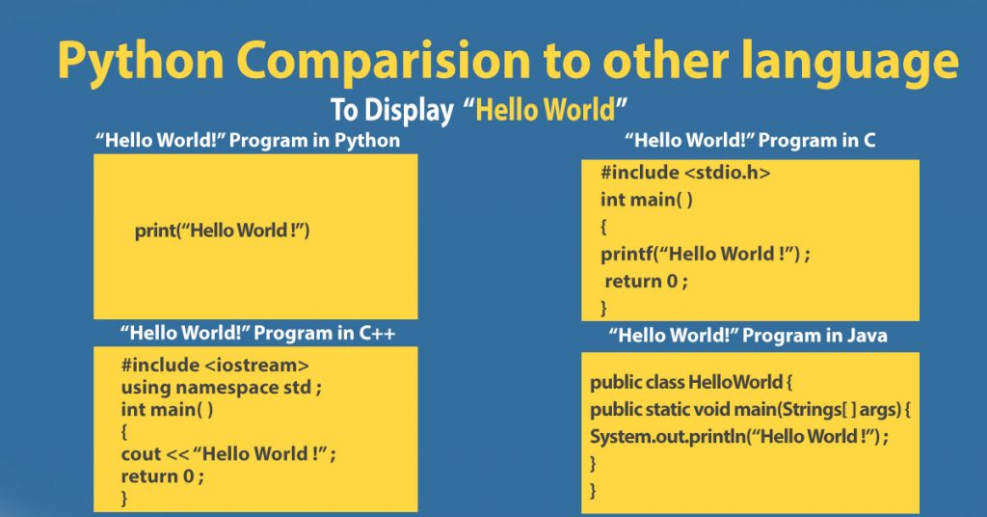
Python Contains Fewer Lines Of Codes

Slide 6
Scope in python
Game devlopment- Pygame
Web devlopment- Django, flask,bottle ……………………frameworks
Machine learning- Scikit , Tensorflow
Data Science- Numpy , Pandas, Scipy
GUI applications – Tkinter, pyQT
Deep learning- Caffe(Fast, open …………………framework)

Slide 7




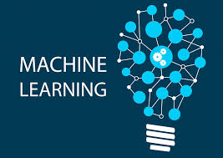

Used in:

Slide 8
Python as a calculator:
you can type an expression at it and it will write the value.

Slide 9
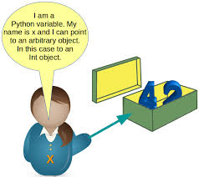
What are variables???
a symbolic name associated with a value and whose associated value may be changed.
Properties:
Name
Type
scope

Slide 10
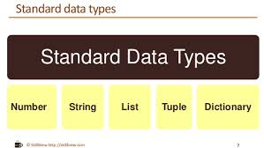

Slide 11
Strings : sequence of characters. Ex: “ram”,”45rt”,”2222”
List: List is a collection which is ordered and changeable. Ex.list=[1,2,3,4,5] or List(1,2,3,4,5)
Tuples : A tuple is a sequence of immutable(unchangeable) Python objects. Ex. (1,2,3,4,5)
Dictionary:dictionary is a collection which is unordered, changeable and indexed.Dictionary are defined into two elements Keys and Values.
Keys will be a single element
Values can be a list or list within a list, numbers, etc.
Ex. thisdict = { "brand": "Ford","model": "Mustang", "year": 1966}

Slide 12
Reserve -words(keywords):
Keywords are defined with predefined meaning and syntax in the language. These keywords have to be used to develop programming instructions. Reserved words can’t be used as identifiers for other programming elements like name of variable, function etc.
>>> import keyword >>> keyword.kwlist

Slide 13
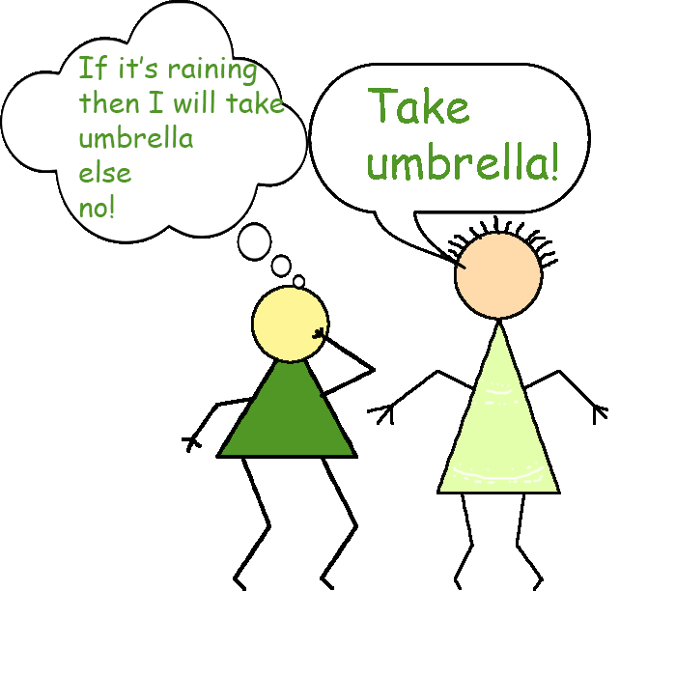
Conditional statements:
Decision making is required when we want to execute a code only if a certain condition is satisfied.
Only-if:
if (it is raining):
print(“take umbrella”)

Slide 14

If-else statement:
When we also want to perform some other action even if condition is false.
if (work finished):
print(“go outside and play”)
else:
print(“complete your work”)
If (work finished):
print(“play”)
Else: print(“do your
work”)

Slide 15
Indentions in python:
Most of the programming languages like C, C++, Java use braces { } to define a block of code. Python uses indentation.
A code block (body of a function, loop etc.) starts with indentation and ends with the first unindented line. The amount of indentation is up to you, but it must be consistent throughout that block.
Generally four whitespaces are used for indentation.

Slide 16
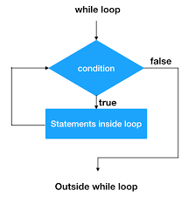
Repetation in python… while loop:

Slide 17
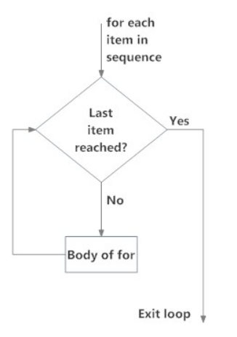
For loop…
A for loop is used for iterating over a sequence ( a list, a tuple, a dictionary or a string).

Slide 18
Functions:
A function is a block of code to do a specific task.
You can pass data, known as parameters, into a function.
Used for code reusability.

Slide 19
Parameterized function:
Information can be passed to functions as parameter.
Parameters are specified after the function name, inside the parentheses. You can add as many parameters as you want, just separate them with a comma.
To let a function return a value, use the return statement:

Slide 20
Syntax of functions:
Def function_name(parameters):
return statement
Def add(a,b):
return(a+b)

Slide 21


