Slide 1

AUTOMATES: AUTOMATA REIMAGINED
A JOURNEY THROUGH STATES WITH INTERACTIVE TOOLS & VISUAL SIMULATIONS
A WEB-BASED PLATFORM FOR LEARNING AND EXPLORING FINITE AUTOMATA
CREATED BY:
PRAGYA SRIVASTAVA
ASHMI BANSAL
ADITI MISHRA
B.TECH CSE 2ND YEAR
THEORY OF COMPUTATION PROJECT

Slide 2

PROBLEM STATEMENT
PAGE 01
OBJECTIVE:
To address the challenges of grasping complex Finite Automata by offering an intuitive and interactive web-based learning environment.
KEY ISSUES:
Lack of interactive tools for visualizing DFA, NFA, and related concepts
01
Difficulty in experimenting with automata processes (e.g., minimization, conversion)
02
Need for an accessible platform for students and educators
03
PROPOSED SOLUTION:
AutoMates is a web-based Finite Automata Simulator offering interactive simulations, real-time visualizations, hands-on experimentation, and integrated tutorials for DFA/NFA learning.

Slide 3
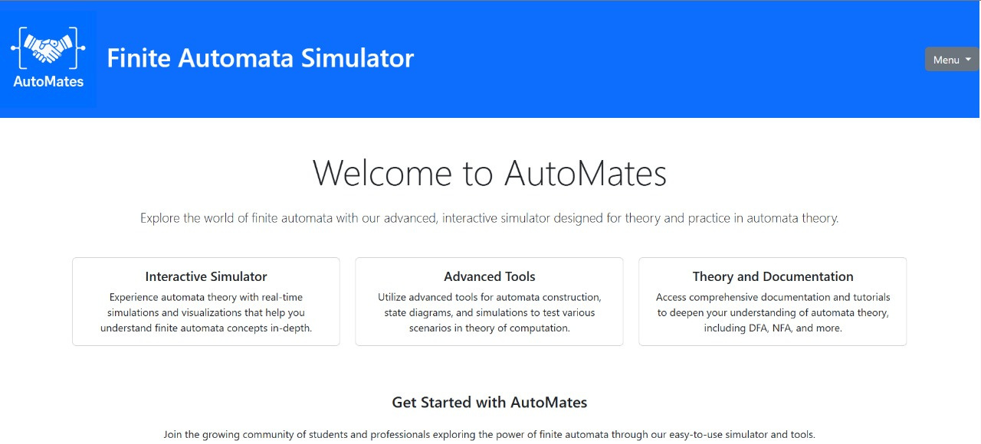
PROJECT OVERVIEW
PAGE 02
GOAL:
Develop a website with tools to simulate and visualize Finite Automata concepts
SCOPE:
01
Interactive simulations for DFA, NFA, regex, and more
02
Step-by-step visualizations for learning
03
User-friendly interface for students and educators
TARGET AUDIENCE:
B.Tech CSE students, Theory of Computation enthusiasts

Slide 4
STRATEGIES TO ADDRESS CHALLENGES
PAGE 03
01
02
03
CHALLENGES
COMPLEX ALGORITHMS
CROSS-BROWSER COMPATIBILITY
UI INTUITIVENESS
Use well-documented libraries and reference materials
Modular coding for easier debugging
Test on Chrome, Firefox, and Safari
Use standardized web technologies
Conduct user testing with peers
Iterate based on feedback
RISK MITIGATION:
Prioritize core features for MVP
Maintain regular backups and version control
01
02

Slide 5
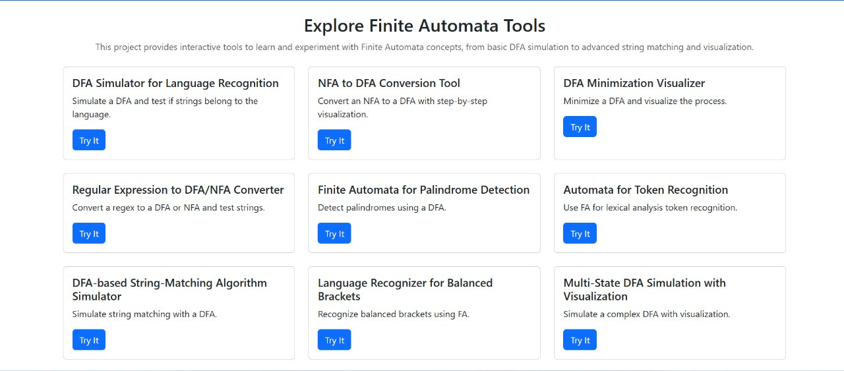
KEY FEATURES
PAGE 04
CORE TOOLS:
DFA Simulator for language recognition
NFA to DFA conversion with visualization
DFA Minimization Visualizer
Regex to DFA/NFA Converter
Palindrome and Balanced Brackets Detection
String Matching and Token Recognition
CFG to Normal Form (CNF/GNF)
ADDITIONAL FEATURES:
01
Multi-State DFA Simulation
02
Probabilistic FA Exploration

Slide 6
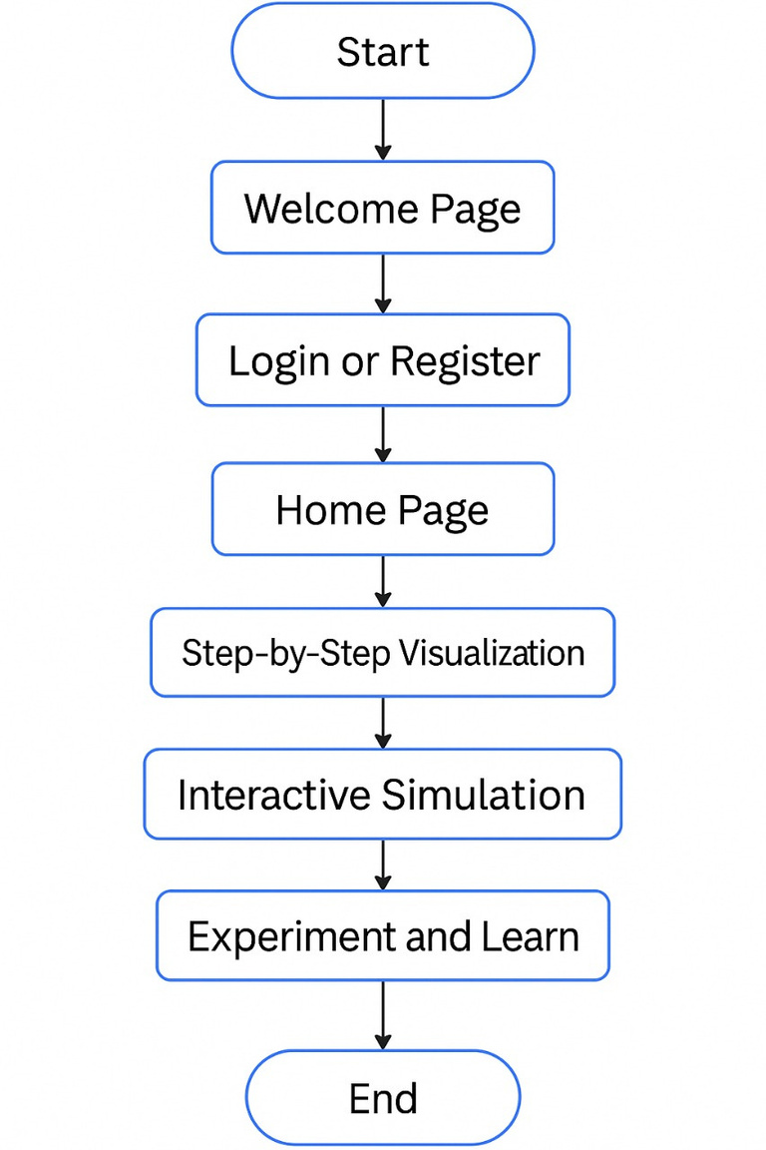
PROPOSED SOLUTION
PAGE 05
SOLUTION:
A web-based platform hosting a suite of Finite Automata tools
APPROACH:
01
Interactive simulations with real-time feedback
02
Step-by-step visualizations for complex processes
03
Modular design for easy tool addition
USER BENEFITS:
01
Enhanced understanding through hands-on experimentation
02
Accessible learning for Theory of Computation

Slide 7
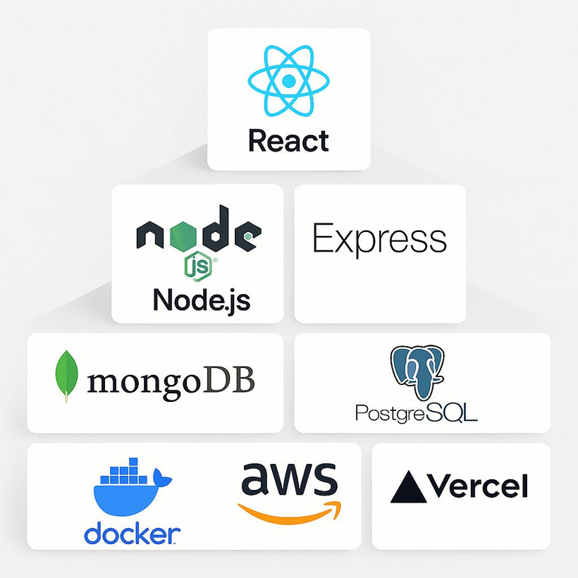




TECHNOLOGIES TO BE USED
PAGE 06
FRONTEND:
01
HTML and CSS
02
Bootstrap for dynamic UI
03
D3.js for visualizations
BACKEND:
01
Node.js with Express.js
02
Python (optional) for complex algorithms

Slide 8


FEASIBILITY AND VIABILITY
PAGE 07
FEASIBILITY: | CHALLENGES:
TECHNICAL: FEASIBLE WITH OPEN-SOURCE TOOLS AND STUDENT SKILLSET | COMPLEX ALGORITHM IMPLEMENTATION
ECONOMIC: LOW-COST DEVELOPMENT USING FREE PLATFORMS | ENSURING CROSS-BROWSER COMPATIBILITY
OPERATIONAL: MANAGEABLE WITHIN A SEMESTER | USER INTERFACE INTUITIVENESS
RISKS:
Time constraints for feature completion
Bugs in visualization logic

Slide 9
POTENTIAL IMPACT AND BENEFITS
PAGE 08
LONG-TERM VALUE:
IMPACT ON TARGET AUDIENCE:
01
Portfolio project for B.Tech students
01
Simplifies learning of Theory of Computation
Contribution to open-source education
02
02
Encourages hands-on experimentation
03
Supports educators with teaching aids
BENEFITS:
Interactive and engaging learning experience
Free and accessible to all students
Scalable for future enhancements (e.g., new tools)
01

Slide 10
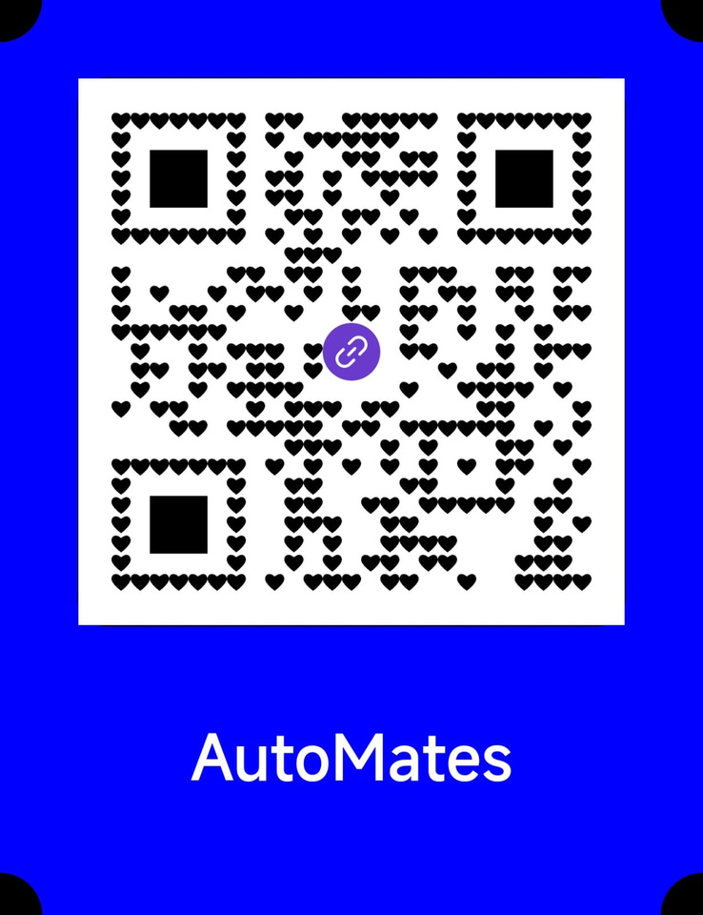
CONCLUSION
PAGE 09
SUMMARY:
CALL TO ACTION:
Finite Automata Simulator: A comprehensive toolset for learning automata
Try the Finite Automata Simulator at [Website URL]
01
02
Interactive, visualized, and student-friendly
03
Addresses key challenges in Theory of Computation
FUTURE SCOPE:
01
Add more tools (e.g., Turing Machine Simulator)
02
Mobile app version
02
Community contributions via open-source

Slide 11
THANK YOU
-TEAM AUTOMATES
02
02

