Slide 1
Face Swap Using Deep Learning
😂😉😋😒 😭

Slide 2

BY
Roselyn Lorson 101648
Tanya Jacob 101656
Pragya Verma 101661

Slide 3
Abstract
Face has been used as one of the mainstream manners for user identification. Recently, image synthesis technology such as face swapping have been receiving attention gradually. We are implementing Face Swap application where two peoples faces are automatically exchanged in real time.
We consider the problem of face swapping in real time camera. But we preserve the pose, facial expressions and lighting. This will allow the person in front of the camera to change their facial appearance.
The face swap is performed irrespective of the age, sex or ethnicity of the subject in front of the camera. This is intended for gaming, shopping, educational or entertainment purposes and will be presented in a real-time setup.

Slide 4

LITERATURE SURVEY

Slide 5

Fast Face-swap Using Convolutional Neural Networks By:- Iryna Korshunova, Wenzhe Shi ,Joni Dambre ,Lucas TheisIDLab, Ghent University The Image Blending Method For Face Swapping By:- Zhang Xingjie , Joongseok Song , Jong-Il Park Department of Computer Software Hanyang University, Seoul, Korea

Slide 6
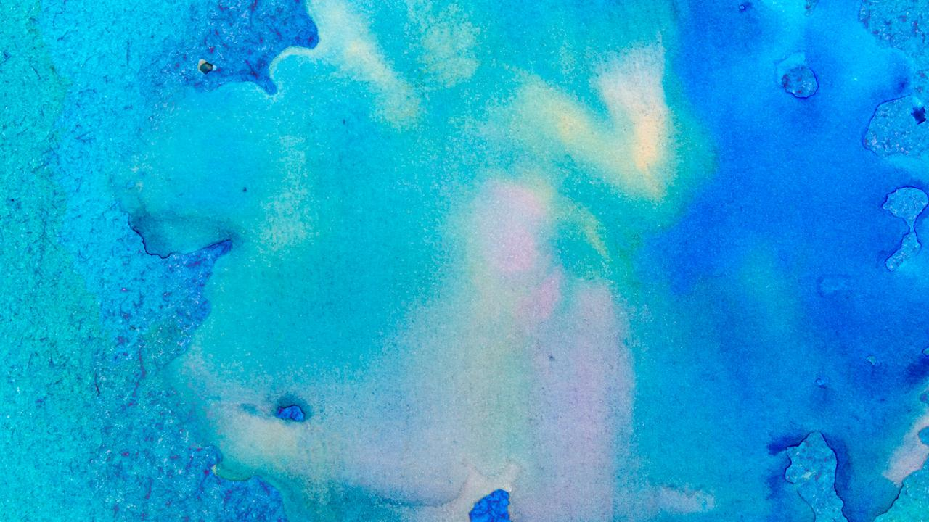
Who do you want to be? Real-
time face swap By:- Tim M.den UylH., Emrah Tasli, Paul Ivan, Mariska Snijdewin
Vicarious Perception Technologies, Amsterdam, The Netherlands
Deep Learning Based
Computer Generated Face
Identification Using
Convolutional Neural Network
By:- L. Minh Dang , Syed Ibrahim Hassan , Suhyeon Im , Jaecheol Lee , Sujin Lee and Hyeonjoon Moon
Department of Computer Science and Engineering, Sejong University, Seoul 143-747, Korea

Slide 7
What is Deep learning

Slide 8
Deep learning is an aspect of artificial intelligence (AI) that is concerned with emulating the learning approach that human beings use to gain certain types of knowledge. At its simplest, deep learning can be thought of as a way to automate predictive analytics.

Slide 9
Basic concept
Algorithms and functions used

Slide 10

Let’s review some concepts
Harr cascade
It is classifier which is used to detect the object for which it has been trained for from the source.
Open CV
It is an open source computer vision and machine learning software library. It was built to provide a common infrastructure for computer vision applications
Functions of cv2 used
videoCapture
cvtColor
rectangle
resize
imshow
Functions of harrcascade
CascadeClassifier
detectMultiscale

Slide 11
Face Swap

Slide 12
Our process is easy
First:
Face Detection
Second:
Cropping the faces
Last:
Swapping the cropped faces

Slide 13
Difficulties in Face Swap
Facial Geometry varies a bit in every other face.
Lighting on the face combined with tome of the skin can make images look very different.
Pose of the face can vary significantly.
Texture of the skin can vary from smooth to almost leathery.

Slide 14

A picture is worth a thousand words

Slide 15
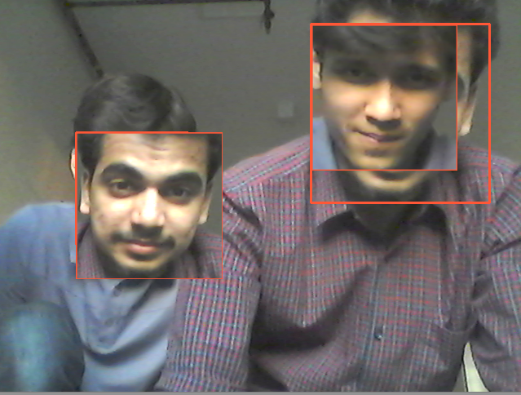
😸
😸
Place your screenshot here
VOILA!!!
Picture after swapping!!!!

Slide 16
Thanks!

