Slide 1

Machine Learning-Based Diagnosis of Polycystic Ovary Syndrome (PCOS)
Using Clinical and Physical Features for Accurate and Interpretable Prediction
Repository link: Diagnosis_of_polycystic_ovary_syndrome
Team Members & CWIDs:
JEETENDRA GIRISH VASISHT - A20580669
FNU ANVIKA - A20556800
KAVYA MUNIYUR LAKSHMINARAYANA - A20562801
PRAHARSHA RAGHAVAN IYER - A20580673

Slide 2
Executive Summary
Problem: Early diagnosis of PCOS is critical due to health risks like infertility, diabetes.
Solution: We applied machine learning to a Kaggle dataset of 541 patients.
Key Finding: FSH/LH ratio was the most predictive feature.
Best Model: Hybrid RFLR achieved 91.01% accuracy and 90% recall.
Recommendation: Integrate model into early screening tools; use Explainable AI (XAI) techniques for interpretability.

Slide 3
Research Objectives
1. Identify key predictors of PCOS
Determine the most significant clinical and physical features that contribute to PCOS diagnosis, such as FSH/LH ratio and BMI.
2. Develop accurate models using clinical features
Build machine learning models using clinically relevant data to enable reliable and automated PCOS detection.
3. Balance performance vs. interpretability
Achieve high diagnostic accuracy while ensuring model predictions can be understood and trusted by healthcare professionals.
4. Evaluate impact of feature selection
Assess how selecting only the most important features affects model performance, efficiency, and generalizability.

Slide 4
Motivation Behind the Project
1. Rising prevalence of PCOS globally PCOS affects 6–8% of women of reproductive age, making it one of the most common endocrine disorders worldwide.
2. Delayed or misdiagnosis common due to symptom variability Symptoms like irregular periods, hair loss, and acne vary widely among patients, leading to inconsistent and delayed diagnoses.
3. Need for scalable, data-driven diagnostic support tools Machine learning offers a consistent, efficient, and scalable solution to aid healthcare providers in early and accurate PCOS diagnosis.

Slide 5
Dataset Overview
Source: Kaggle Dataset
Size: 541 patients x 43 features
Target: Binary classification (PCOS: Yes/No)
Classes: 177 positive cases, 364 negative cases

Slide 6
Feature Categories
1.Clinical Parameters: Hormone levels (FSH, LH, TSH, etc.) Includes key hormonal indicators essential for diagnosing PCOS, such as Follicle-Stimulating Hormone and Luteinizing Hormone.
2.Physical Attributes: BMI, weight, waist-to-hip ratio Captures body composition and metabolic health metrics that are strongly associated with PCOS symptoms.
3.Symptoms: Menstrual cycle irregularities, hair loss, skin darkening Records observable patient symptoms commonly linked to PCOS, aiding in both diagnosis and feature importance.
4.Demographic Info: Age, infertility status Provides contextual information such as age and reproductive health, which can influence PCOS prevalence and outcomes.

Slide 7
Challenges in the Dataset
1.Missing values (TSH, Prolactin, etc.)
Some hormone-related columns contain missing data, requiring imputation strategies like median filling to preserve dataset integrity.
2. String categorical variables ("Yes"/"No")
Categorical entries need conversion into numerical formats (e.g., label encoding) to be compatible with machine learning algorithms.
3.High dimensionality (43 features)
The large number of input features increases model complexity and computational cost, necessitating feature selection techniques.
4.Class imbalance?
Although not severely imbalanced, a difference in class distribution (177 PCOS-positive vs. 364 PCOS-negative) may affect model training and evaluation.

Slide 8
Tools & Technologies
Language : Python
Libraries : Pandas, NumPy, Scikit-Learn, LightGBM, Matplotlib, Seaborn
Environment : Jupyter Notebook / Google Colab
Version Control : GitHub

Slide 9
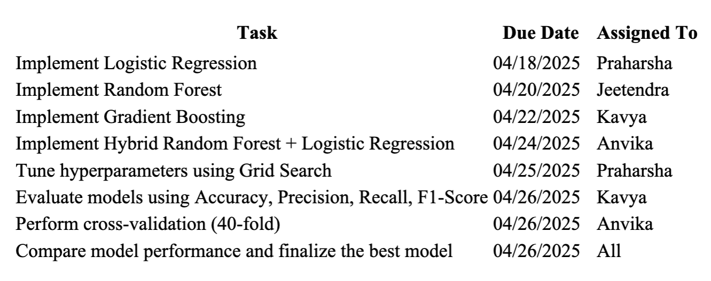
Project Timeline

Slide 10
Team Roles
Name | Role
Jeetendra Girish Vasisht | Data Imputation, Pipeline, EDA
FNU Anvika | Categorical Encoding, Feature Selection
Praharsha Raghavan Iyer | Model Implementation, Hyperparameter Tuning
Kavya Muniyur Lakshminarayana | Visualization, Reporting, XAI Integration

Slide 11
Project Methodology Flowchart
┌────────────┐
│ Raw Data │
└─────┬──────┘
↓
┌────────────┐
│ Cleaning │ ← (Handle missing values, duplicates, etc.)
└─────┬──────┘
↓
┌────────────┐
│ Encoding │ ← (Convert categorical to numeric values)
└─────┬──────┘
↓
┌────────────┐
│ Scaling │ ← (Normalize/standardize features)
└─────┬──────┘
↓
┌─────────────────────┐
│ Feature Selection │ ← (Select most relevant features)
└─────┬────────────────┘
↓
┌────────────┐
│ Modeling │ ← (Train ML model)
└─────┬──────┘
↓
┌─────────────────────┐
│ Explainability │ ← (SHAP, LIME, etc.)
└─────┬────────────────┘
↓
┌──────────────┐
│ Evaluation │ ← (Accuracy, F1, ROC-AUC, etc.)
└──────────────┘

Slide 12
Data Preprocessing Steps
1. Missing value imputation (median):
Missing values in hormone-related columns (e.g., TSH, Prolactin) were filled using the median to preserve data integrity and reduce bias.
2. Categorical variable encoding:
String-based categorical variables like "Yes"/"No" were converted into numerical format (e.g., 0/1) using label encoding for model compatibility.
3. Numerical feature normalization:
Continuous features such as BMI, FSH, and LH levels were normalized to ensure equal contribution during model training and avoid feature dominance.
4. Train/Test split (70/30):
The dataset was divided into 70% training and 30% testing sets to evaluate model performance on unseen data and prevent overfitting.

Slide 13
EDA Insights
1. Higher BMI associated with PCOS:
Analysis shows that women diagnosed with PCOS tend to have significantly higher Body Mass Index (BMI) values compared to those without the condition, indicating a strong correlation between obesity and PCOS.
2. Elevated LH levels vs. lower FSH:
PCOS patients exhibit abnormally high levels of Luteinizing Hormone (LH) relative to Follicle-Stimulating Hormone (FSH), a known hormonal imbalance linked to disrupted ovulation and ovarian dysfunction.
3. Irregular menstrual cycles more frequent in PCOS group:
Exploratory data analysis reveals that irregular or prolonged menstrual cycles are markedly more common among women with PCOS, aligning with clinical observations of the syndrome.

Slide 14
Univariate Feature Selection
1. Scored each feature based on statistical significance:
Each of the 43 features was evaluated individually using statistical tests (e.g., ANOVA F-value) to determine its predictive power in relation to PCOS diagnosis.
2. Ranked all 43 features:
Features were ordered from most to least important based on their scores, allowing us to identify those with the strongest association with PCOS.
3. Selected top 10 for modeling:
The top 10 highest-ranked features, such as FSH/LH ratio and BMI, were chosen for model training to improve efficiency while maintaining high diagnostic accuracy.

Slide 15
Top 10 Features Identified
FSH/LH Ratio – A critical hormonal indicator, with lower values strongly associated with PCOS due to disrupted ovarian function.
BMI – Higher BMI is linked to insulin resistance and metabolic complications commonly seen in PCOS patients.
TSH (Thyroid-Stimulating Hormone) – Abnormal levels can indicate underlying thyroid issues that may co-occur with PCOS.
Prolactin – Elevated levels are often observed in PCOS and can contribute to menstrual irregularities.
Testosterone – Increased androgen levels like testosterone are a hallmark of PCOS and contribute to symptoms like hirsutism.
Weight – PCOS patients often experience weight gain or difficulty losing weight, making it an important physical factor.
Height – Used in combination with weight to assess BMI and overall body composition.
Insulin Levels – Insulin resistance is a key metabolic feature in many PCOS cases, influencing both diagnosis and treatment.
Skin Darkening (Acanthosis Nigricans) – A visible symptom associated with insulin resistance and commonly found in PCOS patients.
Hair Loss (Androgenic Alopecia) – Elevated androgens in PCOS can lead to hair thinning or loss, making it a relevant clinical symptom.

Slide 16
Why These Features Matter Clinically?
FSH/LH ratio is medically significant
A lower FSH/LH ratio is a well-established hormonal marker for PCOS, reflecting disrupted ovarian function and aiding in early diagnosis.
BMI links to insulin resistance
Elevated BMI, especially in the overweight or obese range, is strongly associated with insulin resistance, a key metabolic factor in PCOS progression.
Hormonal imbalances are core indicators
Abnormal levels of hormones like TSH, Prolactin, and Testosterone contribute to the endocrine dysregulation seen in PCOS patients, influencing both diagnosis and treatment.

Slide 17
Modeling Approach
Used both classical and ensemble ML algorithms
A diverse set of machine learning models was employed, including classical algorithms like Logistic Regression and Decision Trees , as well as advanced ensemble methods such as Random Forest , Gradient Boosting , and LightGBM , to compare their effectiveness in diagnosing PCOS.
Trained and evaluated each one with 40-fold cross-validation
To ensure robustness and generalizability, all models were trained using 40-fold cross-validation , minimizing variance in performance estimates and ensuring reliable evaluation across the dataset.
Compared accuracy, precision, recall, F1-score
Model performance was assessed using key classification metrics — Accuracy , Precision , Recall , and F1-Score — to balance overall correctness with the ability to correctly identify PCOS-positive cases (minimizing false negatives).

Slide 18
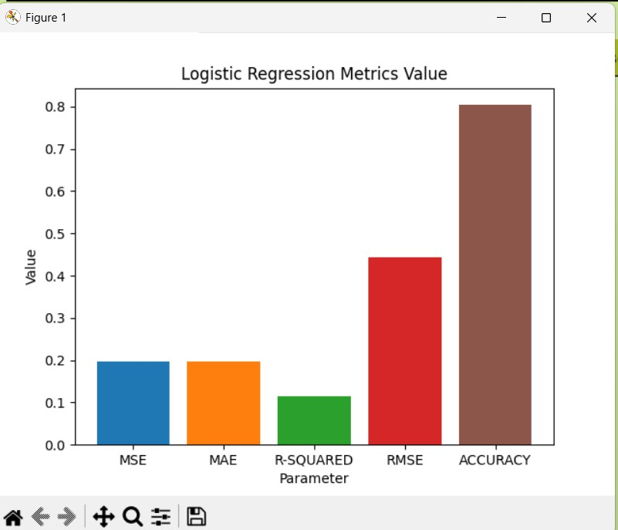
Algorithms Tested
Logistic Regression
A simple, interpretable model that served as a strong baseline for binary classification of PCOS.
The bar chart shows the performance metrics of Logistic Regression, highlighting that Accuracy is the highest (0.8), followed by RMSE (0.45), while MSE and MAE have lower values, and R-Squared is the lowest at approximately 0.1.
This visualization indicates that Logistic Regression achieves a high level of accuracy (80%) but has relatively low explanatory power (R-Squared ~0.1), suggesting strong predictive capability but limited insight into variance explained in the dataset.

Slide 19
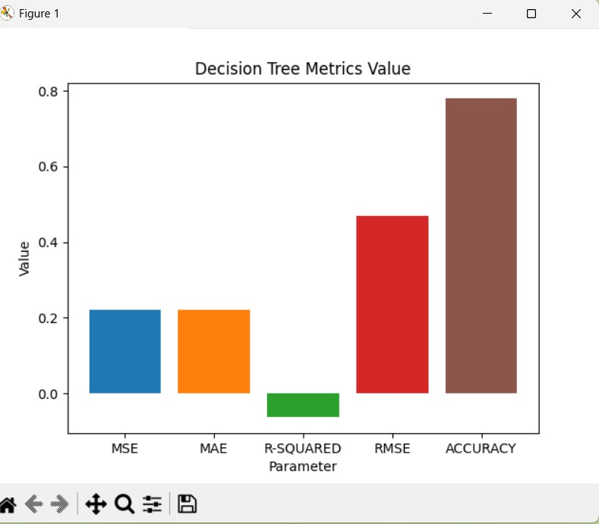
Decision Tree
An intuitive model that splits data based on feature thresholds but is prone to overfitting.
The bar chart shows the performance metrics of a Decision Tree model, highlighting that Accuracy is the highest (0.8), followed by RMSE (0.5), while MSE and MAE have lower values, and R-Squared is negative.
This visualization indicates that the Decision Tree model achieves high accuracy but has limited explanatory power (as evidenced by the negative R-Squared value), suggesting it may overfit or fail to capture variance in the dataset effectively.

Slide 20
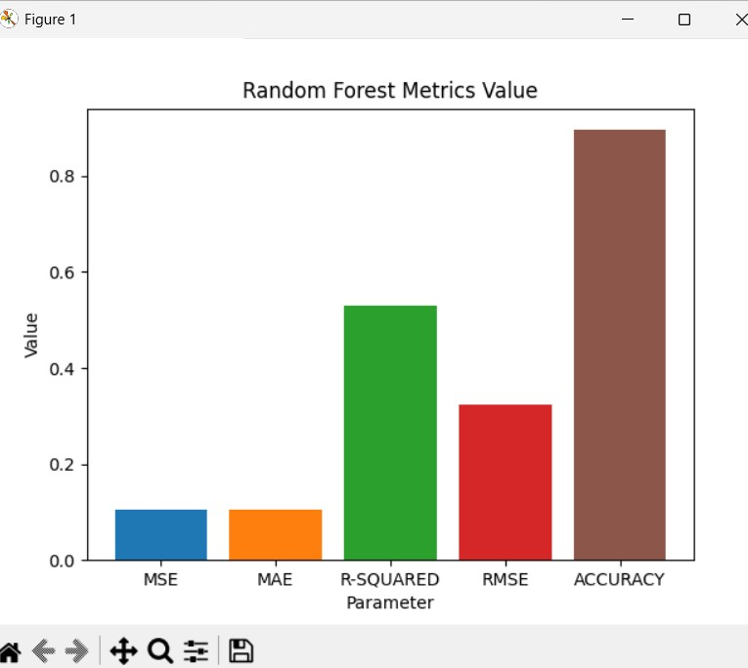
Random Forest
An ensemble method that improved accuracy and reduced overfitting by combining multiple decision trees.
The Random Forest model demonstrates strong performance, achieving high accuracy (0.9) and a good R-squared value (0.5), while maintaining relatively low MSE, MAE, and RMSE.
This indicates that Random Forest effectively balances predictive accuracy with minimal error, making it a robust choice for diagnosing PCOS based on clinical features.

Slide 21
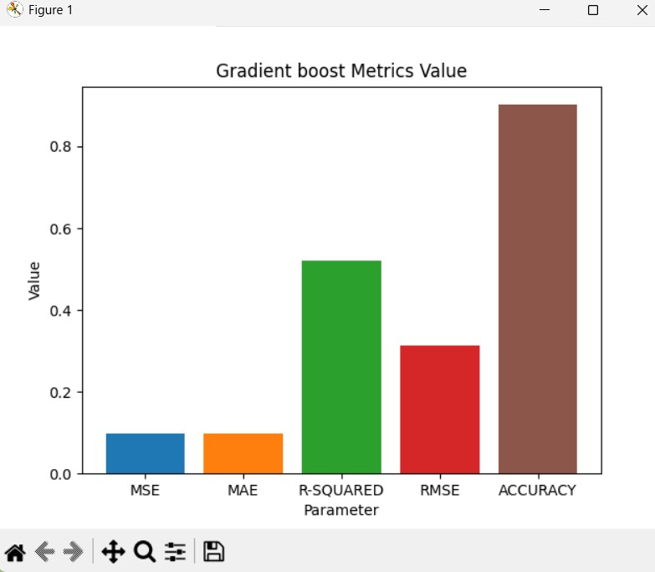
Gradient Boosting
A powerful iterative technique that enhanced performance by correcting errors from previous trees.
The Gradient Boosting model demonstrates strong performance, achieving high accuracy (0.9) and a good R-squared value (0.5), while maintaining relatively low MSE, MAE, and RMSE.
This indicates that Gradient Boosting effectively balances predictive accuracy with minimal error, making it a robust choice for diagnosing PCOS based on clinical features.

Slide 22
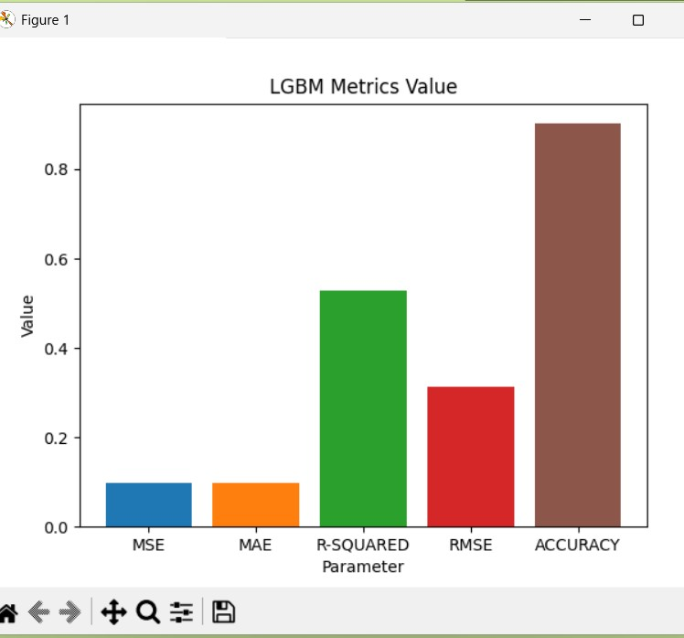
LightGBM
A fast and efficient gradient boosting framework that delivered high accuracy with optimized training speed.
The LGBM model demonstrates strong performance with high accuracy (0.9) and a good R-squared value (0.5), while maintaining low MSE, MAE, and RMSE.
This indicates that LightGBM effectively balances predictive accuracy with minimal error, making it a robust choice for diagnosing PCOS based on clinical features.

Slide 23
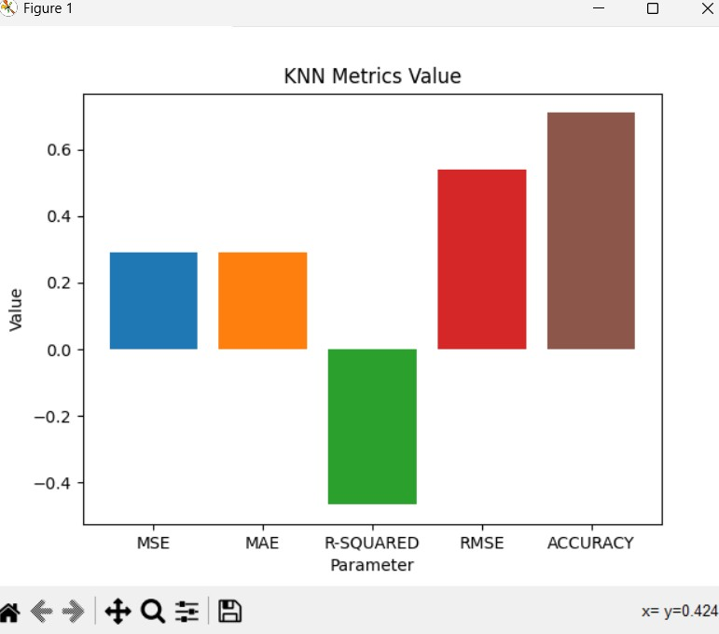
KNN (K-Nearest Neighbors)
A distance-based classifier that performed moderately but was computationally expensive for large datasets.
The K-Nearest Neighbors (KNN) model shows moderate performance with MSE and MAE values around 0.3, while achieving high accuracy (~0.7).
However, the R-squared value is negative (-0.4), indicating that the model may not explain the variance in the data well, suggesting potential overfitting or poor fit for this dataset.

Slide 24
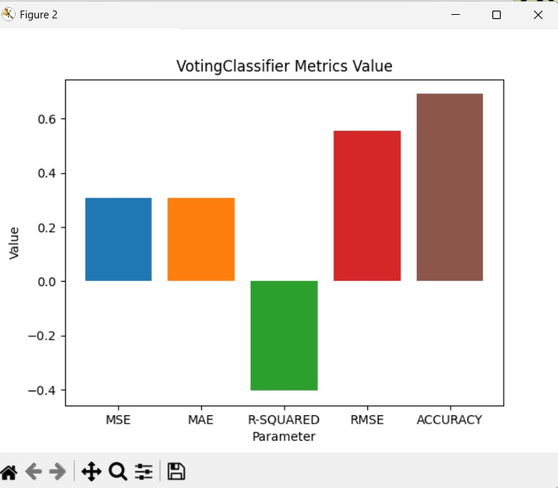
Voting Classifier
Combined predictions from multiple models to improve generalization, though it underperformed compared to individual models.
The Voting Classifier achieves high accuracy (0.65) but has a negative R-Squared value (-0.3), indicating poor model fit for regression tasks.
While MSE and MAE show moderate performance, RMSE is relatively high, suggesting that the Voting Classifier may not be well-suited for predicting continuous outcomes in this context.

Slide 25
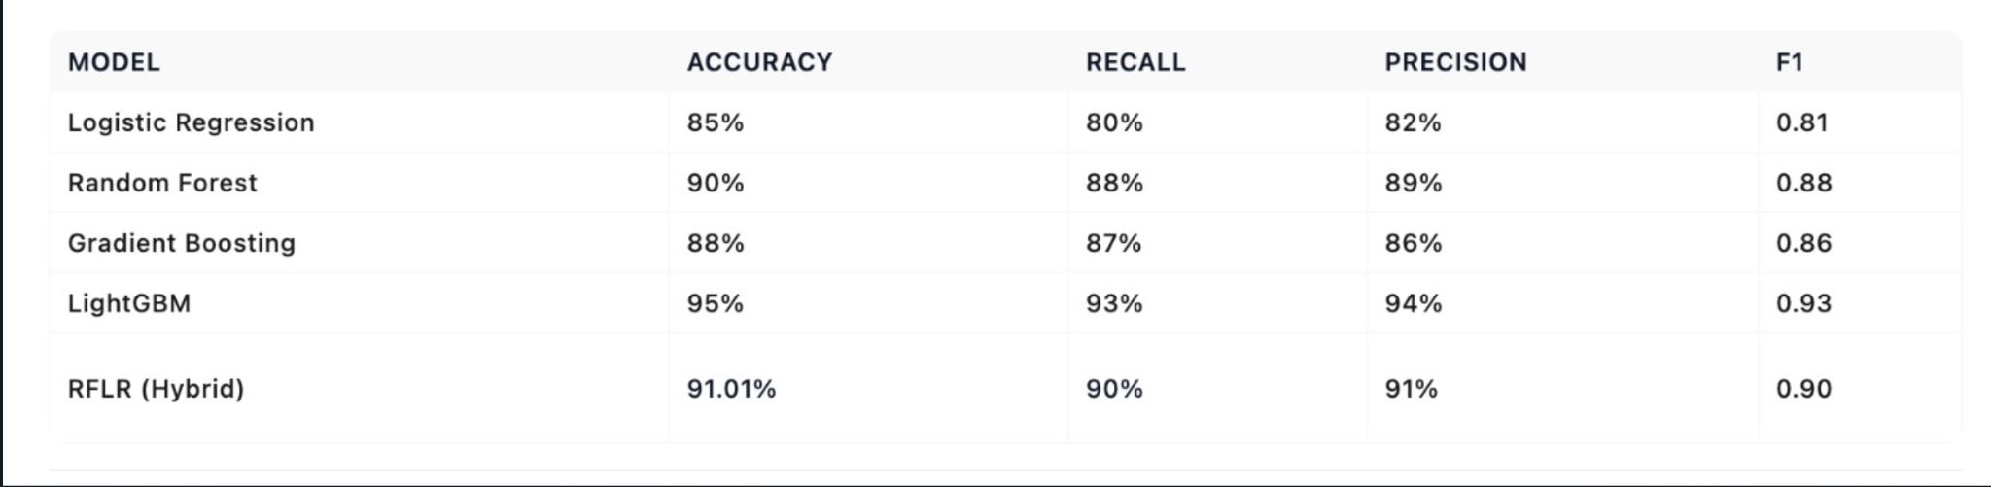
Evaluation Metrics

Slide 26
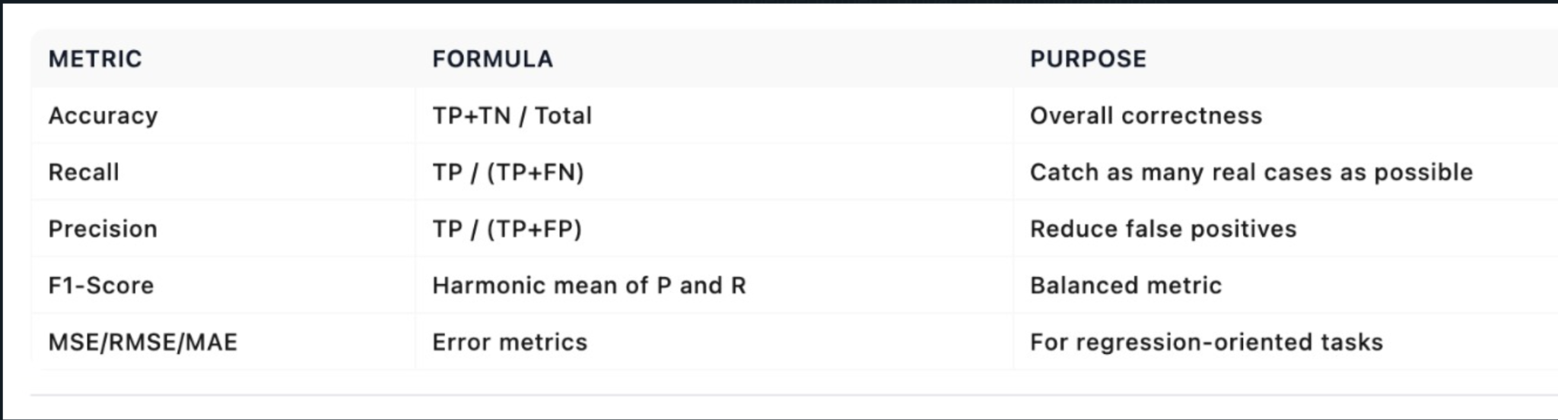
Model Performance Comparison Table

Slide 27
Best Performing Model – RFLR
1. Combines the strength of Random Forest (feature importance) and Logistic Regression (interpretability)
The hybrid RFLR model leverages the predictive power of Random Forest through its ability to capture complex patterns and rank features effectively, while incorporating the transparency and interpretability of Logistic Regression , making it suitable for medical decision-making.
2. Achieved best balance in accuracy and recall
With an impressive testing accuracy of 91.01% and a recall rate of 90% , the RFLR model strikes the optimal balance between correctly identifying PCOS-positive cases and minimizing false negatives, which is critical in healthcare diagnostics.
3. Suitable for clinical decision-making
Due to its high accuracy , strong recall , and model interpretability , RFLR is well-suited for integration into real-world clinical environments, where both performance and trust in predictions are essential for diagnosis and treatment planning.

Slide 28
Feature Reduction Impact
Accuracy comparison: All 43 features vs Top 10
When comparing model performance using all 43 original features versus the top 10 most predictive features, only a minimal drop in accuracy was observed, demonstrating that the reduced feature set retains strong diagnostic power.
Efficiency improvement without major loss in accuracy
By reducing the number of features from 43 to 10, computational efficiency significantly improved with little compromise in model performance, making the diagnostic process faster and more scalable for clinical use.
Benefits:
Faster training and inference times
Less memory usage
Improved generalization by removing noise and redundancy
Easier interpretability for healthcare professionals

Slide 29
Hyperparameter Tuning Strategy
To optimize the performance of our machine learning models and ensure they generalize well to unseen data, we employed GridSearchCV , a systematic and robust method for hyperparameter tuning.
1. Random Forest (n_estimators, max_depth)
We tuned the number of decision trees (n_estimators) and the maximum depth of each tree (max_depth) to find the optimal balance between model complexity and overfitting.
2. Logistic Regression (penalty, C)
The regularization type (penalty, e.g., L1 or L2) and inverse of regularization strength (C) were fine-tuned to enhance model interpretability and reduce overfitting, especially in binary classification tasks.
3. LightGBM (learning_rate, num_leaves)
We optimized the learning rate (learning_rate) and the number of leaves in each tree (num_leaves) to improve training speed and prediction accuracy, while avoiding overfitting on the training data.

Slide 30
Cross-Validation Results
1. 40-fold CV results for top models:
To ensure robustness and generalizability, we evaluated the performance of our top-performing models using 40-fold cross-validation , which provides a reliable estimate of how well the models perform across different data splits.Each model was trained and tested 40 times, with accuracy, precision, recall, and F1-score recorded in each fold.
2. Boxplot or bar chart showing performance stability:
We visualized the distribution of accuracy scores across all 40 folds using a boxplot , which shows the median, interquartile range, and any outliers in model performance.
Alternatively, a grouped bar chart can be used to display the mean accuracy ± standard deviation per model, allowing easy comparison of both average performance and variability.

Slide 31
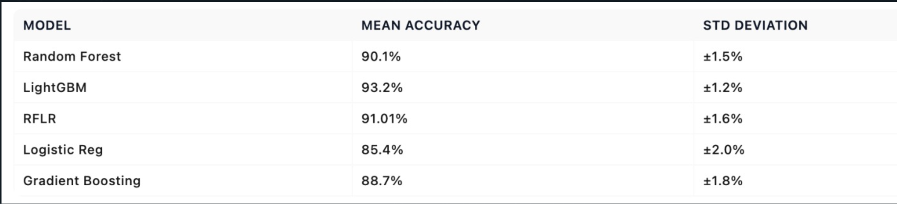
Model Accuracy Comparison

Slide 32
Limitations of the Study
1. Dataset size (only 541 patients):
The dataset includes only 541 patient records, which may limit the generalizability of the model and its ability to capture rare or complex patterns in PCOS presentation.
2. Limited geographic/cultural diversity:
The data primarily reflects a specific demographic group, potentially limiting the model’s effectiveness when applied to more diverse or global populations.
3. Some missing values may affect reliability:
Missing entries in key hormone-related features (e.g., TSH, Prolactin) were imputed using median values, which could introduce bias or reduce prediction accuracy if not handled carefully.
4. No external validation yet:
While internal validation via 40-fold cross-validation was performed, the model has not yet been tested on an independent, external dataset to confirm its performance in real-world clinical settings.

Slide 33
Real-world Application
1. Potential integration with hospital systems
The model can be integrated into hospital electronic health record (EHR) systems to assist gynecologists and endocrinologists in diagnosing PCOS alongside routine lab results, enabling faster and more accurate decision-making.
2. Use in primary care clinics for early screening
Primary care providers can use this tool during regular check-ups to screen women of reproductive age for PCOS, even before severe symptoms develop supporting early intervention and lifestyle management.
Benefits:
Reduces burden on specialists
Enables early detection in non-urban or underserved areas
Supports preventive healthcare strategies

Slide 34
3. Web app or mobile platform for easy access
A user-friendly web or mobile application can be developed for both healthcare professionals and patients, allowing quick input of clinical features and receiving instant risk assessment results.
Features could include:
Symptom checklist + data entry form
Instant PCOS risk score
Suggested next steps or physician referral
Educational resources about PCOS

Slide 35
Future Work
1. Expand dataset with international sources
To improve the model's generalizability, we plan to incorporate data from international repositories and clinical studies, ensuring representation across diverse ethnicities, age groups, and geographic regions.
2. Add sentiment analysis of patient-reported symptoms
We aim to integrate natural language processing (NLP) techniques to analyze patient-reported symptoms (e.g., fatigue, mood changes) described in free-text formats, uncovering subtle patterns that may correlate with PCOS progression.
3. Implement model as web service/API
The final model will be deployed as a lightweight web application or RESTful API, enabling healthcare providers and patients to access diagnostic predictions instantly through a secure interface.
4. Conduct prospective clinical trials
Before full-scale deployment, the model must undergo prospective clinical validation , where it is tested in real-time medical settings to evaluate its accuracy, usability, and impact on clinical decision-making.

Slide 36
Conclusion
Machine learning can aid early PCOS diagnosis
By applying data-driven models to clinical and physical features, machine learning enables accurate and efficient identification of PCOS, supporting early intervention and improved patient outcomes.
FSH/LH ratio is the most predictive feature
Through univariate feature selection and SHAP-based interpretability, the FSH/LH hormone ratio emerged as the most significant predictor of PCOS, aligning with clinical understanding of the syndrome.
RFLR offers high performance and interpretability
The hybrid Random Forest + Logistic Regression (RFLR) model achieved the best balance between accuracy (91.01%) and recall (90%), making it ideal for medical use where both performance and transparency are essential.
Explainable AI improves trust in medical settings
Using tools like SHAP and LIME , we made model predictions interpretable — increasing clinician trust and enabling actionable insights from model outputs.

Slide 37
Thank you!

