Slide 1
Inheritance
Inheritance is a feature or a process in which ,
new classes are created from the existing classes.
NOTE:
The new class created is called “derived class”
The existing class is known as the base class

Slide 2
Syntax :-
Class Base
{
// members of class Base
};
Class Derived : public/protected/private Base
{
// members of class Derived
};

Slide 3
Features:-
The derived class object automatically inherit all the features of the base class.
A class can be derived from different base classes.

Slide 4
Types of inheritance
Types of inheritance : 6 types
Single inheritance
Multi level Inheritance
Multiple inheritance
Hybrid inheritance
Hierarchical Inheritance
Multipath Inheritance

Slide 5
Types of Inheritance :
Single Inheritance
Derived class is inherited by only one base class.
Syntax:
class A
{
-----
};
Class B : moi A
{
-----
};
Base
Derived

Slide 6
inheritance
Size of derived class object = Base class
Datamember
+
derived class
data member
Size of base class object = Base class datamember

Slide 7
Advantages of inheritance
Code reusability and Extensibility
Abilitly to add extra features to the derived class without disturbing the base class.

Slide 8
Conversion table in inheritance
Base
Access
specifier
At Derived class mode of inheritance
public
protected
private
public
public
protected
private
protected
protected
protected
private
private
Can't be
inheritable
Can't be
inheritable
Can't be
inheritable
public -----> low level security
Note : Can't be inherited
means, can't be accessible
in derived class. But there
is a copy of base class private
member in derived class.
protected -----> high level security
private -----> very high level security

Slide 9
Constructor and Destructors in inheritance
Even though constructors and destructors can’t be inherited,the derived class will call
constructors and destructors of base class

Slide 10
Why constructor and destructor can’t be inheritable?
Because the scope of constructors and destructors are belongs to same class

Slide 11
order of constructor and destructor
In inheritance ,constructor are executing from top to bottom [ base class to dervied class]
Destructors are executing from bottom to top
[derived class to base class]

Slide 12
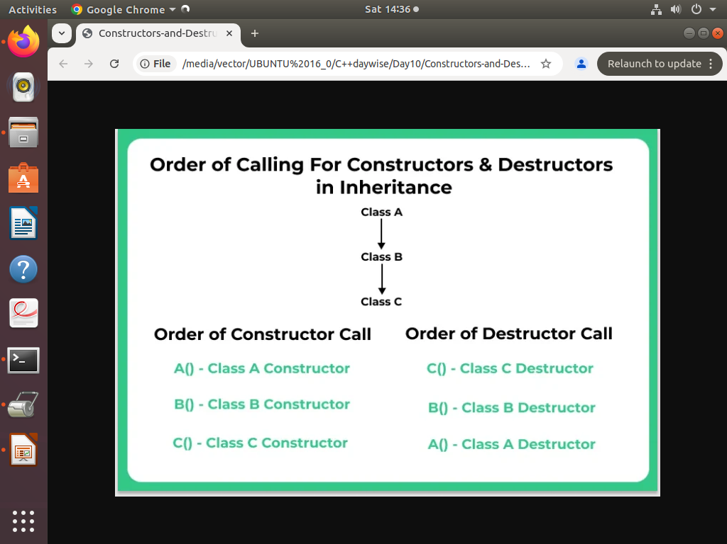

Slide 13
order of constructor and destructor
Every derived class constructor will have base class constructor call as well as every derived class destructor will have base class destructor call
By default,Every derived class constructor will call impilict base class default constructor
Base class members should be initilialized with base class constructor only
Derived class member should be initilalized with derived class constructor only

Slide 14
Inheritance
NOTE:
for every derived class will call impilicitly only base class default constructor .
So,if we call parameterized constructor
Must we have to call explicitly the base class parameterized constructor.

Slide 15
Types of inheritance
Types of inheritance : 6 types
Single inheritance
Multi level Inheritance
Multiple inheritance
Hybrid inheritance
Hierarchical Inheritance
Multipath Inheritance

Slide 16
Types of Inheritance :
Single Inheritance
Derived class is inherited by only one base class.
Syntax:
class A
{
-----
};
Class B : moi A
{
-----
};
Base
Derived

Slide 17
Multi level Inheritance
Syntax:
class A
{
-----
};
Class B : moi A
{
-----
};
Class C : moi B
{
-----
};
Base
Derived2 class is inherited from another derived 1 class
Derived 1
Derived 2

Slide 18
3. Multiple inheritance: Derived class is inherited from more than one base class
base classes.
Syntax:
Class A
{
-----
};
Class B
{
-----
};
Class C
{
-----
};
Class D : moi A, moi B, moi C
{
-----
};
Base-1
Base-2
Base-3
Derived

Slide 19
4. Heirarchical inheritance: Derivation of multiple derived classes from same base class.
Base
Syntax:
Class A
{
-----
};
Class B : moi A
{
-----
};
Class C : moi A
{
-----
};
Class D : moi A
{
-----
};
Derived-1
Derived-2
Derived-3
Assignment :
Create the objects for B,C & D classes, initialize it
And display it.

Slide 20
5. Hybrid inheritance:
Base-1
Derived-1
Base-2
multilevel
single
Derived-11
Derivation of a class involving more than one form inheritance is called hybrid inheritance.

Slide 21
5. Hybrid inheritance:
Syntax:
Class A
{
-----
-----
};
Class B : moi A
{
-----
-----
};
Class C
{
-----
-----
};
Class D : moi B, moi C
{
-----
-----
};
A( )
{
}
Assignment :
Create the objects for D class, initialize it
And display it.
B( ):A( )
{
}
C( )
{
}
D( ):B( ),C( )
{
}

Slide 22
Multipath Inheritance
Derivation of a class from other derived classes which are derived from the same base class
Base
Derived 1
Derived 2
Derived 3

Slide 23
x
Syntax:
Class A
{
-----
-----
};
Class B : moi A
{
-----
-----
};
Class C : moi A
{
-----
-----
};
Class D : moi B, moi C
{
-----
-----
};
x
A
(x,y)
(x,z)
B
C
m
D

Slide 24
Virtual Base class
Virtual Base class is a class, which makes the single members copy from base class to final derived class in multipath inheritance. Virtual base class avoids duplication copy in final derived class.

Slide 25
x
Syntax:
Class A
{
-----
-----
};
Class B : virtual moi A
{
-----
-----
};
Class C : virtual moi A
{
-----
-----
};
Class D : moi B, moi C
{
-----
-----
};
x
A
y
z
B
C
(virtual)
(virtual)
m
D

Slide 26
Benefits of Inheritance :-
Code Reusability: This is one of the most powerful feature of inheritance. This is done by creating new derived class reusing the properties of the existing or base class.
Reliability: Reusing existing code saves time, money and effort and increases the reliability of a program.

