Slide 1

RECAP
The 'GIK Support' service reveals inconsistent trends over time, with variability in outcomes by service end, indicating unpredictable impacts on client scores.'System Navigation & Advocacy' demonstrates a tendency for client scores to improve by service conclusion, despite initial fluctuations, suggesting a generally positive effect on client outcomes.
It revealed the importance of customizing services based on gender, race, and case status to enhance service impact and satisfaction. It underscores the need for gender-specific and culturally responsive interventions to address the diverse needs of participants effectively.
Analysis of closed and active datasets focusing on individuals with high Secret Sauce indicator scores reveals consistent trends in service utilization. "Micro Counselling," "Financial Support," and "GIK Support" are prominently accessed services, underscoring the importance of effective system navigation and addressing health and counseling needs for this group.

Slide 2
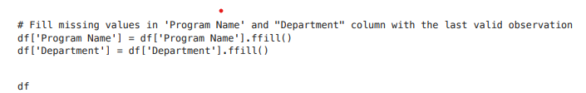
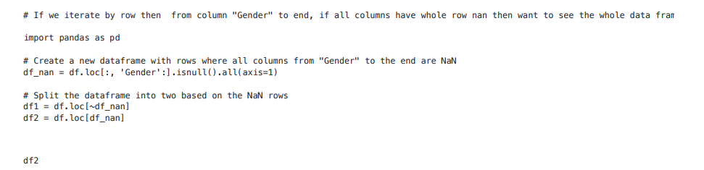
BUSINESS QUESTION
How do demographic factors influence participant engagement or outcomes in our programs?
Fig. 1
Fg. 2
Data quality ensured by dropping rows with all missing values from specified columns to address incomplete data entries.
Forward filling applied to 'Program Name' and 'Department' columns to ensure continuity in the data, addressing potential gaps.
Imputation strategies used for 'Age' and 'Gender' columns to handle missing data: median for 'Age' and mode for 'Gender'.
Rows with missing values in every column starting from "Gender" to the end stored in variable df2, allowing for targeted analysis or remedial actions on incomplete dataset entries.

Slide 3
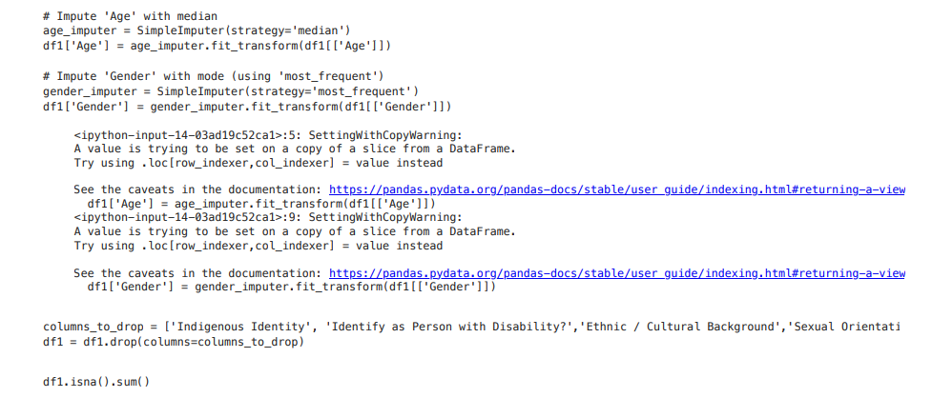
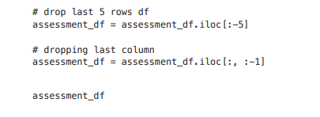
How do demographic factors influence participant engagement or outcomes in our programs?
Fig. 3
Fg. 4
DataFrame df1 undergoes data imputation for missing values in the "Age" and "Gender" columns.
Columns specified in the columns_to_drop list are removed from df1.
iloc indexer with slicing [:-5] utilized to remove the last 5 rows from the DataFrame, eliminating trailing records.
Operations contribute to refining the DataFrame by eliminating unnecessary rows and columns, potentially enhancing data quality and focus for further processing or analysis.

Slide 4
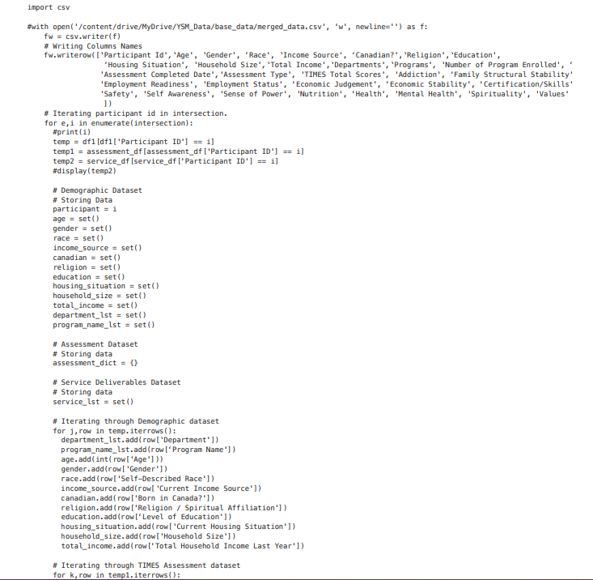
How do demographic factors influence participant engagement or outcomes in our programs?
Fig. 5 combines information from three distinct datasets: "Demographic," "Assessment," and "Service Deliverables,".
Distinct values for demographic characteristics such as age, gender, race, etc., are gathered during each iteration and stored in appropriate sets.
Efficiently combines several data sources into one file for thorough analysis and reporting.
Fig. 5

Slide 5
MODELLING
How do demographic factors influence participant engagement or outcomes in our programs?
Label Encoding used to convert categorical variables in DataFrame df into numerical format, crucial for most machine learning algorithms.
train_test_split function from scikit-learn divides dataset into training and testing sets, ensuring accurate reflection of data distribution.
Random Forest Regressor model initialized with 100 decision trees and trained on the training set using the fit approach.
Random Forest method builds multiple decision trees and aggregates predictions to increase accuracy and decrease overfitting.
Model applies predict technique to forecast the target variable ('Scaled Difference Score') for the test set.
Mean Squared Error (MSE) and R-squared (R2) score calculated to evaluate model performance.
Assessment metrics provide insights into model's suitability for precise predictions on new data and its effectiveness in reflecting underlying patterns.

Slide 6
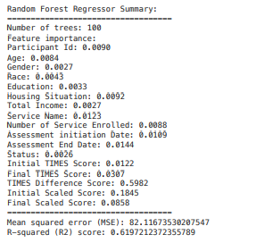

How do demographic factors influence participant engagement or outcomes in our programs?
Fig. 6
Mean Squared Error (MSE) value of approximately 82.12 indicates the average squared difference between actual and predicted values in the test set.
R-squared (R2) score of around 0.62 indicates the percentage of target variable's variance explained by independent variables in the model.
Summary evaluates effectiveness and significance of features in Random Forest Regressor model.
Model comprises 100 trees and utilizes "Scaled Difference Score" to determine feature importance in predicting target variable.
Feature significance values reveal relative impact of each feature on model predictions.
'TIMES Difference Score' holds highest significance (0.5982), followed by 'Initial Scaled Score' (0.1845) and 'Final Scaled Score' (0.0858).
'TIMES Difference Score' identified as feature with greatest influence on model's overall predictive performance.

Slide 7
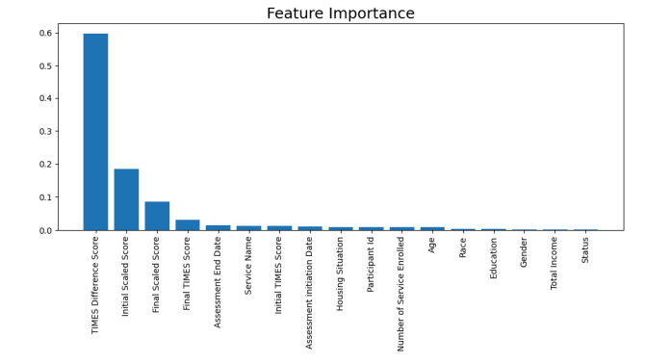
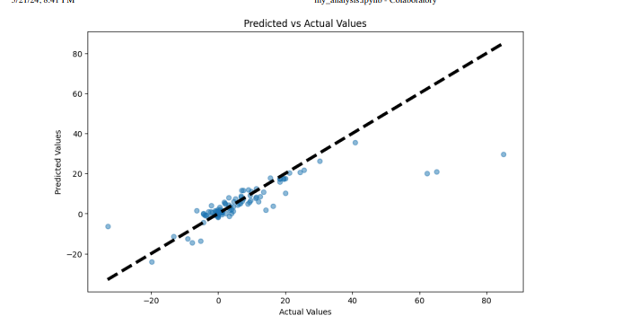
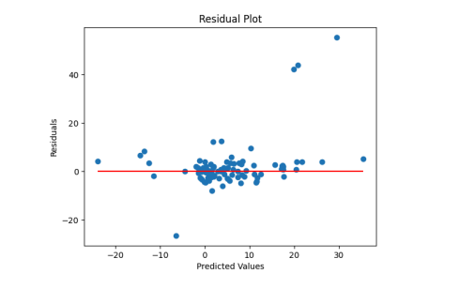
How do demographic factors influence participant engagement or outcomes in our programs?
Learning curve assesses performance of Random Forest Regressor model with various training data sizes.
RandomForestRegressor model initialized with 100 estimators.
Function calculates training and cross-validation scores for different training set sizes.
Parameters specified include train_sizes, score ('neg_mean_squared_error'), cv (number of cross-validation folds), and n_jobs (number of CPU cores to use, -1 for all available cores).
Fig. 7

Slide 8
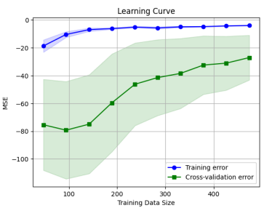
How do demographic factors influence participant engagement or outcomes in our programs?
High Bias: Both training error and cross-validation error are high, indicating strong bias in the model. It fails to accurately describe underlying patterns in the data.
Convergence of Errors: As training data increases, cross-validation and training errors converge, suggesting limited gains in model performance from additional data. Learning curve plateaus, indicating possible limit in complexity or features.
Stable Cross-Validation Error: Cross-validation error remains relatively constant despite increased data points, suggesting limited improvement in model's generalization capacity. Variation in performance on cross-validation set noted by wide shaded region, representing error variance.
Fig. 8

Slide 9
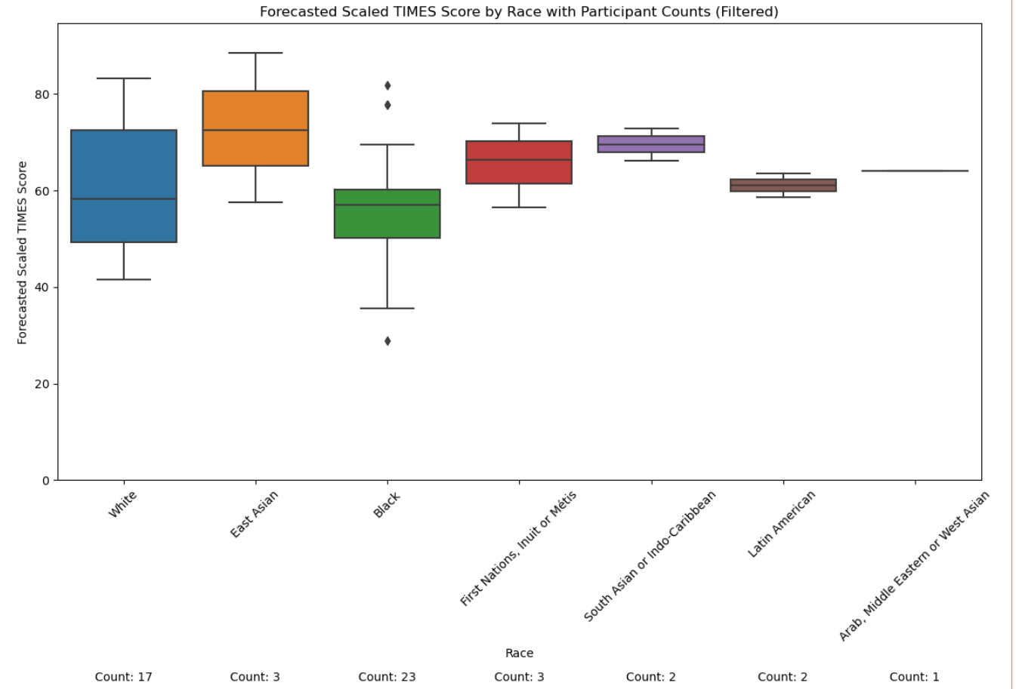
BUSINESS QUESTION 2
How can we identify participants at risk of decreased engagement and predict their future Scaled TIMES Scores, to inform targeted interventions and support measures?
Dataset comprises individuals whose scores have been decreasing. Data categorized by race for understanding intervention needs.
Black participants: highest representation (23 individuals).
White participants: second highest (17 individuals).
Least representation: Arab, Middle Eastern, or West Asian (only one participant).
Fig .9

Slide 10
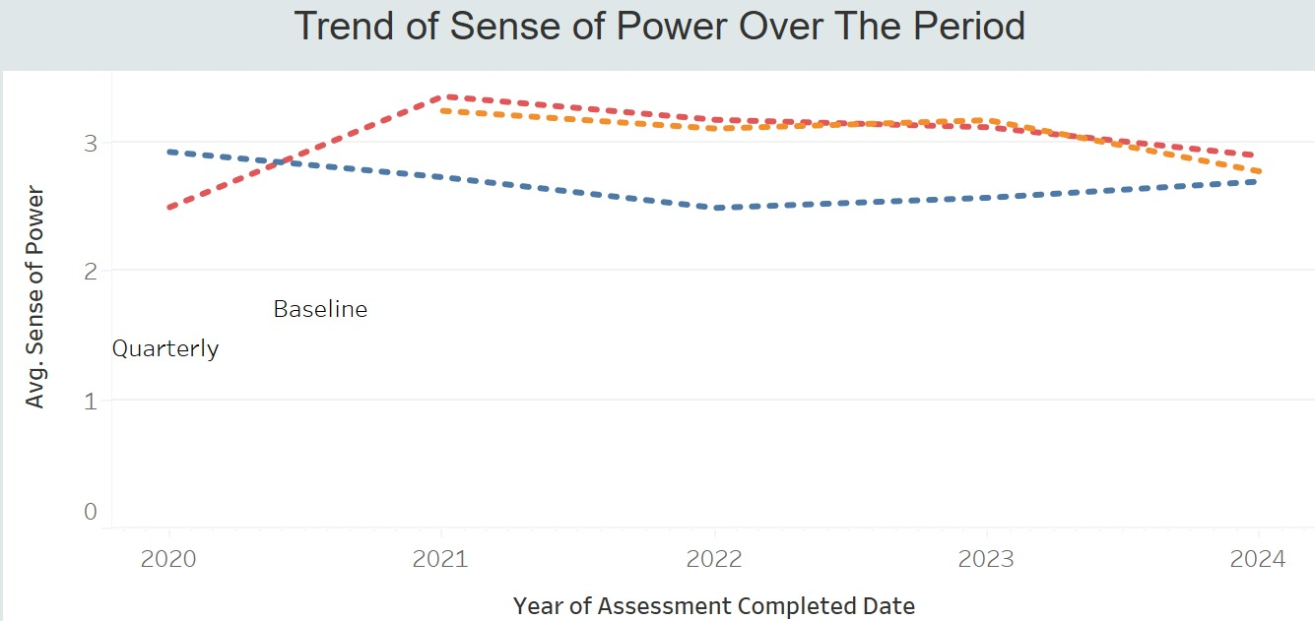
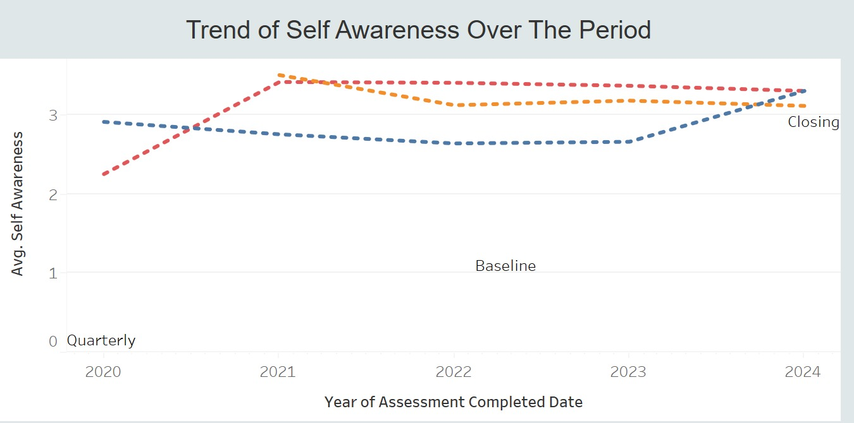
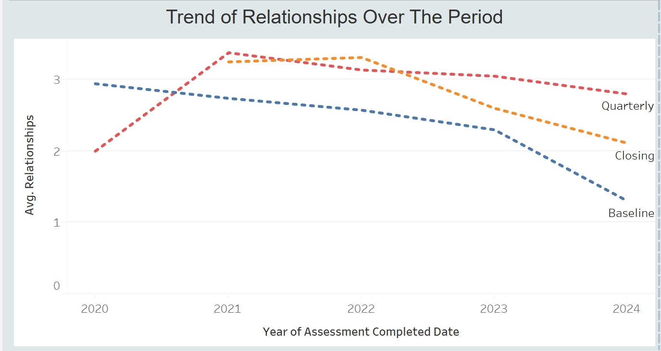
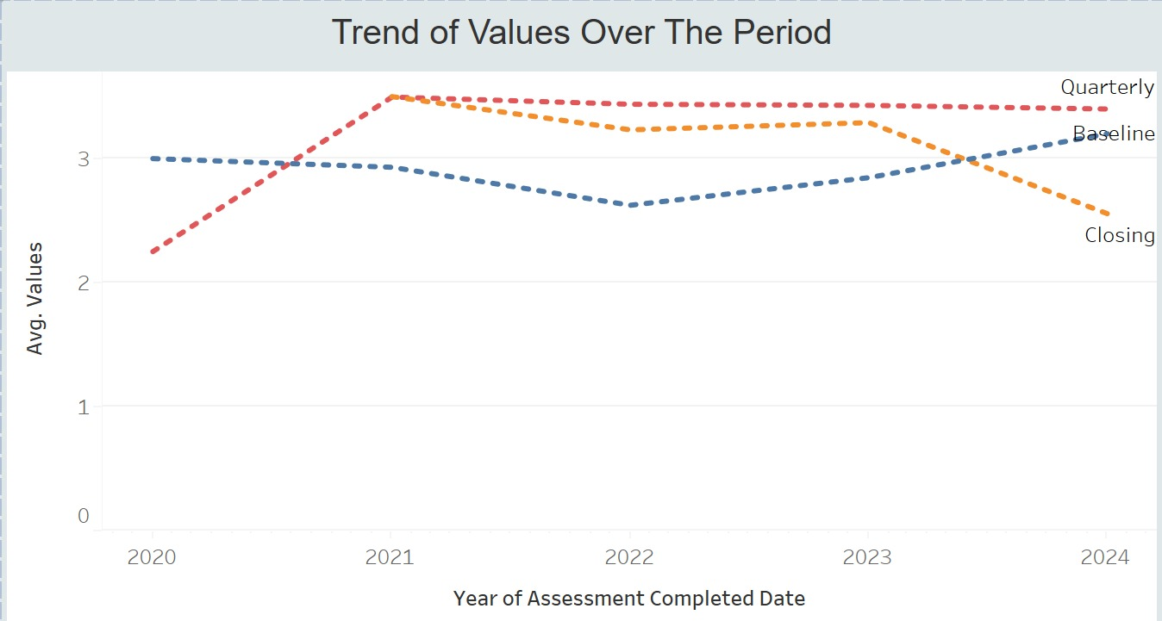
DASHBOARD

Slide 11
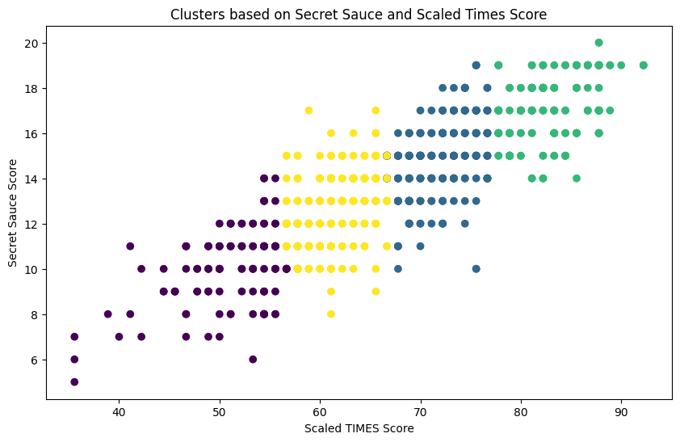
BUSINESS QUESTION 3
Secret Sauce VS TIME SCORE in different distributed groups, and to predict the cluster success rate
Cluster 0: Low Scaled Times Score, Low Secret Sauce Score
Cluster 1: High Scaled Times Score, Low Secret Sauce Score
Cluster 2: Low Scaled Times Score, High Secret Sauce Score
Cluster 3: High Scaled Times Score, High Secret Sauce Score
Fig. 10

Slide 12
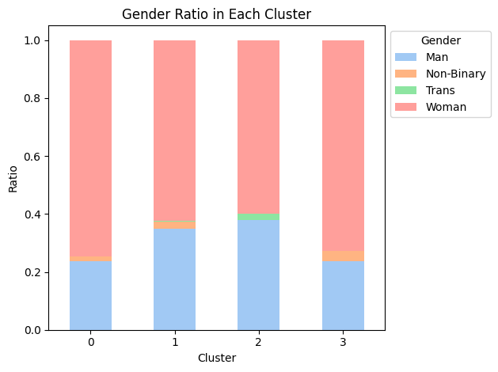
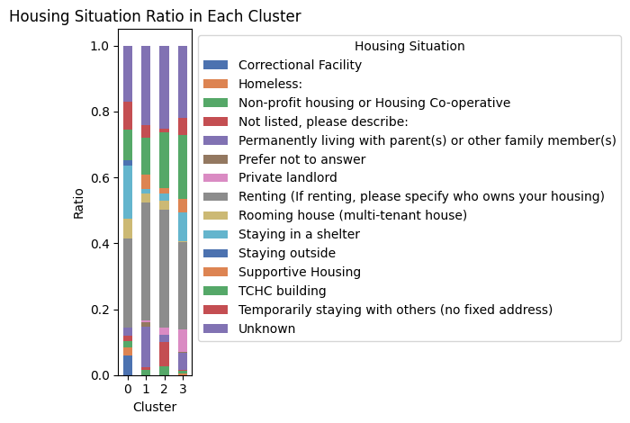
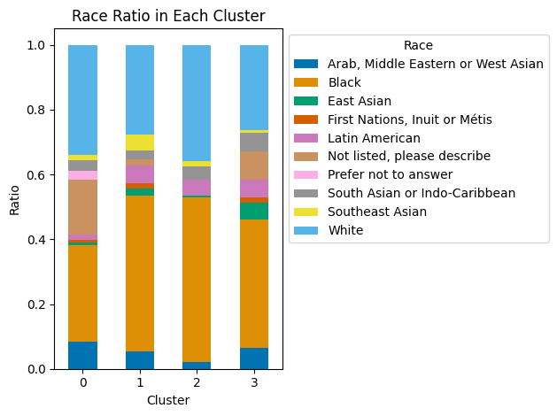
Secret Sauce VS TIME SCORE in different distributed groups, and to predict the cluster success rate
Fig. 11
Fig. 12
Cluster 0: Low Scaled Times Score, Low Secret Sauce Score
Cluster 1: High Scaled Times Score, Low Secret Sauce Score
Cluster 2: Low Scaled Times Score, High Secret Sauce Score
Cluster 3: High Scaled Times Score, High Secret Sauce Score
Fig. 13

Slide 13
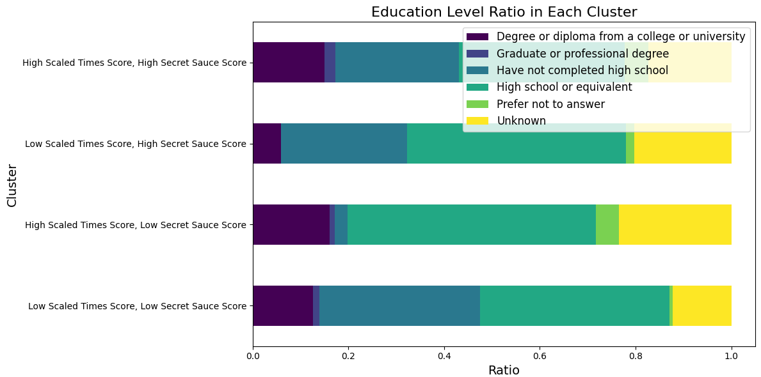
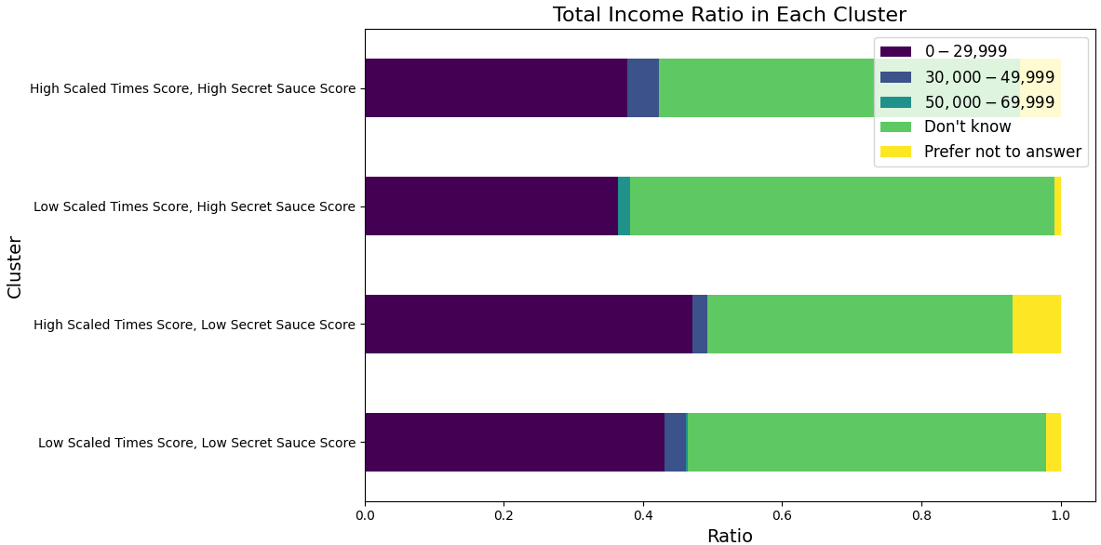
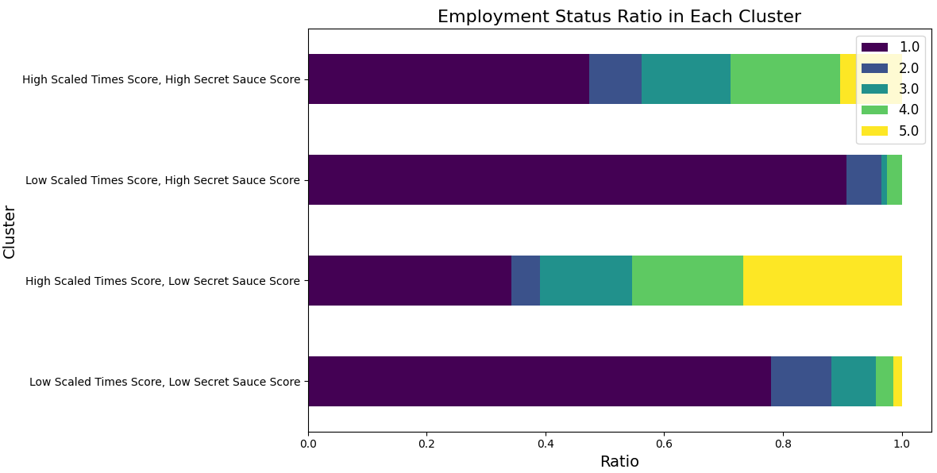
Secret Sauce VS TIME SCORE in different distributed groups, and to predict the cluster success rate
Fig. 14
Fig. 15
Cluster 0: Low Scaled Times Score, Low Secret Sauce Score
Cluster 1: High Scaled Times Score, Low Secret Sauce Score
Cluster 2: Low Scaled Times
Score, High Secret Sauce Score
Cluster 3: High Scaled Times Score, High Secret Sauce Score
Fig. 16

Slide 14
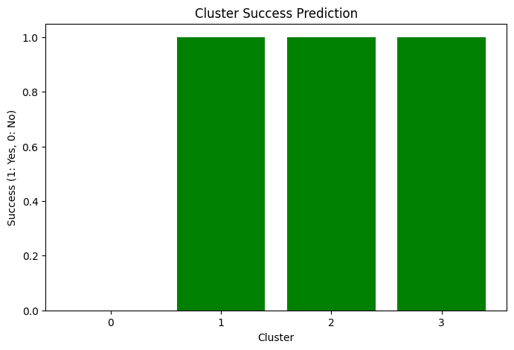
Secret Sauce VS TIME SCORE in different distributed groups, and to predict the cluster success rate
Cluster 0: Low Scaled Times Score, Low Secret Sauce Score
Cluster 1: High Scaled Times Score, Low Secret Sauce Score
Cluster 2: Low Scaled Times Score, High Secret Sauce Score
Cluster 3: High Scaled Times Score, High Secret Sauce Score
We used Random Forest for Prediction of Success Rate of each cluster.
Fig. 17

Slide 15

CONCLUSION
The Random Forest Regressor model achieved an MSE of approximately 82.12 and an R2 score of around 0.62, indicating moderate predictive performance.
Feature analysis revealed that the 'TIMES Difference Score' had the highest significance, followed by 'Initial Scaled Score' and 'Final Scaled Score', suggesting these features play crucial roles in predicting the target variable.
The integration of the Linear Regression model to predict declining Scaled TIMES Scores, particularly with its emphasis on demographic variables such as race, enables YSM to tailor interventions more precisely. By identifying and understanding the engagement trajectories of participants from diverse backgrounds, YSM can allocate resources more effectively and design support measures that are culturally and contextually sensitive, potentially enhancing participant outcomes and engagement.
From our analysis of the created clusters, we observe that clients classified as high_high, low_high, and high_low tend to show promising outcomes. To enhance their progress, we should implement various factors such as "Micro Counselling," "Financial Support," and "GIK Support" services within these clusters.

