Slide 1

PROJECT UDYAM DIGITAL · ENTERPRISE TRACK A
Accel Saathi
An AI business advisor that discovers, quotes, verifies and activates an MSME bundle in one sitting: on WhatsApp, in the owner's language.
7.4% → 16.5% activation
Live in ≤5 days, not 17.6
₹15k → ₹6.7k per SMB
Team buri buri zaimon · NIT Karnataka (NITK)
Prohorj Babu Bormon · Mubashir Afzal
Prototype + code: github.com/praharj123barman-glitch/airtel-sync-saathi
Notes:
Accel Saathi: a digital-first acquisition and onboarding journey for Accel Business. One conversation on the owner's phone replaces a 17.6-day, field-led process. The prototype is built and tested: a Voiceflow agent with five playbooks and eleven tested function tools, a demo site and a back-office page; the code is public on GitHub. All numbers in this deck come from our analysis of the case data pack (smb_leads.csv, product_catalogue.csv, mock registries).

Slide 2

01 THE PROBLEM
Only 7 in 100 MSME leads get activated, and over a third of drop-offs come from our own process, not from price or demand
Lead funnel, Apr–Jun 2026
% of previous stage
1,652 of 4,632 drop-offs (36%) are process failures we can remove
Leads generated
5,000
—
827
Stalled waiting for a sales visit
→ AI advisor, any time
Owner had no time 531 · visit never scheduled 296
Contacted
3,406
68%
385
Quote too slow or too complex
→ Instant one-price quote
Needs assessed
1,974
58%
3–5 day PDF full of product codes: 179 slow · 206 confusing
Quote accepted
861
← steepest drop in the funnel
44%
273
Stuck in KYC paperwork
→ Smart KYC
KYC complete
588
68%
Missing GST/Udyam 94 · too long 79 · signatory away 53 · mismatch 47
Activated
368
63%
167
Lost after KYC
→ Feasibility check + tracker
Install >21 days 98 · fibre not feasible 41 · first payment failed 28
17.6 days
₹15,053
3×
54%
of activated bundles held none of the products the owner asked about: pitches follow targets, not needs
22
activations (6%) went live on cancelled or suspended GSTINs that manual KYC let through
average from lead to activation
to acquire one SMB, vs a ₹6,900/mo median bundle
each customer chased status before going live
Source: team analysis of smb_leads.csv (5,000 synthetic leads, Apr–Jun 2026) and mock_gstin_registry.csv. Drop reasons grouped by the last stage reached; ‘process failures’ = reasons a digital journey removes directly.
Notes:
The demand is there: 5,000 leads a quarter. But only 368 activate. The biggest leak is between needs assessment and quote acceptance (44%). When we read the drop reasons, 1,652 of 4,632 losses are process failures: owners waiting for a visit, slow or confusing quotes, paperwork, and installs that slip past 21 days. Two hidden costs: in 54% of activations the bundle sold contained none of what the owner asked for, and 22 activations went live on cancelled or suspended GSTINs.

Slide 3
02 WHO WE WIN FIRST, WITH WHAT BUNDLE
Go digital-first with offices and micro retail; point the field force at the 21% of leads that bring 73% of new revenue
Professional offices
Micro retail & services
Small multi-site
Small manufacturers
25% of leads · clinics, CA firms, coaching
54% of leads · kirana, salon, pharmacy
15% of leads · 3–10 store chains
6% of leads · auto parts, textiles
WAVE 1 · DIGITAL-FIRST
WAVE 1 · ZERO-TOUCH
WAVE 2 · DIGITAL-ASSISTED
FIELD-LED · SAATHI TOOLS
Activation rate
11.1%
Activation rate
4.1%
Activation rate
11.0%
Activation rate
12.8%
Median bundle / month
₹6,575
Median bundle / month
₹2,470
Median bundle / month
₹28,080
Median bundle / month
₹15,910
Cost per activation
₹10,695
Cost per activation
₹20,007
Cost per activation
₹15,614
Cost per activation
₹15,324
Months of revenue to repay CAC
1.6
Months of revenue to repay CAC
8.1
Months of revenue to repay CAC
0.6
Months of revenue to repay CAC
1.0
6-month churn
13.8%
6-month churn
22.7%
6-month churn
10.8%
6-month churn
8.1%
OFFICE PRO
DUKAAN DIGITAL
CHAIN CONNECT
FACTORY ASSURED
₹4,815–6,138/mo
from ₹1,198/mo
≈₹2,500/site/mo
₹15,260/mo
Biz Fibre 300 + 4G/5G failover · 2–3 business postpaid · cloud email and endpoint security per desk · 1 TB backup
5G AirFiber (live in 2 days) or Biz Fibre 100 · 1–2 business postpaid · add Cloud POS, CCTV, WhatsApp catalogue
Per site: Biz Fibre 100, failover, secure Wi-Fi, Cloud POS · HQ: postpaid lines, toll-free · optional SD-WAN
Leased line 20 Mbps (99.5% SLA) + managed firewall · 4 business postpaid · cloud email · machine-monitoring IoT
12 months · ₹1,500 one-time
6–12 months · ₹0 setup on core
12–24 months · 8 sites ≈ ₹23,900/mo
24 months · site survey first
HOW WE SELL
HOW WE SELL
HOW WE SELL
HOW WE SELL
Saathi self-serve: WhatsApp + web
Saathi self-serve + partner assist
Saathi qualifies, specialist closes
Field-led; Saathi for quote + KYC
Metrics: smb_leads.csv, Apr–Jun 2026. Prices = catalogue floor price for the committed term (product_catalogue.csv); GST-only products are offered only to verified GSTINs. Months to repay CAC = cost per activation ÷ median monthly bundle.
Notes:
We prioritise by where a digital journey changes the economics. Professional offices convert well, standardise easily and repay acquisition cost in 1.6 months: that is our pilot. Micro retail is 54% of leads but costs ₹20k to acquire against a ₹2.5k bundle (8 months to repay), and it takes 40% of acquisition spend for 6% of new revenue. Only a zero-touch journey fixes that. Multi-site and manufacturers are 21% of leads but 73% of new monthly revenue: that is where the field force should spend its time, with Saathi handling quote, KYC and tracking.

Slide 4
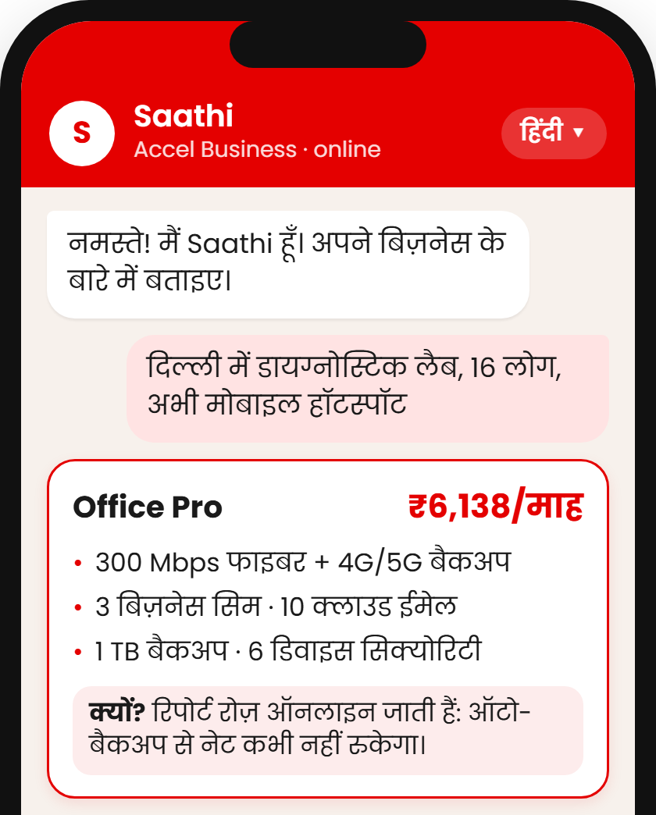
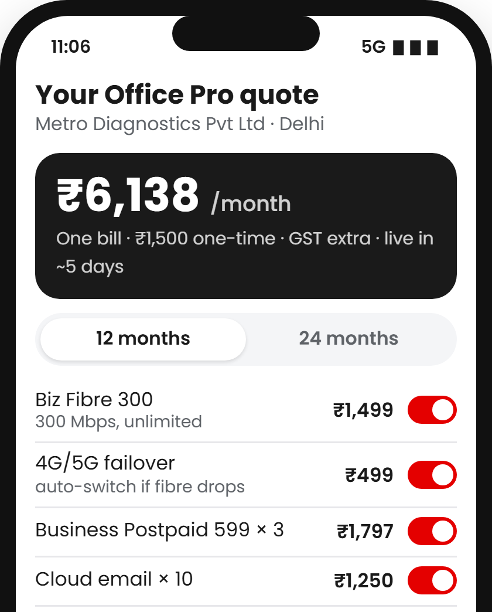
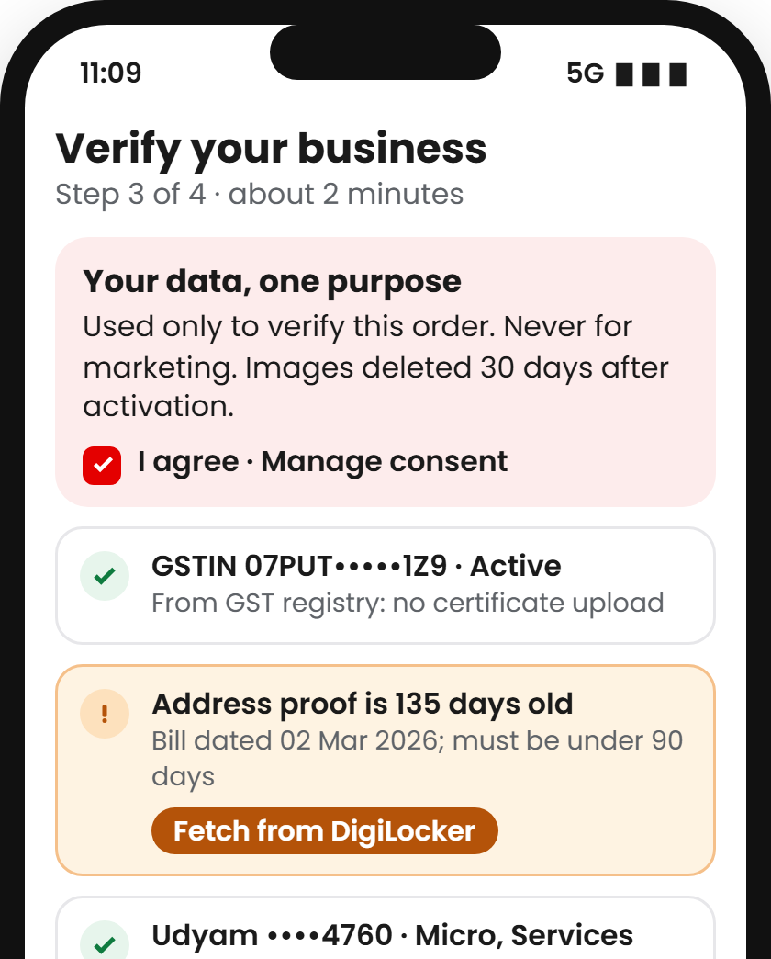
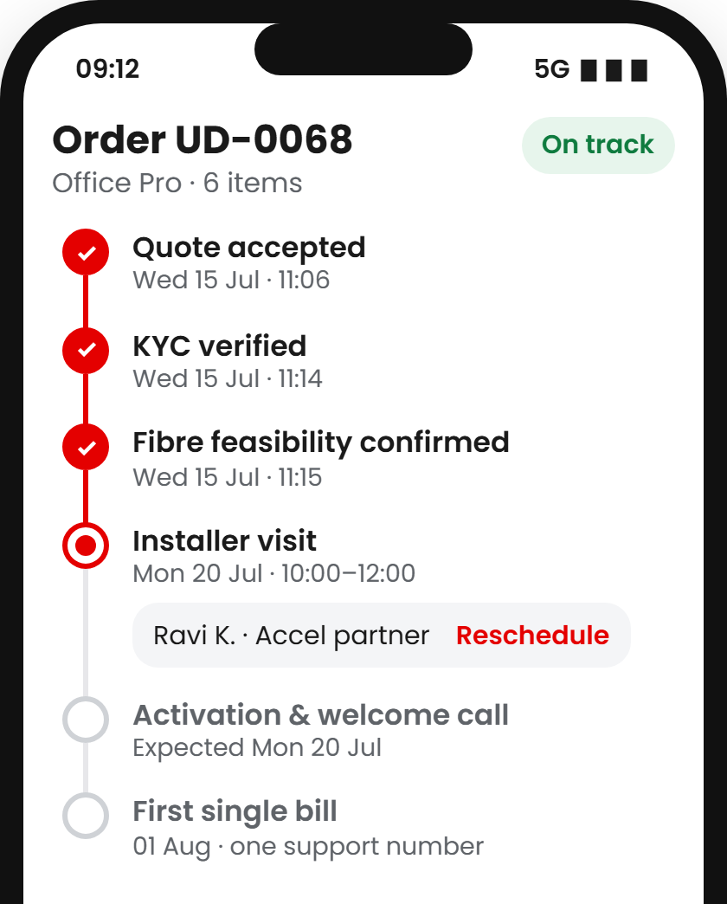
03 THE SOLUTION: SAATHI JOURNEY AND PROTOTYPE
Saathi replaces a 17.6-day, field-led process with one 10-minute conversation on the owner's phone
1
Advisor
2
Quote & checkout
3
Smart KYC
4
Tracker
The owner shares a GSTIN (or Udyam number): Saathi reads the registries and proposes a bundle with zero questions for 73% of GSTINs; otherwise it asks 1–5.
One monthly price from a rules engine, never the LLM. Add-ons and term toggle live; every quote carries a guarantee: 72 h or a firm date.
Consent per purpose first. GSTIN checksum and registry status block dead GSTINs; a certificate photo is read by OCR on the phone.
Counts down to the quote's guarantee and credits month one if missed. Proactive updates and outage credits replace the 3 chase calls.
Targets 827 visit drop-offs
Targets 385 slow / confusing quotes
Targets 273 paperwork drops
Targets 167 post-KYC losses
People stay in the loop
CA partners and customers refer with a checked code; rewards are paid only after the business stays 90 days.
Field sales focus on multi-site and factories (73% of new revenue); every Saathi hand-off arrives with full context.
Back office works a queue of leads Saathi couldn't close, ranked by a propensity model: the top 20% hold 40% of activations.
Built and tested in Voiceflow: 5 playbooks, 11 function tools, 308 automated tests. Zero-question share measured on all 3,534 registry GSTINs; Udyam entry covers 42.6% of leads without a GSTIN. Screens: lead L00068, IDs masked. Lead score AUC 0.71.
Notes:
Four steps, one sitting. The journey starts from the GSTIN: Saathi reads the GST and Udyam registries and proposes a bundle with no questions for 73% of registered businesses; owners without a GSTIN can start with their Udyam number. Prices and eligibility come from a rules engine, never the LLM. Every quote carries an activation guarantee: 72 hours where the data supports it (small single-site businesses in tier-1 cities), a firm date elsewhere, month one free if missed. Smart KYC asks consent per purpose, blocks cancelled GSTINs and reads a certificate photo on the phone. The tracker replaces chase calls; in the data, customers who chased five times churned at 28% versus 6% for one.

Slide 5
04 ARCHITECTURE AND TRUST
Rules decide, GenAI explains: every price and KYC decision is deterministic, auditable and built for the DPDP Act, 2023
CHANNELS
Web chat widget
WhatsApp *
Voice / IVR *
Back-office page
Privacy by design · DPDP Act, 2023
CORE
Voiceflow agent global prompt · 5 playbooks · 11 tested function tools · consent checkpoint
Consent
Three purposes asked separately (registry lookup, KYC, offers), nothing pre-ticked, in the owner's language; each withdrawable any time in the chat.
SERVICES
Purpose limitation
KYC data is used only to verify and activate the order. Never for marketing, never to train models.
GenAI advisor
Rules & pricing
Smart KYC
Orders & tracker
Lead routing
LLM with tool calls: asks, explains, translates. Never sets a price.
price_bundle: catalogue, eligibility and the quote's guarantee. Deterministic.
GSTIN checksum & status, Udyam entry, consent per purpose; OCR of a GST certificate.
Counts down to the quoted guarantee; month-one and outage credits.
Lead score (AUC 0.71), referral codes, territory rep for Hot leads.
Data minimisation
Lookup before upload: if GSTIN and Udyam verify, no certificate is collected. We store extracted fields, not images.
Masking & access
GSTIN, Udyam and phone shown masked; the lead score sees business fields only, never a name or phone; partners see only their own leads.
DATA & APIs
In the prototype (case data)
Mocked now, real in production
Catalogue · 25 products
GST registry · 3,534
DigiLocker
Aadhaar e-Sign
Udyam registry · 2,723
Knowledge base · 4 docs
UPI Autopay
WhatsApp Business API
Retention
A certificate photo is read on the owner's phone and never uploaded; the KYC record is kept only as long as telecom KYC rules require.
Lead queue (Sheet)
Consent record
CRM / BSS-OSS
Network monitoring
Built: Voiceflow agent + 11 JavaScript function tools (the rules, 308 automated tests) · demo site with in-browser OCR · back-office page. * Voiceflow channels for the same agent, not switched on yet. Code: github.com/praharj123barman-glitch/airtel-sync-saathi
Notes:
The design principle is simple: the LLM never decides anything that has money or compliance attached. It asks questions, explains and translates; eleven tested function tools set eligibility, price and the activation guarantee from the catalogue and the case data, so every answer is reproducible and auditable. Smart KYC runs a GSTIN checksum and registry status check (which would have blocked the 22 cancelled or suspended GSTINs) and lets owners without a GSTIN start with their Udyam number. Privacy follows the DPDP Act: consent per purpose, lookup before upload, masking, and short retention. The prototype runs in Voiceflow today; WhatsApp and voice are channels of the same agent.

Slide 6
05 COMPETITIVE ANALYSIS
Rivals offer either a bundle or a fast sign-up, never both: Saathi pairs Accel's install network with a zero-wait journey
Full stack on one bill
Needs-based advice
Instant, clear price
Paperless KYC
Regional languages
Self-serve tracking
On-ground install network
Where Saathi wins
1
Right-sized, not fixed tiers
Saathi sizes the bundle to the business, which tackles the 414 ‘price too high’ drop-offs without a price war.
Saathi (prototype)
Accel Business
Accel Business today
field sales, one product at a time
2
Network + digital speed
SaaS players sign up in minutes but can't lay fibre or fit CCTV. Accel can do both in one order, on one bill.
JioBusiness
7 fixed tiers from ₹901/mo (2021 launch)
Vi Business
ReadyForNext self-assessment
3
A warm base to start from
38% of leads already use Accel, mostly mobile-only: Saathi can reach them on WhatsApp and pre-fill identity.
Tata Tele Business
Smartflo, Smart Internet
Digital-first SaaS
WhatsApp API, cloud telephony, POS
Local ISP / reseller
relationship-led, separate bills
Watch-out: JioBusiness entry tier starts at ₹901/mo. We answer with value, not price: Dukaan Digital from ₹1,198 includes a business line and a 2-day AirFiber install.
offered
partial
not evident in public information
Sources: JioBusiness launch coverage (Business Today, DQ India, Mar 2021); Vi Business ReadyForNext and PayU releases (2024–26); TTBS Smartflo / Smart Internet coverage; team assessment of public information, Nov 2026. Accel share of leads: smb_leads.csv.
Notes:
Every competitor gets one half of the problem right. JioBusiness has bundles and published prices but fixed tiers. Digital-first SaaS players sign up instantly but only for one product and can't install anything physical. Local resellers speak the owner's language but run on paper and separate bills. Saathi is the only model that combines a needs-based advisor, instant price, paperless KYC and tracking with an on-ground install network. Our warm start: 38% of leads already use Accel.

Slide 7
06 IMPACT, METRICS AND ROLLOUT
Recovering half the process-driven drop-offs takes activation from 7.4% to 16.5% and cuts acquisition cost by 55%
Success metric
Today
6-month target
12-month target
2.2×
activations per 5,000 leads
368 today → 608 at 6 months → 823 at 12 months
Lead → activation conversion
7.4%
12%
16%
Days from lead to activation
17.6
≤ 7
≤ 5
−55%
cost per activated SMB
₹15,053 → ₹6,729 at today's acquisition spend
Cost per activated SMB
₹15,053
₹9,100
₹6,700
Status chases per customer
3.0
1.0
≤ 0.5
6-month churn
15.2%
12%
≤ 10%
₹3.8 Cr
extra annual revenue per quarter of leads
455 extra activations × ₹6,900 median bundle × 12
Guardrail: activations on invalid GSTIN
22
0
0
PHASE 1 · PILOT · M0–3
PHASE 2 · SCALE · M4–9
PHASE 3 · EXPAND · M10–18
Key risks → mitigation
2 tier-1 cities · Hindi + English · professional offices · WhatsApp + web · A/B test against a field-sales control group
Micro retail on Dukaan Digital · all 10 lead languages · voice front end · partner assist mode live
Multi-site and factories in assisted mode · propensity-routed field queue · national rollout
GenAI mis-sells → rules engine, not the LLM, sets price and eligibility; every answer logged
Channel conflict → referral codes credit the partner; paid after 90 days
KYC fraud → registry lookups, cross-checks, e-Sign, review queue
Costly promises → 72 h only where data supports it: ₹93L → ₹52L credits per 1,000 orders
Gate: conversion ≥ 10% and CAC ≤ ₹10k
Gate: micro CAC ≤ ₹3k
Gate: 12-month targets met
Model: stage conversion lifted by recovering 30% (6 months) or 50% (12 months) of the 1,652 process-driven drop-offs, cascaded through the funnel at the same acquisition spend; revenue at the ₹6,900 median bundle. Baselines: smb_leads.csv.
Notes:
We set five metrics with targets from a funnel model, not guesses. If Saathi recovers 30% of the process-driven drop-offs, activation reaches 12% in six months; at 50% it reaches 16.5% and cost per activated SMB falls from ₹15,053 to ₹6,729 at today's spend. That is about 455 extra customers and ₹3.8 crore of annual revenue from every quarter of leads. We roll out in three gated phases, starting with professional offices in two cities against a field-sales control group.

