Slide 1

PROJECT UDYAM DIGITAL · ENTERPRISE TRACK A
Accel Saathi
An AI business advisor that discovers, quotes, verifies and activates an MSME bundle in one sitting: on WhatsApp, in the owner's language.
7.4% → 16.5% activation
Live in ≤5 days, not 17.6
₹15k → ₹6.7k per SMB
Team [Team Name] · [Campus Name]
Prohorj Babu Bormon · [Teammate Name]
Notes:
Accel Saathi: a digital-first acquisition and onboarding journey for Accel Business. One conversation on the owner's phone replaces a 17.6-day, field-led process. All numbers in this deck come from our analysis of the case data pack (smb_leads.csv, product_catalogue.csv, mock registries).

Slide 2

01 THE PROBLEM
Only 7 in 100 MSME leads get activated, and over a third of drop-offs come from our own process, not from price or demand
Lead funnel, Apr–Jun 2026
% of previous stage
1,652 of 4,632 drop-offs (36%) are process failures we can remove
Leads generated
5,000
—
827
Stalled waiting for a sales visit
→ AI advisor, any time
Owner had no time 531 · visit never scheduled 296
Contacted
3,406
68%
385
Quote too slow or too complex
→ Instant one-price quote
Needs assessed
1,974
58%
3–5 day PDF full of product codes: 179 slow · 206 confusing
Quote accepted
861
← steepest drop in the funnel
44%
273
Stuck in KYC paperwork
→ Smart KYC
KYC complete
588
68%
Missing GST/Udyam 94 · too long 79 · signatory away 53 · mismatch 47
Activated
368
63%
167
Lost after KYC
→ Feasibility check + tracker
Install >21 days 98 · fibre not feasible 41 · first payment failed 28
17.6 days
₹15,053
3×
54%
of activated bundles held none of the products the owner asked about: pitches follow targets, not needs
22
activations (6%) went live on cancelled or suspended GSTINs that manual KYC let through
average from lead to activation
to acquire one SMB, vs a ₹6,900/mo median bundle
each customer chased status before going live
Source: team analysis of smb_leads.csv (5,000 synthetic leads, Apr–Jun 2026) and mock_gstin_registry.csv. Drop reasons grouped by the last stage reached; ‘process failures’ = reasons a digital journey removes directly.
Notes:
The demand is there: 5,000 leads a quarter. But only 368 activate. The biggest leak is between needs assessment and quote acceptance (44%). When we read the drop reasons, 1,652 of 4,632 losses are process failures: owners waiting for a visit, slow or confusing quotes, paperwork, and installs that slip past 21 days. Two hidden costs: in 54% of activations the bundle sold contained none of what the owner asked for, and 22 activations went live on cancelled or suspended GSTINs.

Slide 3
02 WHO WE WIN FIRST, WITH WHAT BUNDLE
Go digital-first with offices and micro retail; point the field force at the 21% of leads that bring 73% of new revenue
Professional offices
Micro retail & services
Small multi-site
Small manufacturers
25% of leads · clinics, CA firms, coaching
54% of leads · kirana, salon, pharmacy
15% of leads · 3–10 store chains
6% of leads · auto parts, textiles
WAVE 1 · DIGITAL-FIRST
WAVE 1 · ZERO-TOUCH
WAVE 2 · DIGITAL-ASSISTED
FIELD-LED · SAATHI TOOLS
Activation rate
11.1%
Activation rate
4.1%
Activation rate
11.0%
Activation rate
12.8%
Median bundle / month
₹6,575
Median bundle / month
₹2,470
Median bundle / month
₹28,080
Median bundle / month
₹15,910
Cost per activation
₹10,695
Cost per activation
₹20,007
Cost per activation
₹15,614
Cost per activation
₹15,324
Months of revenue to repay CAC
1.6
Months of revenue to repay CAC
8.1
Months of revenue to repay CAC
0.6
Months of revenue to repay CAC
1.0
6-month churn
13.8%
6-month churn
22.7%
6-month churn
10.8%
6-month churn
8.1%
OFFICE PRO
DUKAAN DIGITAL
CHAIN CONNECT
FACTORY ASSURED
₹4,815–6,138/mo
from ₹1,198/mo
≈₹2,500/site/mo
₹15,260/mo
Biz Fibre 300 + 4G/5G failover · 2–3 business postpaid · cloud email and endpoint security per desk · 1 TB backup
5G AirFiber (live in 2 days) or Biz Fibre 100 · 1–2 business postpaid · add Cloud POS, CCTV, WhatsApp catalogue
Per site: Biz Fibre 100, failover, secure Wi-Fi, Cloud POS · HQ: postpaid lines, toll-free · optional SD-WAN
Leased line 20 Mbps (99.5% SLA) + managed firewall · 4 business postpaid · cloud email · machine-monitoring IoT
12 months · ₹1,500 one-time
6–12 months · ₹0 setup on core
12–24 months · 8 sites ≈ ₹23,900/mo
24 months · site survey first
HOW WE SELL
HOW WE SELL
HOW WE SELL
HOW WE SELL
Saathi self-serve: WhatsApp + web
Saathi self-serve + partner assist
Saathi qualifies, specialist closes
Field-led; Saathi for quote + KYC
Metrics: smb_leads.csv, Apr–Jun 2026. Prices = catalogue floor price for the committed term (product_catalogue.csv); GST-only products are offered only to verified GSTINs. Months to repay CAC = cost per activation ÷ median monthly bundle.
Notes:
We prioritise by where a digital journey changes the economics. Professional offices convert well, standardise easily and repay acquisition cost in 1.6 months: that is our pilot. Micro retail is 54% of leads but costs ₹20k to acquire against a ₹2.5k bundle (8 months to repay), and it takes 40% of acquisition spend for 6% of new revenue. Only a zero-touch journey fixes that. Multi-site and manufacturers are 21% of leads but 73% of new monthly revenue: that is where the field force should spend its time, with Saathi handling quote, KYC and tracking.

Slide 4
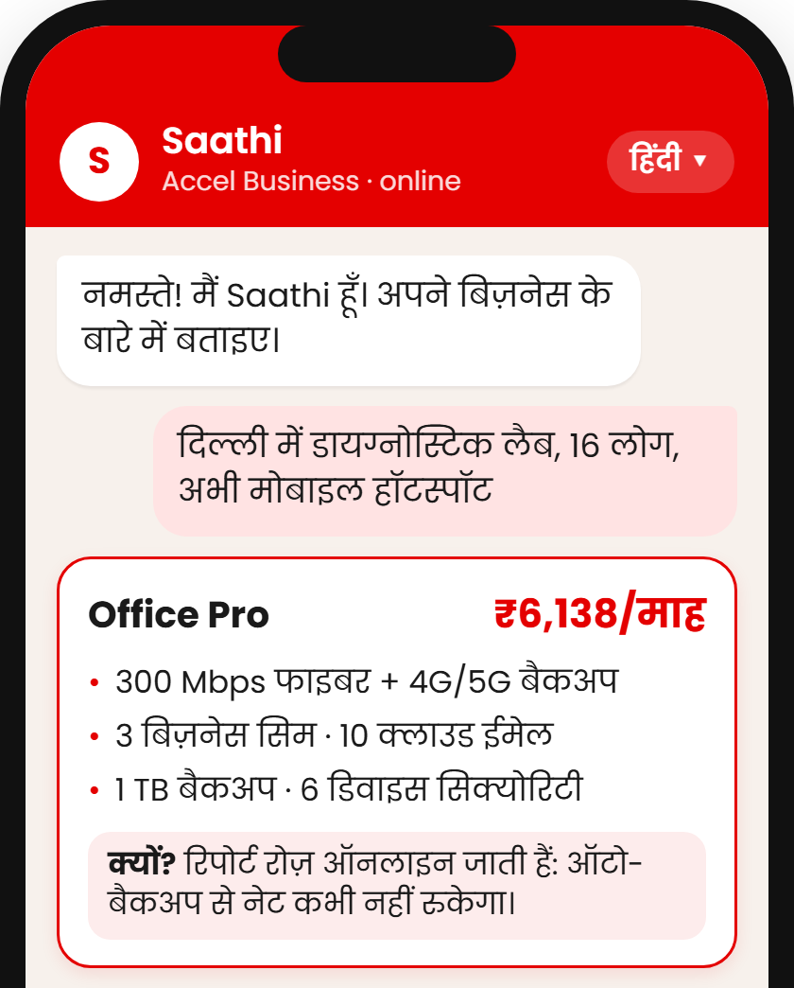
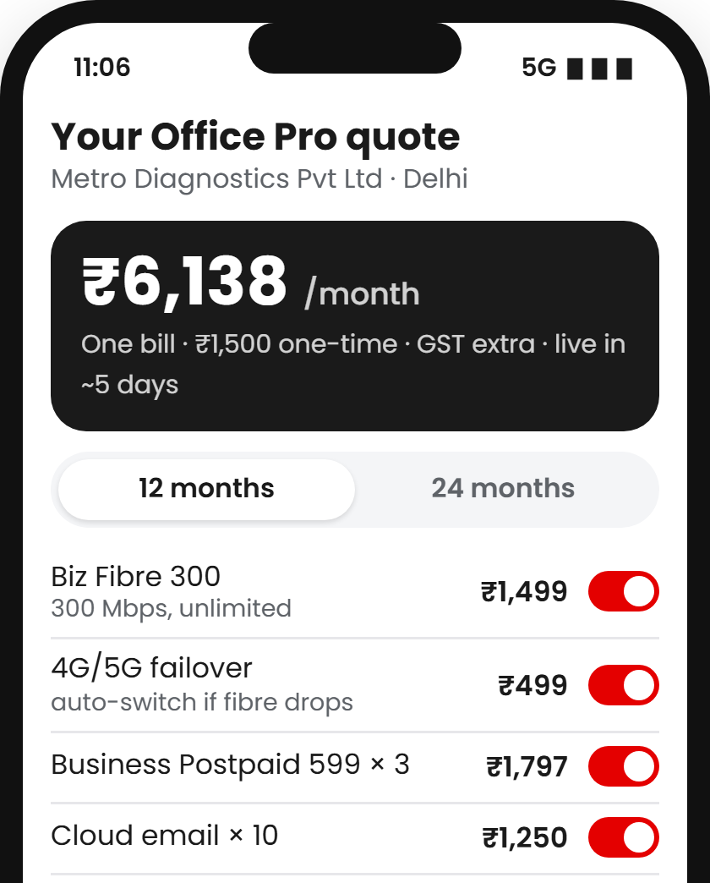
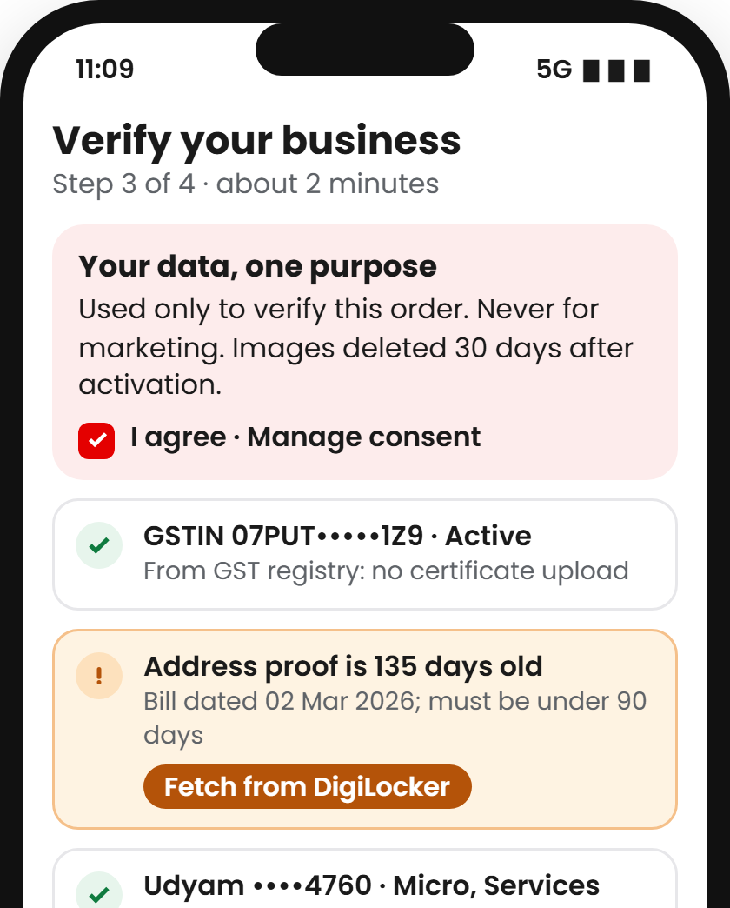
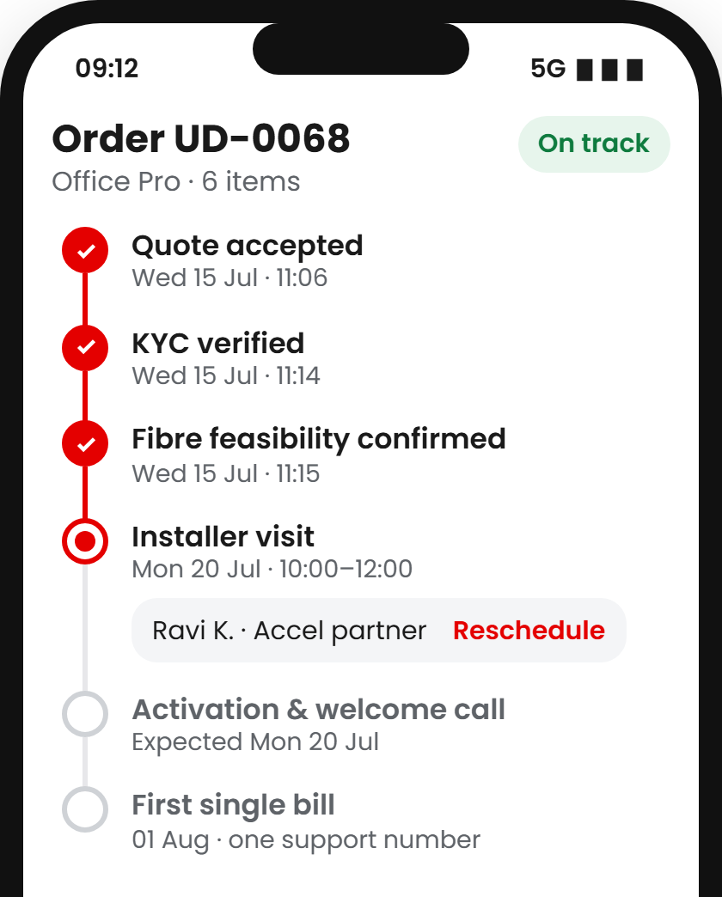
03 THE SOLUTION: SAATHI JOURNEY AND PROTOTYPE
Saathi replaces a 17.6-day, field-led process with one 10-minute conversation on the owner's phone
1
Advisor
2
Quote & checkout
3
Smart KYC
4
Tracker
GenAI advisor (chat or voice, 10 languages) asks 4–5 questions, then recommends a catalogue bundle with one monthly price and a plain-language reason.
One transparent monthly price. The owner toggles add-ons and term; eligibility rules (GSTIN, size, city tier, dependencies) are enforced live.
Consent first. GSTIN and Udyam fetched by lookup; documents read by OCR and cross-checked; signatory signs by e-Sign; DigiLocker fills gaps.
Live status with feasibility, installer slot and go-live date. Proactive WhatsApp updates replace the 3 chase calls per customer.
Targets 827 visit drop-offs
Targets 385 slow / confusing quotes
Targets 273 paperwork drops
Targets 167 post-KYC losses
People stay in the loop
Channel partners assist owners in-store on the same app; their QR code earns commission even if the owner finishes alone.
Field sales focus on multi-site and factories (73% of new revenue); every Saathi hand-off arrives with full context.
Back office works a queue of leads Saathi couldn't close, ranked by a propensity model: the top 20% hold 40% of activations.
Screens: prototype UI using lead L00068 (Metro Diagnostics, Delhi, Hindi-speaking) from the case data; IDs masked. Propensity model: logistic regression on lead-time fields, 5-fold CV AUC 0.71.
Notes:
Four steps, one sitting. The advisor talks in the owner's language and recommends from the real catalogue: the LLM explains, but prices and eligibility come from a rules engine. The quote is one monthly number with toggles. Smart KYC asks for consent first, looks up GSTIN and Udyam so most owners upload nothing, and flags problems like a stale address proof instantly. The tracker replaces chase calls; in the data, customers who chased five times churned at 28% versus 6% for one. Partners and field sales use the same app, so the digital journey adds to them rather than competing.

Slide 5
04 ARCHITECTURE AND TRUST
Rules decide, GenAI explains: every price and KYC decision is deterministic, auditable and built for the DPDP Act, 2023
CHANNELS
WhatsApp
Mobile web (PWA)
Voice / IVR
Partner & field app
Privacy by design · DPDP Act, 2023
CORE
Saathi orchestrator journey state · speech ↔ text in 10 languages · consent checkpoint
Consent
Plain-language notice in the owner's language before any KYC; one purpose per consent; withdraw any time from the tracker.
SERVICES
Purpose limitation
KYC data is used only to verify and activate the order. Never for marketing, never to train models.
GenAI advisor
Rules & pricing
Smart KYC
Orders & tracker
Lead scoring
LLM with tool calls: asks, explains, translates. Never sets a price.
Eligibility, product dependencies and catalogue prices, fully deterministic.
OCR + checks: GSTIN checksum & status, name/address match, proof ≤ 90 days.
Feasibility, install slots; status events pushed to WhatsApp.
Propensity model routes unclosed leads to partners and field.
Data minimisation
Lookup before upload: if GSTIN and Udyam verify, no certificate is collected. We store extracted fields, not images.
Masking & access
GSTIN, ID and phone masked in UI and logs; PII redacted before any LLM call; partners see only their own leads.
DATA & APIs
Accel systems
External APIs (mocked in prototype)
Product catalogue
Lead & order DB
GSTIN lookup
Udyam lookup
Consent ledger
Doc vault (auto-expiry)
DigiLocker
Aadhaar e-Sign
Retention
Uploaded images auto-deleted 30 days after activation; the KYC record is kept only as long as telecom KYC rules require.
Masked audit log
CRM / BSS-OSS
UPI Autopay
WhatsApp Business API
Proposed prototype stack: Next.js PWA + WhatsApp Business API · FastAPI services · PostgreSQL · OCR with LLM vision for documents · mock GSTIN and Udyam APIs backed by the case registries (3,534 and 2,723 records).
Notes:
The design principle is simple: the LLM never decides anything that has money or compliance attached. It asks questions, explains and translates; the rules engine sets eligibility and price from the catalogue, so every recommendation is reproducible and auditable. Smart KYC runs a GSTIN checksum, registry status (which would have blocked the 22 cancelled or suspended GSTINs), cross-document name and address matching and the 90-day address-proof rule. Privacy follows the DPDP Act: consent per purpose, lookup before upload, masking, and short retention.

Slide 6
05 COMPETITIVE ANALYSIS
Rivals offer either a bundle or a fast sign-up, never both: Saathi pairs Accel's install network with a zero-wait journey
Full stack on one bill
Needs-based advice
Instant, clear price
Paperless KYC
Regional languages
Self-serve tracking
On-ground install network
Where Saathi wins
1
Right-sized, not fixed tiers
Saathi sizes the bundle to the business, which tackles the 414 ‘price too high’ drop-offs without a price war.
Saathi (proposed)
Accel Business
Accel Business today
field sales, one product at a time
2
Network + digital speed
SaaS players sign up in minutes but can't lay fibre or fit CCTV. Accel can do both in one order, on one bill.
JioBusiness
7 fixed tiers from ₹901/mo (2021 launch)
Vi Business
ReadyForNext self-assessment
3
A warm base to start from
38% of leads already use Accel, mostly mobile-only: Saathi can reach them on WhatsApp and pre-fill identity.
Tata Tele Business
Smartflo, Smart Internet
Digital-first SaaS
WhatsApp API, cloud telephony, POS
Local ISP / reseller
relationship-led, separate bills
Watch-out: JioBusiness entry tier starts at ₹901/mo. We answer with value, not price: Dukaan Digital from ₹1,198 includes a business line and a 2-day AirFiber install.
offered
partial
not evident in public information
Sources: JioBusiness launch coverage (Business Today, DQ India, Mar 2021); Vi Business ReadyForNext and PayU releases (2024–26); TTBS Smartflo / Smart Internet coverage; team assessment of public information, Nov 2026. Accel share of leads: smb_leads.csv.
Notes:
Every competitor gets one half of the problem right. JioBusiness has bundles and published prices but fixed tiers. Digital-first SaaS players sign up instantly but only for one product and can't install anything physical. Local resellers speak the owner's language but run on paper and separate bills. Saathi is the only model that combines a needs-based advisor, instant price, paperless KYC and tracking with an on-ground install network. Our warm start: 38% of leads already use Accel.

Slide 7
06 IMPACT, METRICS AND ROLLOUT
Recovering half the process-driven drop-offs takes activation from 7.4% to 16.5% and cuts acquisition cost by 55%
Success metric
Today
6-month target
12-month target
2.2×
activations per 5,000 leads
368 today → 608 at 6 months → 823 at 12 months
Lead → activation conversion
7.4%
12%
16%
Days from lead to activation
17.6
≤ 7
≤ 5
−55%
cost per activated SMB
₹15,053 → ₹6,729 at today's acquisition spend
Cost per activated SMB
₹15,053
₹9,100
₹6,700
Status chases per customer
3.0
1.0
≤ 0.5
6-month churn
15.2%
12%
≤ 10%
₹3.8 Cr
extra annual revenue per quarter of leads
455 extra activations × ₹6,900 median bundle × 12
Guardrail: activations on invalid GSTIN
22
0
0
PHASE 1 · PILOT · M0–3
PHASE 2 · SCALE · M4–9
PHASE 3 · EXPAND · M10–18
Key risks → mitigation
2 tier-1 cities · Hindi + English · professional offices · WhatsApp + web · A/B test against a field-sales control group
Micro retail on Dukaan Digital · all 10 lead languages · voice front end · partner assist mode live
Multi-site and factories in assisted mode · propensity-routed field queue · national rollout
GenAI mis-sells → rules engine, not the LLM, sets price and eligibility; every answer logged
Channel conflict → partner QR attribution + commission
KYC fraud → registry lookups, cross-checks, e-Sign, review queue
Fibre not feasible → 5G AirFiber offered at quote time
Gate: conversion ≥ 10% and CAC ≤ ₹10k
Gate: micro CAC ≤ ₹3k
Gate: 12-month targets met
Model: stage conversion lifted by recovering 30% (6 months) or 50% (12 months) of the 1,652 process-driven drop-offs, cascaded through the funnel at the same acquisition spend; revenue at the ₹6,900 median bundle. Baselines: smb_leads.csv.
Notes:
We set five metrics with targets from a funnel model, not guesses. If Saathi recovers 30% of the process-driven drop-offs, activation reaches 12% in six months; at 50% it reaches 16.5% and cost per activated SMB falls from ₹15,053 to ₹6,729 at today's spend. That is about 455 extra customers and ₹3.8 crore of annual revenue from every quarter of leads. We roll out in three gated phases, starting with professional offices in two cities against a field-sales control group.

