Slide 1

Simplify Design Specification
Simplifying complexity

Slide 2


Agenda
Overview
Specification
High-Level System Architecture
ER Diagram
Site Map
Wireframes
Contribution List

Slide 3



Overview

Slide 4

Overview
Simplify is the platform to learn about complexities in a simple manner. A place to learn and teach.
The web application let’s a student enrol and tutor to create and conduct their course in order to make knowledge transfer seamless and precise.

Slide 5
Specification
Alan, 37
Tutor
Daniel, 21
Student
User should be able to login or register using google or a registration form.
User should be able to register as a tutor.
User should be able to create a new course and add pre-existing courses.
User should be able to publish course materials including slides, pdfs, images and videos.
User should be able to add a blog containing an overview of each course.
User should have access to forums for providing important updates regarding the course and for clearing doubts.
User should be able to login or register using google or a registration form.
User should be able to register as a student.
The platform should be able to distinguish between the tutor and the student, with access being given to the student user for only the student specific pages.
User should be able to access all the course material.
User should be able to submit course work provided under a given course.
User should be able to enrol in more than one course at a given time.
User should be able to track the progress of each course.
User should have access to forums for discussion and posting questions

Slide 6
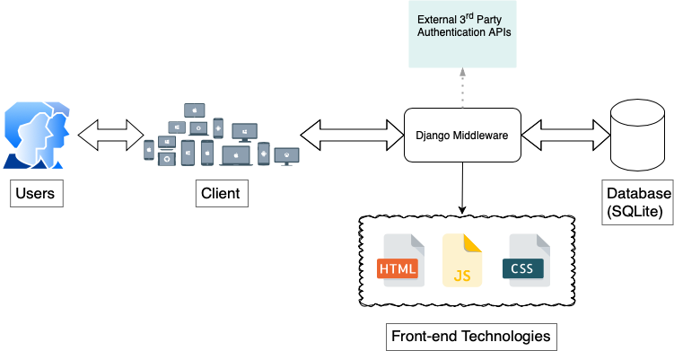
High-Level System Architecture

Slide 7
ER Diagram
Subtitle
Subtitle
Add text, images, art, and videos.
Add transitions, animations, and motion.
Save to OneDrive, to get to your presentations from your computer, tablet, or phone.
Open the Design Ideas pane for instant slide makeovers.
When we have design ideas, we’ll show them to you right there.

Slide 8
Site Map
Subtitle
Subtitle
Add text, images, art, and videos.
Add transitions, animations, and motion.
Save to OneDrive, to get to your presentations from your computer, tablet, or phone.
Open the Design Ideas pane for instant slide makeovers.
When we have design ideas, we’ll show them to you right there.

Slide 9
Wireframes
Subtitle
Subtitle
Add text, images, art, and videos.
Add transitions, animations, and motion.
Save to OneDrive, to get to your presentations from your computer, tablet, or phone.
Open the Design Ideas pane for instant slide makeovers.
When we have design ideas, we’ll show them to you right there.

Slide 10
Chart

Slide 11
Table
 | Category 1 | Category 2 | Category 3 | Category 4
Item 1 | 4.5 | 2.3 | 1.7 | 5.0
Item 2 | 3.2 | 5.1 | 4.4 | 3.0
Item 3 | 2.1 | 1.7 | 2.5 | 2.8
Item 4 | 4.5 | 2.2 | 1.7 | 7.0

Slide 12

The way to get started is to quit talking and begin doing.
Walt Disney

Slide 13
Team
Name Title
Name Title
Name Title
Name Title

Slide 14
Content
Subtitle
Subtitle
Add text, images, art, and videos.
Add transitions, animations, and motion.
Save to OneDrive, to get to your presentations from your computer, tablet, or phone.
Open the Design Ideas pane for instant slide makeovers.
When we have design ideas, we’ll show them to you right there.

Slide 15
Additional content
Subtitle
Subtitle
Subtitle
Add text, images, art, and videos.
Add transitions, animations, and motion.
Save to OneDrive, to get to your presentations from your computer, tablet, or phone.
This PowerPoint theme uses its own unique set of colours, fonts, and effects to create the overall look and feel of these slides.
PowerPoint has tons of themes to give your presentation just the right personality.
Open the Design Ideas pane for instant slide makeovers.
When we have design ideas, we’ll show them to you right there.

Slide 16




Summary
With PowerPoint, you can create presentations and share your work with others, wherever they are. Type the text you want here to get started. You can also add images, art, and videos on this template. Save to OneDrive and access your presentations from your computer, tablet, or phone.

Slide 17


Thank you

