Slide 1

Simplify Design Specification
Simplifying complexity

Slide 2


Agenda
Overview
Specification
High-Level System Architecture
ER Diagram
Site Map
Wireframes
Contribution List

Slide 3



Overview

Slide 4

Overview
Simplify is the platform to learn about complexities in a simple manner. A place to learn and teach.
The web application let’s a student enrol and tutor to create and conduct their course in order to make knowledge transfer seamless and precise.

Slide 5
Specification
User authentication: The platform should provide the users; students and tutors a management system to login or register using google or a registration form. The user should be able to register as a student or a tutor.
User based dashboard: The platform should distinguish between a tutor and a student, with access being given to the student for only the student specific pages.
Course management: The platform should have a user-friendly environment that allows the tutors to create a course, add pre-existing courses, and publish course materials including slides, pdfs, images and videos.
Course accessibility: The platform should provide the student access to view all the course material and submit course work.
Personalization: The platform should provide the student the option to enrol for more than 1 course at a time and track the progress of each course.
Interactive learning: The courses within the platform should include various tools for learning such as forums for posting questions and a blog with an overview of the course.

Slide 6
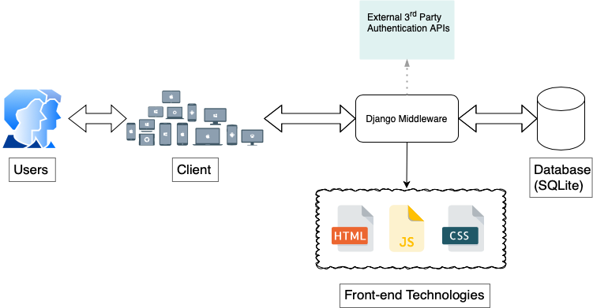
High-Level System Architecture

Slide 7
ER Diagram
Subtitle
Subtitle
Add text, images, art, and videos.
Add transitions, animations, and motion.
Save to OneDrive, to get to your presentations from your computer, tablet, or phone.
Open the Design Ideas pane for instant slide makeovers.
When we have design ideas, we’ll show them to you right there.

Slide 8
Site Map
Subtitle
Subtitle
Add text, images, art, and videos.
Add transitions, animations, and motion.
Save to OneDrive, to get to your presentations from your computer, tablet, or phone.
Open the Design Ideas pane for instant slide makeovers.
When we have design ideas, we’ll show them to you right there.

Slide 9
Wireframes
Subtitle
Subtitle
Add text, images, art, and videos.
Add transitions, animations, and motion.
Save to OneDrive, to get to your presentations from your computer, tablet, or phone.
Open the Design Ideas pane for instant slide makeovers.
When we have design ideas, we’ll show them to you right there.

Slide 10
Chart

Slide 11
Table
 | Category 1 | Category 2 | Category 3 | Category 4
Item 1 | 4.5 | 2.3 | 1.7 | 5.0
Item 2 | 3.2 | 5.1 | 4.4 | 3.0
Item 3 | 2.1 | 1.7 | 2.5 | 2.8
Item 4 | 4.5 | 2.2 | 1.7 | 7.0

Slide 12

The way to get started is to quit talking and begin doing.
Walt Disney

Slide 13
Team
Name Title
Name Title
Name Title
Name Title

Slide 14
Content
Subtitle
Subtitle
Add text, images, art, and videos.
Add transitions, animations, and motion.
Save to OneDrive, to get to your presentations from your computer, tablet, or phone.
Open the Design Ideas pane for instant slide makeovers.
When we have design ideas, we’ll show them to you right there.

Slide 15
Additional content
Subtitle
Subtitle
Subtitle
Add text, images, art, and videos.
Add transitions, animations, and motion.
Save to OneDrive, to get to your presentations from your computer, tablet, or phone.
This PowerPoint theme uses its own unique set of colours, fonts, and effects to create the overall look and feel of these slides.
PowerPoint has tons of themes to give your presentation just the right personality.
Open the Design Ideas pane for instant slide makeovers.
When we have design ideas, we’ll show them to you right there.

Slide 16




Summary
With PowerPoint, you can create presentations and share your work with others, wherever they are. Type the text you want here to get started. You can also add images, art, and videos on this template. Save to OneDrive and access your presentations from your computer, tablet, or phone.

Slide 17


Thank you

