Slide 1


Simplify Design Specification
Praharsh R Dubey 2738037
Vikram Baruah 2795941
Yin Long 2751099
Zhaobo Guo 2815951
Yifan Guo 2721370

Slide 2


Agenda
Overview
Specification
High-Level System Architecture
ER Diagram
Site Map
Wireframes
Contribution List

Slide 3



Overview

Slide 4

Overview
Simplify is the platform to learn about complexities in a simple manner. A place to learn and teach.
The web application let’s a student enrol and tutor to create and conduct their course in order to make knowledge transfer seamless and precise.

Slide 5
Specification
Alan, 37
Tutor
Daniel, 21
Student
User should be able to login or register using google or a registration form.
User should be able to register as a tutor.
User should be able to create a new course and add pre-existing courses.
User should be able to publish course materials including slides, pdfs, images and videos.
User should be able to add a blog containing an overview of each course.
User should have access to forums for providing important updates regarding the course and for clearing doubts.
User should be able to login or register using google or a registration form.
User should be able to register as a student.
The platform should be able to distinguish between the tutor and the student, with access being given to the student user for only the student specific pages.
User should be able to access all the course material.
User should be able to submit course work provided under a given course.
User should be able to enrol in more than one course at a given time.
User should be able to track the progress of each course.
User should have access to forums for discussion and posting questions

Slide 6
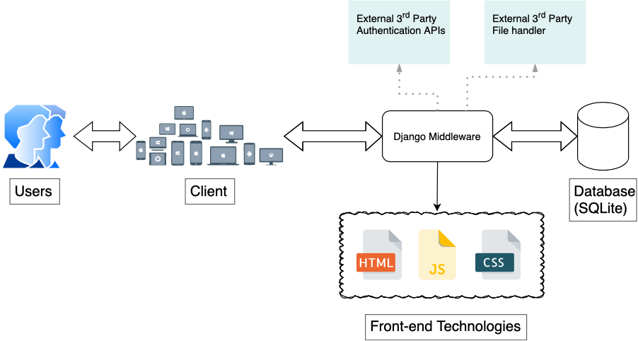
High-Level System Architecture

Slide 7
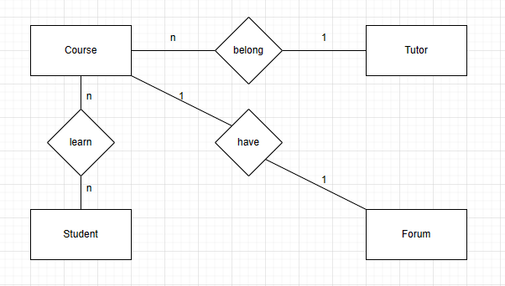
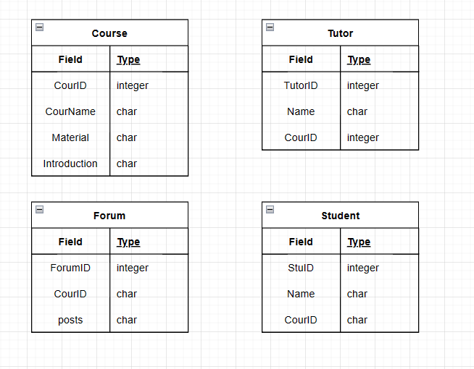
ER Diagram

Slide 8
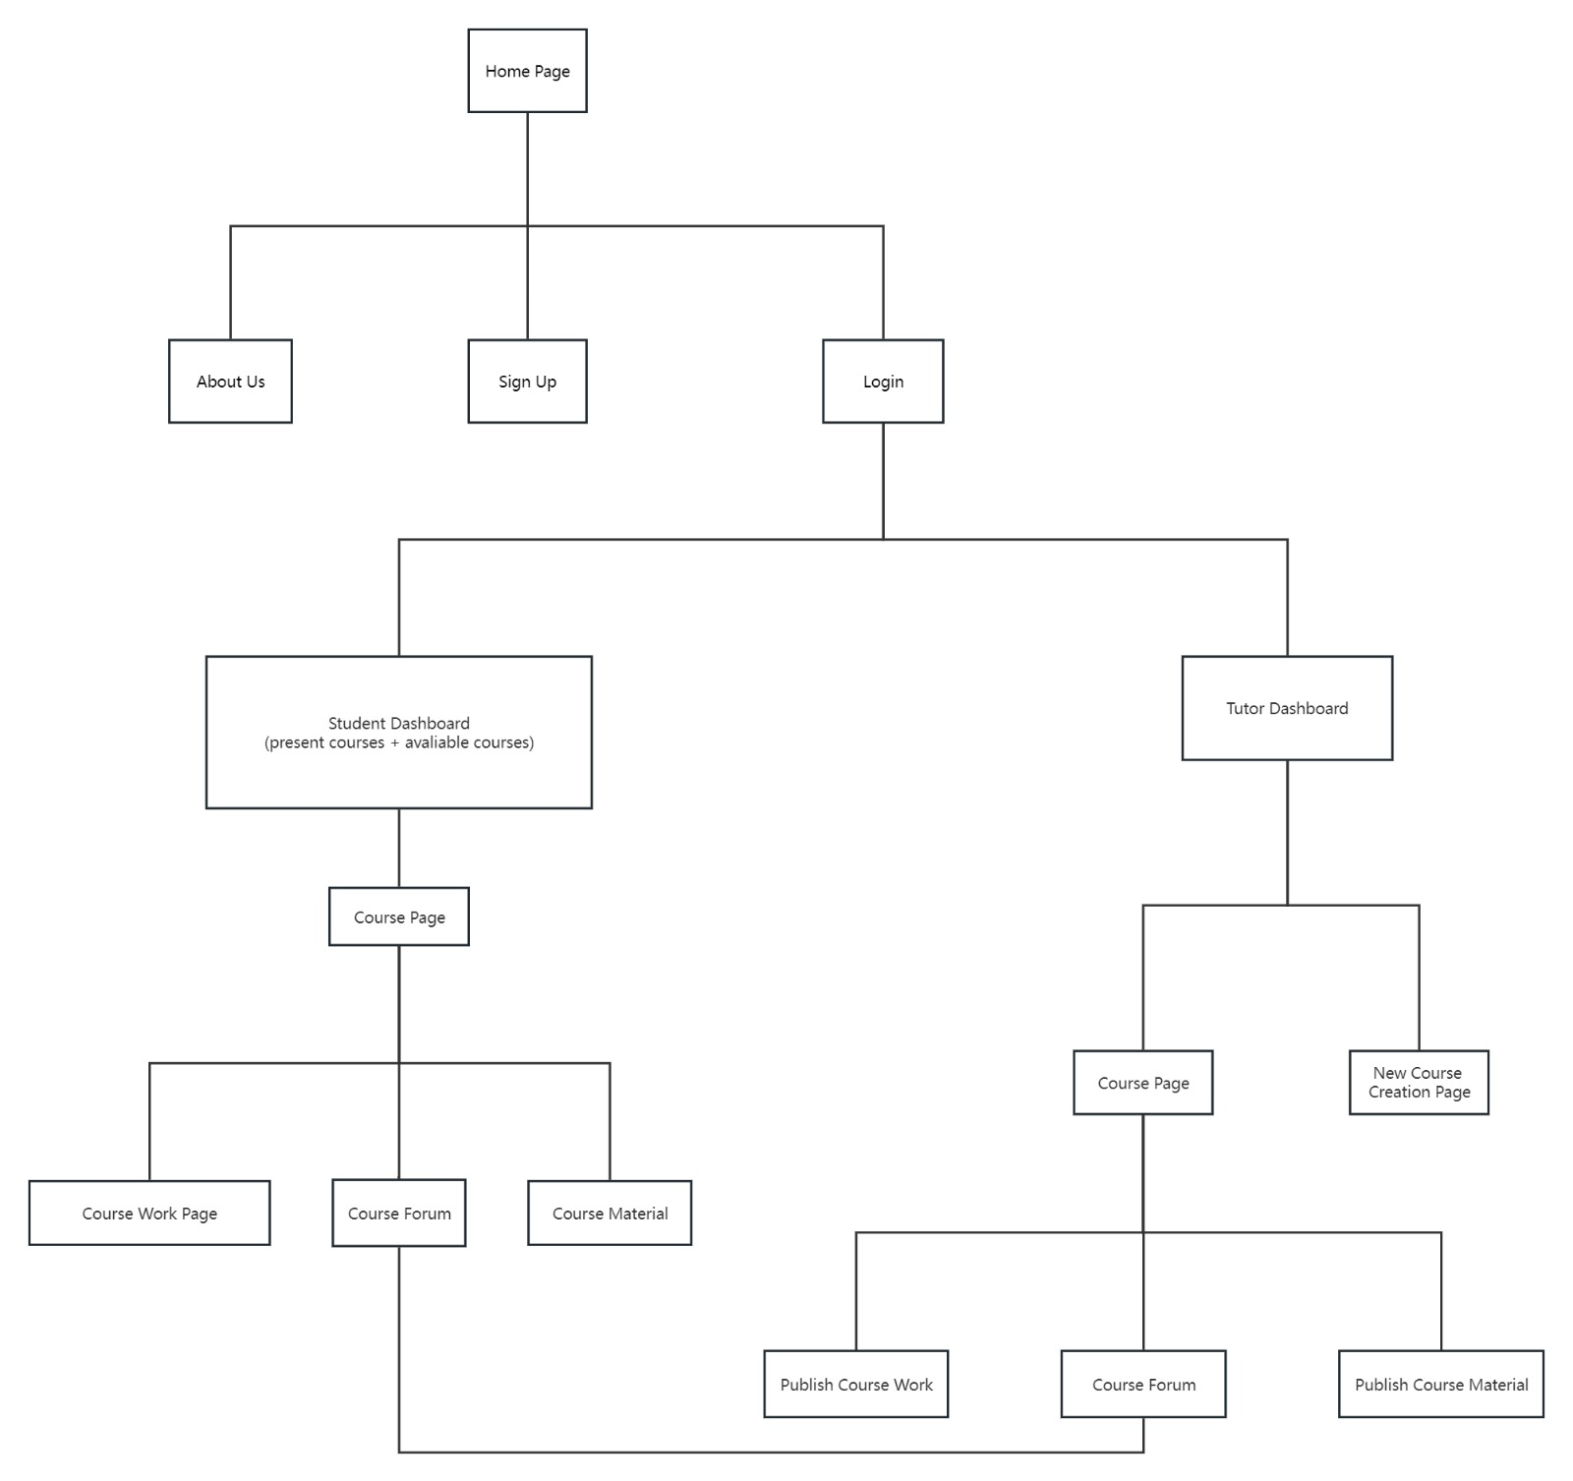
Site Map

Slide 9

Wireframes

Slide 15
Appendix: Contribution
Overview – Praharsh R Dubey, 2738037
Specification – Vikram Baruah, 2795941
ER Diagram – Yin Long, 2751099
High-Level System Design – Praharsh R Dubey
Site Map – Zhaobo Guo, 2815951
Wireframes – Yifan Guo, 2721370

Slide 16


Thank you

