Slide 1
TECHNICAL REPORT · MACHINE LEARNING
Delivery Delay Prediction
& Intelligent Scheduling
ML-based Decision Support System for Supply Chain Optimization

Slide 2
01 · PROBLEM STATEMENT
The Problem
Misaligned Prioritization
Inefficient Delivery Planning
Ignoring Compounded Risk
Priority labels do not guarantee timely delivery, as they fail to account for operational risk and real-world conditions.
Current scheduling relies on static rules (distance, priority) instead of adaptive, data-driven decision-making, leading to suboptimal execution.
Delivery outcomes depend on interacting factors like weather, traffic, and distance, but these are not evaluated together, resulting in underestimated risk.
Current systems fail not due to lack of data, but due to the inability to translate it into dynamic, risk-aware decisions.

Slide 3
02 · DATA ARCHITECTURE
Four Sources. One Unified Frame.
Deliveries.csv
Join: project_id, factory_id
Columns: delivery_id, actual/expected hours, delay_flag, distance_km
Projects.csv
Join: project_id
Columns: coordinates, demand, priority_level
​Factories.csv
Join: factory_id​
Columns: coordinates, production/week, variability
​
External_Factors.csv
Join: date​
Columns: weather_index, traffic_index (daily)
✦ Merged Dataset · Zero Missing Values · No Duplicates ✦

Slide 4
03 · EXPLORATORY ANALYSIS
What the Data Revealed
99%
Distance Effect
Exposure Matters
Delay scales with distance. Very Long routes show dramatically wider delay distributions vs. Short routes.
Weather and traffic only bite on long routes. The same index on a 10km route barely matters — on 400km, it compounds.
of deliveries
were delayed
Priority Doesn't Protect
Factory Variance
Binary classification is useless.
This project is about predicting
how much delay — not whether.
High-priority deliveries overlap with Low and Medium in delay. Priority flags are insufficient alone.
Some factories show systematically higher average delays, a supply-side signal independent of route conditions.

Slide 5
04 · FEATURE ENGINEERING
The Exposure Hypothesis
Primary risk drivers identified through feature importance analysis
weather_distance
traffic_distance
= weather_index × distance_km
= traffic_index × distance_km
Captures how much adverse weather a delivery is exposed to across its full route length. Short routes are nearly immune; long routes compound severity.
Captures sustained traffic congestion exposure. A heavy traffic index on a 400km route creates compounding delay far beyond what the raw index suggests.
​
priority_encoded​
production_variability​
day_of_week​
is_weekend
SUPPORTING FEATURES:
distance_km
weather_index
traffic_index
expected_time_hours
demand

Slide 6
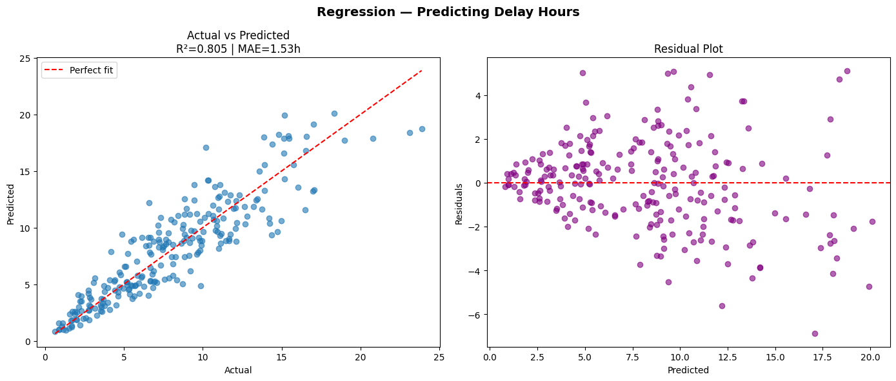
05 · RANDOM FOREST REGRESSOR
Model Performance
0.805
≈1.53 hrs
≈1.99 hrs
R² Score — explains 80.5%
of total delay variance
Mean Absolute Error —
average prediction accuracy
RMSE — penalizes
high-error predictions
SHAP Feature Importance Ranking
Key Finding
Strong Predictive Consistency Across Range:
The model maintains stable accuracy across low and high delay values, with errors remaining relatively controlled even for long-delay scenarios.

Slide 7
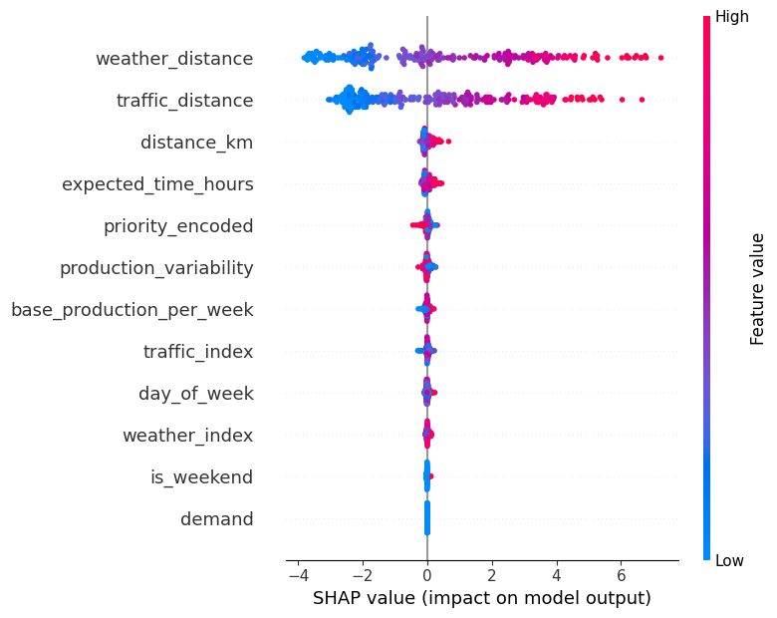
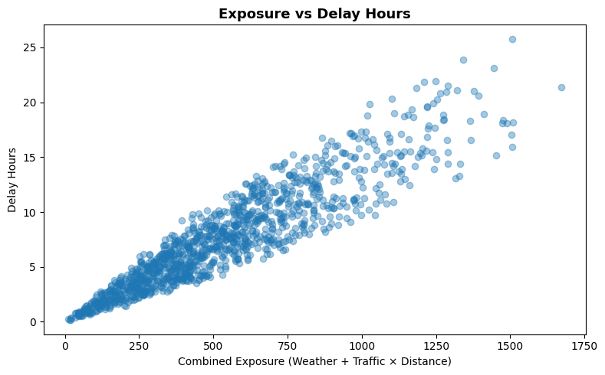
06 · CORE INSIGHT
Delay is not caused by
weather or traffic.
It is caused by EXPOSURE.
A high weather index or even traffic index on a short route barely moves the needle. The same on a very long route compounds into hours of delay.
This single insight unlocked the model's predictive power.
Short route +
bad weather
Long route +
bad weather
≈ Less impact
Hours of delay

Slide 8
07 · PRIORITIZATION STRATEGY
Risk-Based Priority Scoring
Priority Score Formula
Why These Weights?
predicted_delay
Base signal — predicted delay in hours
0.5 Priority
× (1 + 0.5 × priority_encoded)
Highest amplifier — represents an explicit business commitment. High-priority deliveries failing has direct customer impact.
Business priority amplifier (High=3, Med=2, Low=1)
× (1 + 0.3 × demand_norm)
Downstream impact — high-demand sites have less slack
0.5 Risk Escalation
Equal to priority — simultaneous weather + traffic surge demands immediate response before delay compounds.
× (1 + 0.3 × traffic_index)
Live traffic risk at route level
× (1 + 0.3 × weather_index)
Live weather risk at route level
0.3 Demand
High-demand project sites have less operational slack. A late delivery there has greater downstream disruption.
× (1 + 0.5 × risk_escalation)
Combined risk surge: avg(weather + traffic)
0.3 Traffic / Weather
× (1 + 0.2×w_dist + 0.15×t_dist + …)
Additive exposure refinement
Integrates live conditions even after exposure features — ensures current risk is always reflected in scores.

Slide 9
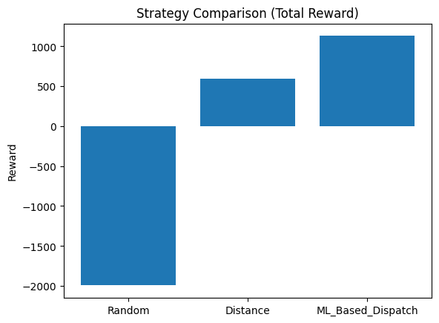
Stratrgy Comparison
Optimization & Reward System
Reward Function Rules
+10 pts
Delivery within 2 hrs of expected time
−15 pts
Delivery exceeds 2-hour threshold
+5 pts
High priority delivery scheduled
−2 pts/hr
Per excess hour beyond threshold (cap: 10hrs)
Top 100 deliveries selected per strategy across 1 simulation run.
ML Dispatch scored ~196% higher than random and ~64% higher than distance-based scheduling.

Slide 10
09 · CONCLUSIONS
What This System Delivers
01
Strong Predictive Power
R² = 0.805 — the model explains 80.5% of delay variance with MAE ≈ 1.53 hrs.
02
Exposure is the Core Driver
weather × distance and traffic × distance outrank all raw individual features in SHAP analysis.
03
Multi-Factor Urgency Scoring
The priority score integrates delay prediction, demand, priority, and live risk into one actionable ranking.
04
ML Dispatch Outperforms Heuristics
~196% higher reward than random, ~64% higher than distance-based scheduling in simulation.
05
Decision Intelligence, Not Just Prediction
This system enables proactive scheduling decisions — not just postmortem delay reports.

