Slide 1
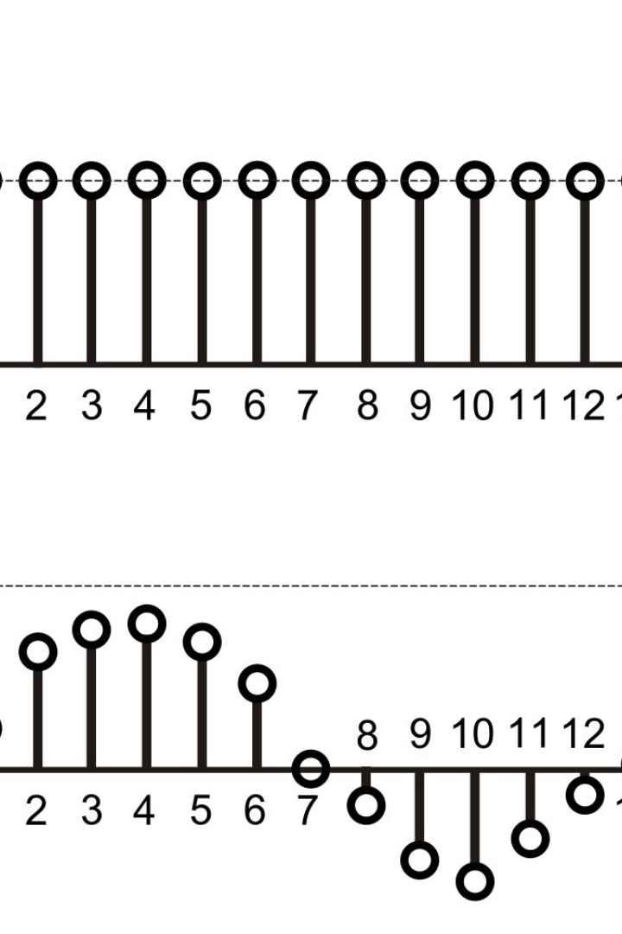
Circular Convolution
The Convolution Theorem of the Discrete Fourier Transform is a powerful tool widely used in signal processing applications. In this presentation, we will discuss circular convolution, its mathematical definition, and its significance in the field.
Praharsh Sharma

Slide 2

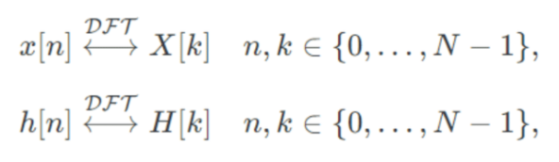
Convolution Theorem of DFT
The Convolution Theorem of the Discrete Fourier Transform (DFT) states that the circular convolution in the time domain is equivalent to the pointwise multiplication in the frequency domain. In mathematical terms, given two finite, discrete-time signals x[n] and h[n] of length N, and their DFTs:
The Convolution Theorem allows us to efficiently perform convolution operations using the fast Fourier transform algorithm, providing significant computational advantages. Understanding and applying the Convolution Theorem is crucial for various applications such as image processing, audio analysis, and communication systems.

Slide 3
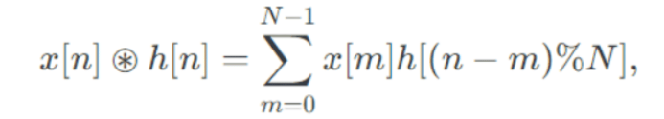
Circular Convolution: Definition and Formula
Definition
Math Formula
Circular convolution is a type of signal processing operation used to combine two signals, x[n] and h[n]
The mathematical formula for circular convolution can be expressed using the DFT.
⊛ symbol in the previous slide denotes the circular convolution.
where % denotes the modulo operation, i.e., 0%N=0; 1%N=1; N−1%N=N−1; N%N=0, etc.
Since both signals are of length N, it is called an N-point circular convolution.

Slide 4
Methods for Circular Convolution
1
Direct Method
Performing a DFT, point wise multiplication of the two DFT representations, and then an inverse DFT.
2
Concentric Circle Method
Take two concentric circles. Plot N samples of x1(n) on the circumference of the outer circle maintaining equal distance successive points in anti-clockwise direction.
Multiply corresponding samples on the two circles and add them to get output.
3
Matrix Multiplication Method
One of the given sequences is repeated via circular shift of one sample at a time to form a N X N matrix.
The other sequence is represented as column matrix.
The multiplication of two matrices give the result of circular convolution.

Slide 5

Why is Convolution Circular?
1
Periodic Boundary Conditions
2
Relation to Cyclical Signals
Understand the underlying mathematics behind circular convolution and how periodic boundary conditions contribute to its circular nature.
Explore the concept of cyclical signals and their connection to circular convolution, shedding light on why it is fundamentally circular.
3
Implications for Signal Processing
Discover the practical significance of circular convolution and how its circular nature enables efficient analysis of time-varying signals.

Slide 6
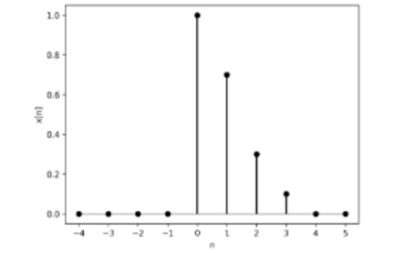
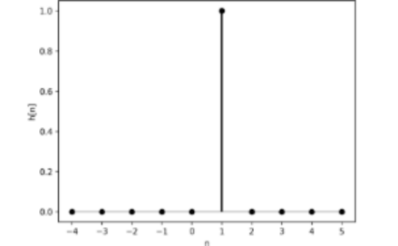
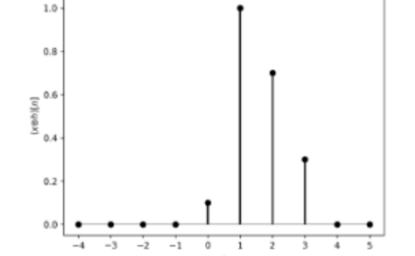
Illustrative Example
Signal 1: x[n]
Signal 2: h[n]
Circular Convolution between x[n] and ℎ[n]

Slide 7
Advantages and Disadvantages
Advantages of Circular Convolution
Drawbacks and Limitations
Uncover the advantages of circular convolution, such as efficient handling of cyclical data and its ability to preserve periodicity.
Explore the limitations of circular convolution, including its sensitivity to boundary effects and potential spectral leakage issues.

Slide 8
MATLAB Code and Conclusion
Performing circular convolution in MATLAB is a straightforward process that involves the fft function. This function computes the circular convolution of two sequences.
a = [2,3,5];
b = [7,11,13];
c = ifft(fft(a) .* fft(b));

