Slide 1

Doctor’s Appointment No-Show
(Team No-Show)
By:-
Chhavi Sharma
Prahasan Gadugu
Supriya Ayalur Balasubramanian

Slide 2
OBJECTIVE
No-show in healthcare-When a patient does not show-up/ cancels/ reschedules an appointment.
Reduce scheduling capacity, contribute to inefficiency, lower the quality of care, and negatively affect the working environment for providers and staff.
Reducing no-show rates can diminish cost and improve quality of health care delivery.
RESEARCH QUESTIONNAIRE
What factors are most likely to determine whether a patient shows up to their scheduled doctor’s appointment?
How is the absence/no-show to a scheduled appointment dependent on the general characteristics and behavior patterns of the patient?
Can we predict whether a patient would show up or not by taking the aforementioned variables as explanatory variables into consideration?

Slide 3




DATA DESCRIPTION:
Basic idea: To identify the reasons behind a patient skipping his/her doctor’s appointment.
Kaggle Dataset- drawn from 300,000 primary physician visits in Brazil across 2014 and 2015
Information about the appointment was labelled. When a patient scheduled an appointment, its label was given by “Status” variable as:
1) No Show 2) Show
15 variables in the original data including: demographic data, time data and patients markers(Habits and ailments):
Age
Gender
AppointmentReservationDate
AppointmentDate
DayOfTheWeek
Status
Diabetes
Alcoholism
Handicap
Tuberculosis
Smoker
Scholarship
Tuberculosis
SMSReminder
WaitingTime

Slide 4
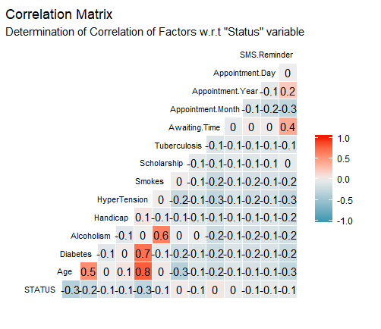
No meaningful relationship observed with ‘Status’

Slide 5
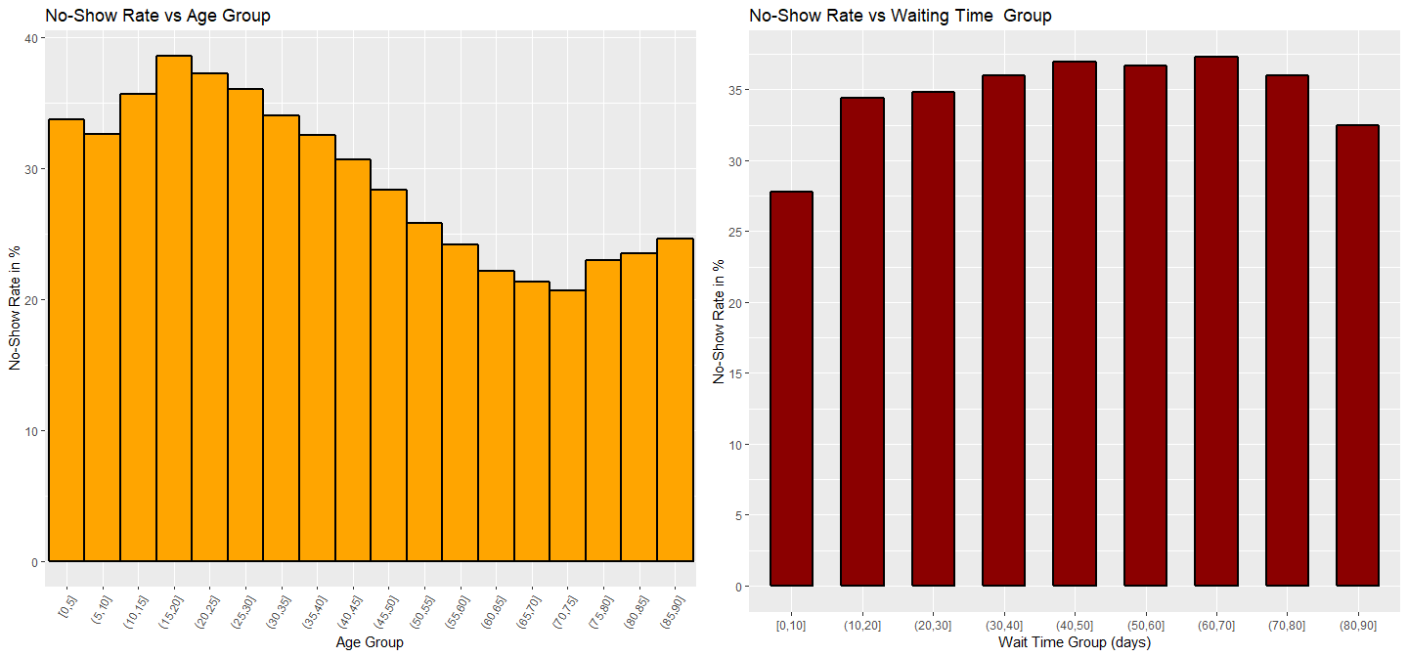
Older people show up more
Absence rate increases with waiting time

Slide 6
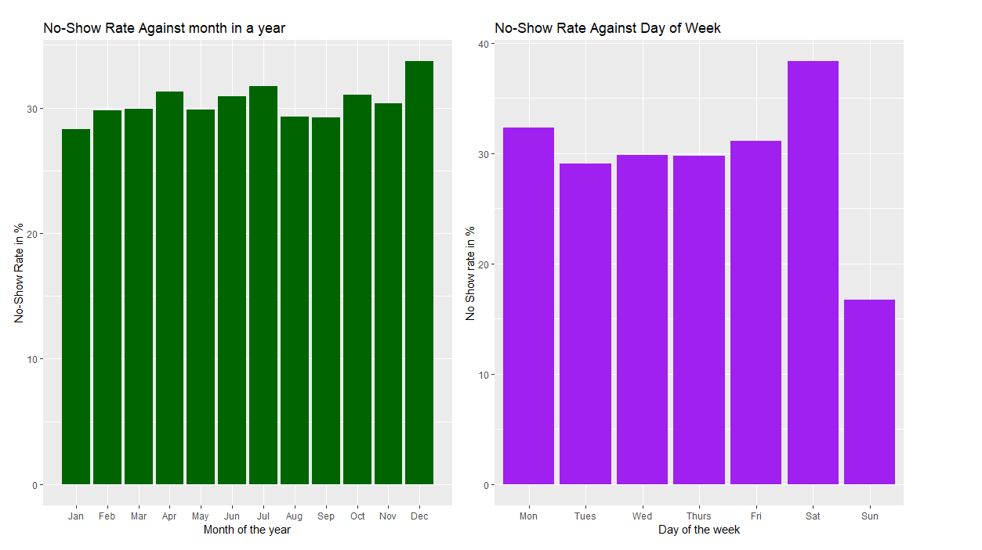
No-show rate highest for December
When excluded Saturday and Sunday(small sample size), Monday and Friday exhibit highest absence rate and Tuesday exhibits lowest absence rate

Slide 7
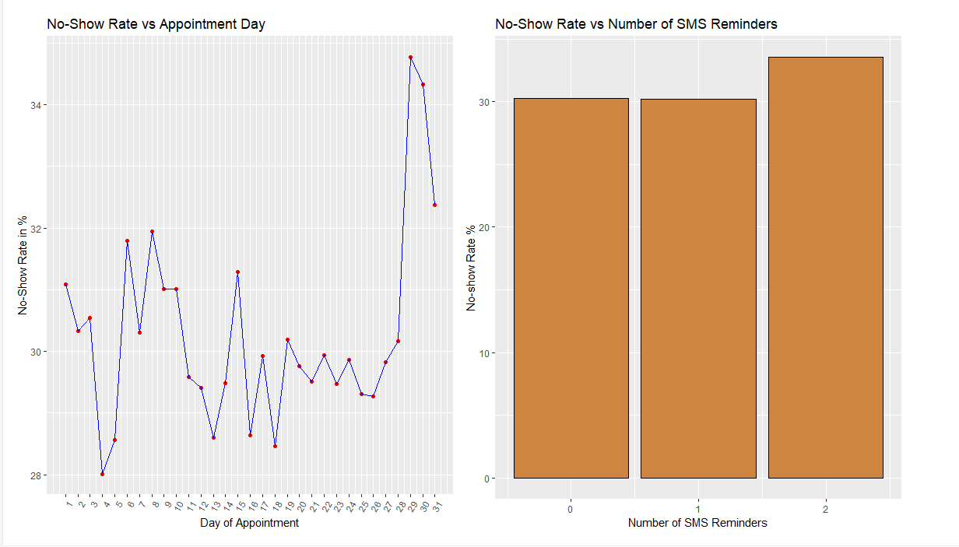
Patients more likely to show up during the beginning of the month rather than towards the end of month (last 3 days)
People receiving no SMS reminders less likely to skip an appointment than people receiving 2 reminders

Slide 8
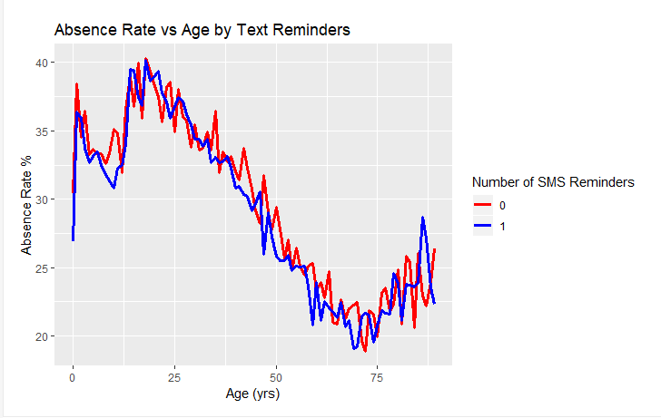
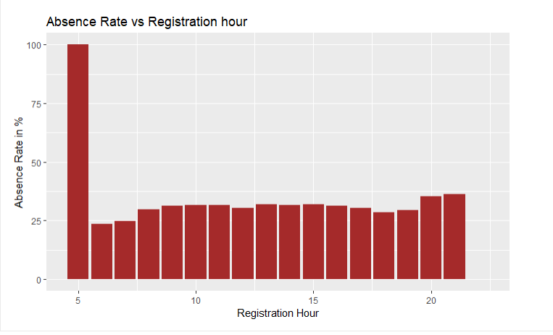
No significant effect of SMS reminders on absence rate given age
People definitely do not show up for appointments registered at 5 am

Slide 9
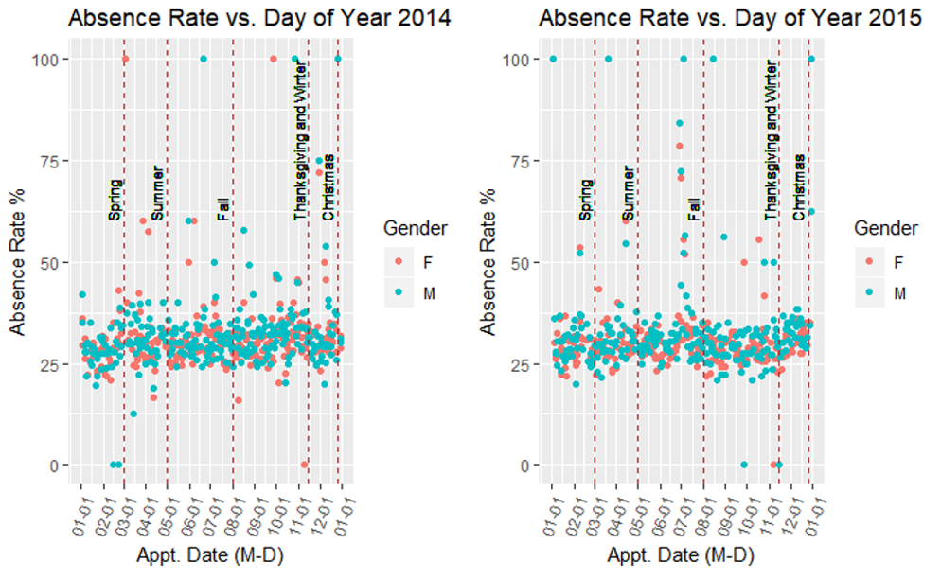
No-show rate each season approximately constant through time for 2014
No-show rate higher in Summers for 2015

Slide 10
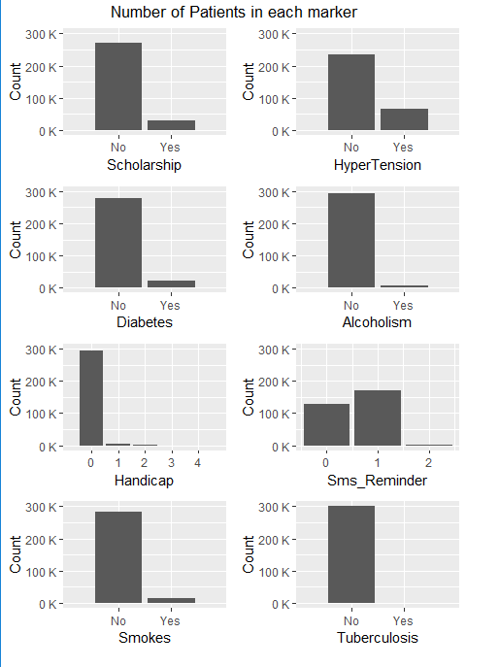
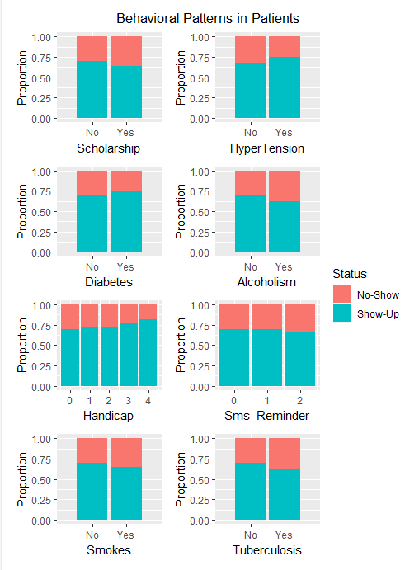
High imbalance observed in data
No clear trends based on behavioral patterns

Slide 11
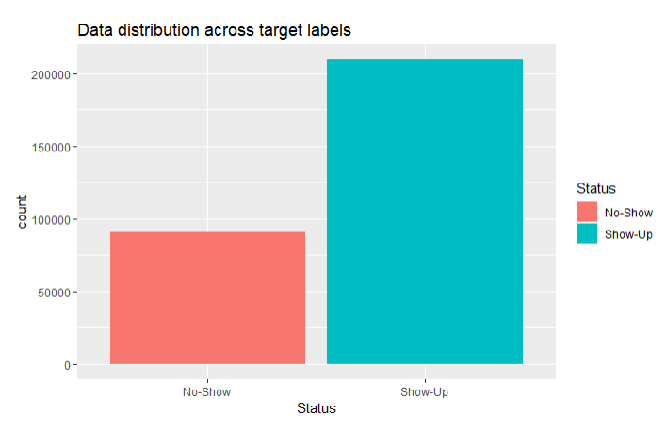
FEATURE ENGINEERING AND PREDICTIVE MODELING:
Appointment Registration and Appointment Date do not contribute towards the Show/No Show prediction.
We will include patient markers/behavioral patterns of the patients in the model despite no significant contribution observed.
Highly imbalanced data with Show-up data being more! Confusion matrix is used as evaluation criteria to deal with imbalance.
Dataset was divided into Train set (80%) and Test set(20%).
Logistic Regression model was implemented.
Imbalanced Data

Slide 12
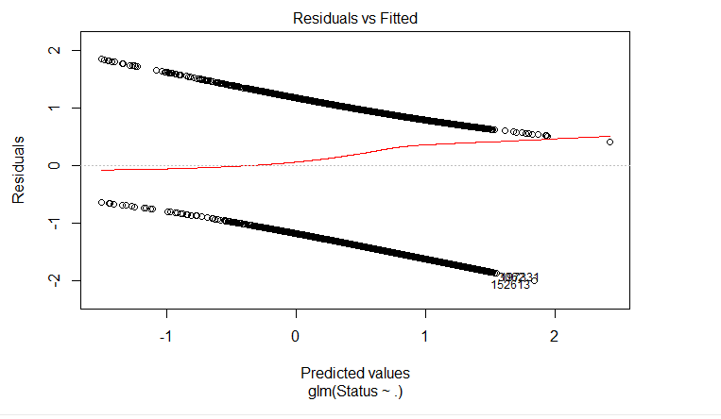
LOGISTIC REGRESSION MODEL RESULTS:
Most Important Features:
Gender.F
DayOfTheWeek.Monday
DayOfTheWeek.Tuesday
DayOfTheWeek.Thursday
DayOfTheWeek.Saturday
Diabetes.0
Alcoholism.0
Hypertension.0
Smokes.0
Scholarship.0
Tuberculosis.0
Sms_Reminder.1
WaitingTime
Age.bin[0,19]
Age.bin[19,38]
Age.bin[38,56]
Confusion Matrix:
No-Show | Show-up
No-Show | 5417 | 12728
Show-up | 8391 | 33462
Test accuracy: 64.8 %

Slide 13
Data is analyzed holistically rather than differentiating on gender.
The relative absence rate can be calculated which would give more individual comparison of the parameters.
The accuracy can be improved by hyperparameter tuning.
FUTURE SCOPE:

Slide 14

Any Questions ??

