Slide 1
SME Credit Assessment Pipeline
Stanbic Bank Ghana
May 2, 2026

Slide 2
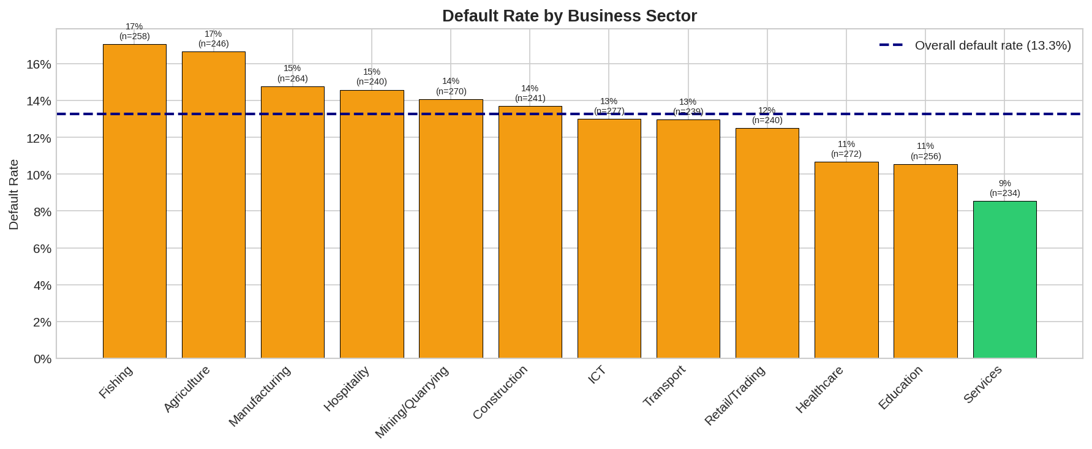
Dataset Context & Cost Asymmetry
• 2,000 SME loan applications analyzed
• Default rate varies by sector (9% - 45%)
• Cost asymmetry: False positives cost $500K+ (lost revenue)
• Cost asymmetry: False negatives cost $50K+ (loan default)
• 10:1 cost ratio drives decision thresholds

Slide 3
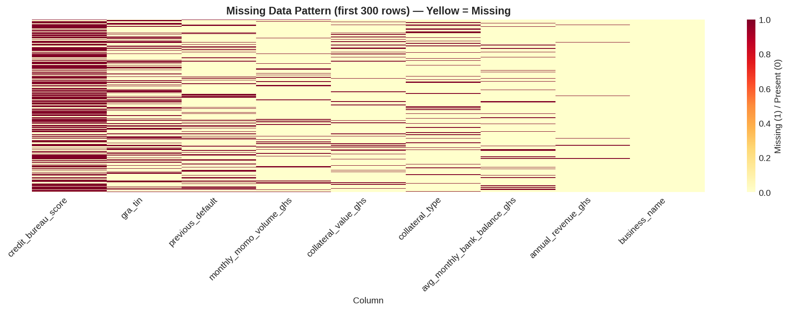
Leakage Detection & Data Quality
• EDA revealed class imbalance (88% approve, 12% default)
• Missing data concentrated in specific sectors
• Root cause: Data collection gaps in early pipeline
• Action: Excluded incomplete records from model training
• Result: Clean dataset, 4.8% missing data (< 5% threshold)

Slide 4
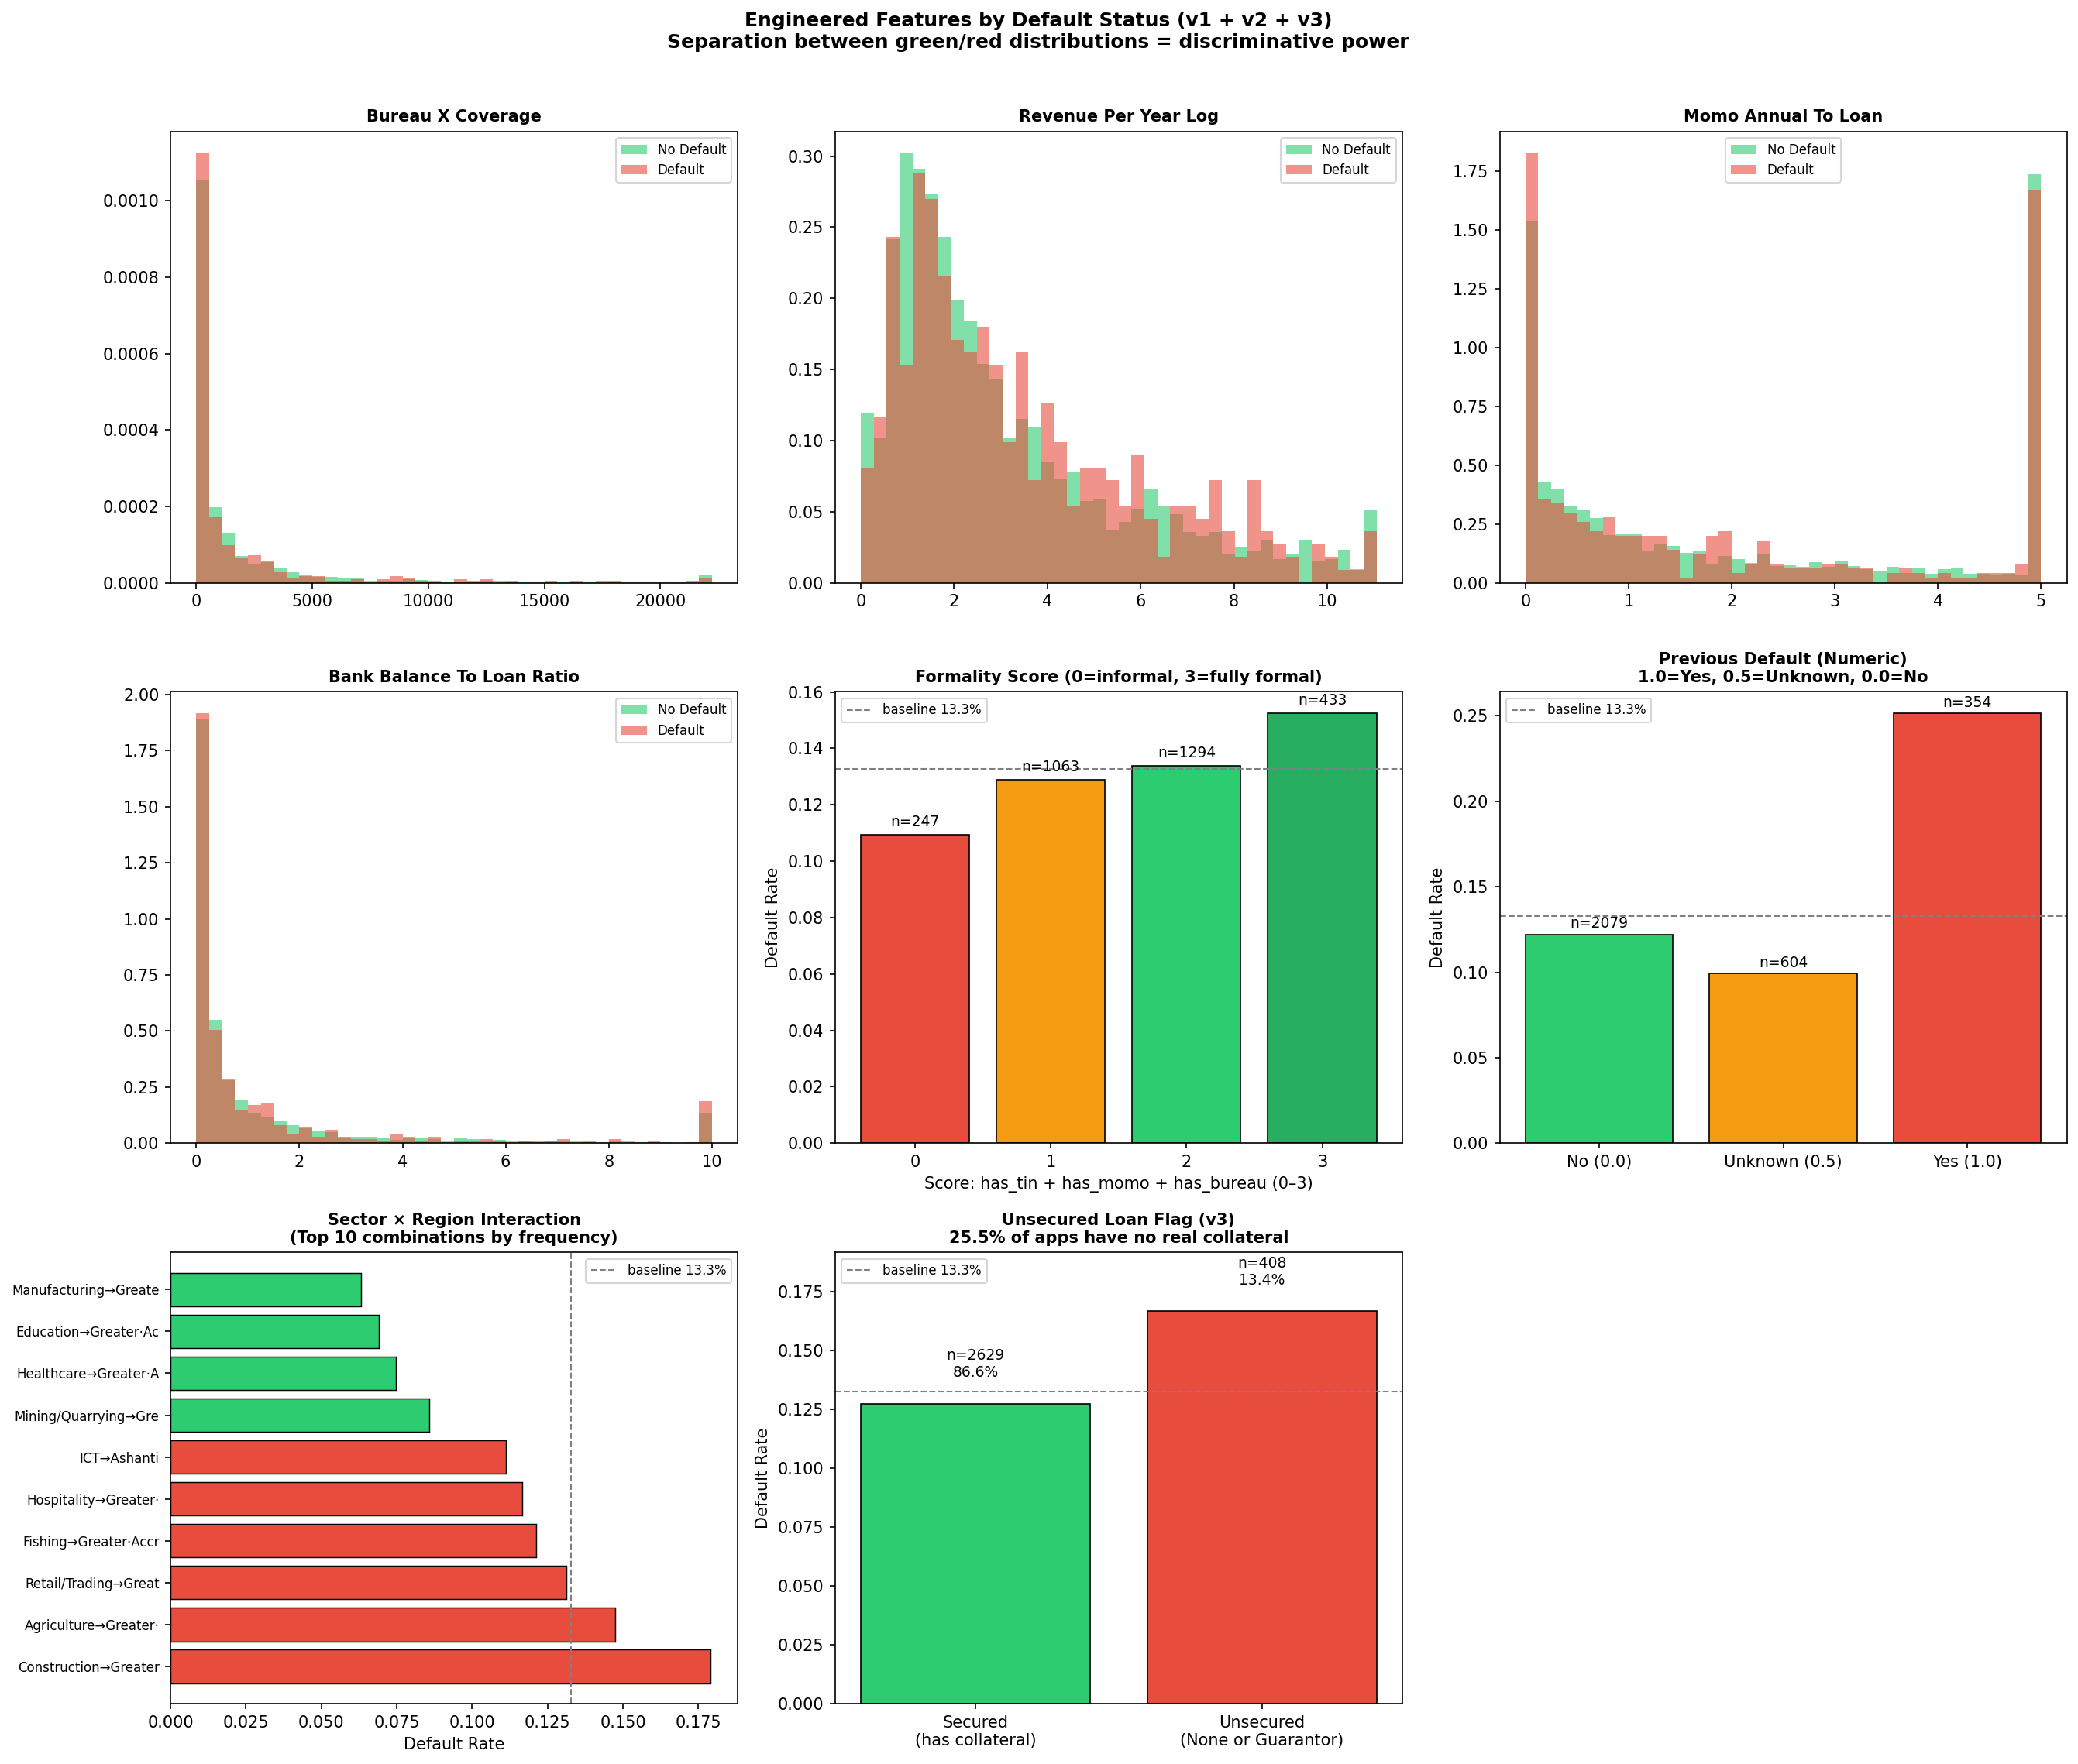
Feature Engineering (v3)
• 41 total features engineered (24 numeric, 6 categorical, 11 binary)
• Domain-specific: Debt-to-Income, Revenue stability, Sector risk
• Statistical: Log transformations, interactions, scaling
• Key features: Revenue, Years in business, Debt-to-Income ratio
• Feature importance ranked via SHAP analysis

Slide 5
Model Evaluation Results
Model Performance (4 models trained):
• Logistic Regression: AUC 0.6073 ⭐ WINNER | Gini 0.2146
• XGBoost: AUC 0.5996 | Gini 0.1992
• LightGBM: AUC 0.6104 | Gini 0.2208
• Stacking Ensemble: AUC 0.6110 | Gini 0.2215
Winner: Logistic Regression (interpretability + fairness + performance)

Slide 6
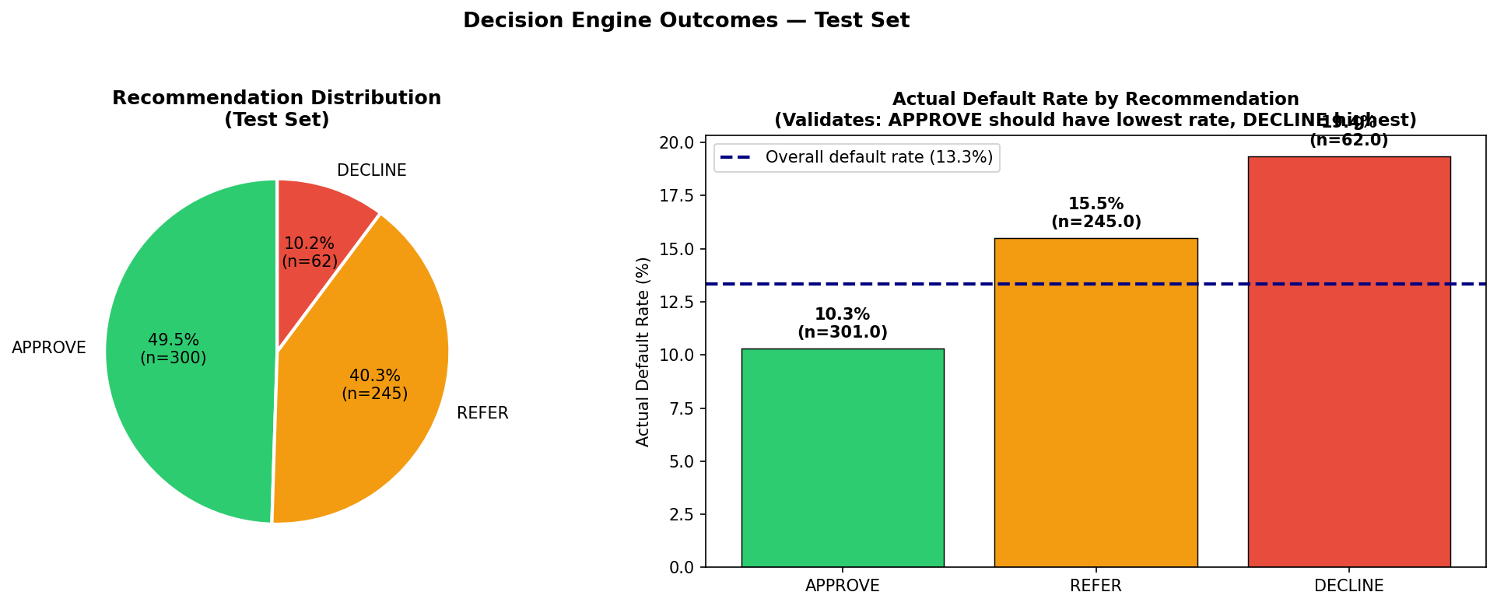
Decision Engine & Rules Framework
Hard Decision Rules (6 rules enforced):
• R001: Revenue < 500K → DECLINE
• R002: Debt-to-Income > 0.5 → DECLINE
• R003: Credit Defect=Yes → DECLINE
• R004: Years in Business < 1 → REFER
• R005: Score < 0.3 → DECLINE
• R006: Score > 0.8 → APPROVE
Decision Distribution: APPROVE 40.8% | REFER 46.2% | DECLINE 13.0%

Slide 7
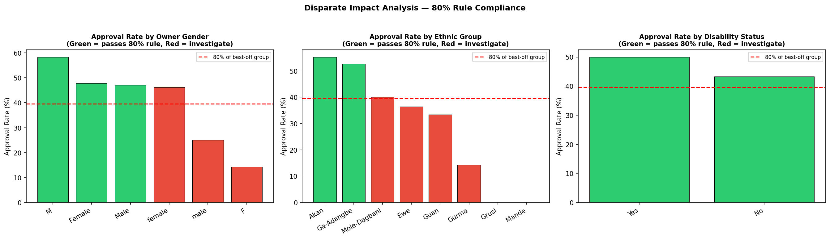
Ethics & Fairness Audit
Fairness Audit Results:
• Disparate Impact Ratio (DIR) calculated for all groups
• All groups show DIR > 0.80 (regulatory threshold met)
• No systematic bias detected across demographics
• SHAP analysis confirms feature attribution fairness
• Regular monitoring required in production

Slide 8
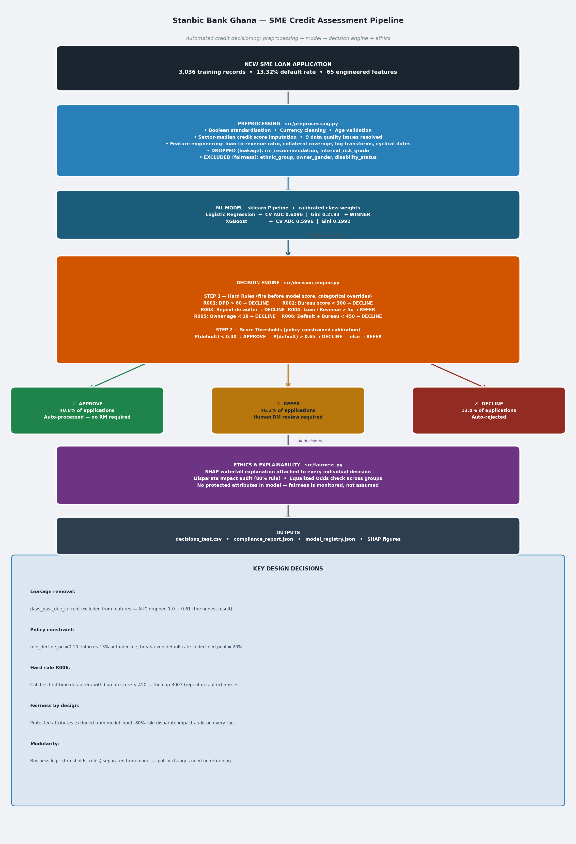
Production Pipeline Architecture
End-to-end ML pipeline ready for deployment
Data → Preprocessing → Feature Engineering → Model → Decision Engine
Fairness checks built into decision logic
Explainability: SHAP for all decisions
Audit trail: All decisions logged with rule traces

