Slide 1

Data Science Salaries 2023 💸
Team: The Demolition Men
Birat Jung Thapa(u3245672)
Prahlad Panthi(u3248319)
Shital Ghimire(u3218501)

Slide 2

Introduction
Description of the problem
1. Data science is a diverse field encompassing various roles, industries, and specializations, and understanding.
2. Salary distribution is crucial for both professionals and employers.
3.It is important to have nsights into salary trends and variations based on factors such as experience, job title, and geographical location.

Slide 3
Objective of project
We aim to Analyse and visualize Data Science salaries for the year 2023 to provide insights into salary trends, variations, and factors influencing compensation within the field.
Scope of the Project
Develop interactive and informative visual representations, including bar charts, pie charts, and geographical maps, to help professionals and employers make data-driven decisions regarding salary expectations, hiring, and workforce planning in the Data Science domain for 2023.

Slide 4
Data
Data Domain:
The project focuses on data related to salaries within the domain of Data Science.
Data Science is a multidisciplinary field that involves the analysis, interpretation, and management of data to extract valuable insights, make data-driven decisions, and solve complex problems.
Data Collection:
1. The salary data was collected from various sources, including job boards, salary surveys, industry reports, and online job postings.
2. The data sources were both public and private, reflecting a wide range of salary information across the Data Science domain.

Slide 5
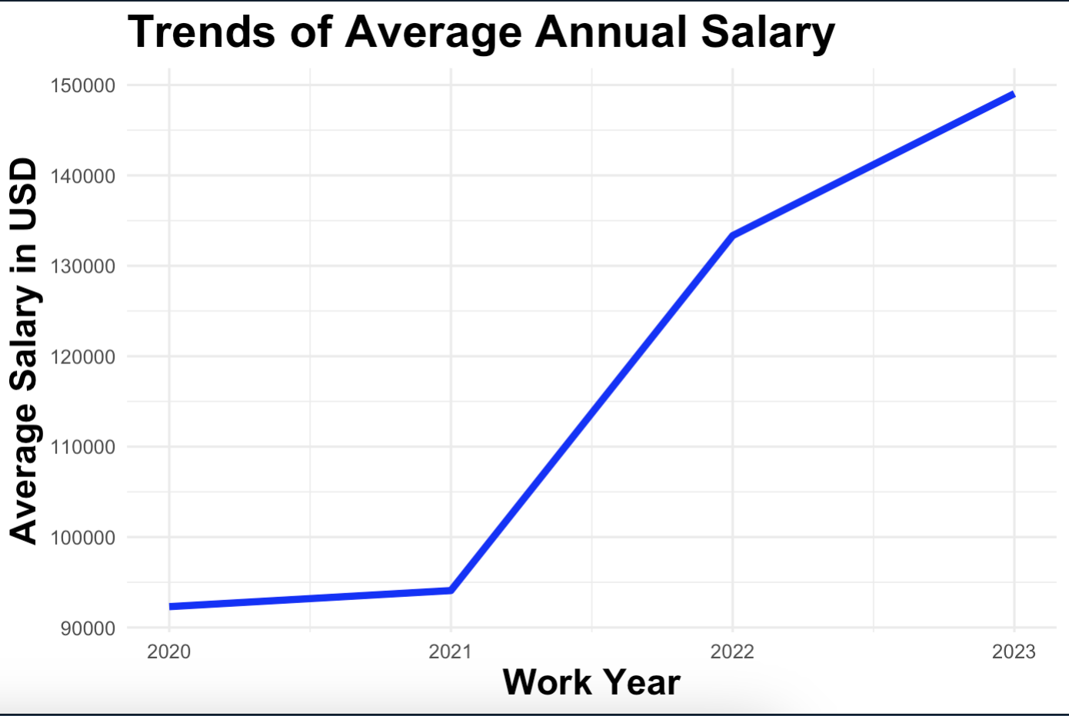
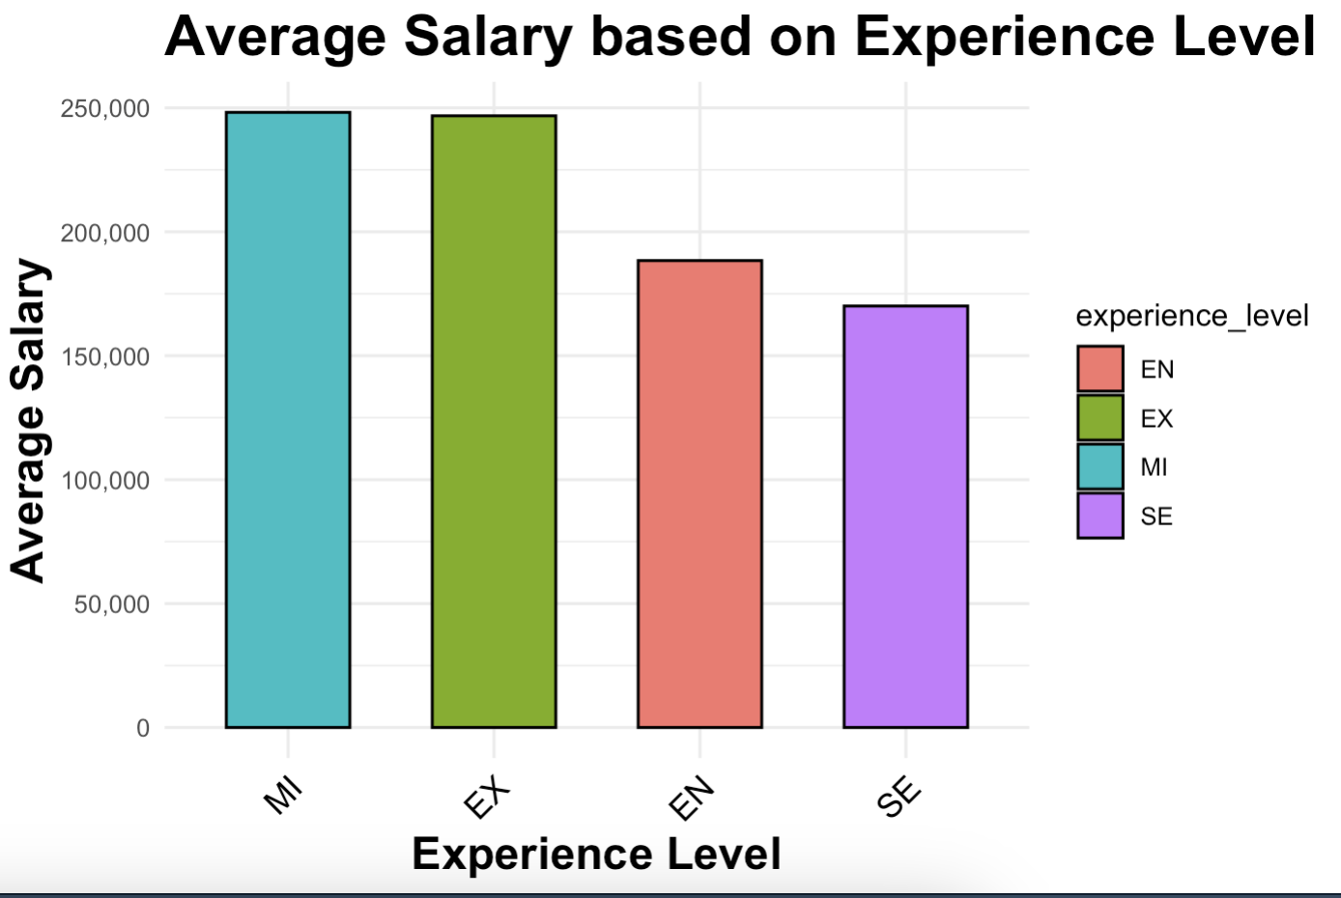
Analysis
How Salary Is trending over the years?
How is Experience level affecting the Salary?

Slide 6
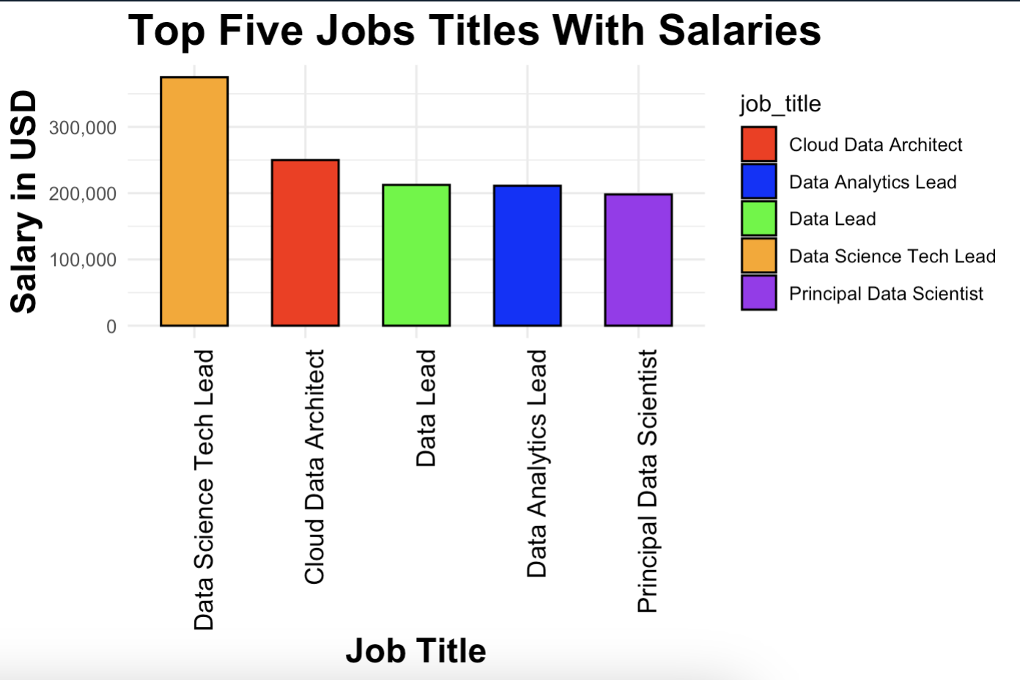
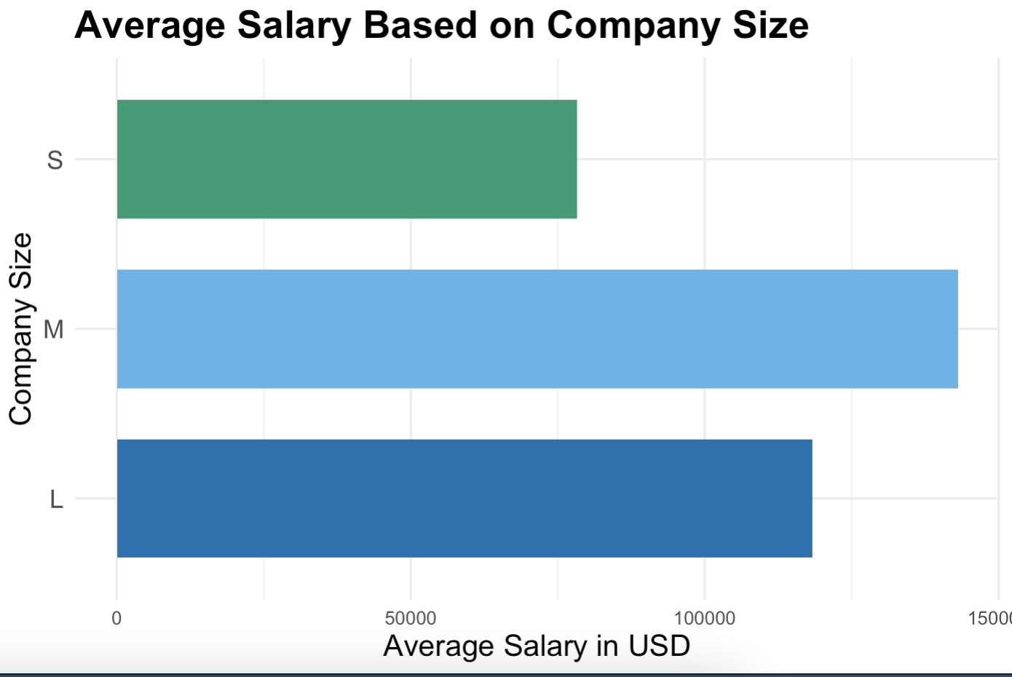
Analysis
Which job title gets the highest?
Does the salary depend on the size of the company?

Slide 7
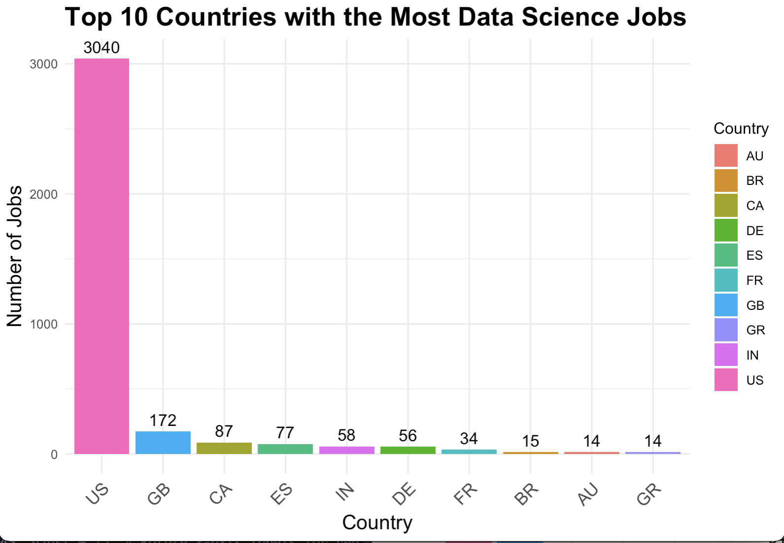
Analysis
WHERE ARE THESE COMPANY LOCATED?

Slide 8
KEY POINTS
PROJECT REVEALS THAT IN AVERAGE, SALARY OF DATA SCIENCE RELATED JOBS INCREASING OVER THE YEARS.
DATA SCIENCE TECH LEAD, CLOUD DATA ARCHITECT ARE AMONG THE TOP PAID.
JOBS WERE DOMINATED BY US MARKET.
COMPANY SIZE ALSO AFFECT THE SALARY.

Slide 9
CALL FOR ACTION
Professionals:
Use the insights to make informed career decisions, including job title choices, skill development, and understanding salary trends
Employers
Gain a better understanding of competitive salary ranges and factors that influence salaries.
Job Seekers:
Consider locations and companies with high job availability in Data Science.

Slide 10
CONCLUSION
The domain continues to offer competitive salaries, with a positive trend in recent years.
Experience levels and company sizes also impact salaries.
Geographical location plays a crucial role.
Certain countries offer more Data Science job opportunities than others.

Slide 11


Packages Used

Slide 12
References
Dataset:
https://www.kaggle.com/datasets/arnabchaki/data-science-salaries-2023/data

Slide 13

Thankyou for listening
Data Science salaries 2023 Q&A

