Slide 1
UMBS-seq: Testing cfDNA
Investigator: Tanner Baldwin
Analysis: C. Bryan Daniels and Chang Ye
Supervisor: Qing Dai
September 8, 2024

Slide 2
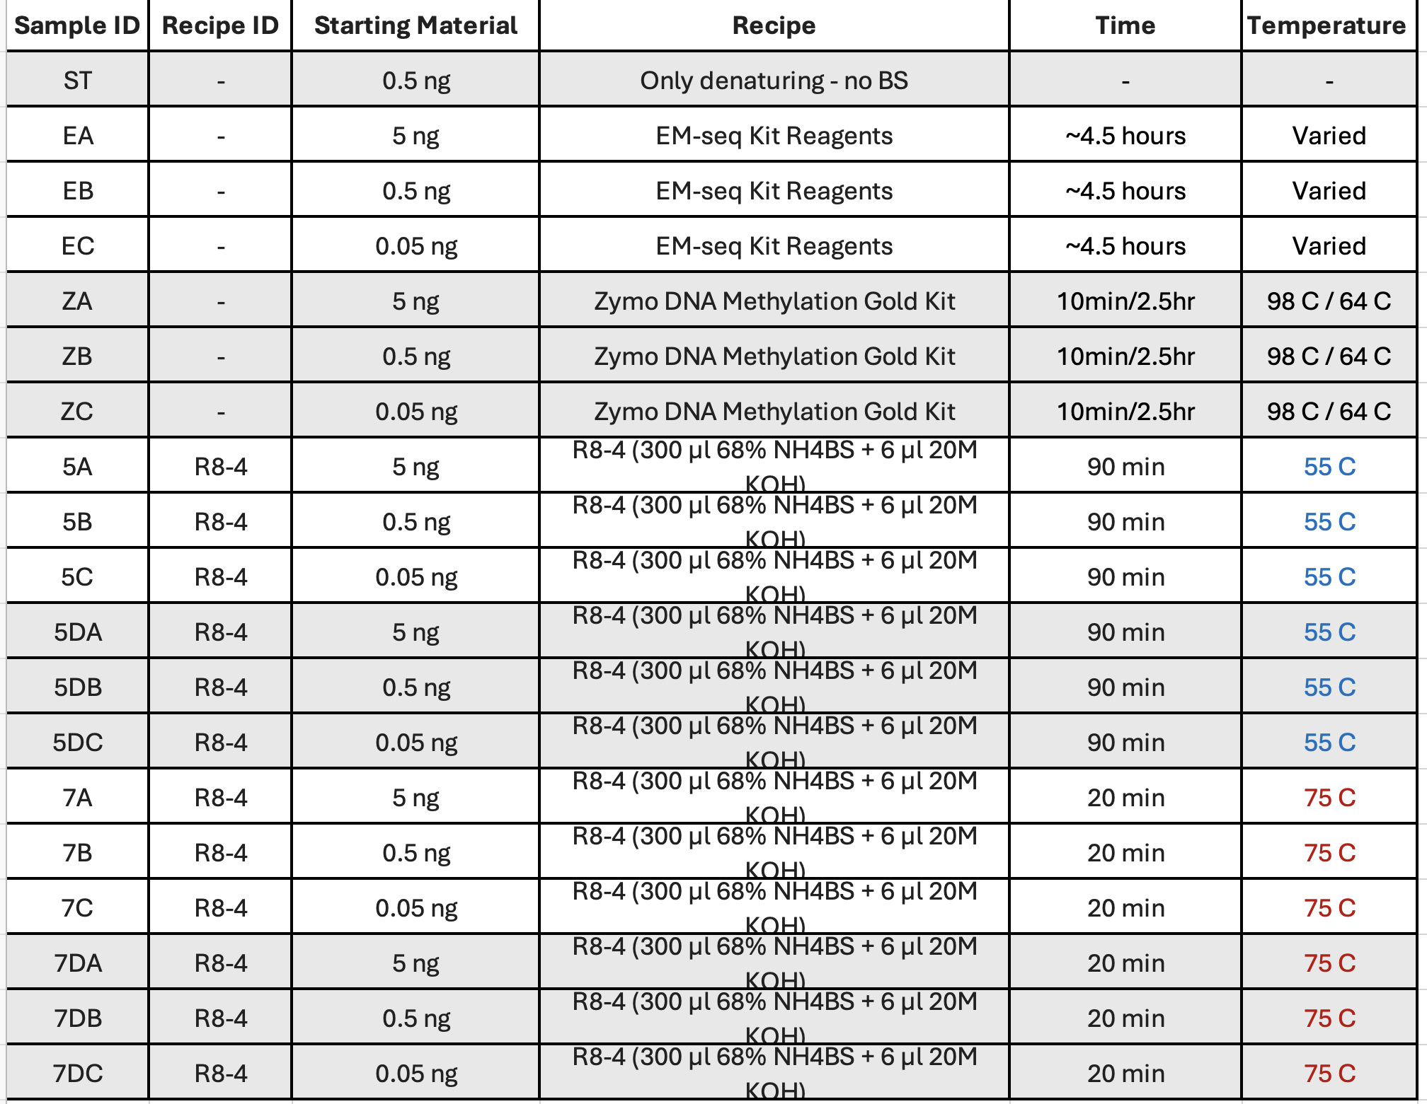

Slide 3


Slide 4


Slide 5


Slide 6
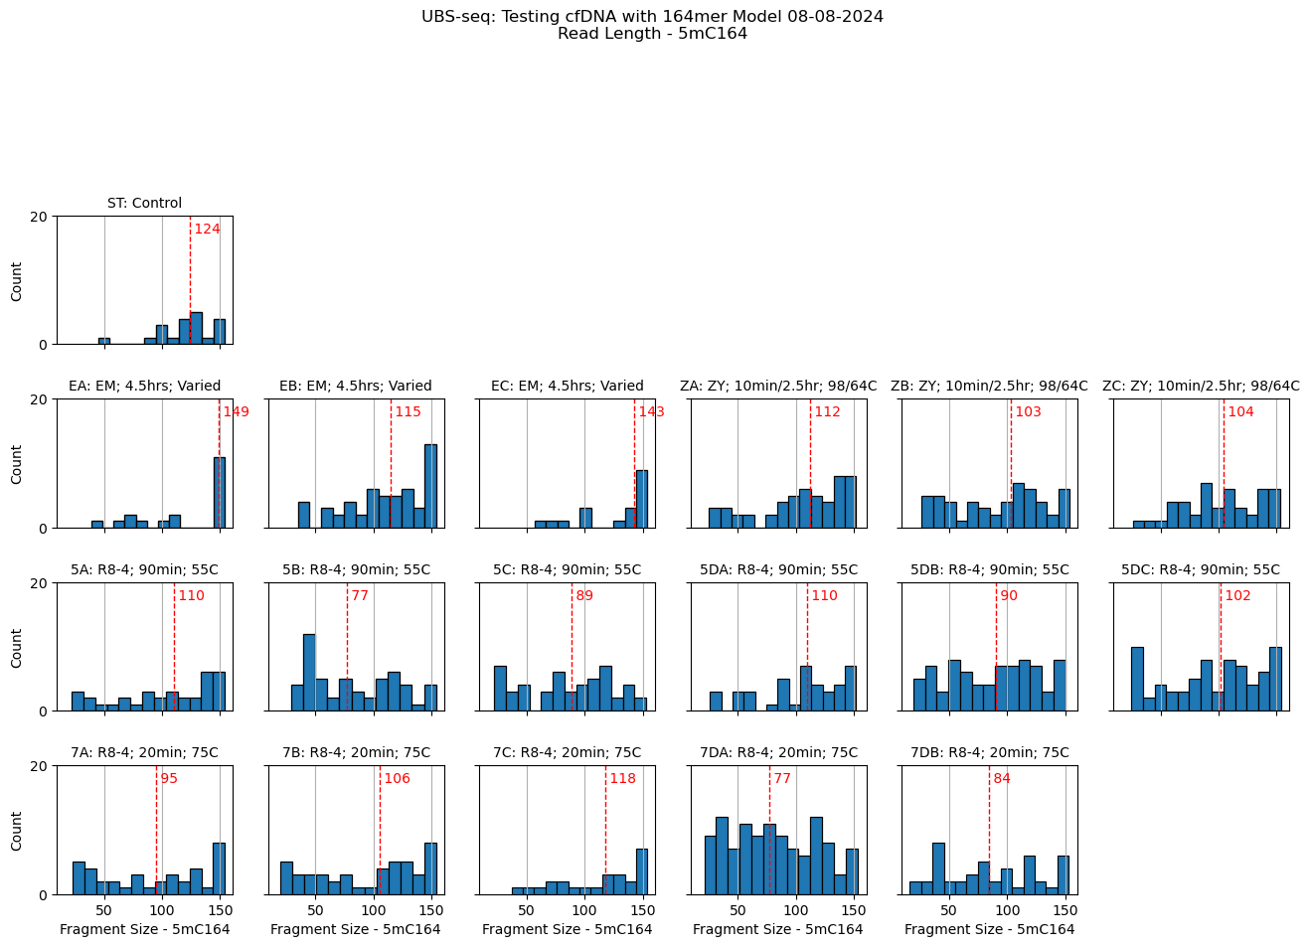

Slide 7
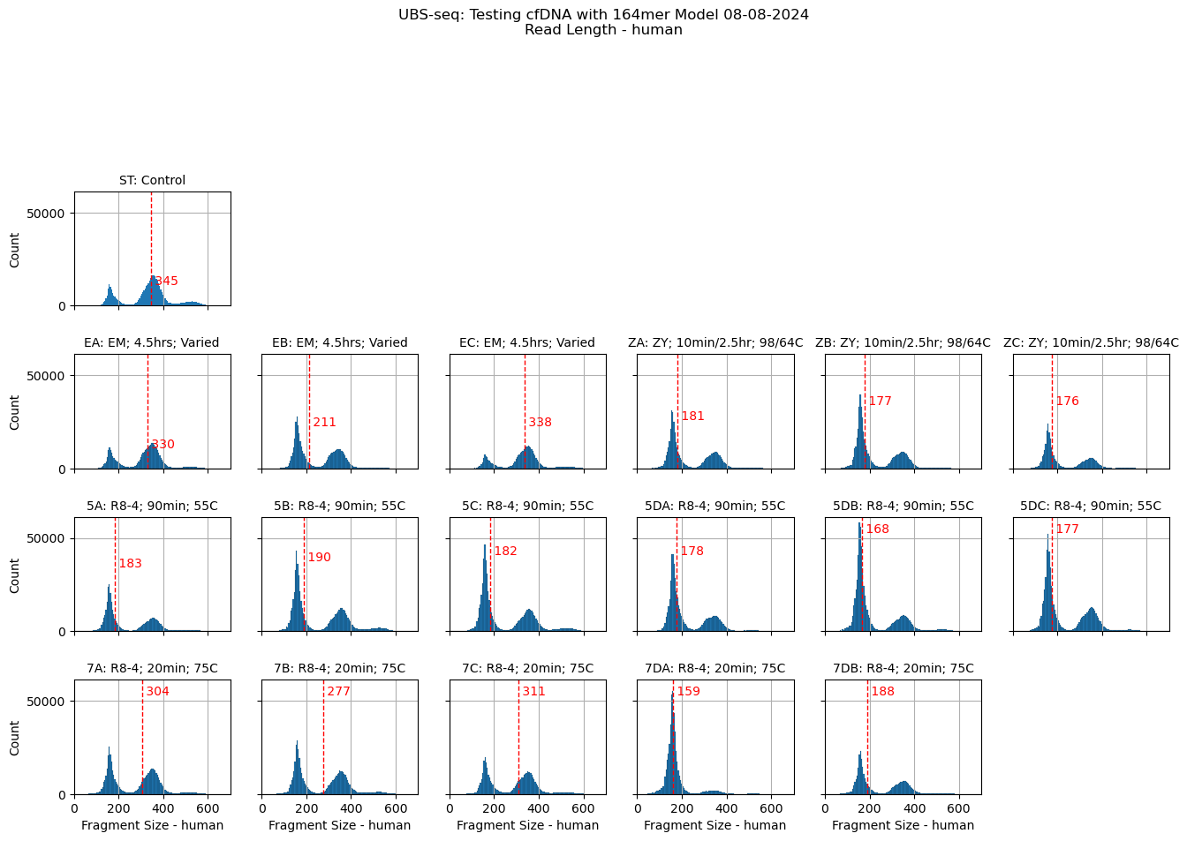

Slide 8
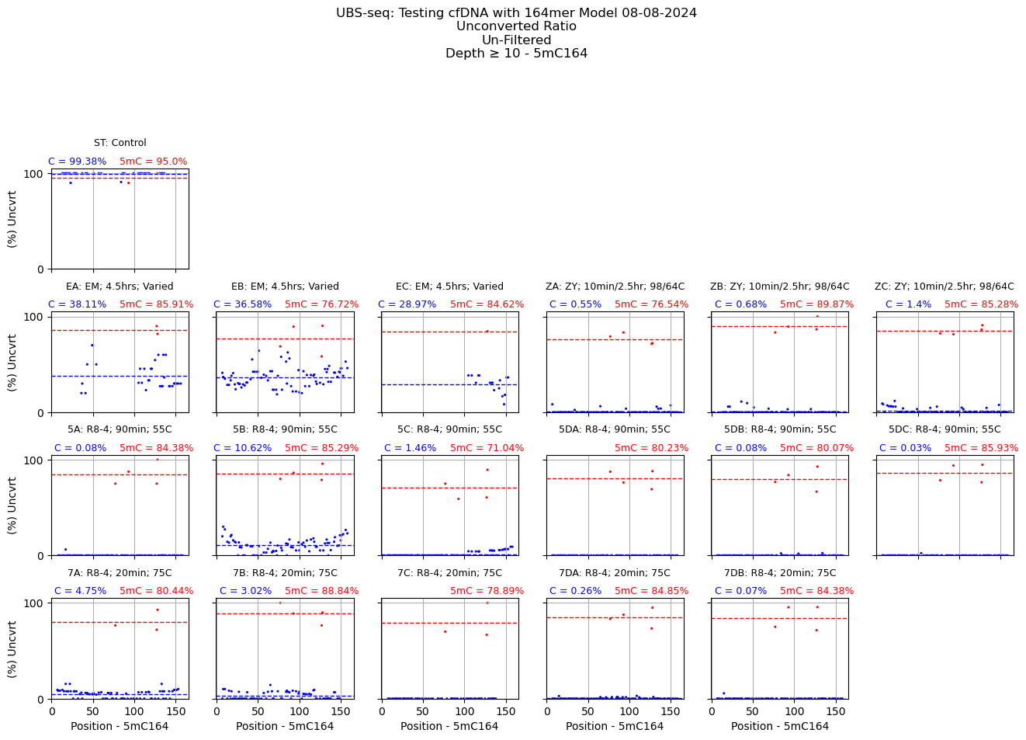

Slide 9
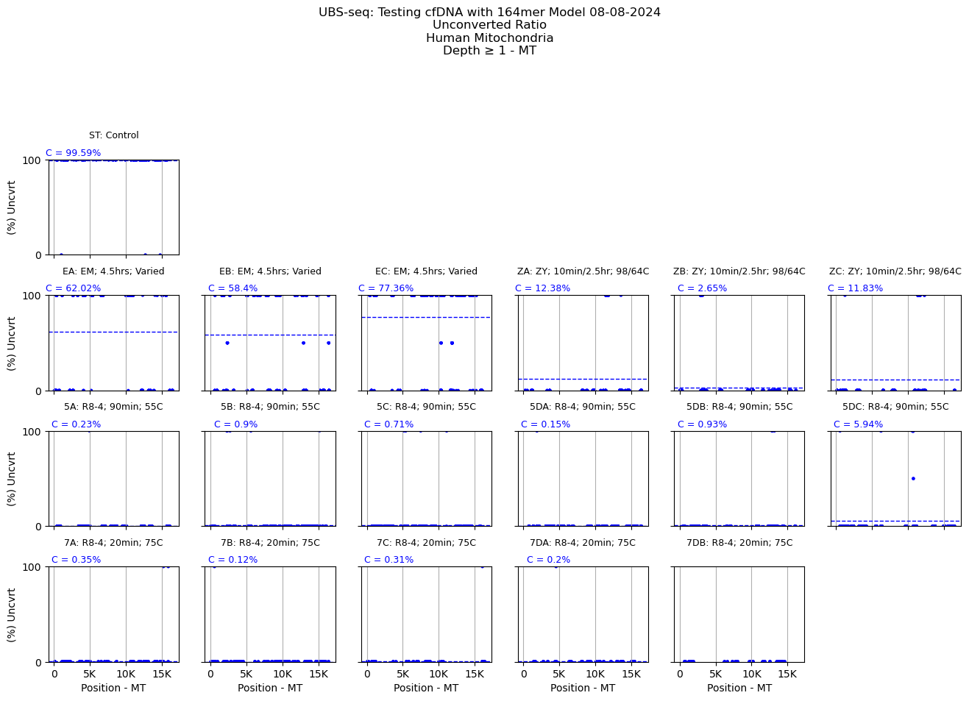

Slide 10
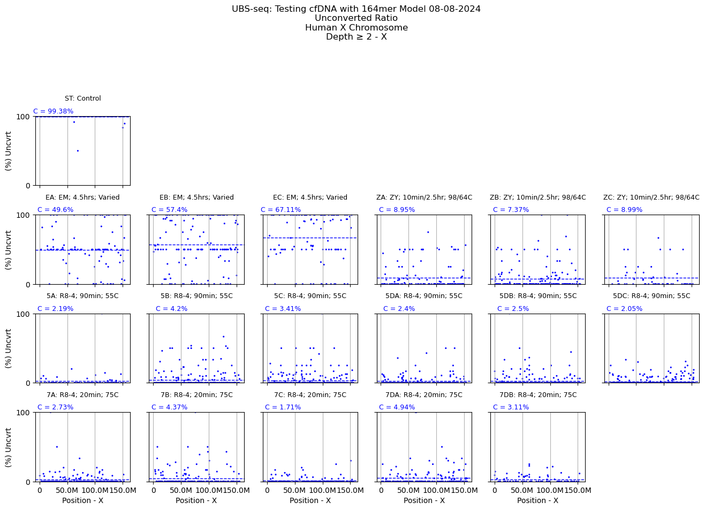

Slide 11
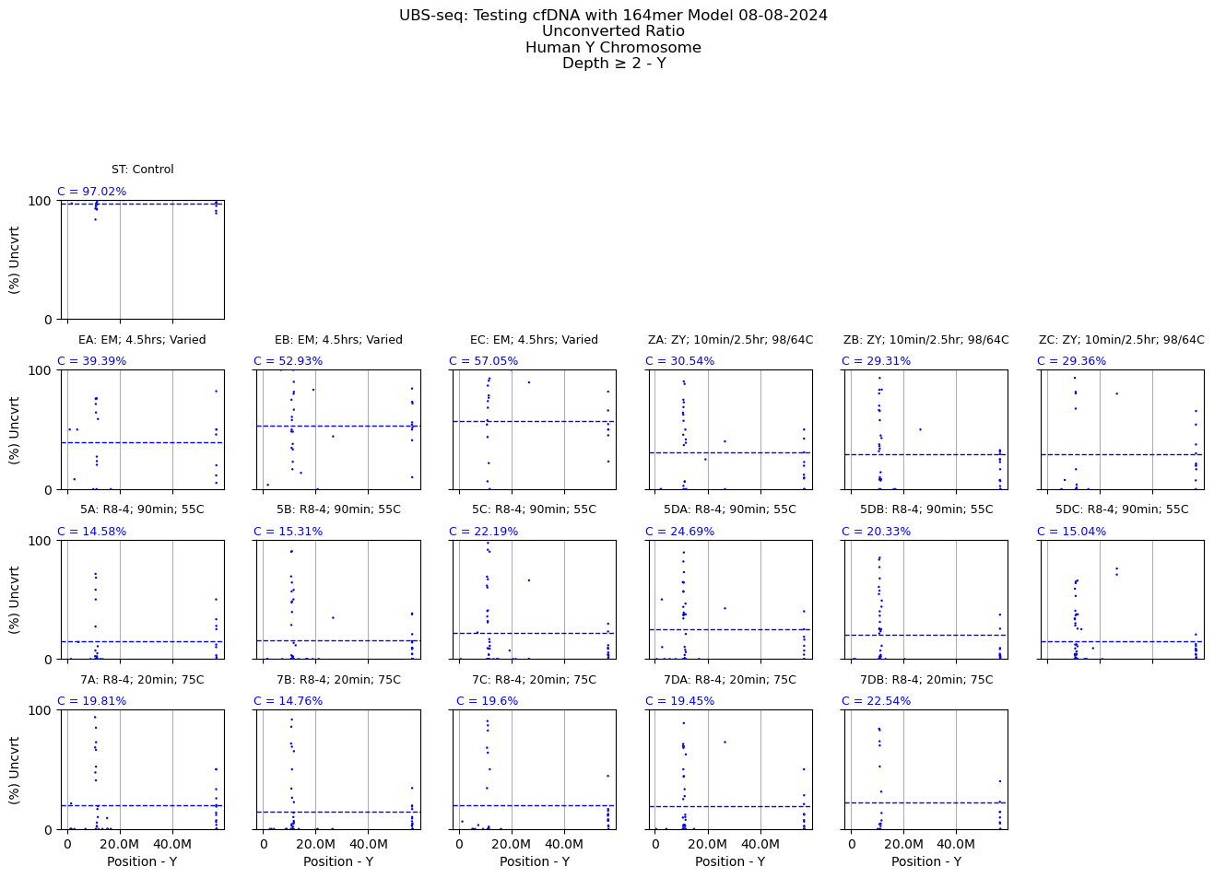

Slide 12
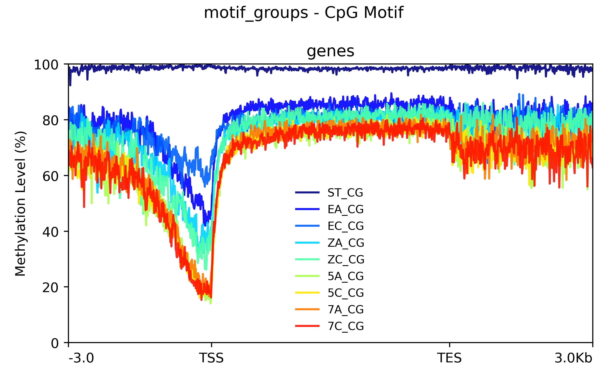

Slide 13
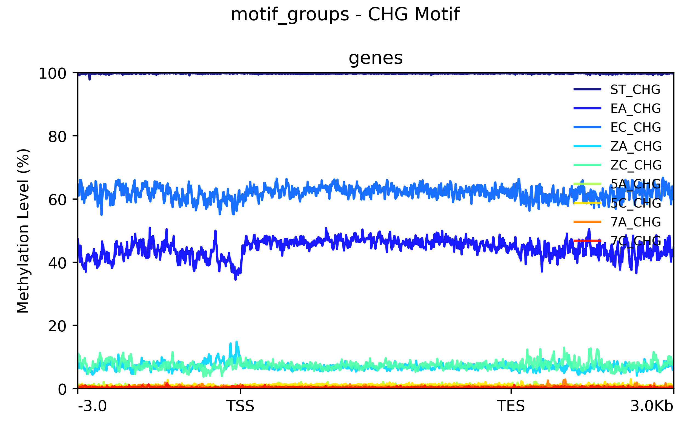

Slide 14
