Slide 1
Low Temperature UMBS Optimization
Investigator: Yushuai Liu
Analysis: C. Bryan Daniels
Sequencing: Chang Ye
Supervisor: Qing Dai
October 16, 2024

Slide 2
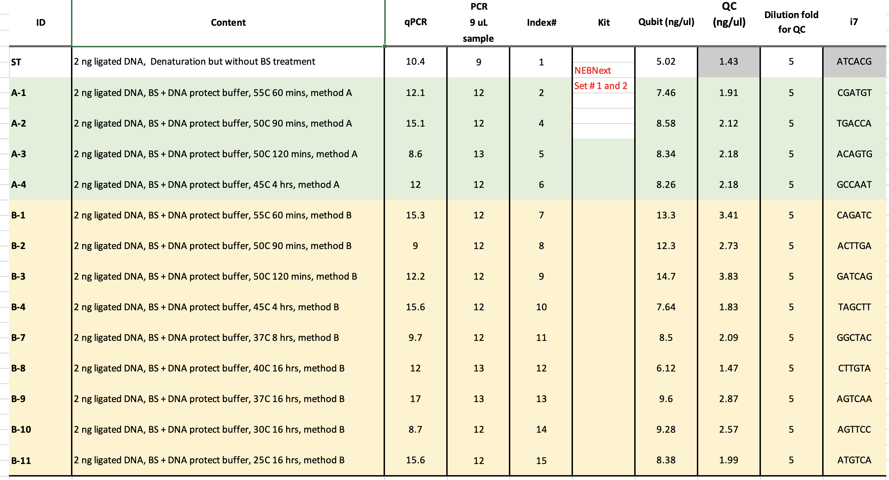

Slide 3


Slide 4


Slide 5
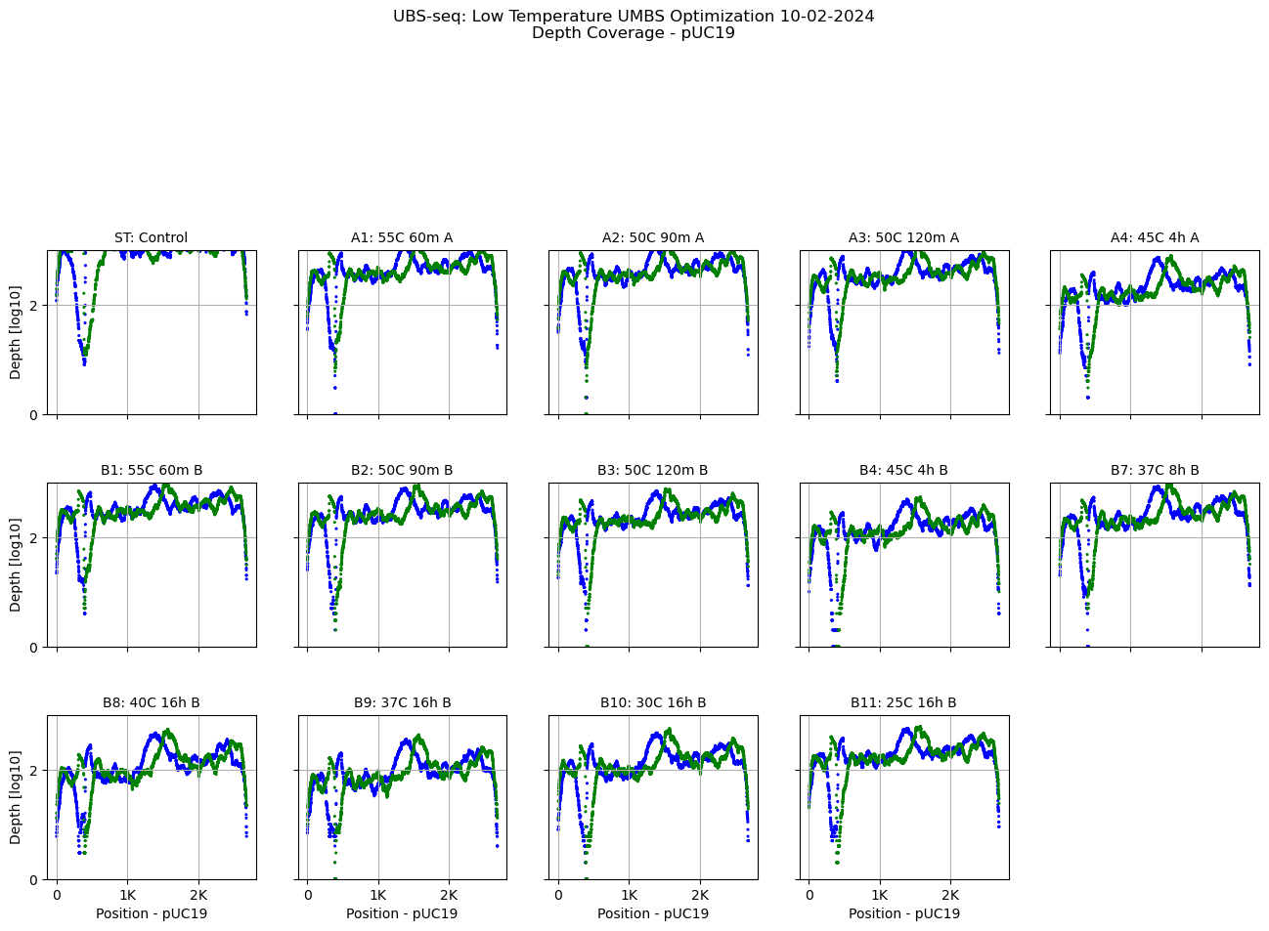

Slide 6
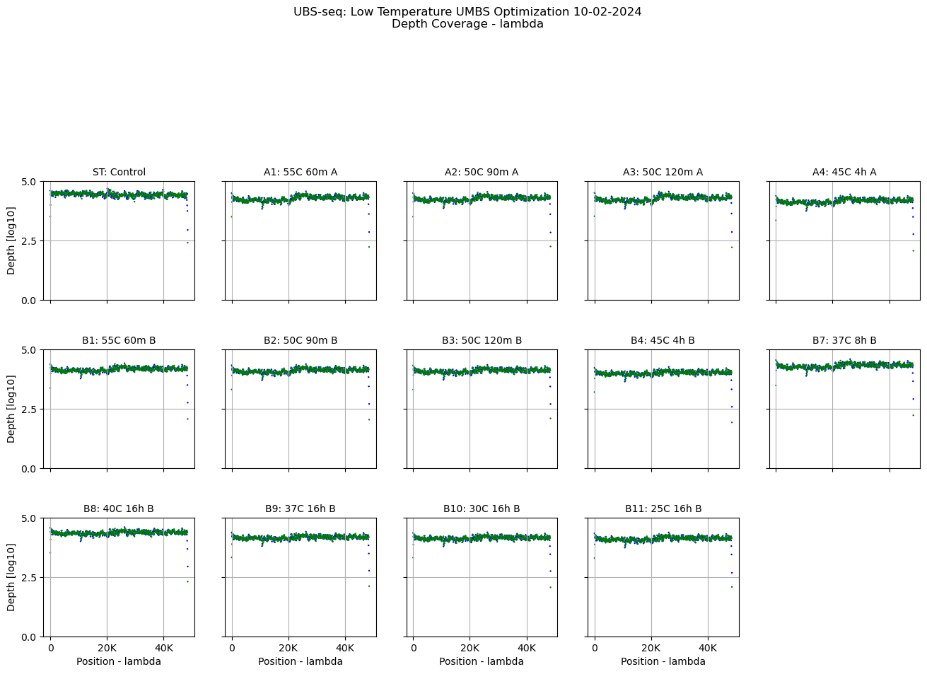

Slide 7
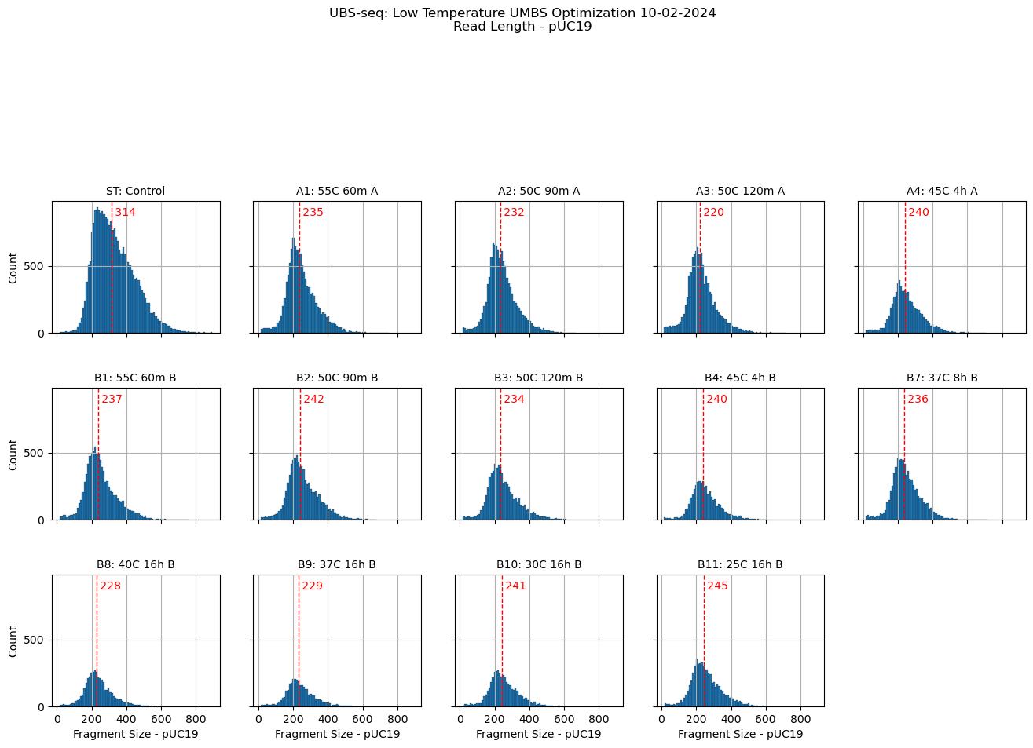

Slide 8
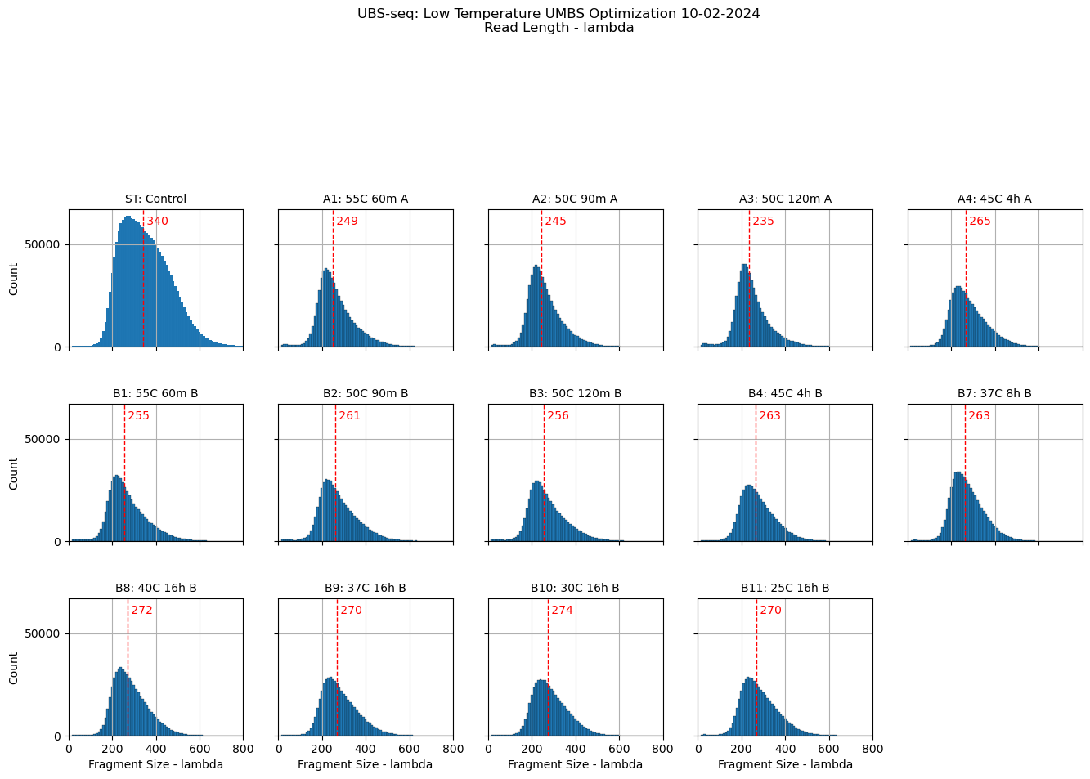

Slide 9
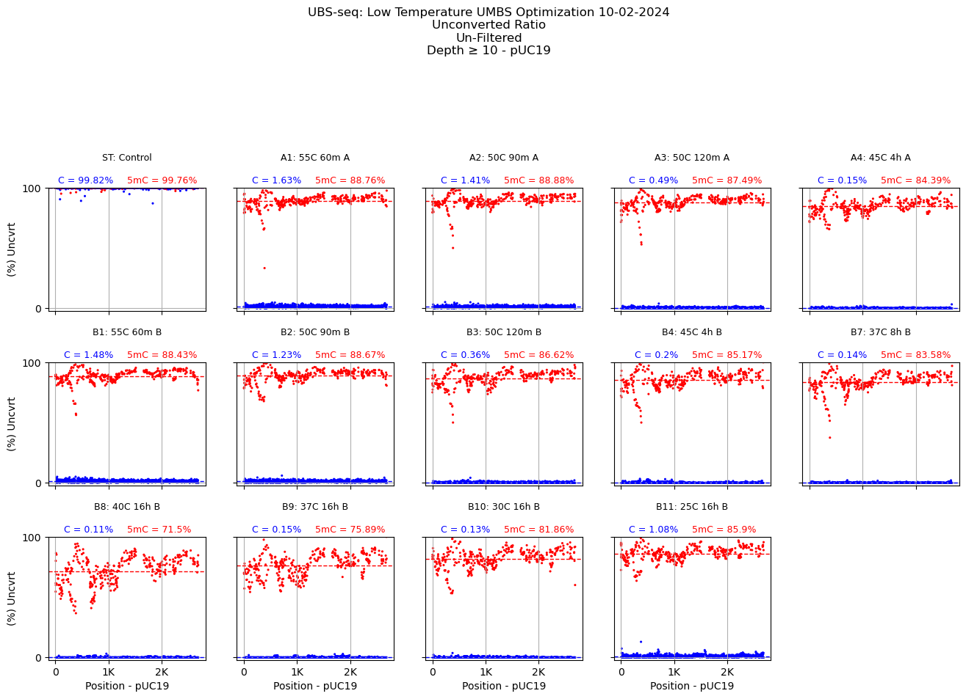

Slide 10
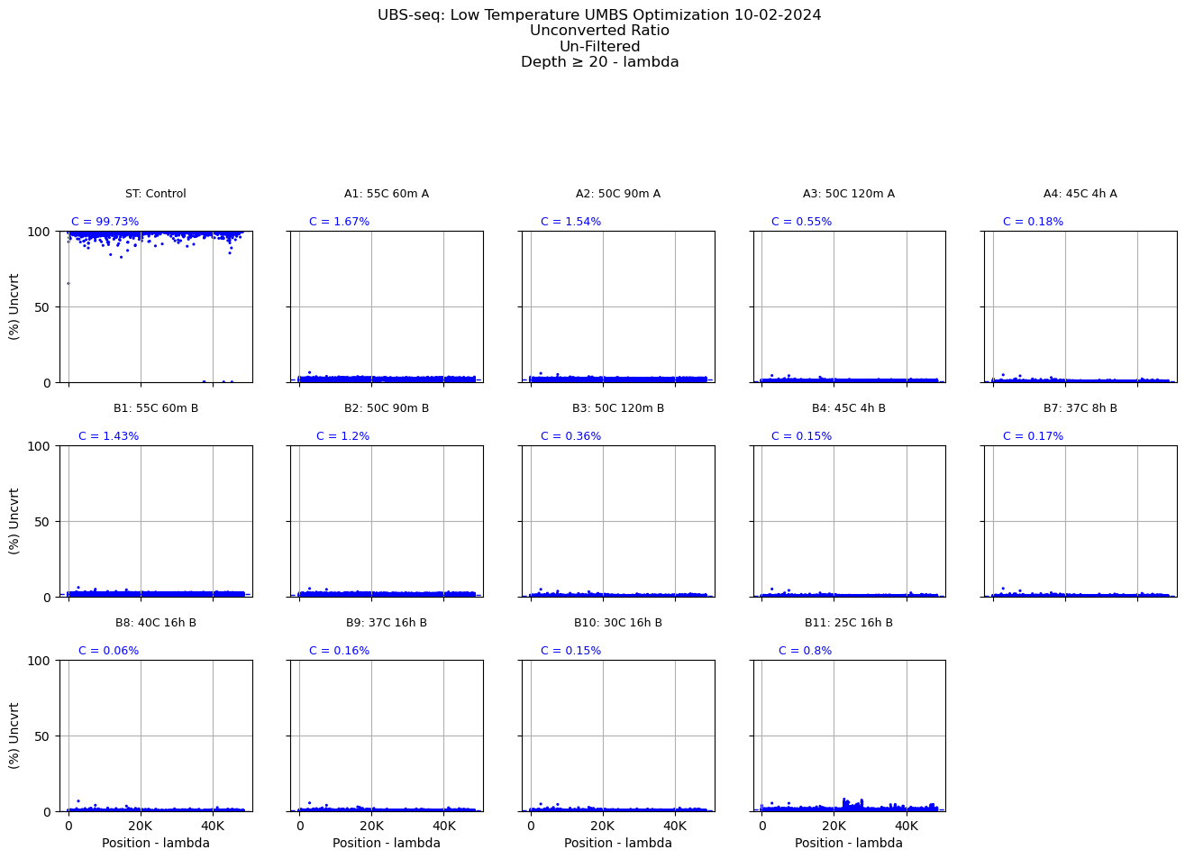

Slide 11


