Slide 1
Predicting the amount of Mexican restaurants based on Hispanic population
using 2010 census data

Slide 2
Restaurants need to know where to build new locations
Restaurants have a hard time choosing where to build new locations
This project analyzes how the Hispanic population in a city affects the diversity of restaurants
Or, how the Hispanic ethnicity of the population of a city dictates the amount of ‘mexican’ restaurants
This research would be of great interest to restaurants of any type as a factor in determining new locations

Slide 3
Data
Place and population 2010 census data retrieved from https://population.az.gov/census-data
Place, percent of Hispanic or Latino people, and percent of other ethnicities, taken in 2010 census, retrieved from https://wpcarey.asu.edu/sites/default/files/census2010az11-11.pdf
Cities in Phoenix metropolitan area are scraped from https://en.wikipedia.org/wiki/Phoenix_metropolitan_area and used to filter 2010 census data
Data was saved as Exel spreadsheets, converted to csv files, and uploaded to Github for inclusion in the project

Slide 4
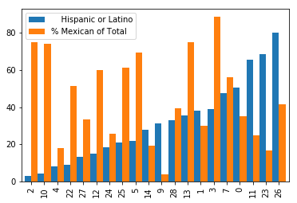
Sorted by the percent of Hispanic people in the population of each city
This graphs shows an inverse relationship – as the Hispanic population increases, the amount of Mexican restaurants decreases

Slide 5
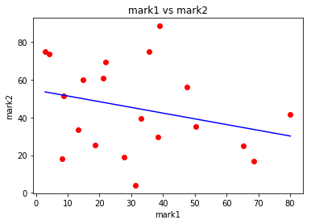
Inverse relationship
The horizonal axis is the percent of Hispanic of population per city or town
The vertical axis is the percent of Mexican restaurants
The line was plotted from the predictions of a linear regression model
The linear regression model achieves an accuracy of approximately 78%

Slide 6
Conclusion
Determined a relationship between independent variables
The prediction model needs improvement, possibly from further separation of cities into smaller areas
Could include more factors (such as overall population or age)

