Slide 1
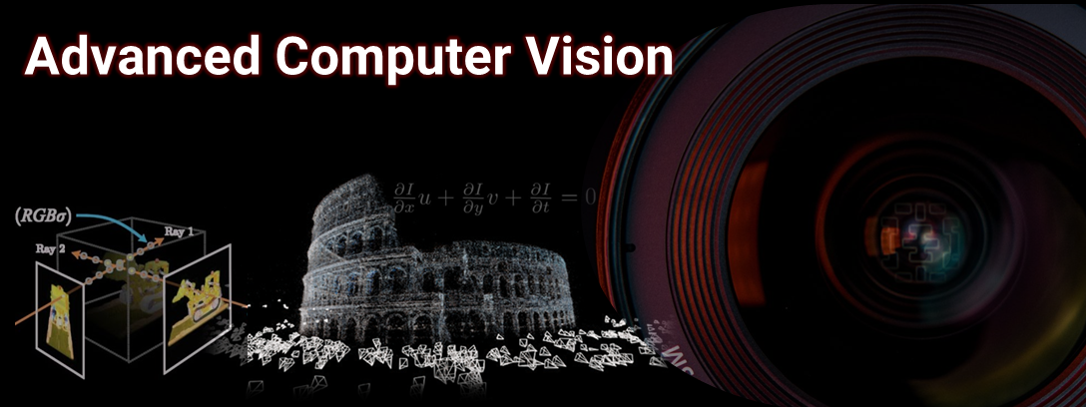


ROBO/MCEN 4085: Advanced Computer Vision
Geometry and Learning-based Methods in Computer Vision
by Chahat Deep Singh
This is an advanced graduate course that deals with classical (or geometric) and deep learning methods in computer vision. This course starts by exploring the mathematical foundations of computer vision and advances to the recent deep learning methods. The course objective is to introduce formal tools in perception for students who are interested in Robot Autonomy and 3D Perception.
In particular, this course will cover (but not limited to) the following topics:
Camera Sensors and Image Formation
Camera Calibration
Single View Geometry
Projective Transformation
Multi-view Geometry
Visual Odometry and Structure from Motion
Optical Flow
Computational Imaging Methods
Radiance Fields and Volume Rendering
Learning-based Methods for Depth Estimation and Reconstruction
Details to follow
Note: Pre-requisites include Linear Algebra and proficiency in Python (or any other scripting language). Students DO NOT require an understanding of computer vision before enrolling in this course.
For previous courses offered by Chahat Deep Singh, please visit http://chahatdeep.github.io/teaching.

