Slide 1

SLDM Assignment- 2
Group: Vedangi Duse 22060641036
Gauri Salunke 22060641048
Prajakta Sawant 22060641038
Learning from data and Model development

Slide 2
Problem 2
About Data
- The dataset, titled "DirectMarketing.csv," comprises data from a direct marketing campaign with 1000 customers. It includes information on customer demographics (age, gender, homeownership, marital status), location, income, family size, purchase history, catalog distribution, and the amount spent.
Business Goal
- The goal is to elucidate the relationship between the customer characteristics and the amount spent in order to optimize the effectiveness of the direct marketing strategy.
Analytics Objective
- To identify key customer characteristics and their impact on the amount spent, enabling the development of a predictive model that can be used to target specific customer segments and optimize the allocation of catalogs in the direct marketing campaign.

Slide 3
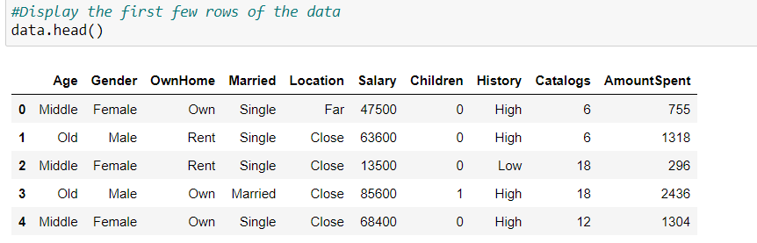
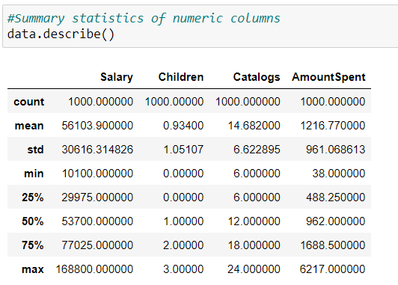
EDA
Displaying first few Rows of the data
Interpretation: Here we could see that the data consist of both numerical and categorical variables.
Interpretation: Here we could see that the mean of our Dependent Variable, ‘AmountSpent’ is around $1216.77
Summary Statistics

Slide 4
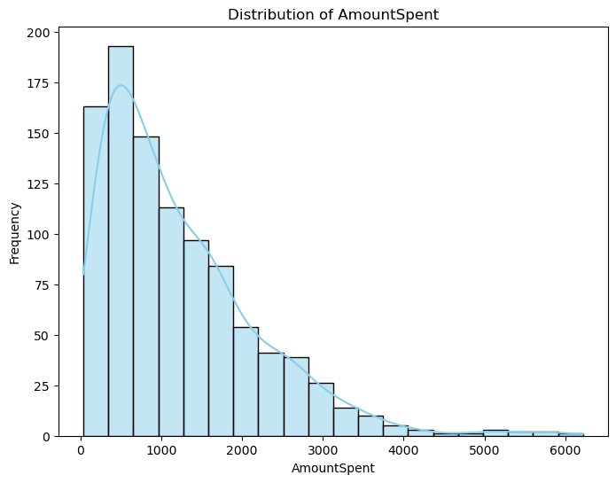
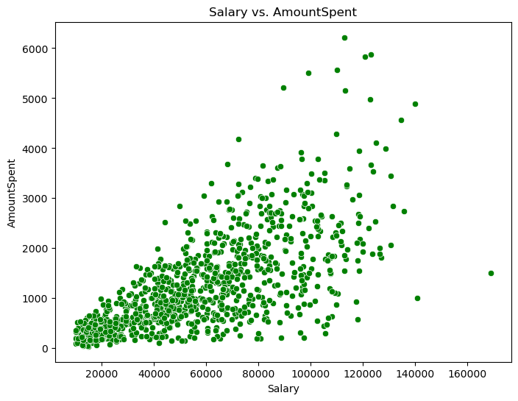
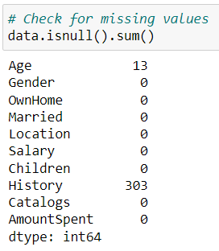
Checking for missing values
Interpretation: The categorical variables, age and history as got some missing values.
Interpretation: From the histogram plot of our Dependent Variable, ‘AmounSpent’, it seems that the distribution is Normal.
Interpretation: From the Scatter plot, it seems that there is positive relationship between, ‘Salary’ and ‘AmountSpent’.

Slide 5
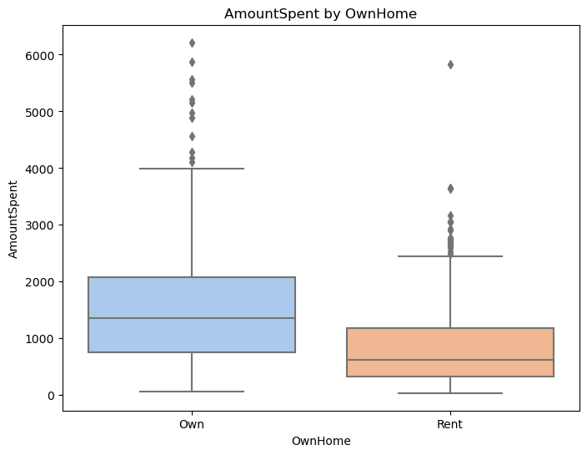
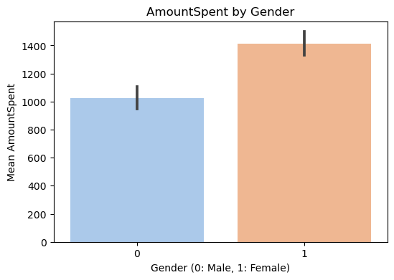
Interpretation: From the above chart, Female tends to spent more than Male.
Interpretation: Customers who owns house, are likely to spent more than the ones who rent.

Slide 6
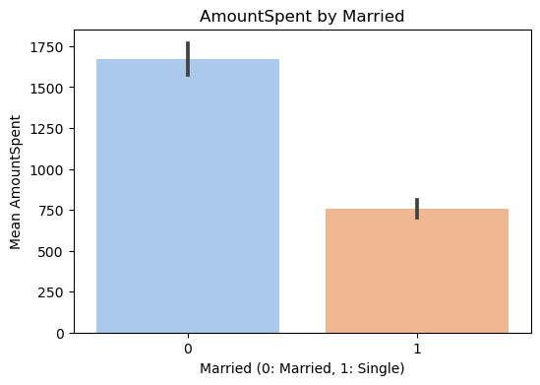
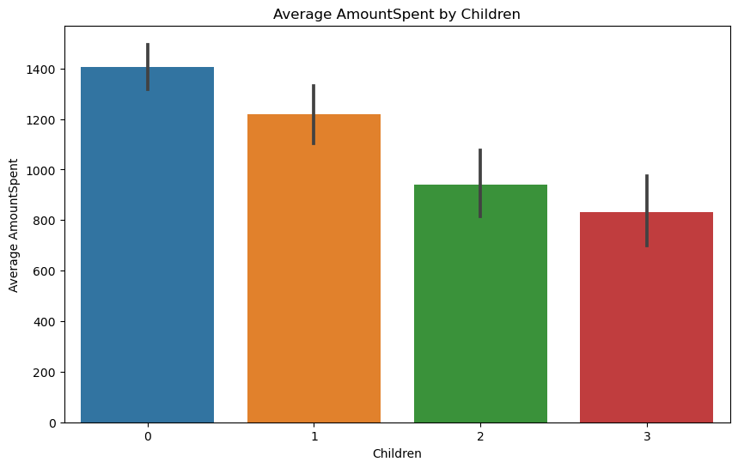
Interpretation: Customers who are Married tends to spent more than Single ones.
Interpretation: Those Customers having zero children tends to spent more , than those Customers who are having one or more children.

Slide 7
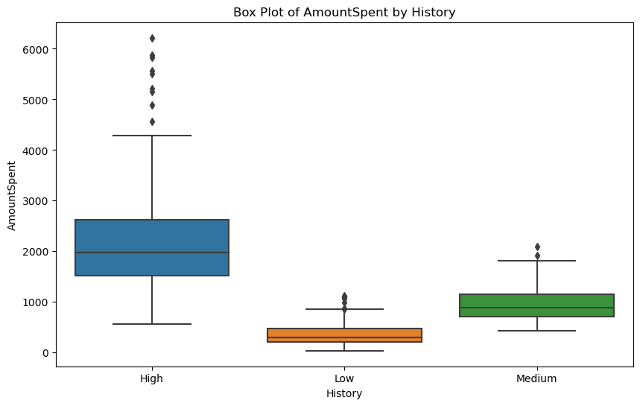
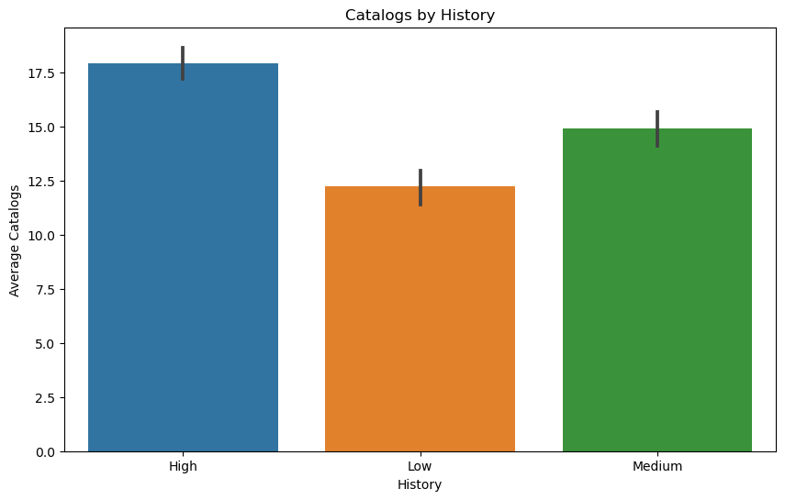
Interpretation: Customers with high previous purchase history has higher amount spent, than with low or medium previous purchase history.
Interpretation: Customers with high previous purchase history are more likely to get more catalogs.

Slide 8
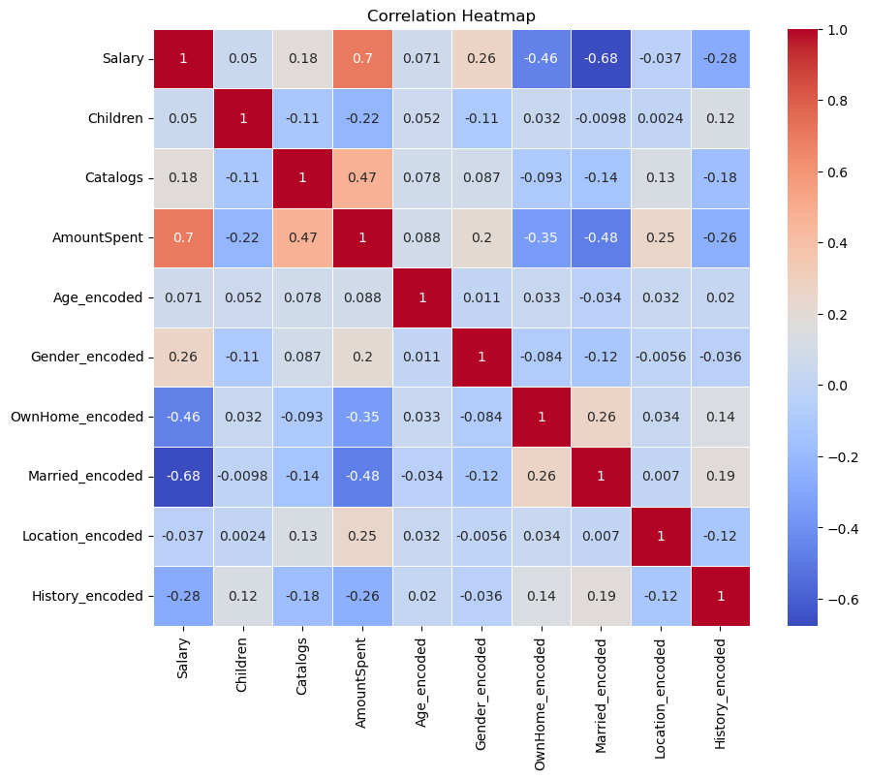
Interpretation: Salary is highly and positively correlated with the AmountSpent, compared to all other variables. Other variables are somewhat less correlated with our dependent variable, ‘AmountSpent’.

Slide 9
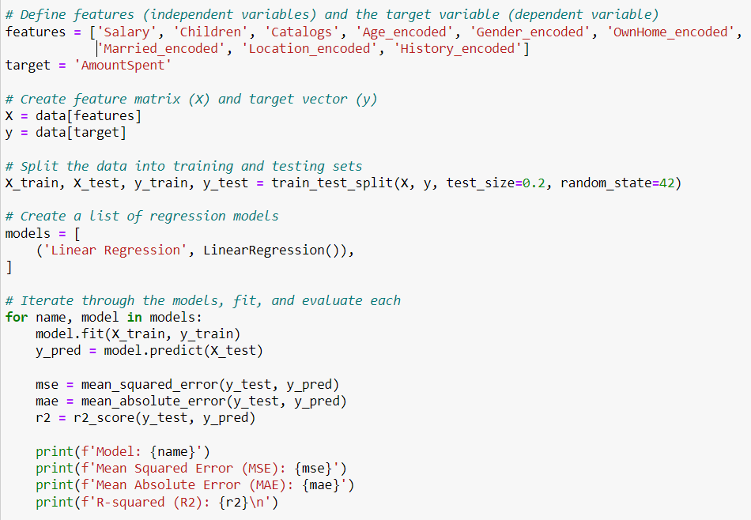
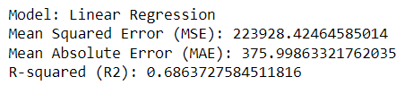
Model Fitting
Input-
Output-
Interpretation: An R-squared of 0.68 indicates that the model captures a significant portion of the variability in 'AmountSpent' based on the selected features.

Slide 10
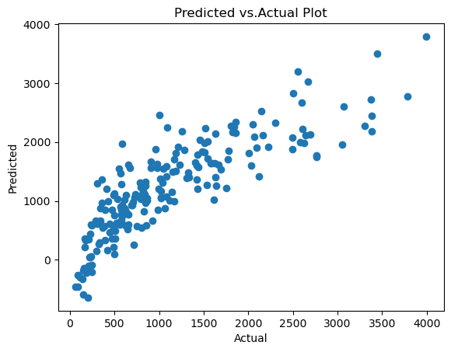
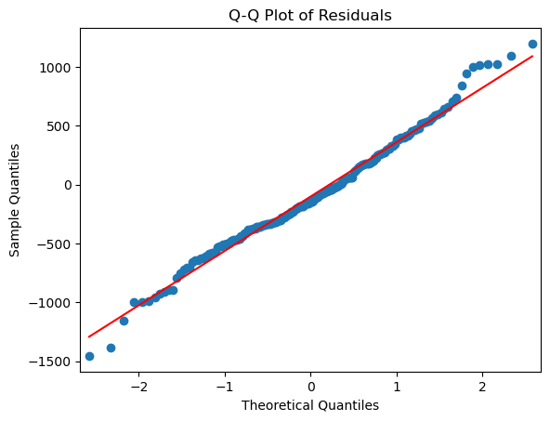
Interpretation: Predicted vs. Actual Plot demonstrates that the model provides accurate and reliable predictions, with minimal errors and outliers.
Interpretation: The Q-Q Plot demonstrates that the residuals follows Normal Distribution, as the points lie very close to the line.

Slide 11
Conclusion
From the above graphical representation, the customer characteristics like the ‘gender’, ‘age’, ‘ownhome’, ‘married’, ‘location’, ‘salary’, ‘children’, ‘history’ and ‘catalogs’ , whether individually or together are very important factors which affect the ‘amountspent’ significantly.
‘Salary’ was found to be highly significant for the dependent variable, which means more salary, more amount spent for the purchase and vice-versa.
From the variable, ‘history’ and ‘catalogs’, it was found that higher previous purchase history customers were more likely to spent more than the low or medium previous purchase history customers. Also, the number of catalogs sent were more to the customer having higher purchase history, which means if the catalogs are sent to low and medium previous purchase history customers than their spending capacity might also increase.
From ‘Gender’, it was found that, female tends to spent more than male, therefore female can be target audience for future spending.
From the model fitting it was found that the Linear Regression Model is well fitted and satisfies all the underlying assumptions.

Slide 12
THANK YOU

