Slide 1
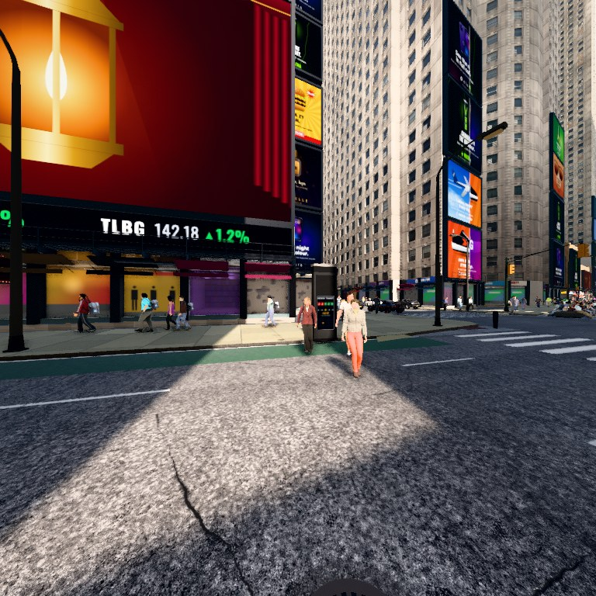
PROGRESS REVIEW · 6 NOVEMBER 2026
World2Brain
Distilling a video world model into the fly connectome, and asking what the real wiring buys
Teacher: V-JEPA 2.1 video world model · Student: the fruit-fly connectome · Test: navigating in the dark
Notes:
Opening. The image is one frame of the NYC digital twin the agent navigates. The deck covers what has been done, what was found, what we can claim, and what runs now.

Slide 2
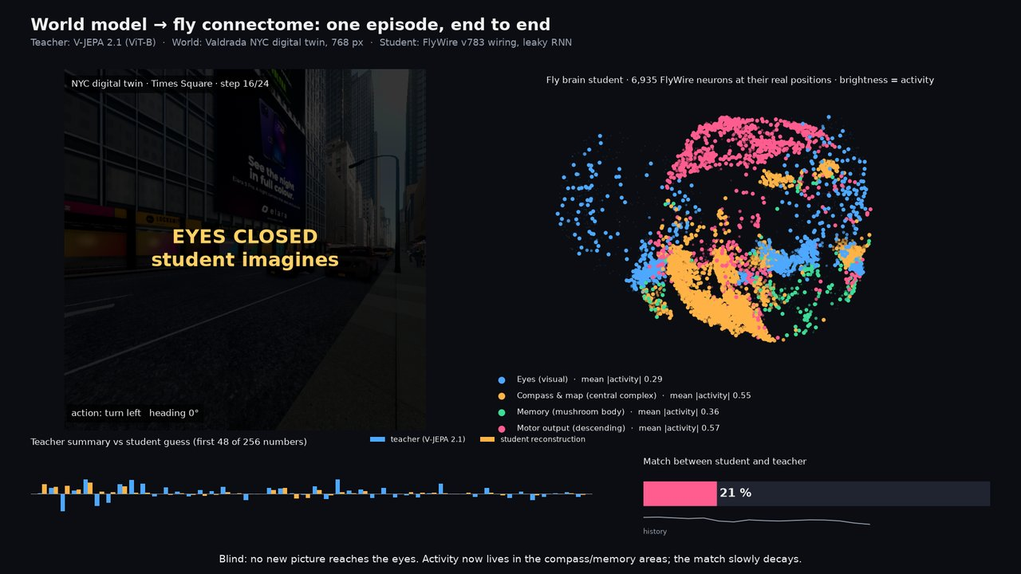
Can a brain’s wiring be a world-model prior?
THE QUESTION
Not a simulation
Not fitting neural data
Matched controls
We do not model fly physiology. The connectome is the fixed recurrent graph of a learning system.
Knowledge flows from the world model into the brain, the reverse of the usual direction.
Every claim is tested against rewired copies of the same brain and against parameter-matched networks.
Notes:
The framing. Previous connectome work either fits networks to recordings or simulates the wiring with guessed physiology. We hold the wiring fixed and let V-JEPA teach it. The payoff is finding what the wiring was already good at.

Slide 3
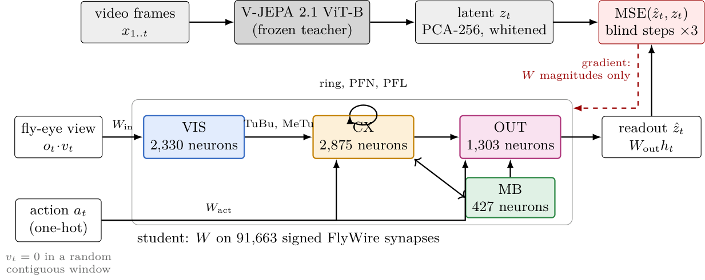
Teacher, student, and one objective
SETUP
Teacher
V-JEPA 2.1 ViT-B, frozen. Its latent, PCA to 256 and whitened, is the target.
Student
A leaky rate RNN whose only recurrent edges are the signed FlyWire synapses. Vision enters VIS, actions enter CX and OUT, readout from all neurons.
Objective
The gradient touches synapse magnitudes, per-neuron gains, input projections and the readout. Signs and topology stay as mapped.
Predict the next latent while vision is blacked out for a random window. No heading, position or navigation label is ever supervised.
Notes:
Figure 1 of the paper.

Slide 4
One fly, two cuts of the same connectome
THE BRAIN
NAVIGATION SUBCIRCUIT · USED IN THE CURRENT PAPER
FULL BRAIN · NOW THE MAIN EXPERIMENT
6,935
139,248
neurons · 91,663 signed synapses
neurons · 2,700,429 signed synapses (5 or more)
Visual projection 2,330 · central complex 2,875 · mushroom-body output 427 · descending 1,303. This is the version every number in this deck comes from. It is the known navigation pathway of the fly: eyes, compass, memory, motor output.
Every mapped neuron of the fly brain. The first full-brain training run has finished and behaves like the subcircuit: a slightly worse predictor. Its navigation tests are being computed today.
Both are cut from one individual fly. When we say “three seeds” we retrain the learned parts three times; the anatomy never changes.
Notes:
Why the subcircuit existed: speed and interpretability. Reviewers asked why four hand-picked regions, and the professor decided on the full brain.

Slide 5
What is learned, what stays fixed
TRAINING
Component | Status | Detail
V-JEPA 2.1 teacher | frozen | A pretrained video model. Its internal summary of each frame is the only thing the student is asked to reproduce
Connectome topology and signs | frozen | Which neuron talks to which, excitatory or inhibitory, never changes
Synapse magnitudes, per-neuron gains | learned | Scaled during distillation, sign preserved
Input projections (vision to VIS, actions to CX and OUT) | learned | How the fly-eye picture and the chosen action enter the brain
Linear readout from all neurons | learned | How we read the student’s guess of the teacher’s summary out of all neurons
Ridge probes for heading, position, distance | fit after training | Evaluation only; never a training signal
Policy head (2-layer MLP, 256 hidden) | cloned after training | A small action-chooser trained afterwards to copy the ideal action from the brain state; the brain itself is not changed
Three seeds re-draw the learned parts. Variance you see is training noise, not biological variation.
Notes:
Answer to ‘are we training anything’. Yes: the student, the probes, the policy head. Not the teacher, not the wiring.

Slide 6
Every row in every table
CONTROLS AND BASELINES
Row | What it holds fixed | What it tests
connectome | the real synapse list | the claim
degree-shuffled | neuron count, edge count, in/out degree | is it the exact topology or the degree profile
block-shuffled | region block structure (VIS, CX, MB, OUT) | is it the fine wiring or the coarse map
random (Erdős–Rényi) | neuron and edge count only | is sparsity alone enough
unsigned / random signs | topology, not Dale’s-law signs | do the excitatory/inhibitory signs matter
dense | neuron count, all-to-all edges | does free recurrence help
GRU, LSTM | parameter count | generic recurrent memory
transformer (causal) | parameter count | attention-based sequence model
oracle / dead reckoning / random actions | no network | ceiling, action-only floor, chance floor
Notes:
Six wiring controls, dense, and three generic baselines, plus three no-network bands. The shuffles are rewirings of the same brain, not other brains.

Slide 7
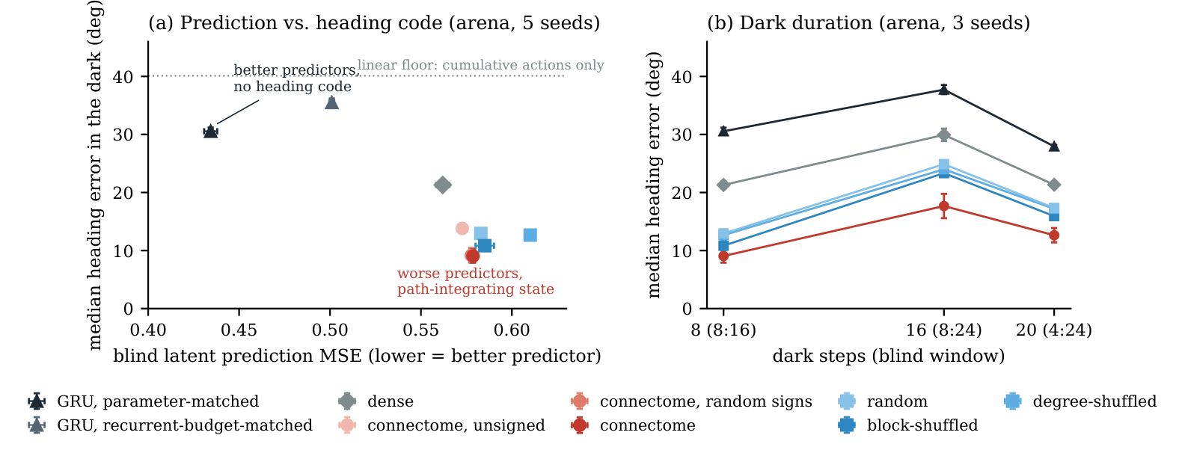
Prediction is not memory
FINDING 1
25%
better prediction error for the ordinary GRU network (0.435 vs 0.579). On the training task itself, the fly brain loses.
9.4°
typical heading error we can read from the fly-brain state after 8 steps without vision. The GRU drifts to 30.3°.
What this means: being good at predicting the next video frame and being good at knowing where you are turn out to be different skills. The networks that predict best (top left of the left panel) have forgotten their heading. The fly wiring predicts worse but keeps its heading, and keeps it over 8, 16 and 20 dark steps (right panel).
R² 0.94
of the agent’s position is recoverable from the fly-brain state (1.0 is perfect). The GRU gives 0.41.
Notes:
The dissociation is the scientific result. A paper that only showed ‘brain beats GRU’ would be ordinary.

Slide 8
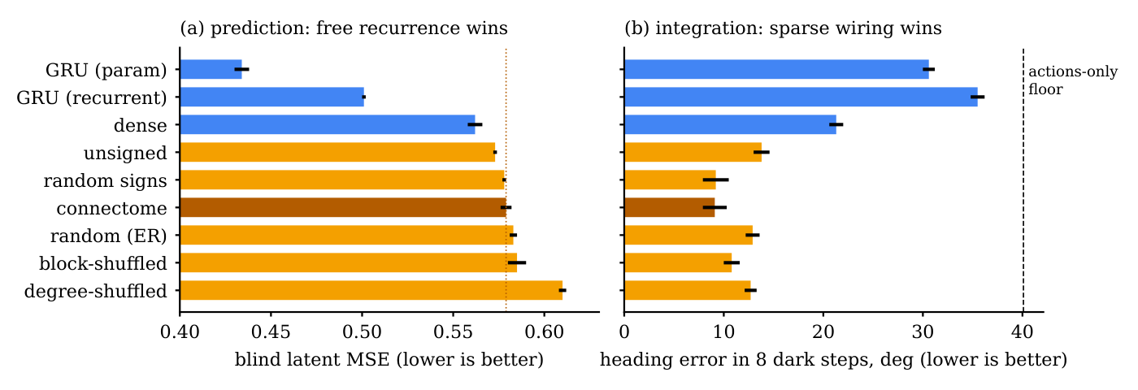
Recurrence predicts, sparse wiring integrates
FINDING 1, ALL ROWS
What this means: blue bars are networks allowed to connect anything to anything; orange bars are sparse wirings with the same number of neurons and edges as the brain. Any sparse wiring keeps heading far better than the dashed “actions only” floor, and the real brain wiring (dark orange) is the best of them. So sparsity gives most of the benefit, the real wiring adds a small, reliable extra.
Notes:
This is the honest version: the shuffled brains form the code too. Real wiring is best by 1.5 to 5.2 degrees.

Slide 9
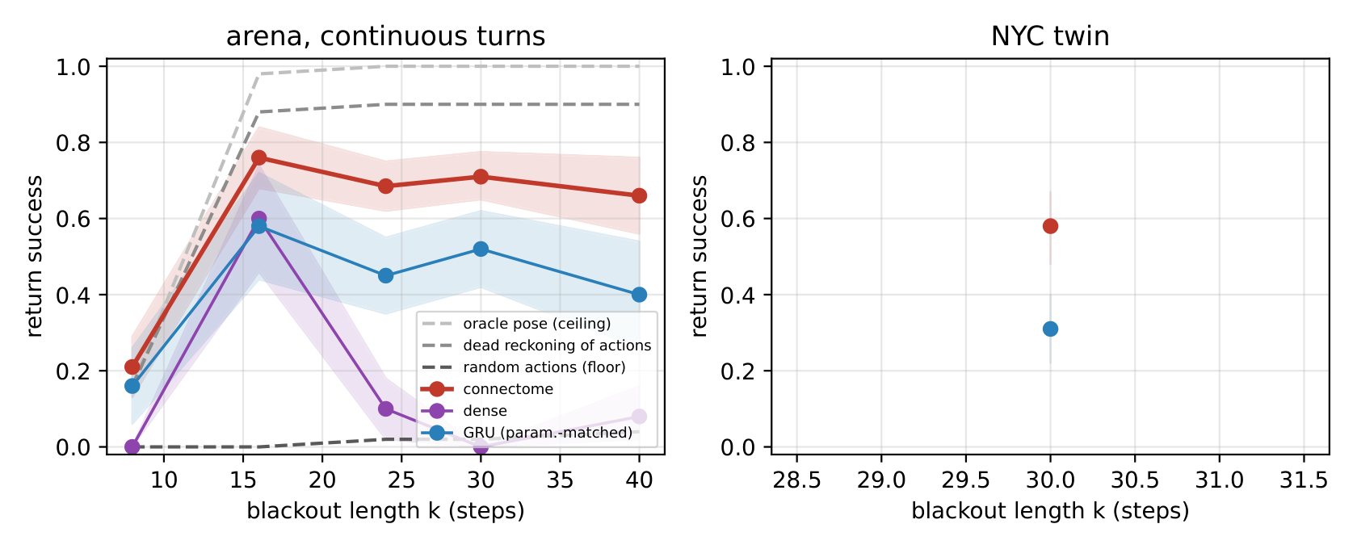
Memory survives darkness and drives behaviour
FINDING 2 · HERO RESULT
0.69 / 0.71
of the time the fly-brain agent finds its way home after 24 / 30 steps in the dark (100 trials each)
0.45 / 0.52
for the ordinary GRU network on the very same trials. The gap is well outside statistical noise.
The task: the agent sees the world for 12 steps, then the lights go out and it must walk home for k steps on memory alone. A perfect position sensor scores 1.00, blindly replaying the actions in reverse scores 0.90, random walking 0.02. A fully connected network collapses to 0.10 and 0.00. What this means: the fly wiring not only remembers where it is, it can act on that memory.
0.58 vs 0.31
on the Manhattan digital twin after 30 dark steps: fly brain vs GRU
Notes:
Benchmark 3b in the paper. The state is not only decodable, it drives a closed-loop return.

Slide 10
Blind return success, 95% intervals
FINDING 2 · NUMBERS
world | row | k = 8 | k = 16 | k = 24 | k = 30 | k = 40
arena | oracle pose (ceiling) | 0.16 | 0.98 | 1.00 | 1.00 | 1.00
arena | dead reckoning of actions | 0.16 | 0.88 | 0.90 | 0.90 | 0.90
arena | random actions (floor) | 0.00 | 0.00 | 0.02 | 0.02 | 0.04
arena | connectome | 0.21 [0.13, 0.29] | 0.76 [0.68, 0.84] | 0.69 [0.62, 0.75] | 0.71 [0.65, 0.78] | 0.66 [0.56, 0.76]
arena | GRU (param.-matched) | 0.16 [0.06, 0.26] | 0.58 [0.44, 0.72] | 0.45 [0.35, 0.55] | 0.52 [0.42, 0.62] | 0.40 [0.26, 0.54]
arena | dense | 0.00 | 0.60 [0.46, 0.74] | 0.10 [0.02, 0.18] | 0.00 | 0.08 [0.02, 0.16]
NYC twin | connectome | — | — | — | 0.58 [0.49, 0.68] | in progress
NYC twin | GRU (param.-matched) | — | — | — | 0.31 [0.22, 0.40] | in progress
How to read it: each cell is the fraction of 100 trials where the agent got home, with the range we would expect from chance in brackets. At k = 8 the blackout is too short even for a perfect sensor to walk back, so the meaningful region is k of 16 and above. The fly brain beats the GRU at every length, and the two ranges never overlap at 24 and 30. Rows for shuffled wirings are being computed now.
Notes:
The claim in the paper is limited to k 24 and 30, where intervals are clean.

Slide 11
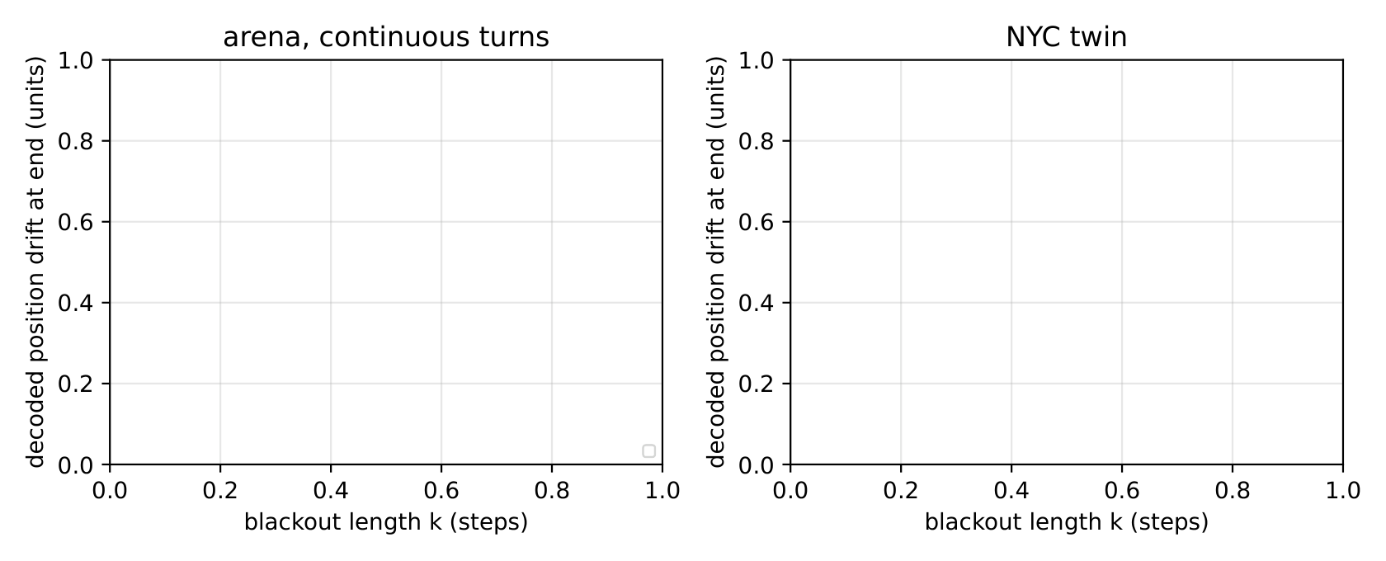
Wiring matters, but sparsity matters more
FINDING 3
1.5° to 5.2°
better heading from the real wiring than from a copy with its connections shuffled inside each brain region
≈ same
a random sparse wiring of the same size also learns to keep track of position. Sparsity does most of the work.
What this means: the figure shows how far the agent’s internal estimate of its position drifts while it walks in the dark. The fly brain drifts least, which is why it gets home. Nobody taught it to track position; it fell out of being asked to predict video with its eyes shut. The honest reading is: sparse, signed recurrent wiring at brain scale is the ingredient, and the real synapse list adds a small, repeatable bonus on top.
no gain
from wiring two or three copies of the brain together through the real cross-hemisphere connections. More neurons do not help.
Notes:
The professor’s abstract states this as: real wiring modestly improves spatial memory but offers no consistent navigation advantage over artificial wiring. We do not hide it.

Slide 12
Blackout Navigation: memory without perception
BENCHMARK CONTRIBUTION
T1 · Return
T2 · Continue
T3 · Re-entry
See the arena for 12 steps, then walk home with vision cut for k steps. Success if within the home radius.
See the goal for 12 steps, then reach it through k dark steps with a bumper controller. Success and SPL.
Open-loop latent error over a blind window, and how fast the state recovers when vision returns.
Design choice | Value
Blackout lengths k | 8, 16, 24, 30, 40 · pre-registered, never changed after seeing results
Worlds | procedural arena (continuous turns) and a raycast digital twin of Midtown Manhattan
Bands | oracle pose (ceiling), dead reckoning of actions, random actions (floor)
Ways of reading the brain | a linear probe, a small nonlinear probe, and an action-chooser that actually drives the agent
Episodes | 100 per cell, bootstrap 95% CI pooled over seeds
Notes:
No published navigation benchmark cuts vision for a fixed number of steps. This one applies to any recurrent model and is the reusable part of the paper.

Slide 13
What we can say today, and what we cannot yet
CLAIMS
Supported by data
Not yet claimable
The wiring does not help predict video: the GRU is 25% better and shuffled brains predict as well as the real one
The wiring keeps a position in the dark: it gets home 69–71% of the time vs 45–52% for the GRU, and 58% vs 31% in Manhattan
A fully connected network of the same size almost never gets home (10% and 0%), so sparsity is necessary
We can see why: its internal position estimate drifts less while blind
All of this with the wiring frozen; only the input, output and per-neuron gains are learned
That it holds on the full brain: the first full-brain navigation results arrive today, the repeats within two days
That it holds across individuals: we have one fly. A second fly brain (the male brain map) would need its own build
That shuffled wiring loses the homing ability: those trials are being computed now
That it holds at every blackout length: the claim is limited to 24 and 30 steps for now
Which part of the brain does it: no region-by-region removal test yet
That no GRU of any size could do it: only a size-matched GRU has been tested
Notes:
Safest one-line claim: a real connectome, frozen, is far better than a generic RNN at blind path integration, though worse at prediction, and shuffled wiring does not keep this advantage.

Slide 14
What is running right now
EXPERIMENTS IN PROGRESS · 6 NOV 2026
Full brain: first training pass, 6 wirings × 3 environments
100%
finished this morning
Full brain: heading/position probes and homing-in-the-dark tests
0%
results expected within hours
Subcircuit: full homing sweep, every wiring, 3 repeats
66%
adds the shuffled-wiring rows to the hero figure
Real-video evaluation (teacher on real street footage)
50%
fills the last open numbers in the paper
Manhattan: longer blackouts and closed-loop goal navigation
30%
pilot runs
Full brain: two repeat training passes
0%
about two days
First full-brain result: prediction error 0.63 against 0.58 for the subcircuit. The whole brain is a slightly worse predictor, exactly what the story predicts; whether it is an equally good navigator is the result we are waiting for.
Notes:
All of these run unattended and report when finished.

Slide 15
What makes it CVPR-strong, and what it costs
PLAN
Item | Why | current GPU, hours | H200, hours
Full brain, every wiring, 3 environments, 5 repeats | the main result at whole-brain scale | 30 | 6
Blackout sweep to k 64, random onset, 5 seeds, both worlds | a larger, statistically modelled gap between real and artificial wiring | 80 | 15
Banino 2018 grid-cell RNN baseline | closest published competitor on path integration | 15 | 4
The male fly brain as a second individual, 3 repeats | lets us say it holds across two flies, not one | 40 | 8
A return-consistency training term, with and without | the one algorithmic addition worth claiming | 30 | 6
Full brain with every synapse kept (15 million edges) | answers “why drop weak synapses” | needs more memory | 10
Habitat PointNav (Meta’s standard benchmark) with added blackouts | the only external benchmark reviewers recognise | not feasible | 60–80
Total |  | ≈ 5 days, no Habitat | ≈ 130, one week
Skip: ObjectNav, GOAT, SG-Nav, VLN-CE (those agents get maps, depth or language), a cross-connectome shared core (a second paper), and a results-free abstract.
Notes:
The H200 factor is about 5x, not the raw 8x FLOP ratio: the sparse 139k-neuron recurrence is bandwidth bound.

Slide 16
Three calls for the professor
DECISIONS NEEDED
1 · Habitat PointNav
2 · Brain in the abstract
3 · Second brain
Yes or no. It is the one item that changes the paper’s scope: two to three weeks of work and a large GPU.
The current abstract quotes the 6,935-neuron subcircuit. Once the full-brain numbers land it should quote 139,248, or we decide which version goes to CVPR.
Building the male fly brain, about one week, makes the across-individuals claim possible. The other public fly datasets overlap the one we use and do not count as new individuals.
Already done: the three-part abstract is in the paper, the full brain is the main student, the reviewer fixes are applied, and the paper body sits at the 8-page CVPR limit.
Notes:
Close on decisions. Everything else proceeds without input.

