Slide 1
Healthcare Project

Slide 2
Brief Description:
By analyzing patient records, treatment data, and insurance claims, our SQL project provides data-driven healthcare insights. We gain essential information for informed decision-making and better patient care by using efficient SQL queries.
Business Problem:
Making strategic decisions in healthcare without data insights can lead to inefficiencies in patient care and resource allocation. It is difficult to extract significant patterns from complex patient data and treatment records.
Solution Approach:
We handle this difficulty by integrating and analyzing data with SQL, allowing us to identify trends, correlations, and opportunities. Our optimized queries deliver actionable information that guide healthcare decisions and optimize resources for better patient outcomes.
Overview:

Slide 3



Tools and Technologies Used:

Slide 4
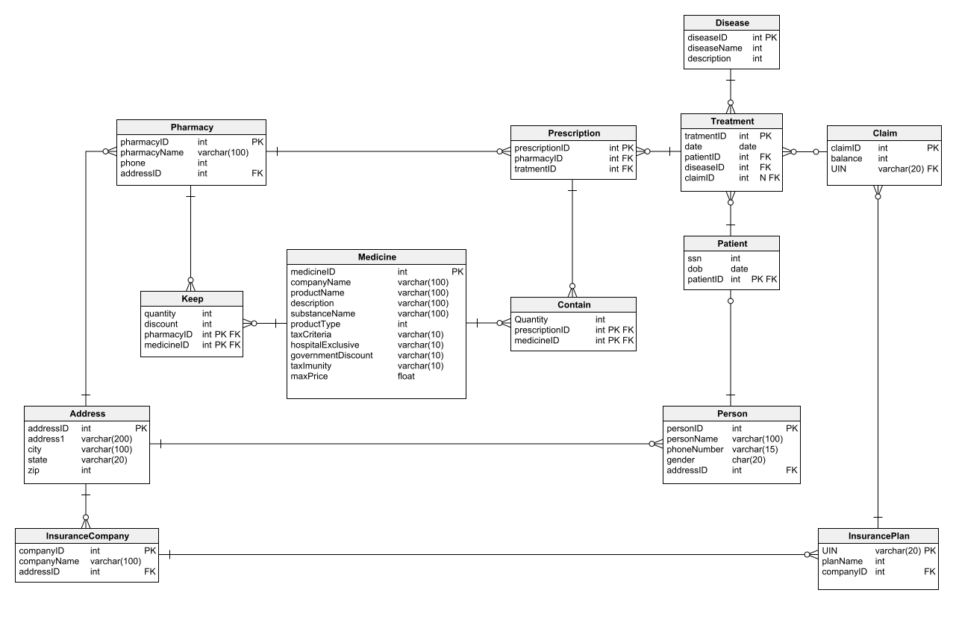
Relevant Diagram/s:

Slide 5
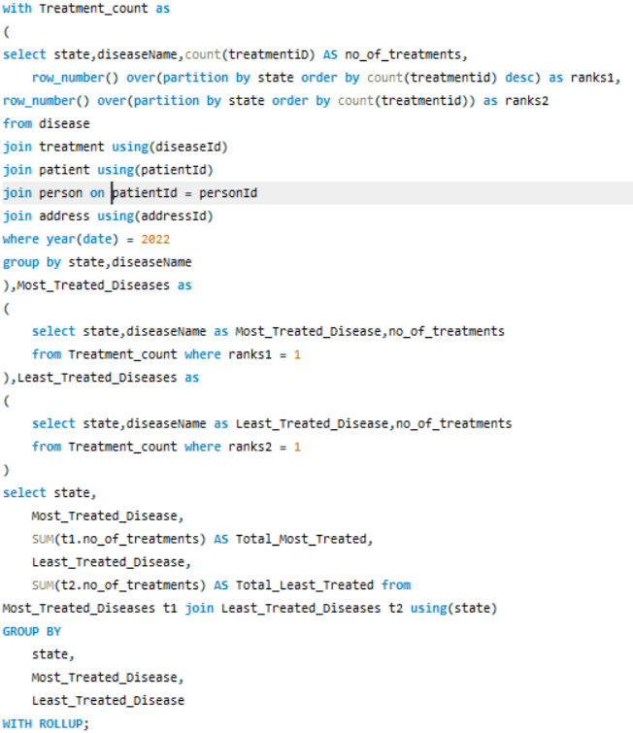
QUERY :
Sarah, from the healthcare department, is trying to understand if some diseases are spreading in a particular region.
Assist Sarah by creating a report which shows each state the number of the most and least treated diseases by the patients of that state in the year 2022.
It would be helpful for Sarah if the aggregation for the different combinations is found as well. Assist Sarah to create this report.

Slide 6
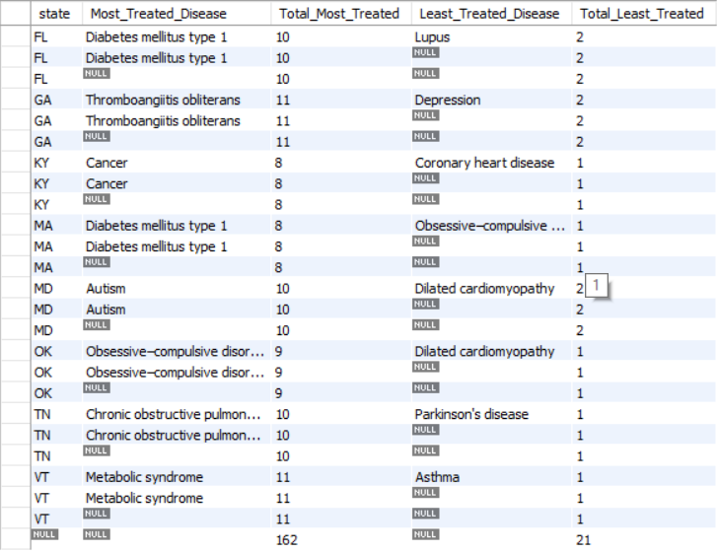
OUTPUT :

Slide 7
Headline Statistics:
Execution Time: 31 ms​
Wakatime Metrics: ​
Total Coding Time: 10 mins​
Daily Coding Activity: 4 hrs​
Most Active Time: 11 pm to 1 am
​Top Files and Languages: Healthcare.sql(SQL)​ ​
Lines of Code (LoC/KLoC): 32 lines​ ​
Total Number of Functions: 6
Number of User-defined Procedure Used: 0​ ​
Avg. Number of Lines per Function: 5-6 lines​
Number of comments written: 2 comments ​ ​
IDE/Code Editor Used: SQL Workbench​ ​
Plugins Used: None​ ​
Function/Complexity breakdown:​
Simple Implementations : Basic tasks like counting​ and summing
Intermediate Implementations : Grouping data and Rollup
Complex Implementations : Using CTE Instead of sub query

Slide 8
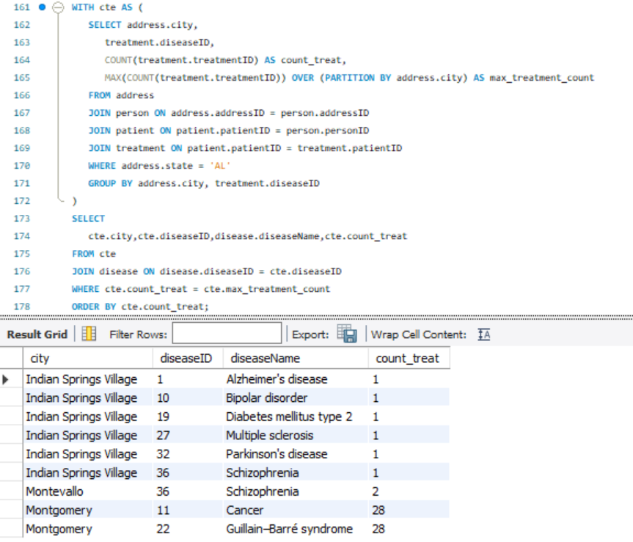
QUERY 1:
The State of Alabama (AL) is trying to manage its healthcare resources more efficiently.
For each city in their state, they need to identify the disease for which the maximum number of patients have gone for treatment.
Assist the state for this purpose.
Note: The state of Alabama is represented as AL in Address Table.

Slide 9
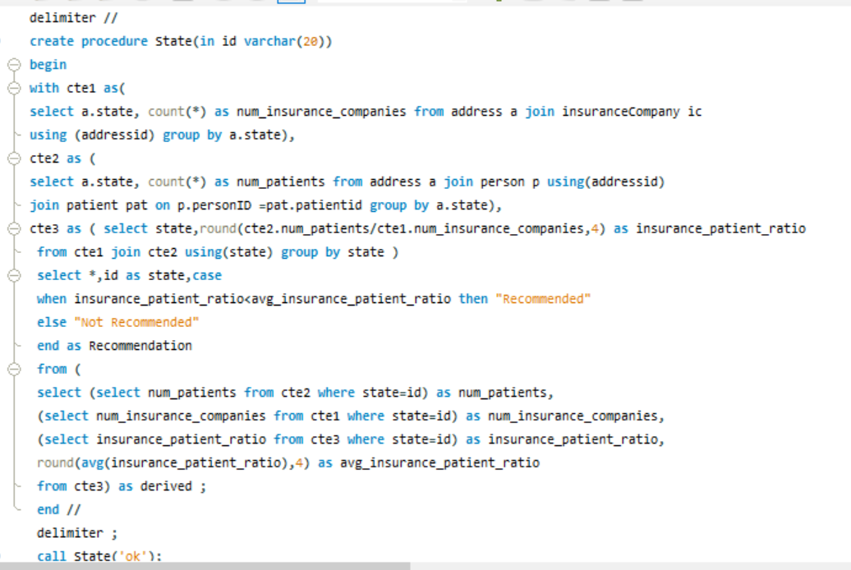
Implementation Screenshots/Code Snippets:
QUERY 2:
Jacob, as a business strategist, wants to figure out if a state is appropriate for setting up an insurance company or not.
Write a stored procedure that finds the num_patients, num_insurance_companies, and insurance_patient_ratio, the stored procedure should also find the avg_insurance_patient_ratio and if the insurance_patient_ratio of the given state is less than the avg_insurance_patient_ratio then it Recommendation section can have the value "Recommended" otherwise the value can be "Not Recommended".

Slide 10
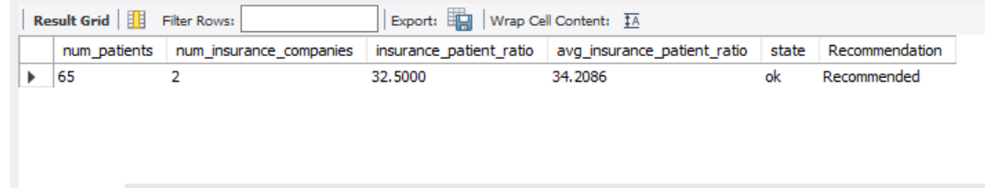
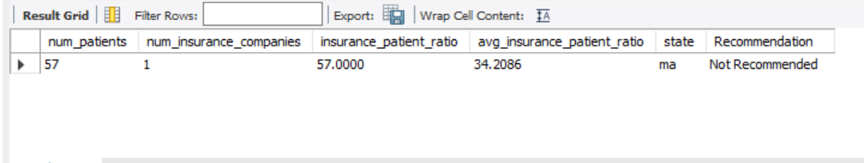
Implementation Screenshots/Code Snippets:
OUTPUT : 01 For state ‘OK’
OUTPUT : 02 For state ‘MA’

Slide 11
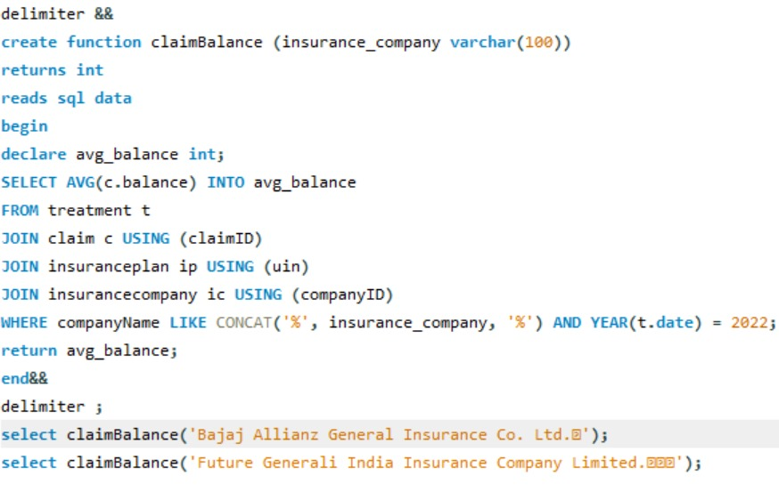
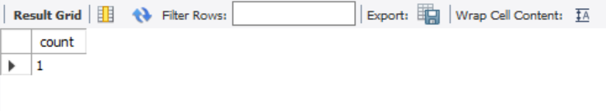
Query:
QUERY 3:
The representative of the pharma union, Aubrey, has requested a system that she can use to find how many people in a specific city have been treated for a specific disease in a specific year.
Create a stored function for this purpose.
Output:

Slide 12
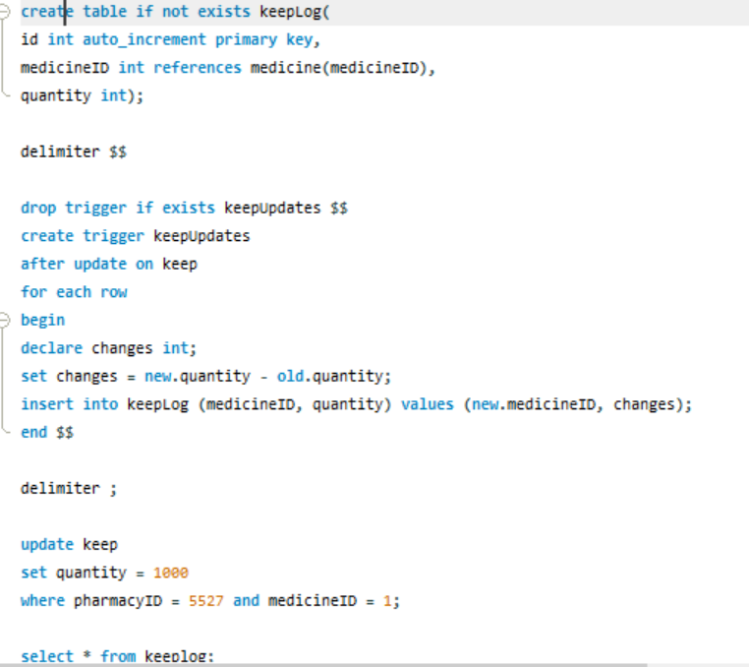
Implementation Screenshots/Code Snippets:
QUERY 4:
Some pharmacies suspect there is some discrepancy in their inventory management. The quantity in the ‘Keep’ is updated regularly and there is no record of it.
They have requested to create a system that keeps track of all the transactions whenever the quantity of the inventory is updated.
You have been given the responsibility to create a system that automatically updates a Keep_Log table which has the following fields:
id: It is a unique field that starts with 1 and increments by 1 for each new entry
medicineID: It is the medicineID of the medicine for which the quantity is updated.
quantity: The quantity of medicine which is to be added. If the quantity is reduced then the number can be negative.

Slide 13
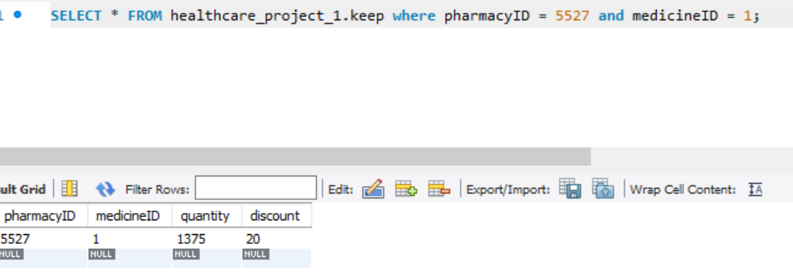
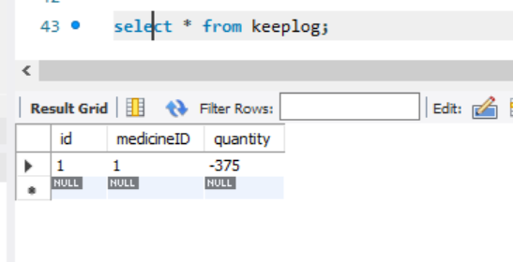
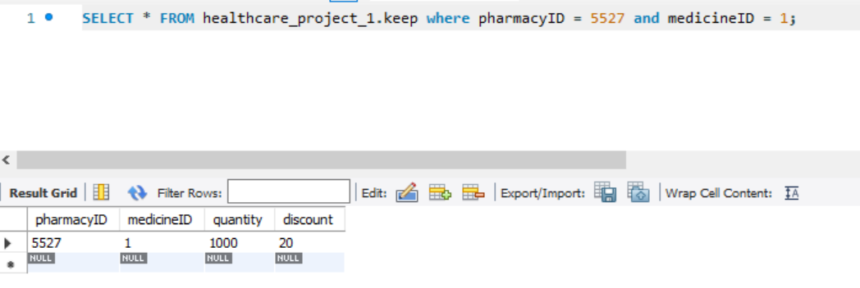
Keep Table before updation:
Keep Log after updation:
Keep Table before updation:

Slide 14
Comprehensive Healthcare Analysis
Dynamic Age Categorization
Pharmacy Inventory Management
Medicine Affordability Assessment
Gender-based Disease Reports
Insurance Claim Trends
Patient Demographics Insights
Clear Medicine Pricing Report
This project offers a multifaceted approach to healthcare analysis, leveraging data-driven insights to enhance decision-making across patient care, medicine pricing, insurance claims, and overall healthcare strategy.
Highlights & Standout Features:

Slide 15
Optimizations and Best Practices Used:
Indexing for Performance: We strategically applied indexes to essential columns, enhancing query speed and minimizing the time required for data retrieval. This indexing approach significantly accelerates analysis, especially for large datasets.
Direct Join Approach: Replaced the subquery in the CTE with a direct join approach for aggregating data. This can help the query optimizer choose a better execution plan, potentially improving performance.
Limited Columns in Subquery: Advised selecting only the necessary columns in the subquery of the CTE. This reduces the data that needs to be processed and transmitted between steps, enhancing performance.

Slide 16
1. Complex Queries: Addressed complexity by breaking down queries and optimizing each segment for improved performance and readability.
2. Data Volume: Managed large datasets through data partitioning and indexing to enhance query speed and efficiency.
Roadblocks & Resolutions

Slide 17
1. Predictive Insights: Utilize advanced analytics to predict disease outbreaks, patient health trajectories, and insurance claim patterns for proactive and targeted interventions.
2. Machine Learning Integration: Integrate machine learning algorithms to automate data classification, optimize treatment recommendations, and enhance patient risk profiling.
3. Enhanced Visualization: Develop interactive and user-friendly data visualization tools to facilitate intuitive exploration and interpretation of healthcare trends.
4. Data Security Enhancements: Implement robust security measures, including encryption and authentication, to safeguard sensitive healthcare data against emerging threats.
Future Scope:

Slide 18
Thank You

