Slide 1
Churn Analysis and
Customer Intelligence

Slide 2

Churn Analysis and Customer Intelligence
1.The Business Challenge
In the hyper-competitive OTT landscape (Netflix, Hotstar, Prime), retention is the only way to survive. You will act as a Data Analyst tasked with identifying high-risk subscribers using a multi-dimensional dataset (Customer demographics, Subscription tiers, and Support escalations).
2. Core Tech Stack
SQL & Python Integration (numpy, pandas, sqlite3, matplotlib, seaborn), Performance Engineering (data cleaning, feature engineering, analytics), Behavioral Visualization, Writing Actionable Insights.
3. Project Milestones
• Relational Data Extraction: Connecting Python to SQL databases to pull multi-table datasets.
• Advanced Feature Engineering: Data imports, calculating tenure, churn rates, and customer aging. • Executive Reporting: Translating technical findings into billion-dollar business insights.

Slide 3


Churn Analysis - Roadmap
• Connect SQL database to Python – pandas and sqlite3
• Data import using SQL query in Python – pandas and sqlite3
• Data Cleaning – numpy and pandas
• data types, rename cols, select specific cols, QCs, handle missing/null values
• Feature Engineering – numpy and pandas
• create new calculated cols, data transformation, use filters
• Data Analysis – numpy and pandas
• EDA - aggregation, group by, pivot table
• Data Visualization – matplotlib and seaborn

Slide 4

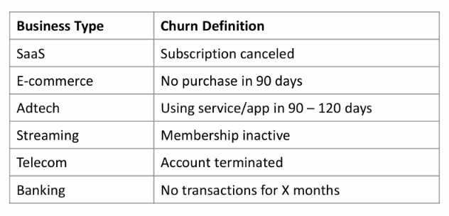
Churn Definition by Business
Churn analysis is the process of figuring out why customers stop doing business with you.
For this, we only need to look at three things:
• "Who": Identifying which customers left or will leave in future
• "Why": Analyzing their behavior before they left.
• "When": Finding the "danger zone" – point when a user leave

Slide 5

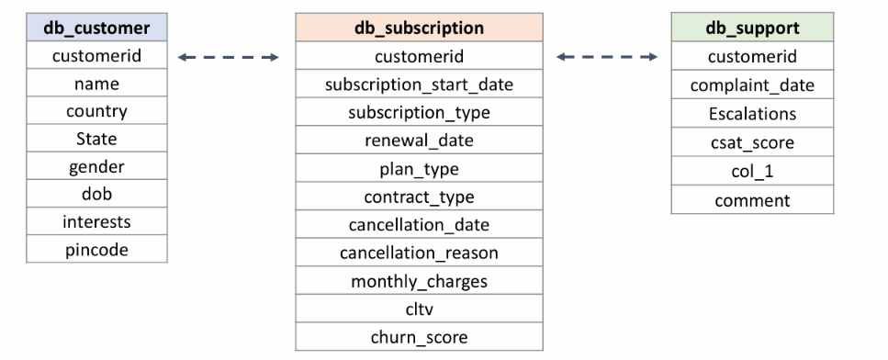
Database Tables
Database: customer_churn

Slide 6
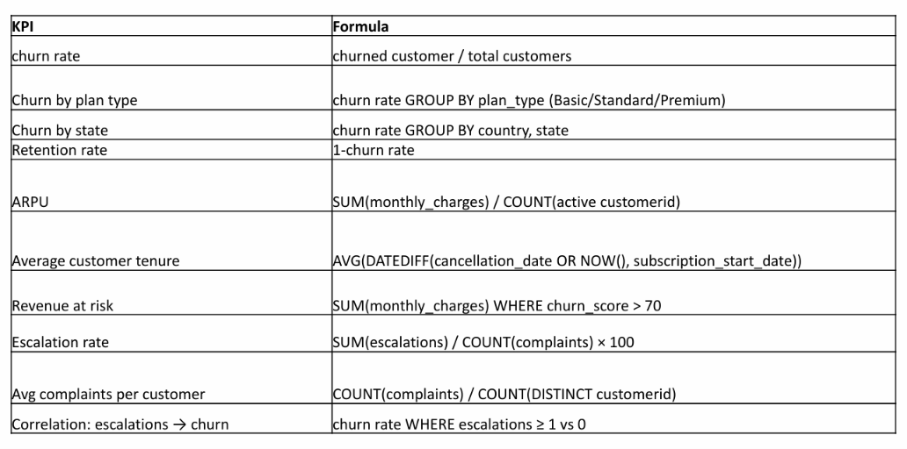
Calculated Metrics

Slide 7
Insights
Insights
• Churn Rate: 28.6% | Retention Rate: 71.4%
• Most of the churn is from basic subscription plan – nothing to worry in terms of major revenue impact
• Most of the churn happened in the month of Sep 2024 and, most affected state is Karnataka
• Average Tenure (Days): 1,451 | ARPU is Rs 18.8
• Total Revenue = 395
• Revenue loss due to churn = 74 | CLTV Lost = 2,047
• % Revenue loss = 18%
• monthly vs annual churn = 55.6% vs 8.3%
Action Items
• Check what happened in Karnataka – was there any increase in price, user complaints, tech issues, etc
• Did we increased subs price for Basic plan or recently made any changes – specially in sep month?
• Check what competitor is doing – bcoz one user has moved to competitor
• Focus on customers with ‘High’ & ‘Med’ churn risk, check their LTV (to make priority list), complaint request, reach out to them through email, sms, calls and fix their issue.

