Slide 1
Crop Production Analysis
Prajakta Bose

Slide 2
Introduction
Problem Statement:
The project aims to analyze crop production in India to understand the dynamics of agricultural productivity across different regions and seasons, focusing on various crops' area and production metrics.
Project Overview:
This analysis utilizes a comprehensive dataset containing information on crop production in India, including factors like state, district, crop type, area, and production quantities, spanning from 1997 to 2015.
Objectives:
To conduct a thorough data cleaning and preprocessing to prepare the dataset for analysis.
To perform exploratory data analysis (EDA) to uncover patterns and trends in crop production.
To identify key findings and insights that can inform policy-making and agricultural practices.

Slide 3
Dataset Information
State_Name- name of the state where the crop is growing.
District_Name- name of the district the state lies in.
Crop_Year- A crop year is a period from one year's harvest
to the next for an agricultural commodity.
Season- name of the season the crop was harvested.
Crop- name of the crop which was harvested.
Area- It is a surface of land on which crop is grown.
Production- It is the quantitively measure of crop yield in
given measured area of field

Slide 4
Methodology
Data Preprocessing:
Univariate Analysis: Analysis of unique values in columns such as State Name, District Name, and Crop to understand the diversity of the dataset.
Bivariate and Multivariate Analysis: Investigation of relationships between different variables, like the correlation between area and production, and the impact of seasons on crop production.
Exploratory Data Analysis (EDA):
Univariate Analysis: Analyzing the distribution of key variables like crop type, area, and production quantity.
Bivariate Analysis: Examining the relationship between area and production, crop types and their yields, and comparing production across different states and seasons.

Slide 5
Data Analysis
Key Findings:
Significant variations in crop production across different states and seasons were observed, indicating the influence of geographic and seasonal factors on agricultural productivity.
Certain crops dominate in specific regions, highlighting the potential for regional specialization in crop cultivation.
Insights:
The analysis underscores the importance of tailored agricultural policies that consider regional and seasonal variations to boost productivity.
Identifying high and low production trends across states and seasons can guide strategic interventions to enhance crop yields and sustainability.

Slide 6
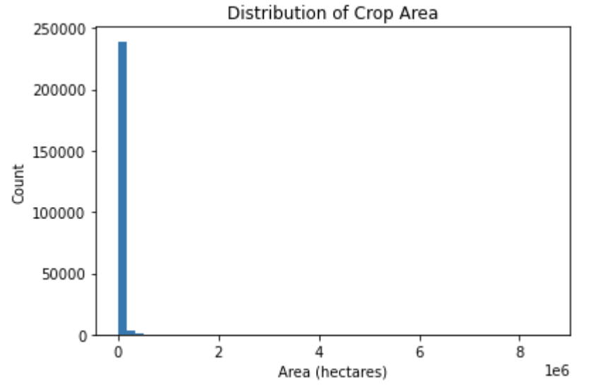
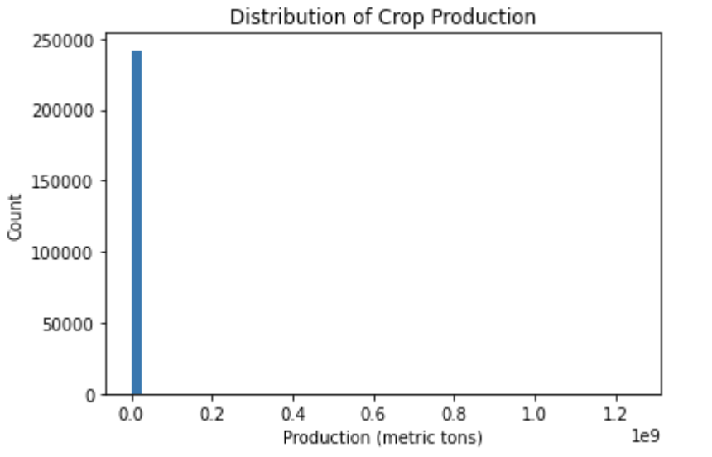
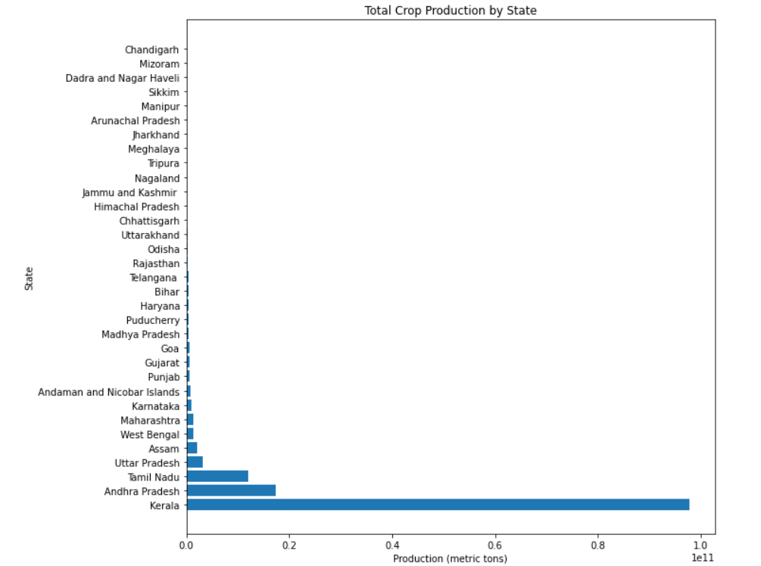
Key Visualizations
The histogram shows the number of production values that fall in the bin range.
The histogram shows how the crop areas are distributed, with the majority of crops having a smaller area and fewer crops having larger areas.
States are arranged in descending order of production

Slide 7
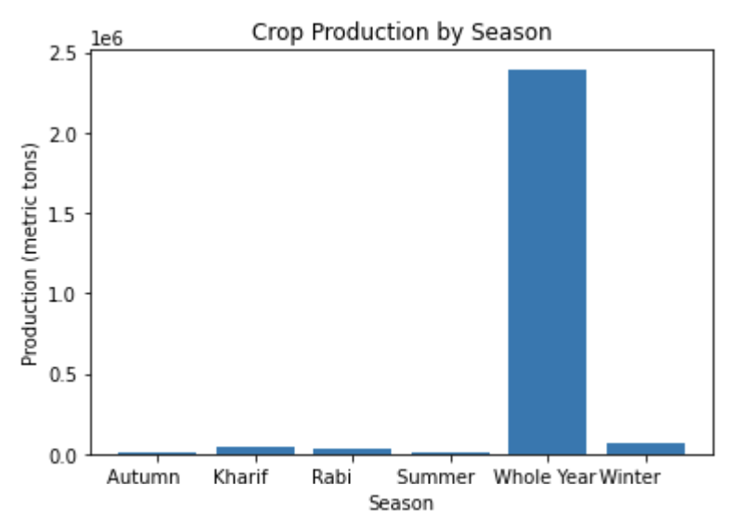
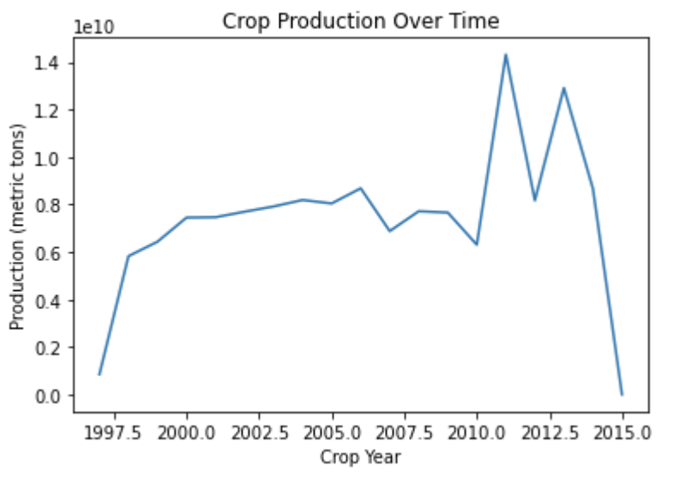
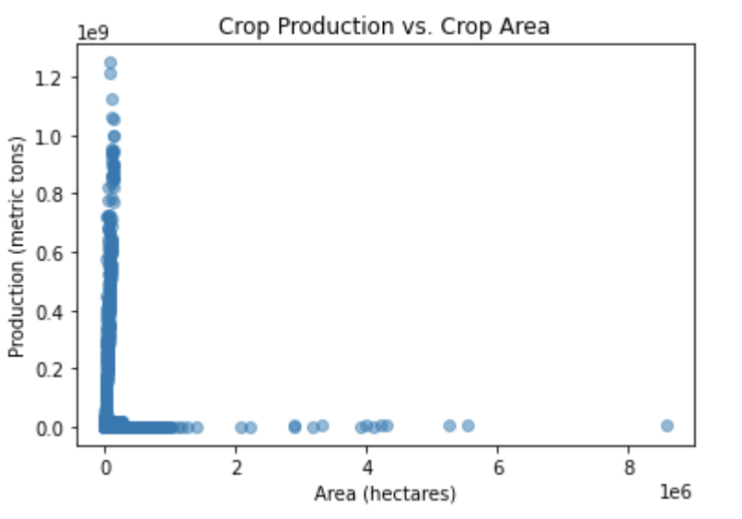
Key Visualizations
This Histogram shows how the crop production varies across different seasons
This shows how crop production has changed over time
This shows the relationship between the crop area and production

Slide 8
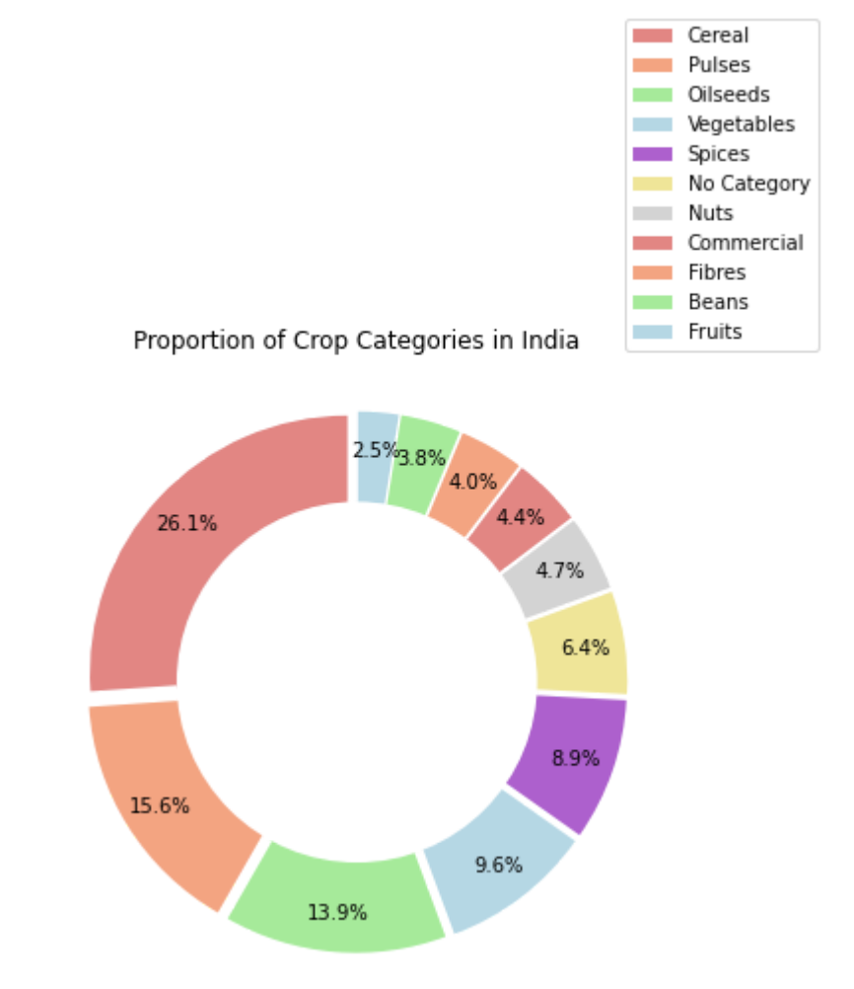
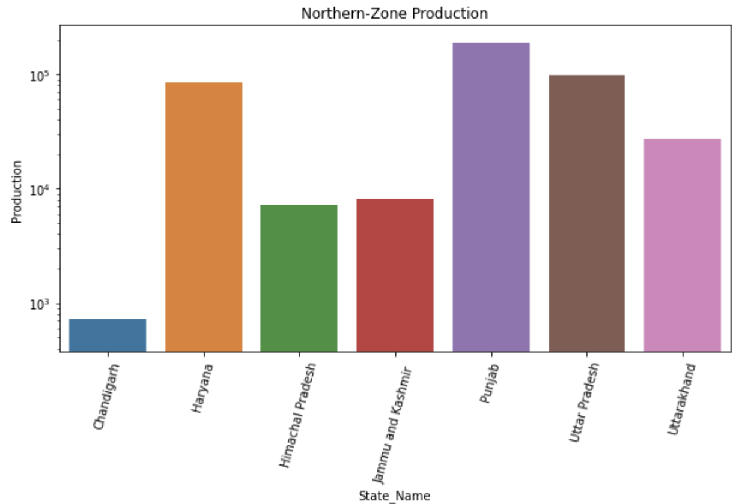
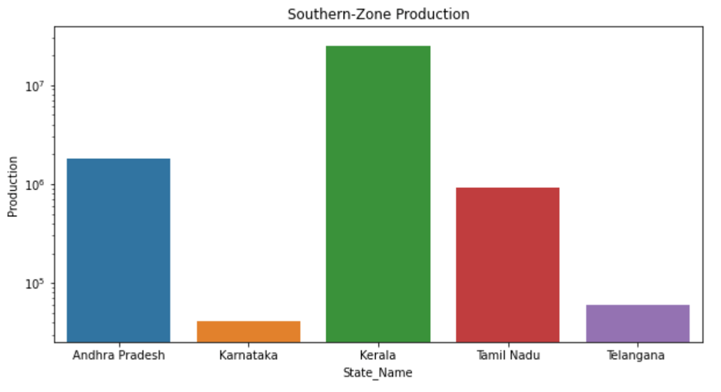
Key Visualizations
Different crop productions in India
The above bar plot shows the production in North zone
The above bar plot shows the production in North zone

Slide 9
Conclusion
Summary of Findings:
The project successfully analysed various aspects of crop production across India, including trends over time, differences in productivity by state and district, and the impact of different factors such as crop type and cultivation area. Key findings highlighted significant regional variations in agricultural productivity, with certain crops dominating in specific areas. The analysis also revealed the influence of seasons on crop yields, underscoring the importance of tailored agricultural practices.
Future Directions:
Climate Impact Analysis: Future work could include a detailed examination of how changing climate conditions affect crop yields. Incorporating weather data such as rainfall, temperature, and humidity could offer insights into climate-resilient farming practices.

