Slide 1
CREDIT CARD CHURN
- Presented by
Prajakta Dhawale
Manan Shah

Slide 2
AGENDA
Project Introduction
Dataset Details
EDA
Data Processing
Model Building
Hyperparameter Tuning

Slide 3
PROJECT INTRODUCTION
Objective: Develop a predictive model to identify customers at risk of churning in credit card services.
Challenge: Low churn rate of 16.07%, requiring proactive strategies for customer retention.
Benefits: Enable the bank to take preemptive measures and enhance customer retention efforts.

Slide 4
Dataset Details
Column | Description
CLIENTNUM | Client number. Unique identifier for the customer holding the account
Attrition_Flag | Internal event (customer activity) variable - if the account is closed then 1 else 0
Customer_Age | Demographic variable - Customer's Age in Years
Gender | Demographic variable - M=Male, F=Female
Dependent_count | Demographic variable - Number of dependents
Education_Level | Demographic variable - Educational Qualification of the account holder (example: high school, college graduate, etc.)
Marital_Status | Demographic variable - Married, Single, Divorced, Unknown
Income_Category | Demographic variable - Annual Income Category of the account holder (< $40K, $40K - 60K, $60K - $80K, $80K-$120K, >
Card_Category | Product Variable - Type of Card (Blue, Silver, Gold, Platinum)
Months_on_book | Period of relationship with bank
Total_Relationship_count | Total no. of products held by the customer
Months_Inactive_12_mon | No. of months inactive in the last 12 months
Contacts_Count_12_mon | No. of Contacts in the last 12 months
Credit_Limit | Credit Limit on the Credit Card
Total_Revolving_Bal | Total Revolving Balance on the Credit Card
Avg_Open_To_Buy | Open to Buy Credit Line (Average of last 12 months)
Total_Amt_Chng_Q4_Q1 | Change in Transaction Amount (Q4 over Q1)
Total_Trans_Amt | Total Transaction Amount (Last 12 months)
Total_Trans_Ct | Total Transaction Count (Last 12 months)
Total_Ct_Chng_Q4_Q1 | Change in Transaction Count (Q4 over Q1)
Avg_Utilization_Ratio | Average Card Utilization Ratio

Slide 5
Exploratory Data analysis (EDA)

Slide 6
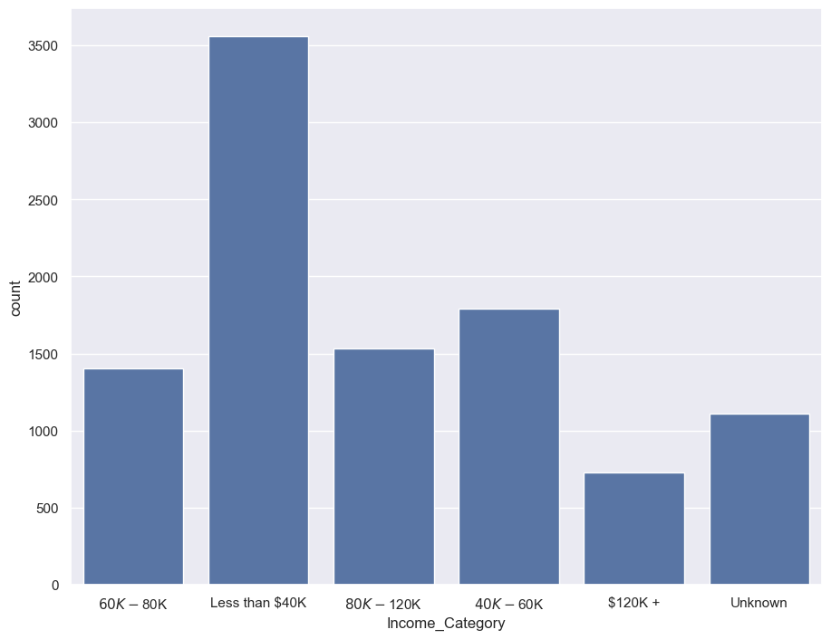
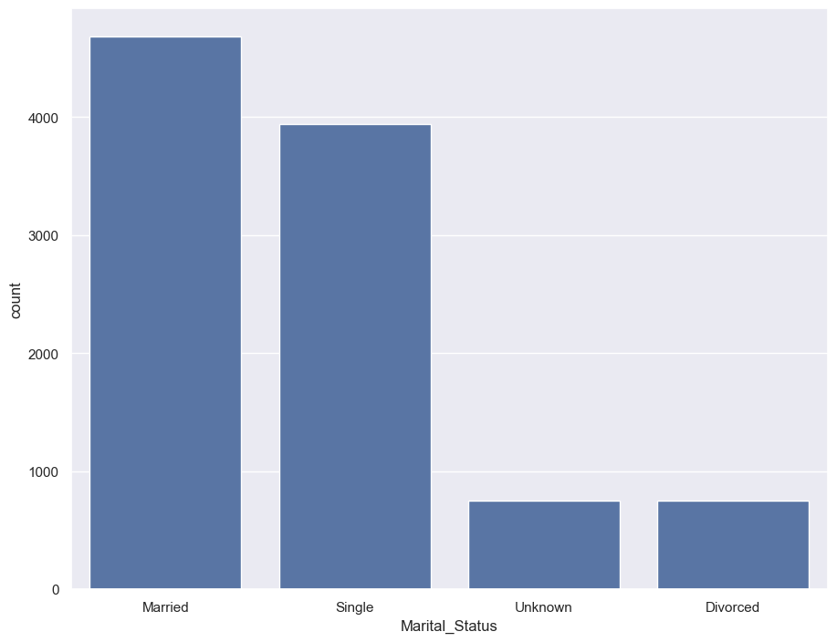
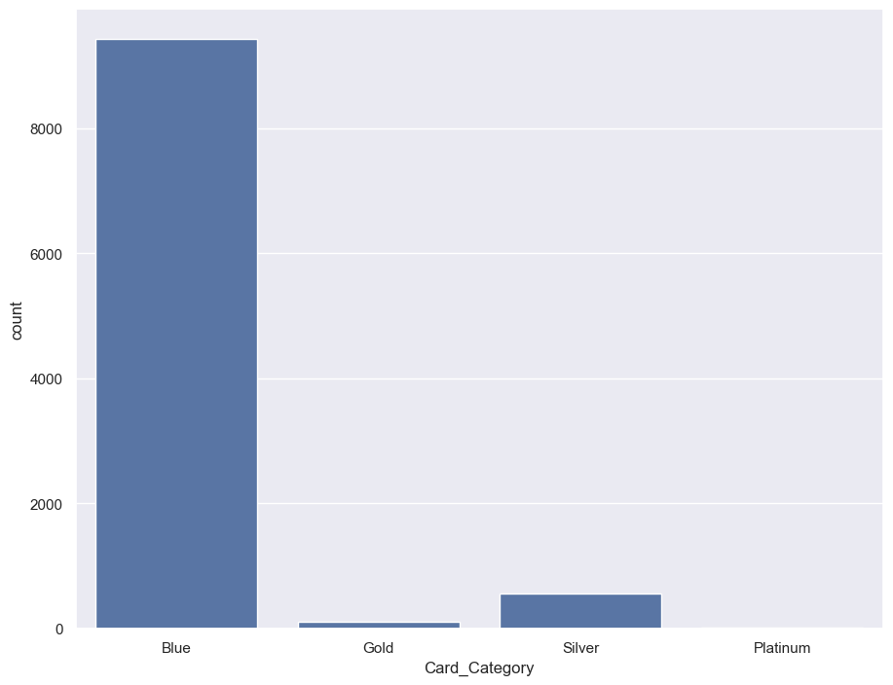
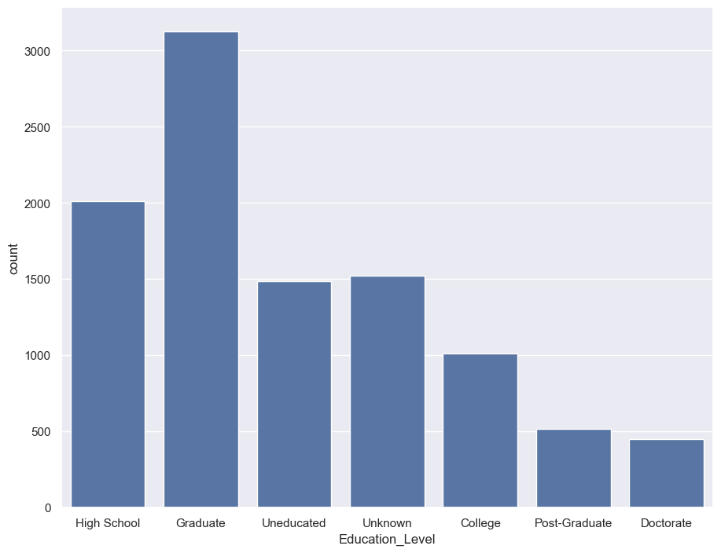
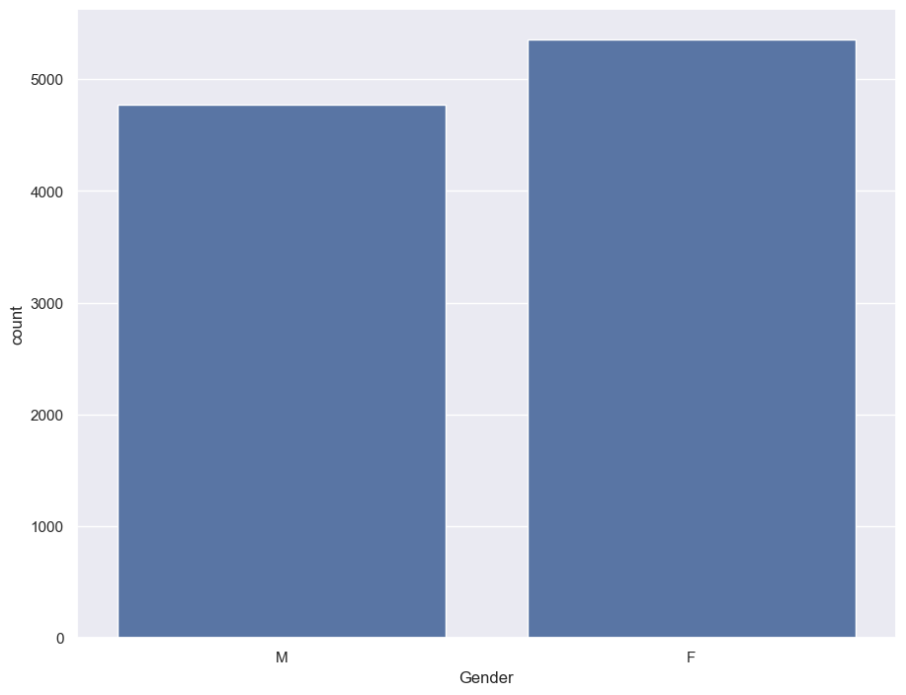
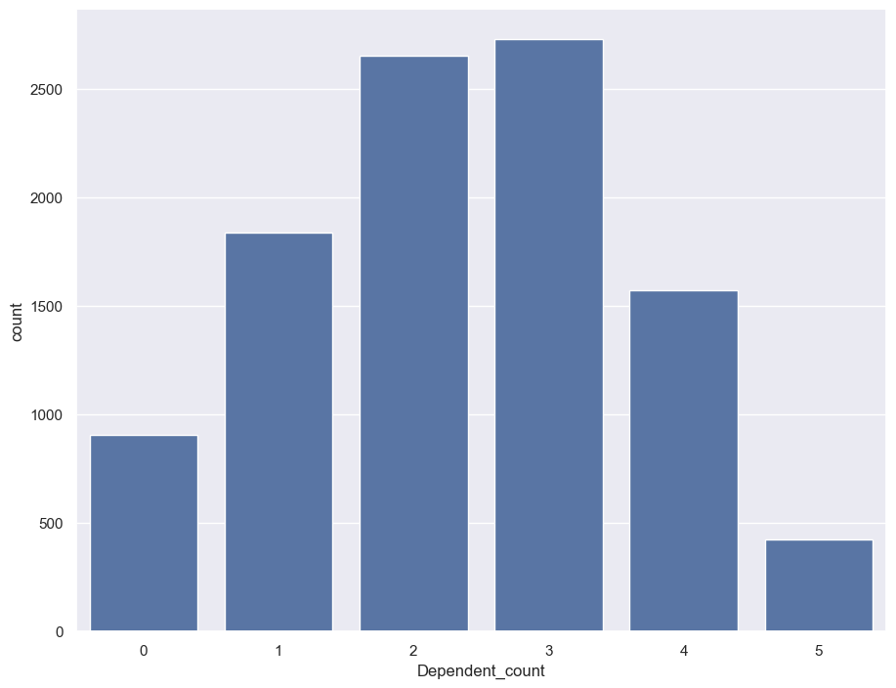
Distribution Variables (CATEGORICAL)

Slide 7
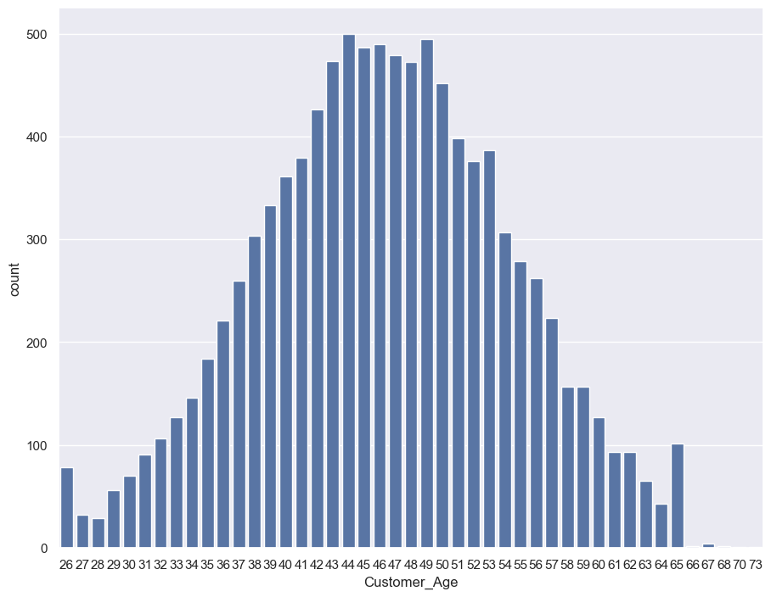
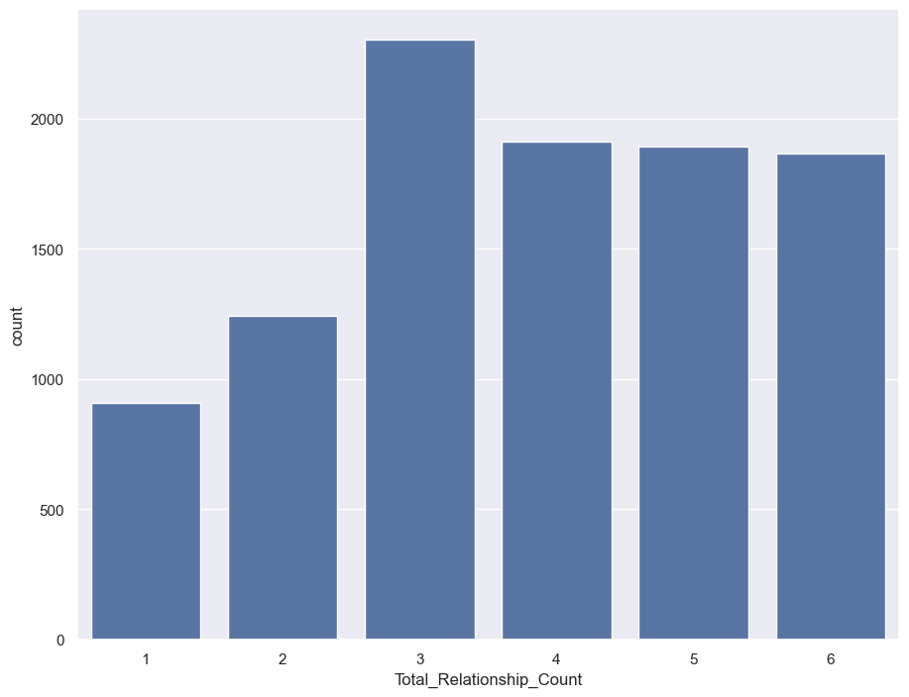
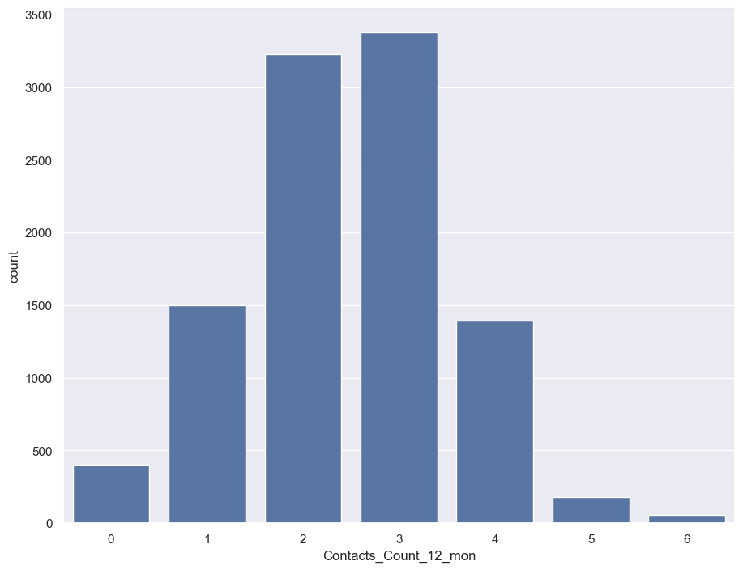
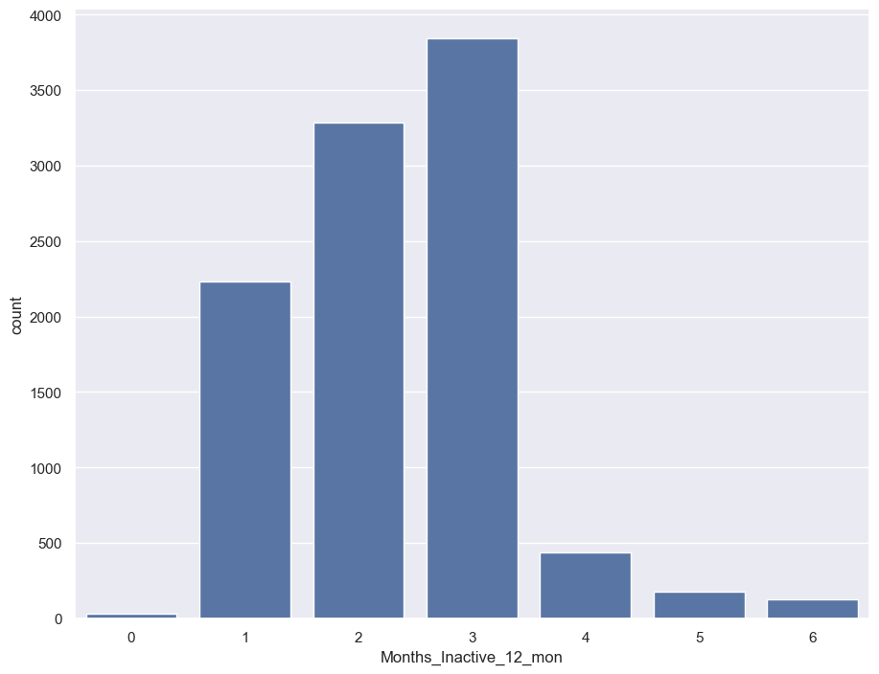
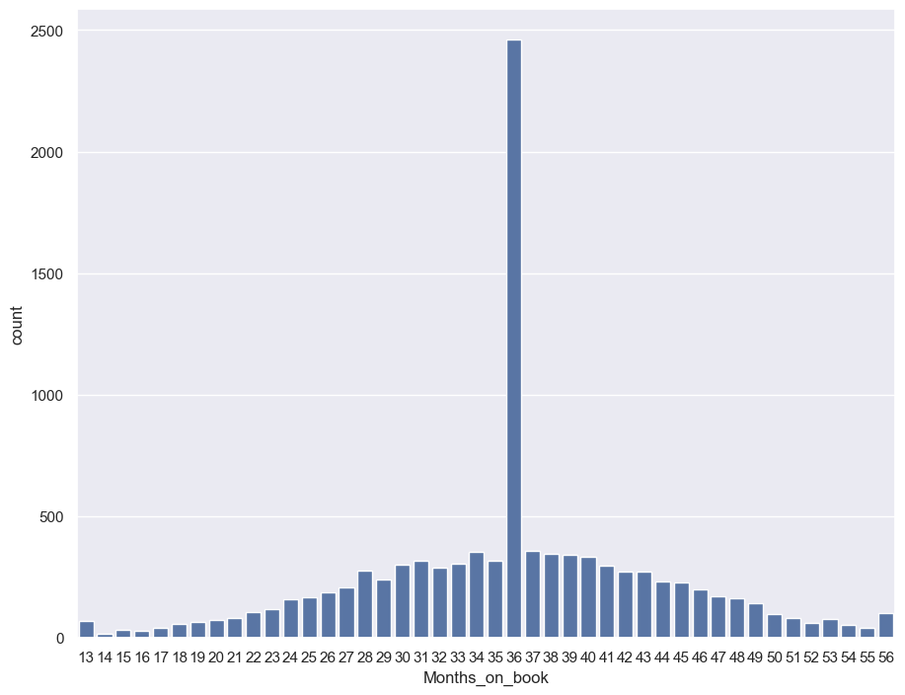
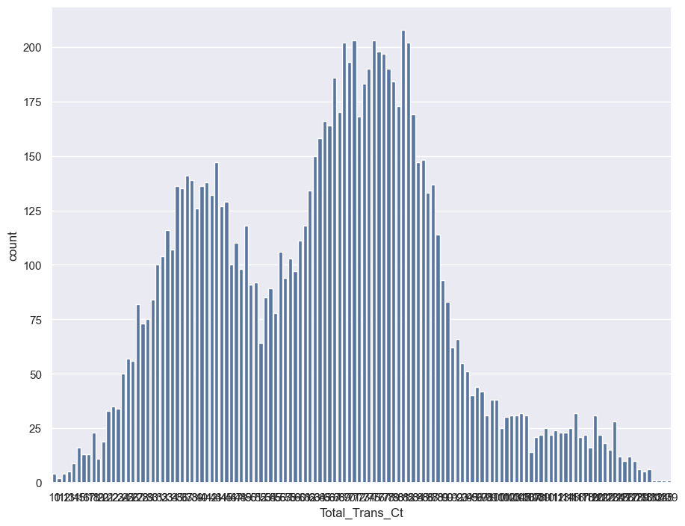
Distribution Variables (NUMERICAL)

Slide 8
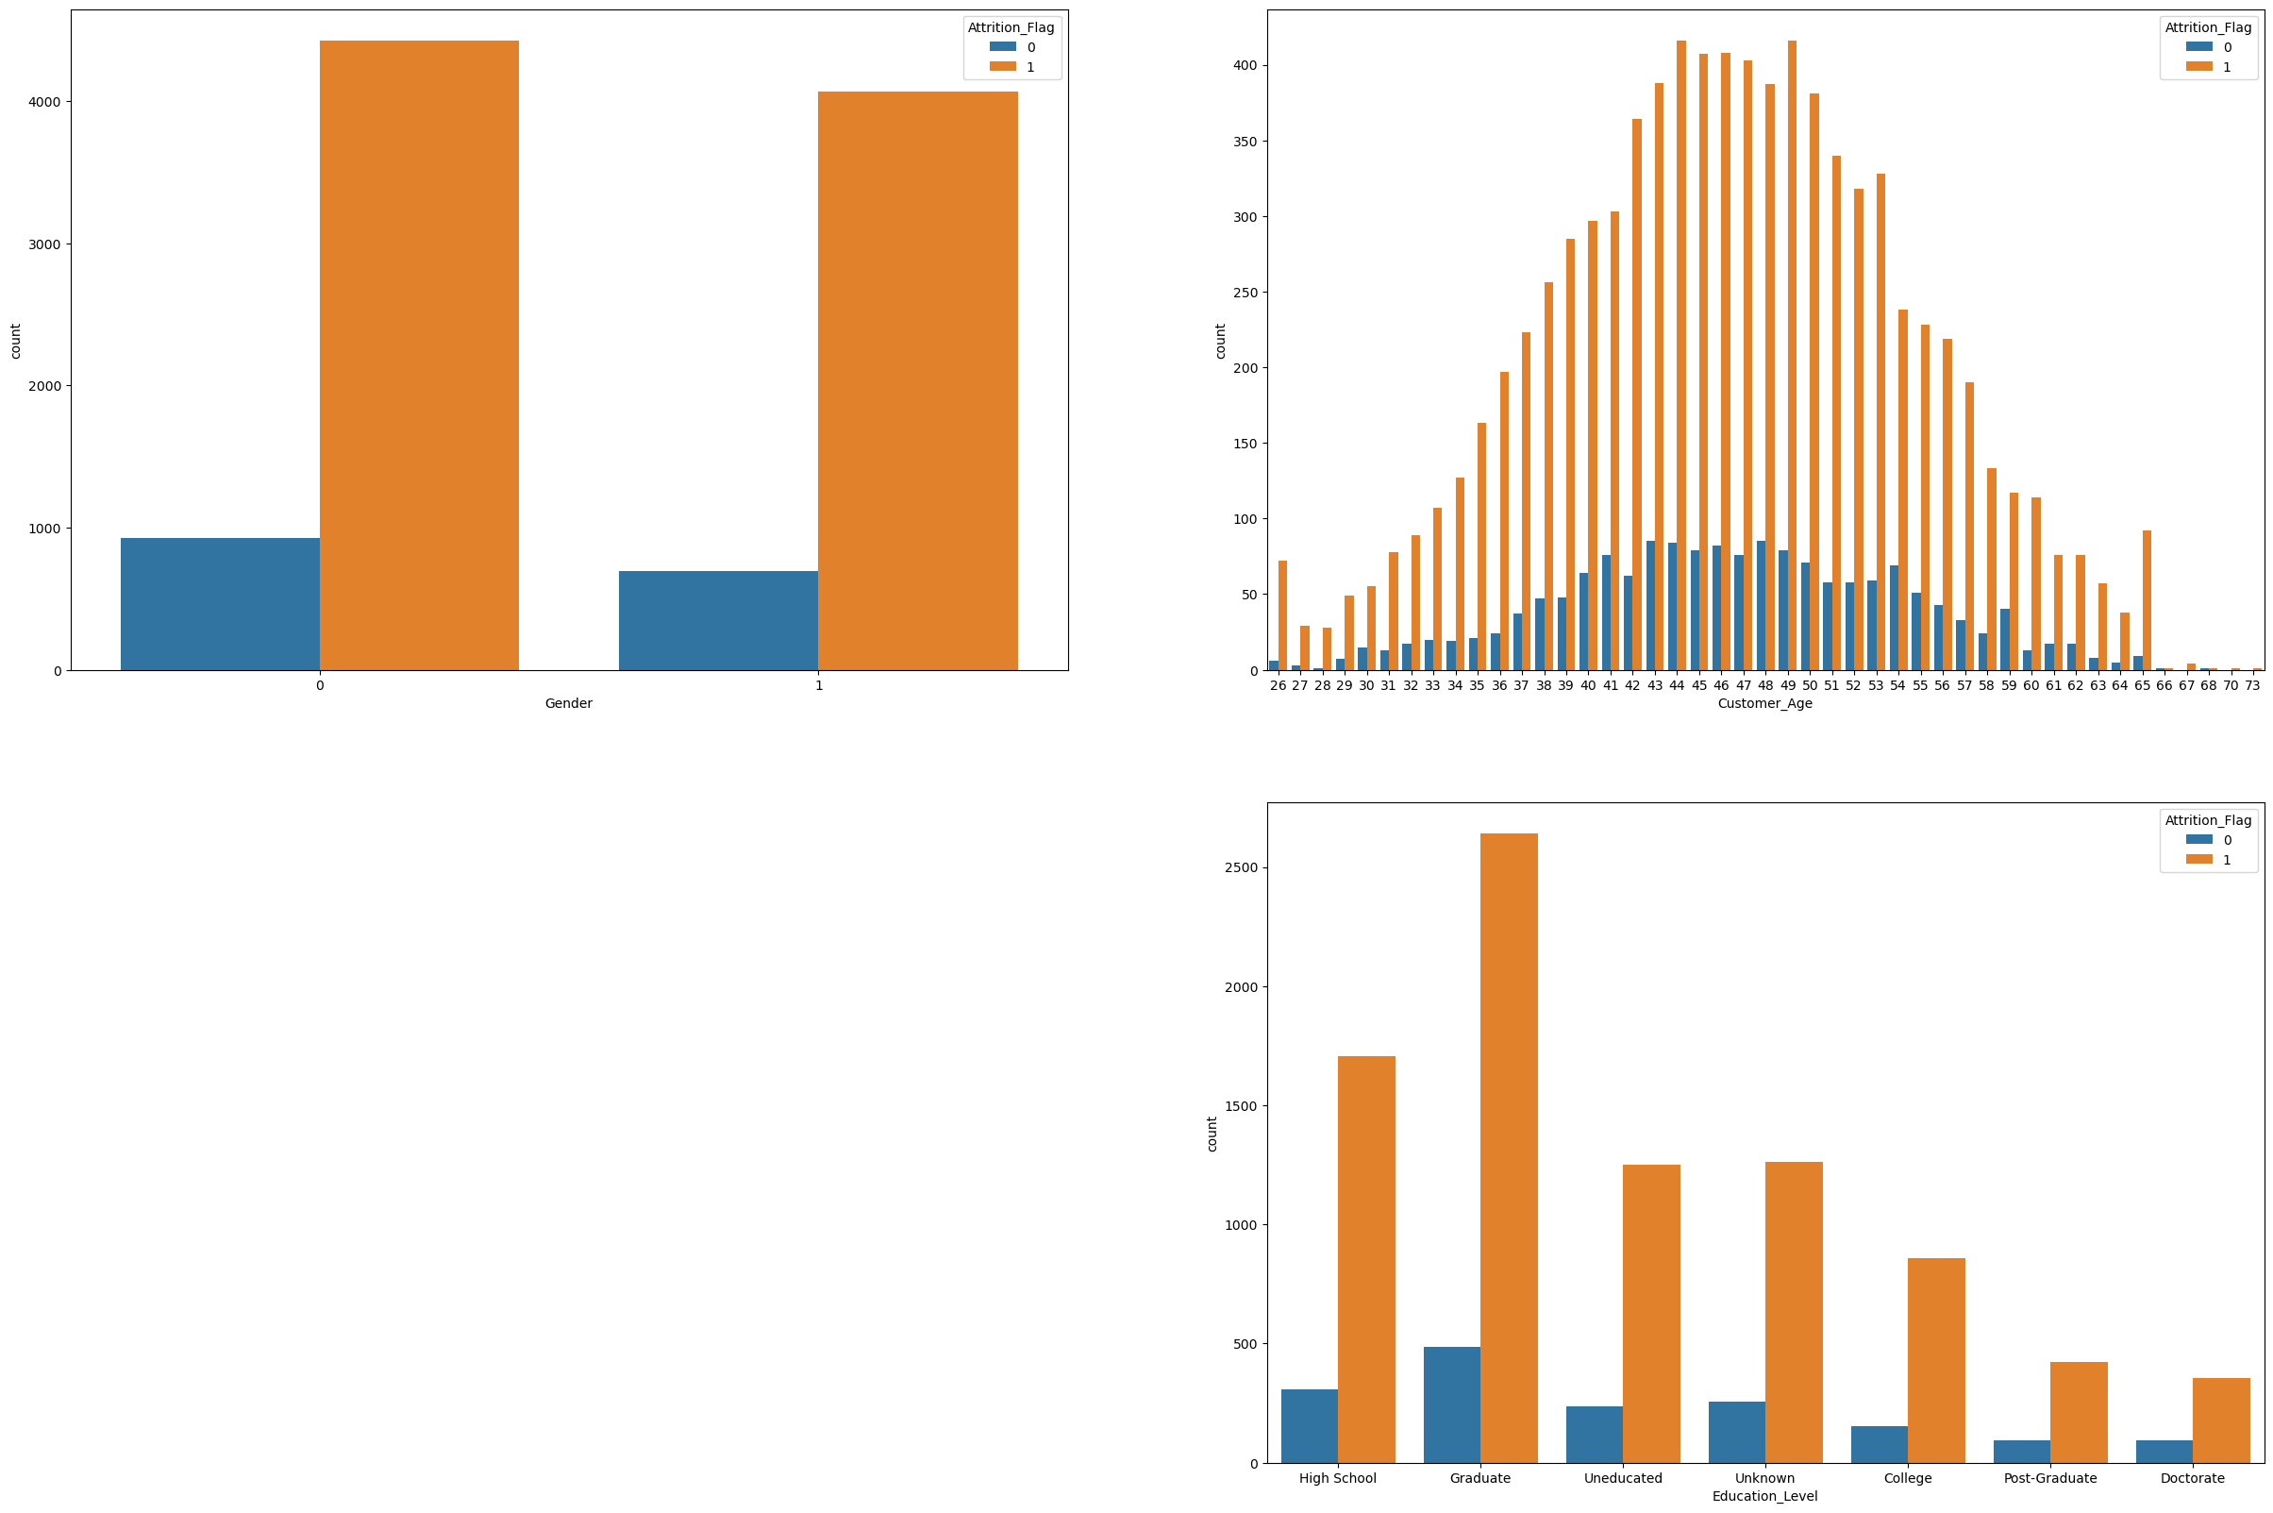
Bivariate Analysis
To further

Slide 9
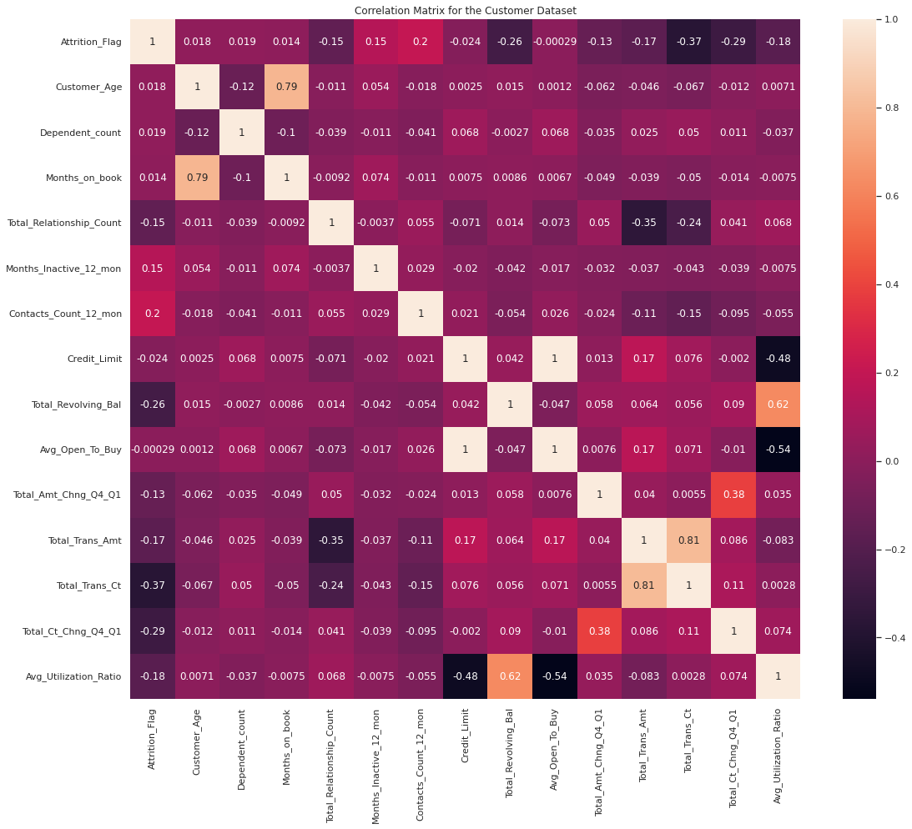
Correlation between variables
Customer Age and Months on Book exhibit a strong positive correlation (0.79), indicating that older customers tend to have a longer association with the bank.
Total Relationships and Transactions display a negative correlation (-0.35), suggesting that customers with more relationships have lower transaction amounts.
Credit Limit and Open-to-Buy show a strong positive correlation (0.99), indicating that both variables represent available credit for the customer.
Utilization Ratio and Revolving Balance exhibit a strong positive correlation (0.62), implying that a higher utilization ratio correlates with a higher revolving balance..

Slide 10
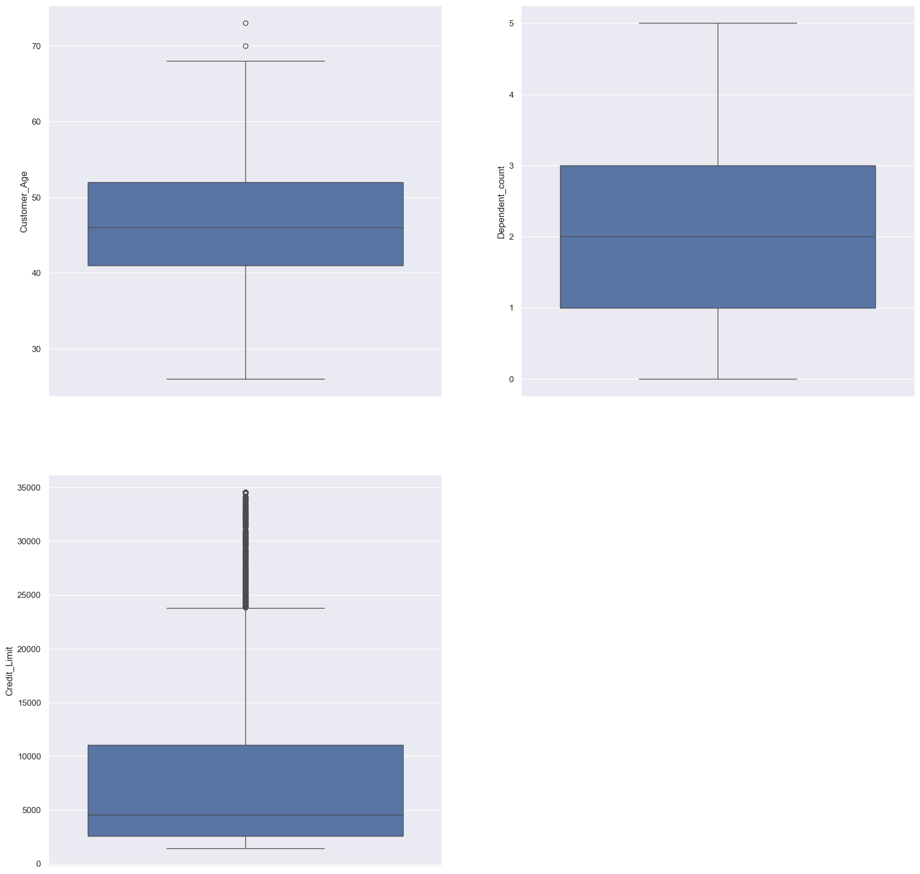
Distribution Variables (NUMERICAL)
Note : Credit_limit here has a lot of outliers but can't remove them because they are considered to considerable outliers

Slide 11
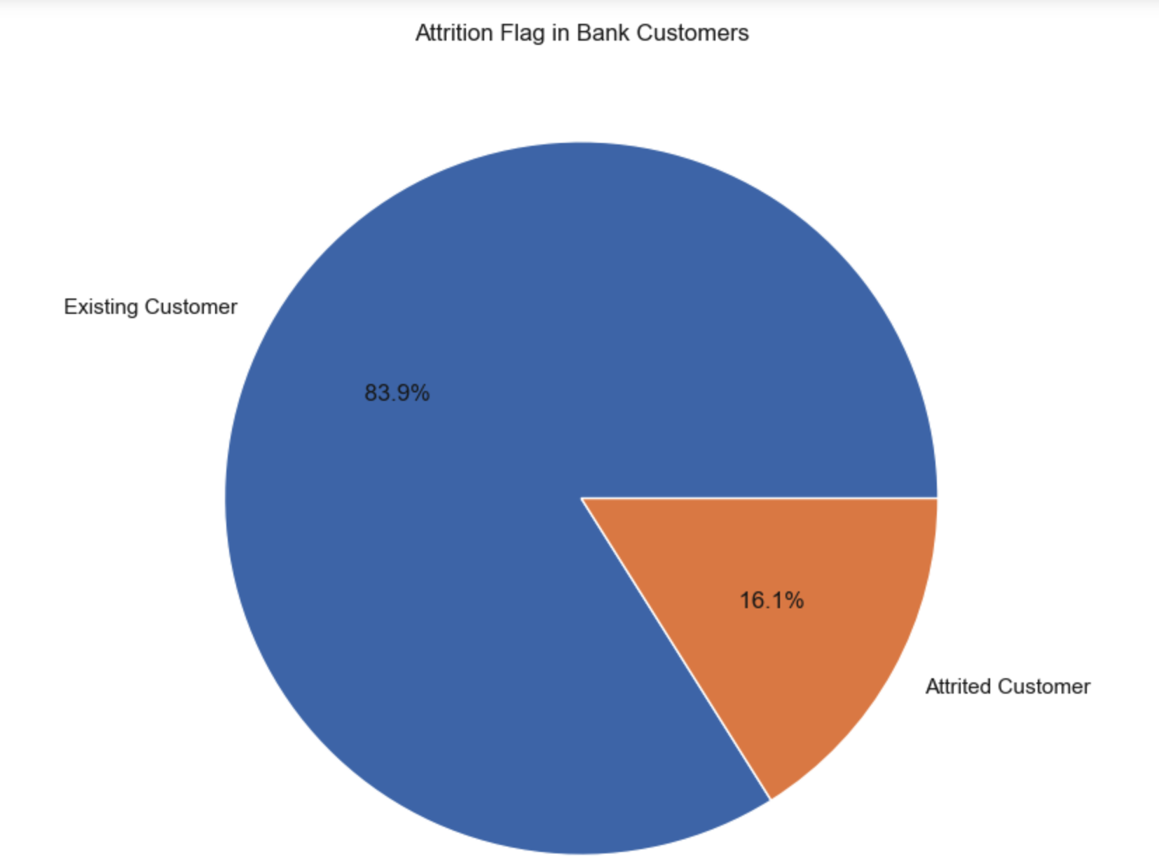
The class distribution suggests that there might be a class imbalance, with existing customers significantly outnumbering those who have churned (attrited). We have balanced the data using SMOTE

Slide 12
Data Processing

Slide 13
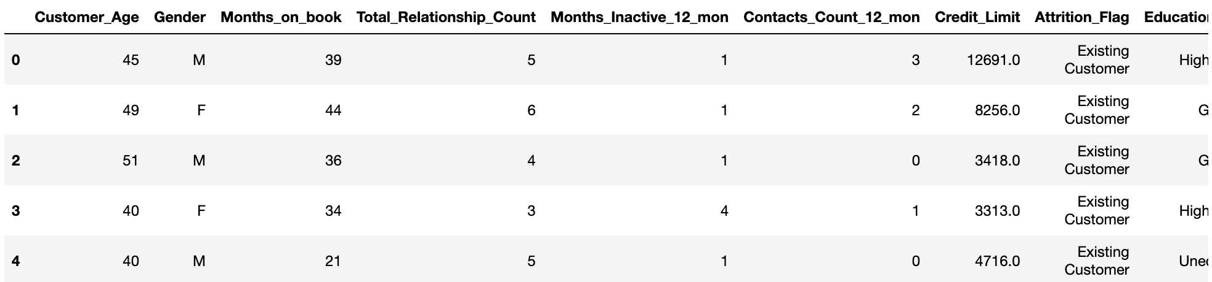
Data Selection and Encoding
Curating relevant features and transforming categorical variables:
Label Encoding was done to transform "Attrition_Flag" and "Gender" into numerical format for model compatibility.
One-Hot Encoding was done to expand categorical features ("Education_Level," "Marital_Status," "Income_Category," "Card_Category") into binary columns.

Slide 14
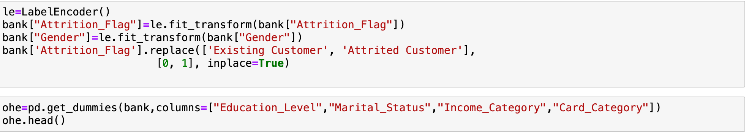
Data Encoding Overview
Label Encoding was done to transform "Attrition_Flag" and "Gender" into numerical format for model compatibility.
One-Hot Encoding was done to expand categorical features ("Education_Level," "Marital_Status," "Income_Category," "Card_Category") into binary columns.

Slide 15
MODEL BUILDING

Slide 16

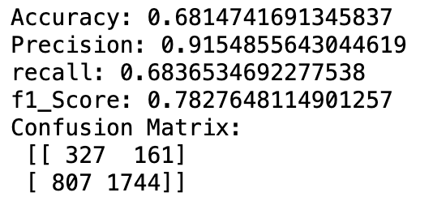
1) LOGIstic regression
The model excels in precision, minimizing false positives, and demonstrates a satisfactory balance between identifying at-risk customers and overall accuracy.
OUTPUT:
MODEL ACCURACY
Achieved an overall accuracy of 68.15%, indicating the proportion of correctly predicted instances
PRECISION EXCELLENCE
Demonstrated high precision at 91.55%, showcasing the model's accuracy in predicting positive instances, especially customer churn
RECALL
A commendable recall rate of 68.37% suggests the model's ability to effectively identify customers at risk of churning.
Attained a well-balanced F1-score of 78.28%, reflecting a harmonious trade-off between precision and recall
F1-SCORE BALANCE

Slide 17
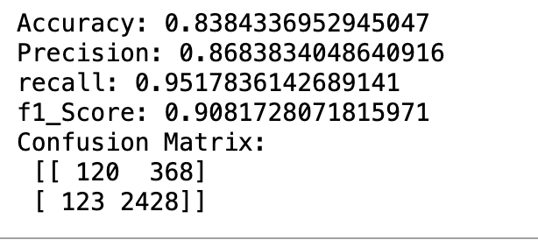
2) RANDOM Forest
OUTPUT:
The Random Forest model excels at accurately identifying churned customers with a high recall, minimizing missed instances. Its precise predictions of customer churn contribute to an overall effective performance in distinguishing both churned and non-churned customers, striking a good balance between precision and recall
ACCURACY
Achieved an accuracy of 83.8%, indicating the proportion of correctly classified instances out of the total
PRECISION
Precision of 86.8%, denoting the accuracy of positive predictions (churned customers) among all instances predicted as positive
RECALL
High recall of 95.2%, indicating the ability to correctly identify the majority of actual positive instances (churned customers)
F1-Score of 90.8%, providing a balanced measure of precision and recall
F1-SCORE

Slide 18
GridSearch
Conclusion:
While hyperparameter tuning improved certain aspects, there's a trade-off in model performance.
The tuned model sacrificed a bit of accuracy and recall for potential generalization.
Further evaluation and business considerations may guide the selection of the optimal model for deployment.
Continuous monitoring and reevaluation are essential for adapting to changing data patterns.
 | Base model | Tuned model
Accuracy | 0.8384 | 0.8259
Precision | 0.8683 | 0.8649
Recall | 0.9517 | 0.9392
F1 Score | 0.9081 | 0.9005

Slide 19
THANK YOU

