Slide 1

 | S.S.V.P.S’s B. S. Deore Polytechnic, Dhule Department of Computer Engineering Academic Year : 2026-2027
SEMINAR AND PROJECT INITIATION COURSE
Sem : CO 5 K |  | SPI – 315003 | Date :
Topic : Industrial Immersive Training Platform
Roll No. |  | Name of Student
14 |  | Purva Vikas Bhamare
34 |  | Shubhangi Sanjay Kedar
39 |  | Prajakta Chetan Mahale
46 |  | Mansi Pradip Nandre

Slide 2
Contents
Certificate
Abstract
Introduction
Literature Review
Information to Seminar topic
Advantages and Disadvantages
Conclusion
Project Initiation :
  Description of problem statement.
  Scope and objectives.
  Stake holder
  seminar exsicussion plan
  Platform/ Equipment/ Resources identification.
Bibliography
References

Slide 3
Abstract
Immersive technology is becoming useful in education, industrial training, and technical skill development.
Traditional training needs physical machines, trained instructors, and
workshop facilities, so students get limited practical exposure.
The Industrial Immersive Training Platform is a web-based application to learn industrial machines through interactive digital content.
Features: machine search, machine information, interactive 3D visualization, safety instructions, simulated troubleshooting, quizzes, and progress tracking.
Runs in a web browser, with no VR headset required. Intended for education only; it does not replace workshop training or official safety procedures.

Slide 4
1. Introduction
Industrial training helps students understand machines, their components, working principles, and safety procedures.
Access to real machines is limited by high cost, maintenance needs, and
safety risks.
VR, AR, and interactive 3D visualization let learners explore digital machine models.
Proposed project: a web-based application with machine information, 3D models, component identification, simulated troubleshooting, safety quizzes, and progress tracking.
Objective: make machine learning more accessible and interactive, while supporting (not replacing) workshop training.

Slide 5
2. Literature Survey
Sr. No. | Aapproach Type | Technology Used | Dataset | Key Objective | Limitations
1. | VR Training for KUKA Robot Operators (Pratticò & Lamberti, 2021) | VR, Robotics | Case Study | Train robot operators virtually | Limited real-world testing
2. | AR Tools for Aeronautic Maintenance (Loizeau et al., 2021) | AR | Field Evaluation | Support Maintenance Workers | Industry-specific
3. | Situated Visualization for Maintenance Training (BagheriFard et al., 2025) | AR, Visualization | User Study | Improve maintenance learning | Limited evaluation
 |  |  |  |  |  |  | 5

Slide 6
2. Literature Survey
Sr. No. | Aapproach Type | Technology Used | Dataset | Key Objective | Limitations
4. | Immersive Technologies for Safety Training (Babalola et al., 2023) | VR, AR, XR | 67 Articles | Review safety training methods | Varied study quality
5. | XR and Workers’ Safety (Dodoo et al., 2025) | XR, VR, AR | Literature Review | Study XR in high-risk industries | Adoption challenges
6. | VR-ManuSafe (Fengjin et al., 2026) | VR, Unity | 8 Injury Types | Teach manufacturi ng safety | Limited scope
 |  |  |  |  |  |  | 6

Slide 7
2. Literature Survey
Sr. No. | Aapproach Type | Technology Used | Dataset | Key Objective | Limitations
7. | An Emerging Immersive Technology – A Survey (Pavithra et al., 2020) | VR, AR, MR | Literature Survey | Explore immersive technologies | General overview
8. | Immersive Technology: Uses and Challenges (Handa et al.) | VR, AR, MR | Literature Review | Discuss uses and challenges | Limited practical analysis
9. | State of Immersive Technology Research (Suh & Prophet, 2018) | VR, AR, MR | Research Literature | Analyze research trends | Depends on available studies
 |  |  |  |  |  |  | 7

Slide 8
2. Literature Survey
Sr. No. | Aapproach Type | Technology Used | Dataset | Key Objective | Limitations
10. | Web-Based Digital Twin for E-Learning (Weis et al., 2025) | Web 3D, Digital Twin | 7 Professional s | Support interactive learning | Small pilot study
11. | Immersive Learning for Machine Operators (Pletz & Zinn, 2020) | VR, Video Analysis | 13 Participants | Evaluate operator training | Small sample size
12. | Industrial Machine Identification Using AR (Kavya et al., 2021) | Unity, Vuforia, ARCore | Prototype | Identify machines using AR | Platform limitations
 |  |  |  |  |  |  | 8

Slide 9
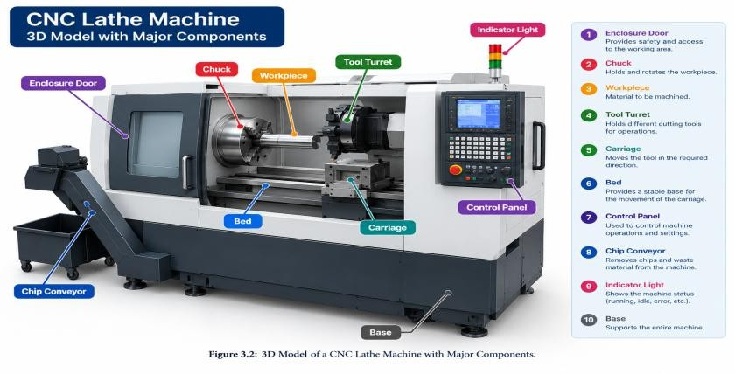
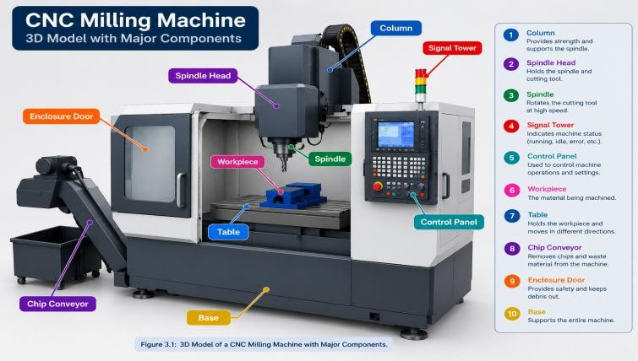
3. Information to seminar topic
Industrial machines: used in manufacturing, processing, assembly, and packaging; the platform gives each machine's name, use, components, and working principle.
Types: Manufacturing (drilling, milling, lathe), Material Handling (conveyors, lifting), Assembly, Packaging, and Industrial Robots.
3D visualization: rotate, zoom, and view a machine from different angles;
selecting a component shows its name and basic information.
Component identification: labelled 3D models and diagrams, e.g. a drilling machine has a drill bit, spindle, worktable, base, and column.

Slide 10
4. Advantages / Disadvantages
Advantages Disadvantages
Interactive learning
Easy access through a browser, no
VR headset
Better understanding of machine structure
Self-paced learning
Safety awareness
Simulated troubleshooting practice
Progress tracking
Less dependence on physical
equipment
Cannot replace hands-on
experience
3D models take skill and time to build
Needs a reasonably capable device
Needs a stable internet connection
Limited simulation of real faults
Content accuracy affects learning
Needs regular updates
Quizzes do not replace formal
safety training

Slide 11
5. Conclusion
The Industrial Immersive Training Platform is a proposed web-based application that supports industrial machine learning through interactive digital technology.
It brings machine information, 3D visualization, component identification, simulated troubleshooting, and safety quizzes into one place.
Users can explore machine models and learn about components in a web browser, without a VR headset.
It cannot fully replace real equipment experience; its value depends on model quality, content accuracy, and successful implementation.
Future scope: more machine models, more training activities, and improved interactive features.

Slide 12
6. Project Initiation
6.1 Description of problem statement
6.2 Scope and objectives
6.3 Stakeholders
6.4 Seminar discussion plan
6.5 Platform / equipment / resources identification

Slide 13
6.1 Description of problem statement
Industrial training is important in technical education, but students may not get access to different machines because of high cost, limited availability, and maintenance needs.
Learning only from textbooks and static images makes machine components and working principles hard to understand.
Need: an interactive learning platform with machine information and
digital visualization.
Solution: a web-based environment to explore machines, identify components, practise simulated troubleshooting, and learn basic safety procedures.

Slide 14
6.2 Scope and objectives
Scope
A web-based platform for basic industrial machine training with machine categories and search, 3D visualization, component identification, simulated troubleshooting, safety quizzes, user accounts, and progress tracking. For education only; supplements workshop training.
Objectives
Develop a web-based industrial training platform
Provide information on machines and their components
Enable interactive 3D exploration of machine models
Provide basic component identification activities
Support learning through simulated troubleshooting
Improve safety awareness through quizzes
Let users review their learning progress

Slide 15
6.3 Stakeholders
Students: learn about industrial machines and their components.
Teachers: use the platform as a supplementary teaching resource.
Factory employees: revise basic machine-related concepts.
Institution administrators: manage institution users and learning resources.
Platform administrators: manage user accounts, machine information,
and content.
Project developers: design, develop, test, and maintain the application.

Slide 16
6.4 Seminar discussion plan
Introduction to industrial immersive technology
Need for interactive industrial machine training
Overview of the Industrial Immersive Training Platform
Proposed system and its features
Technologies required for development
Advantages and disadvantages
Possible applications and future improvements
Conclusion and questions from the audience

Slide 17
6.5 Platform / Equipment / Resources
Laptop / Computer: develop and test the application
Antigravity: assist with application development and coding
HTML and CSS: structure and style web pages
JavaScript: application logic and interactivity
React: build the user interface
Three.js: display and interact with 3D machine models
MySQL Database: store user and machine data
3D Machine Models: digital representations of industrial equipment
Web Browser: access and test the application
Internet Connection: online tools, libraries, and services

Slide 18
Bibliography
Books
  Burdea, G. C., & Coiffet, P. (2003). Virtual Reality Technology (2nd ed.). Wiley-IEEE Press.
  Craig, A. B. (2013). Understanding Augmented Reality: Concepts and Applications. Morgan Kaufmann.
  Sherman, W. R., & Craig, A. B. (2003). Understanding Virtual Reality:
Interface, Application, and Design. Morgan Kaufmann.
Websites
https://doi.org/10.1016/j.ssci.2023.106214 https://doi.org/10.1016/j.ssci.2025.106804 https://doi.org/10.1016/j.simpa.2025.100790

Slide 19
References
Pratticò, F. G., & Lamberti, F. (2021). Towards the Adoption of Virtual Reality Training Systems for the Self-Tuition of Industrial Robot Operators: A Case Study at KUKA.
Loizeau, Q., et al. (2021). Methodology for the Field Evaluation of the Impact of Augmented Reality Tools for Maintenance Workers in the Aeronautic Industry.
BagheriFard, Z., et al. (2025). Situated Visualization Towards Manufacturing Maintenance Training: Scoping Review, Design and User Study.
Babalola, A., et al. (2023). Applications of Immersive Technologies for Occupational Safety and Health Training and Education: A Systematic Review.
Dodoo, J. E., et al. (2025). XR and Workers’ Safety in High-Risk
Industries: A Comprehensive Review.
Lei, F., Singh, D., & Chun, L. M. (2026). VR-ManuSafe: Virtual Reality Learning Environment for Manufacturing Safety Training.

Slide 20
Thank you
20

