Slide 1
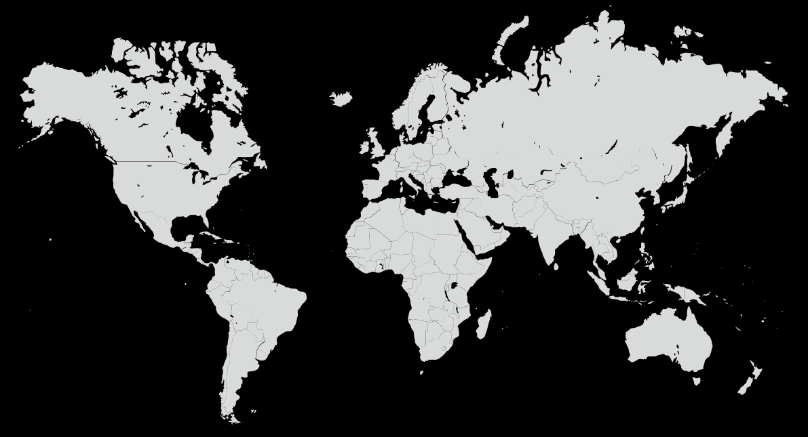




San Francisco
California -USA
Pune
India
Work locations
Registered Office
Location

Slide 2
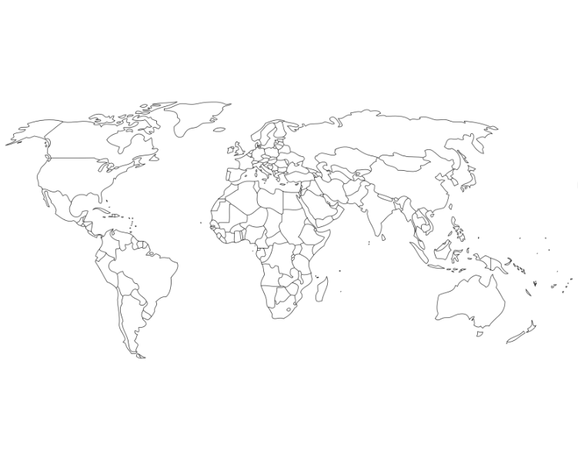

Slide 3
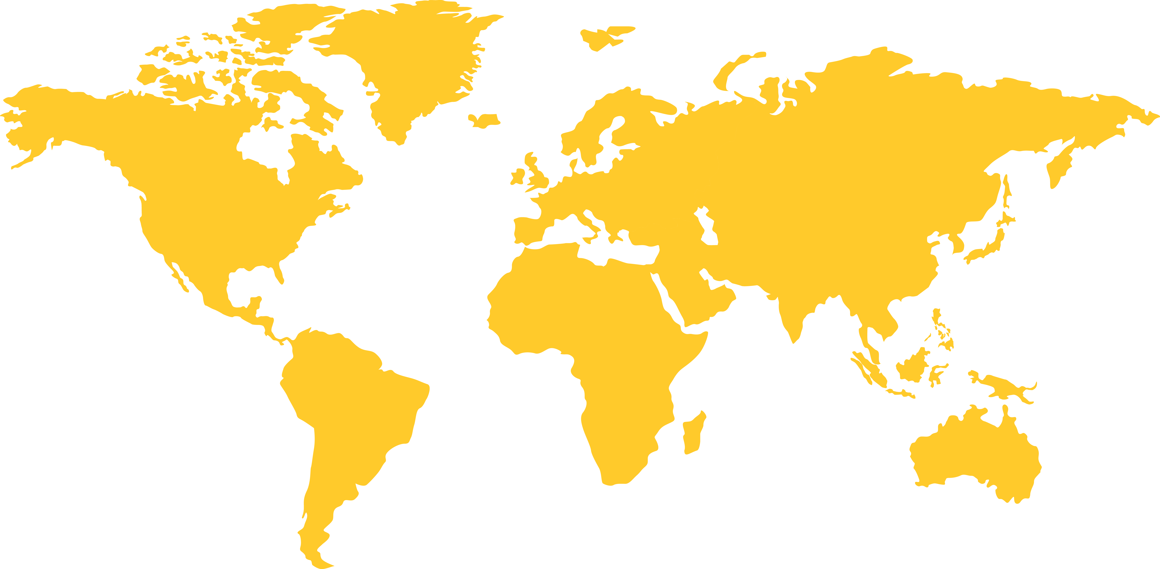

Slide 4
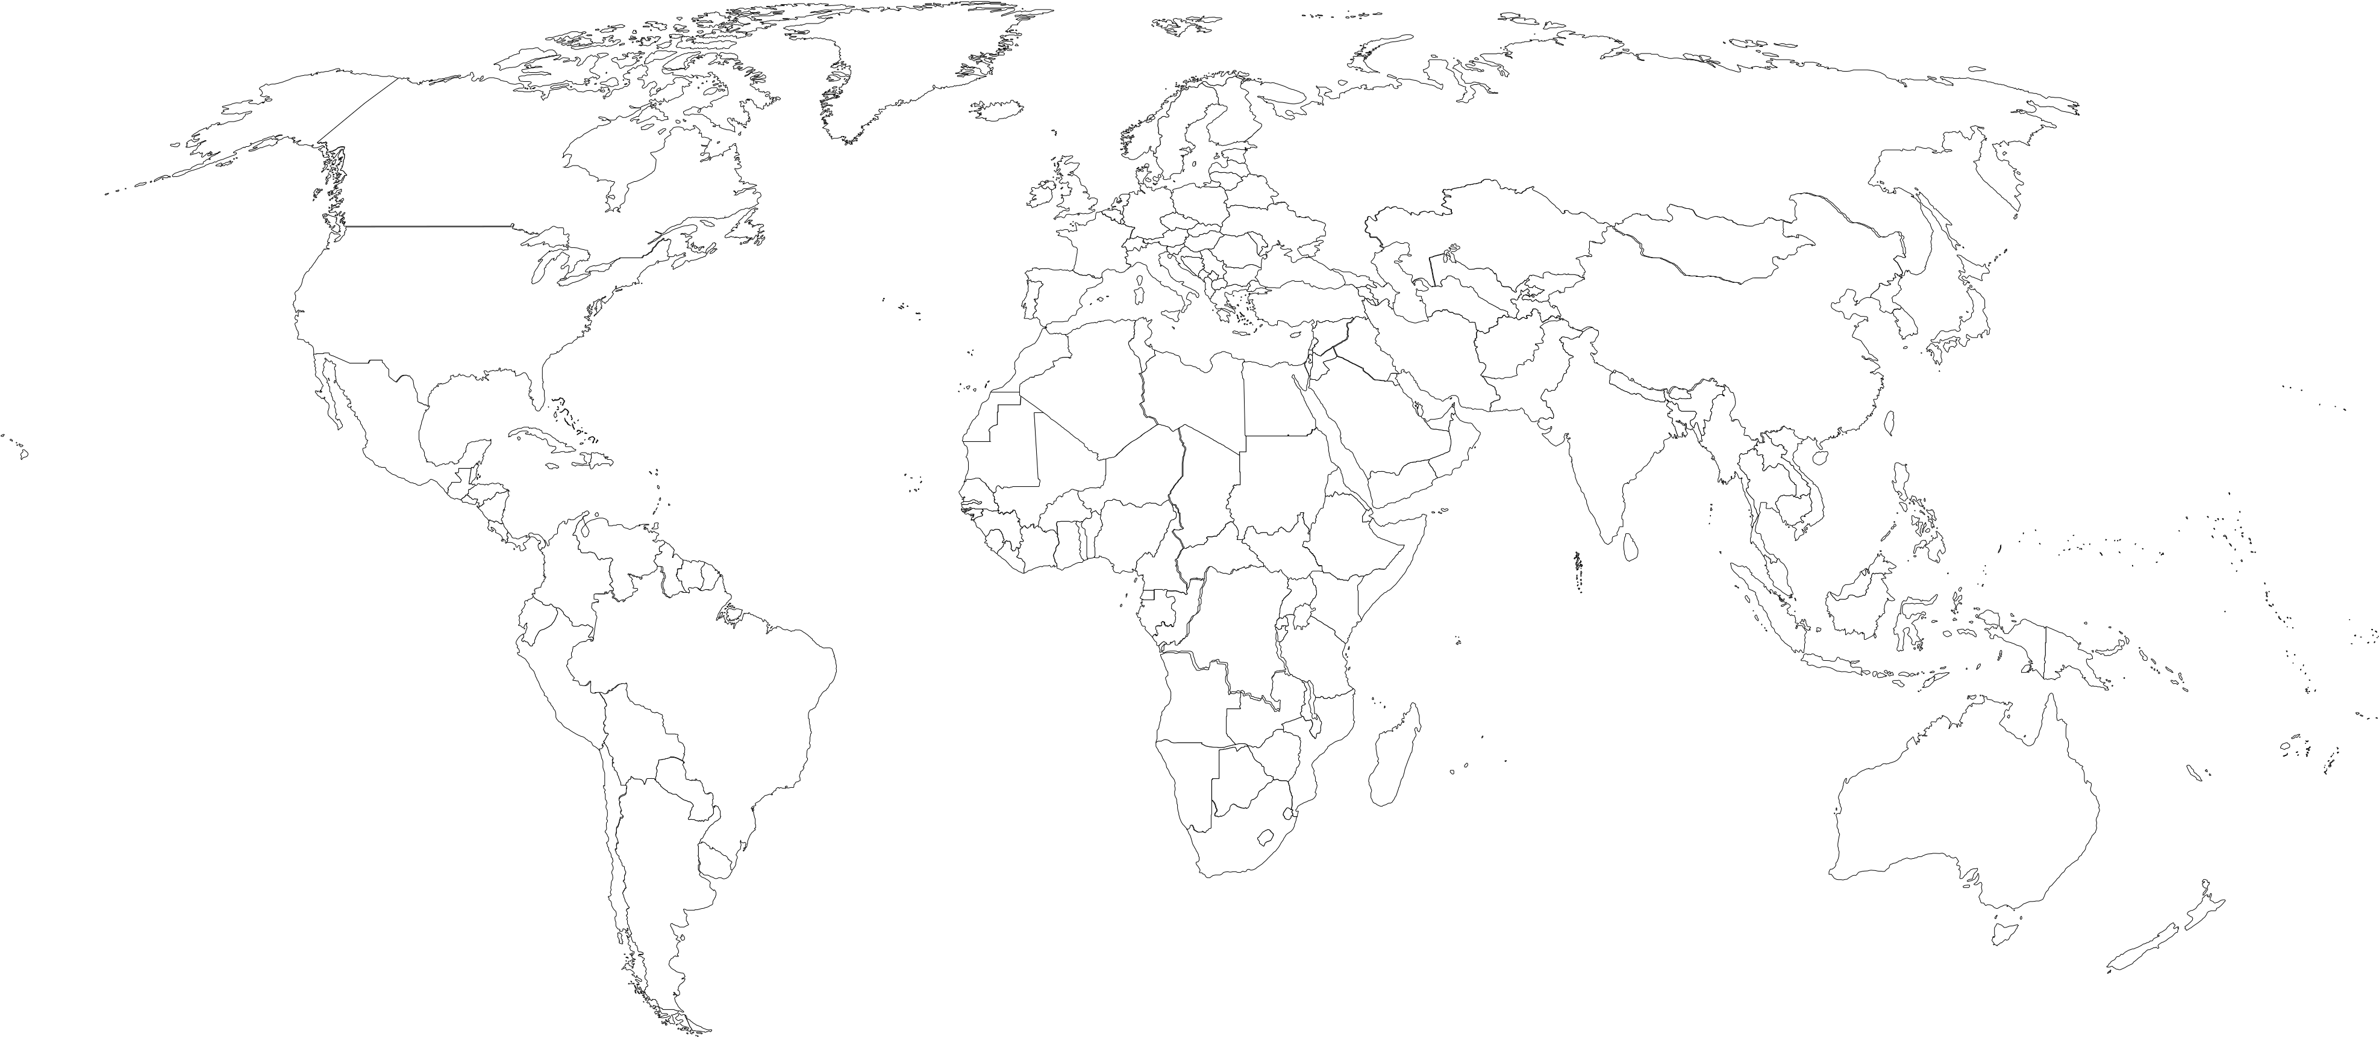

Slide 5
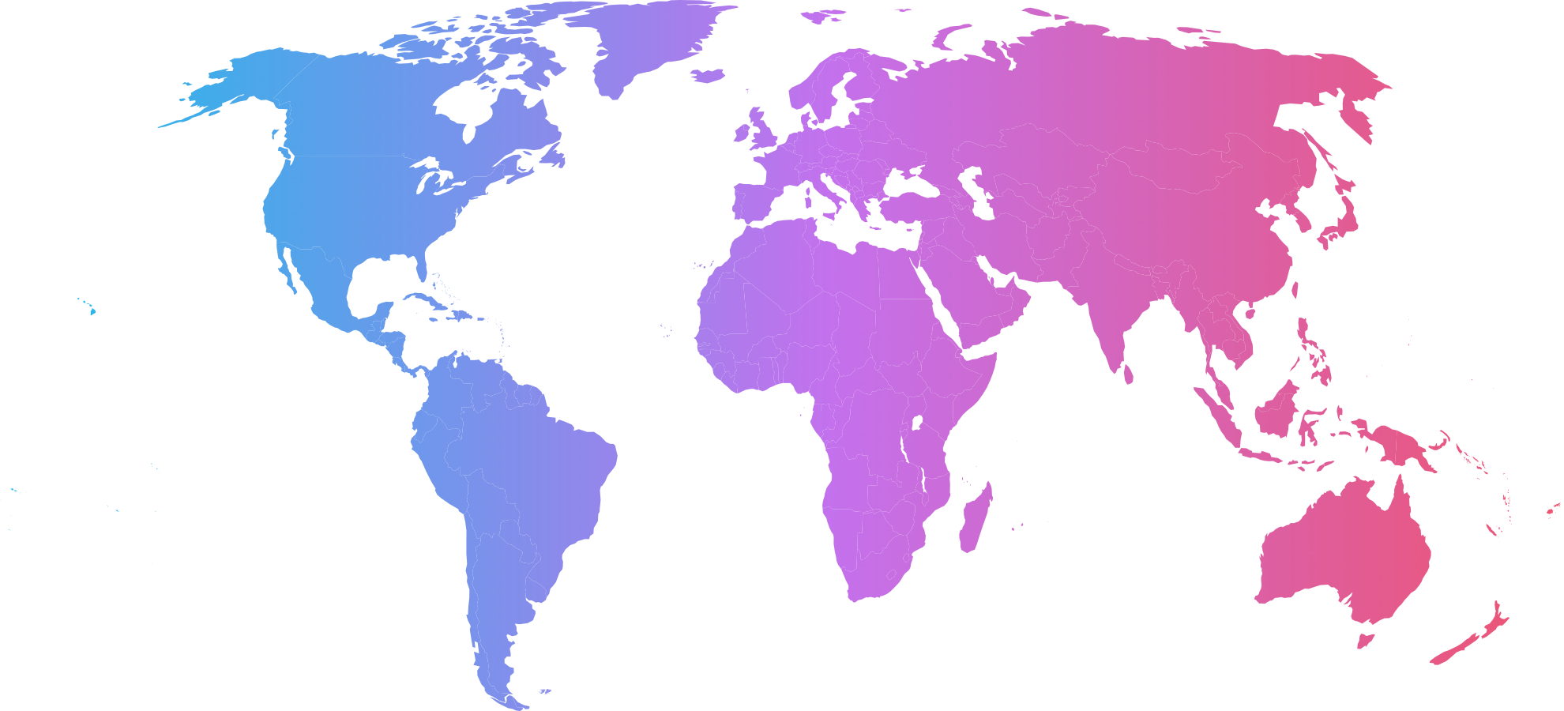

Slide 6
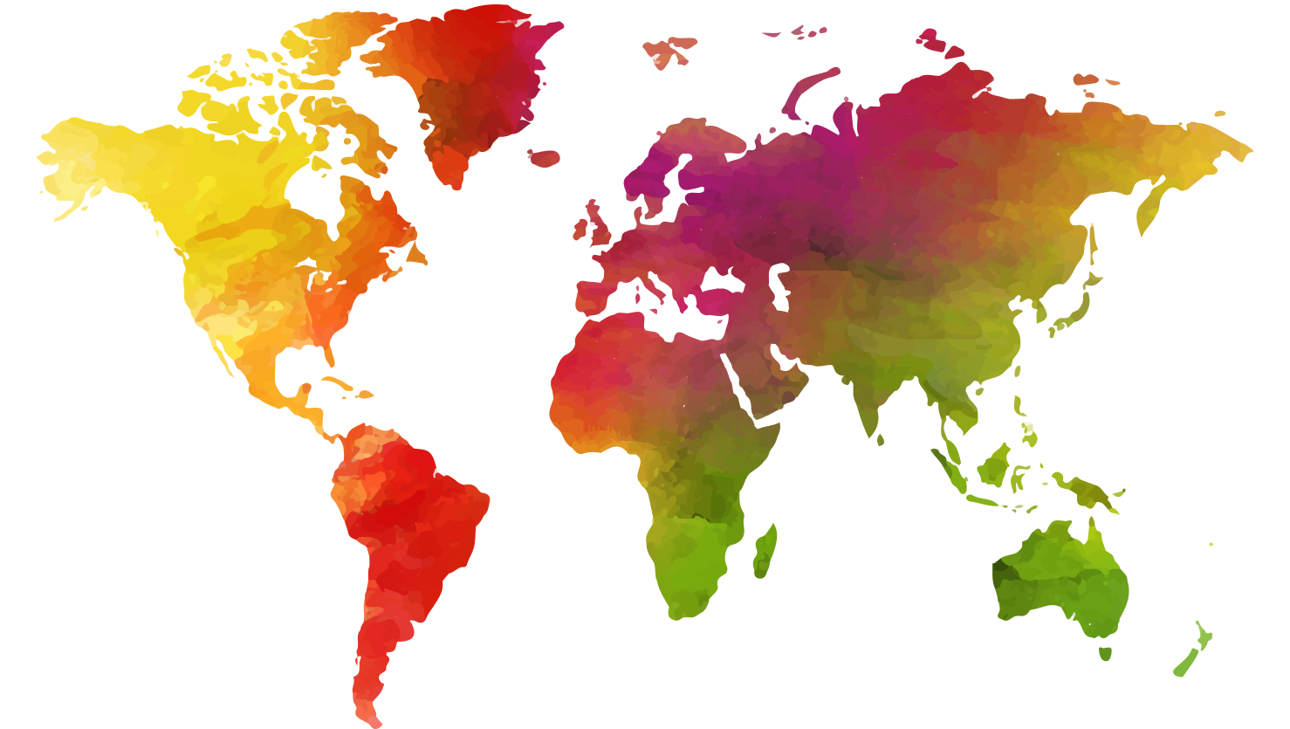

Slide 7
San Francisco
California -USA
Pune
India
Work locations
Registered Office
Location

Slide 8
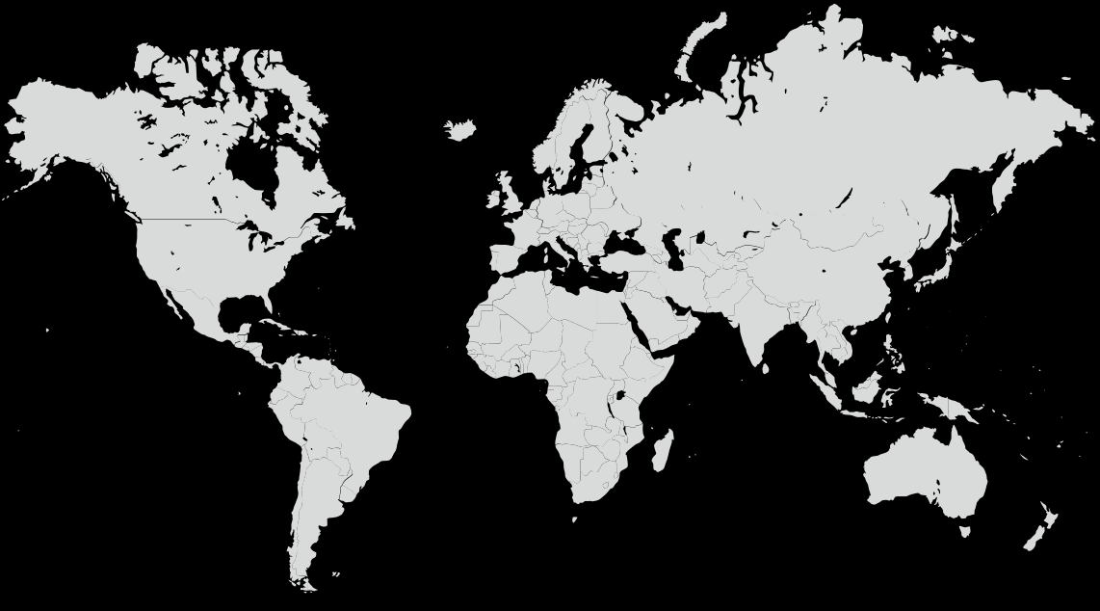
Work locations
Registered Office
Location

