Slide 1
E-Commerce

Slide 2
Table of Contents
E-Commerce Overview
Definition of E-Commerce
History of E-Commerce
Types of E-Commerce
Example-Amazon
About Amazon
Home Page
Features
Wow Factor in E-Commerce
Benefits of E-Commerce
Conclusion

Slide 3
E-Commerce Overview
Definition of E-Commerce
E-commerce, short for electronic commerce, is the buying and selling of goods and services over the internet. It allows people to shop and conduct business transactions online using computers, smartphones, and other digital devices. This includes activities like online shopping, online banking, and digital payments.

Slide 4
E-Commerce Overview
History of E-Commerce
E-commerce began in the 1960s with Electronic Data Interchange (EDI). Key milestones include the first online shopping system in 1979, the rise of the internet in the 1990s with Amazon and eBay, and the growth of PayPal and Shopify in the 2000s. The 2010s saw mobile and social media commerce. The 2020s focus on AI, AR, and sustainability, accelerated by the COVID-19 pandemic.

Slide 5
Types of E-Commerce
C2B
(Consumer-to-Business)
B2A
(Business-to-Administration)
B2B
(Business-to-Business)
C2C
(Consumer-to-Consumer)
Mobile
E-Commerce
B2C
(Business-to-Consumer)
A2B
(Administration-to-Business)

Slide 6

Amazon
Amazon is one of the world's largest e-commerce platforms, allowing individuals and businesses to buy and sell a vast array of products online. It provides a user-friendly interface for browsing, purchasing, and delivering goods to customers worldwide. Additionally, Amazon offers features such as customer reviews, personalized recommendations, and fast shipping options through services like Amazon Prime.

Slide 7
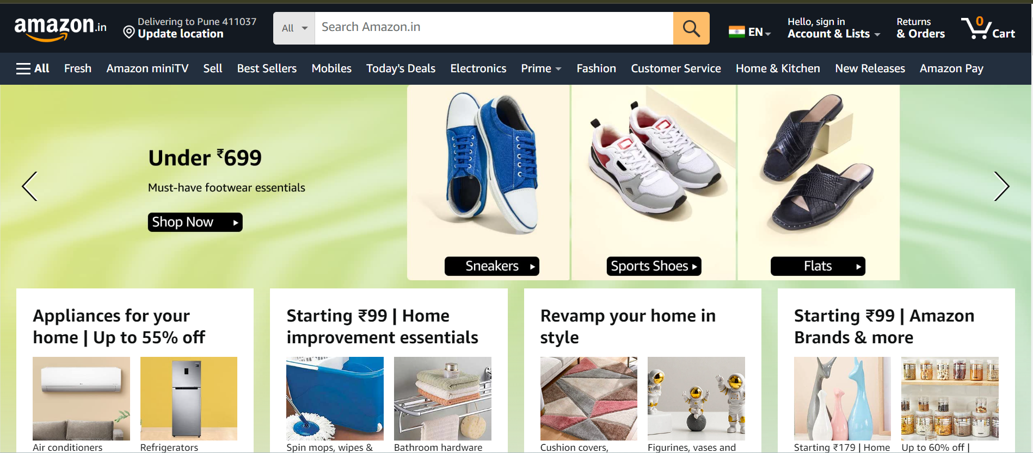
Home Page View

Slide 8
Features of AWS
Product Selection
Reviews and Ratings
Personalized Recommendations
Amazon Prime
Advertising
Alexa and Echo Devices

Slide 9
Wow Factor in E-Commerce
User
Experience
(UX)
Design
Product
Presentation
Customer
Engagement
Shipping
and
Delivery
Post-Purchase
Service
Customer
Service
Innovative
Features
Security
and
Trust

Slide 10
Benefits of E-Commerce
Global Reach
Wide Product Selection
Benefits of E-Commerce
Convenience
Convenient Payment Options
Cost Efficiency
Accessibility

Slide 11
Conclusion
E-commerce represents a game-changer in business and consumer interactions. It's all about reaching customers worldwide, offering convenience, and saving costs. With a vast array of products and personalized experiences, it's reshaping how we shop and do business. As technology evolves, e-commerce keeps getting better, making commerce more accessible and exciting for everyone.

Slide 12
Thank you

