Slide 1
Spotify Music Using SQL
Exploring music trends, artist performance, and user insights
Name : Prajakta Laxman Thopte
Course : DS-DA
| Project | 2025

Slide 2
Project Introduction
This project focuses on analyzing Spotify music data using SQL. The aim is to explore patterns in artists, albums, tracks, and user behavior to gain meaningful insights into the music industry.
The project involves:
Building a relational database with tables for Artists, Albums, Tracks, and Users.
Writing SQL queries ranging from simple selection to advanced analysis with aggregation and filtering.
Extracting insights on popular tracks, artist performance, album trends, and user subscription distribution.

Slide 3
Problem Statement
With millions of songs, albums, and artists, Spotify generates massive amounts of music and user data every day.
The challenge is to:
Organize data about artists, albums, tracks, and users into a structured relational database.
Apply SQL queries to analyze track popularity, artist performance, and user subscription trends.
Identify patterns and insights that can help understand music trends and user preferences.

Slide 4
Project objective
Build a relational database for Spotify data.
Write SQL queries (simple to advanced).
Analyze tracks, albums, artists, and users.
Identify top artists, popular tracks, and subscription trends.
Gain insights into music patterns and user preferences.

Slide 5
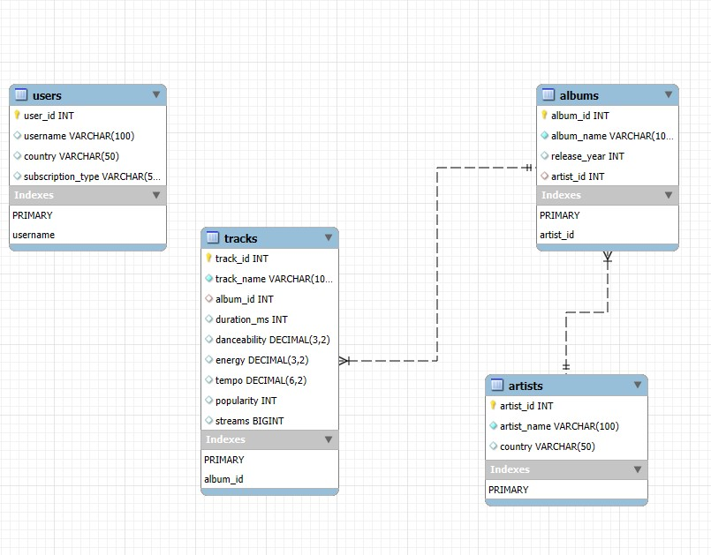
Database Schema (ER Digram)

Slide 6
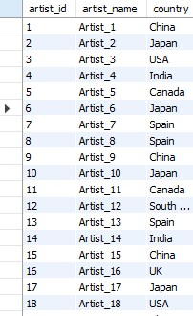
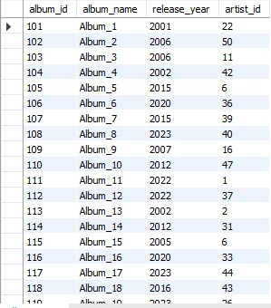
Dataset Information
Artist – Albums -

Slide 7
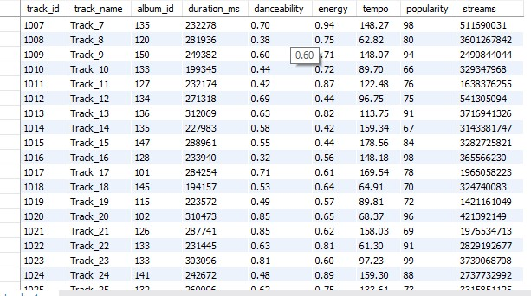
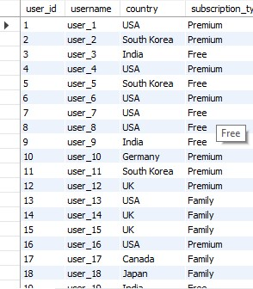
Tracks - Users -

Slide 8
Queries Classification
• Simple Queries: Basic SELECT, WHERE, ORDER BY
• Intermediate Queries: GROUP BY, HAVING, Aggregates
• Advanced Queries: Joins, Aggregations

Slide 9
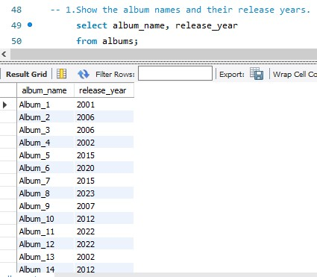
Simple Queries
1. Albums name and Release Year

Slide 10
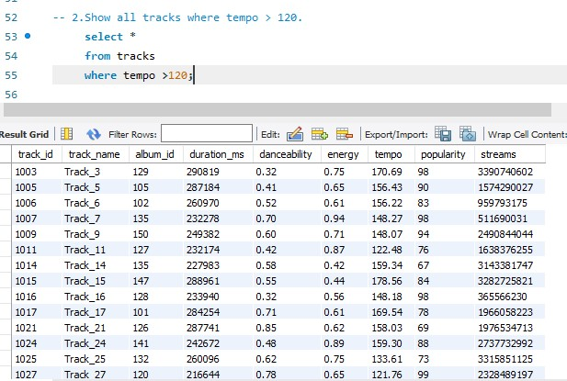
2.Tracks with tempo > 120

Slide 11
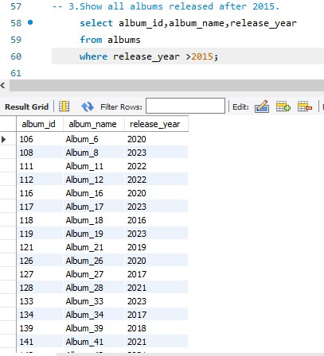
3.Albums after 2015

Slide 12
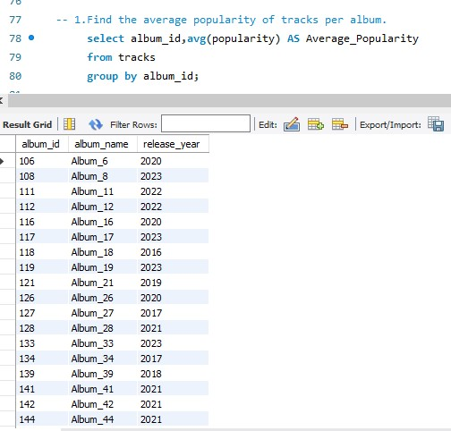
Intermediate Queries
1.Average track popularity per album

Slide 13
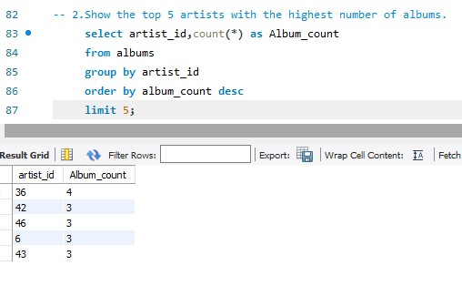
2.Top 5 artists by album count

Slide 14
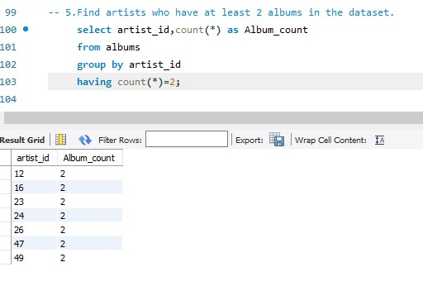
3.Artists with ≥ 2 albums

Slide 15
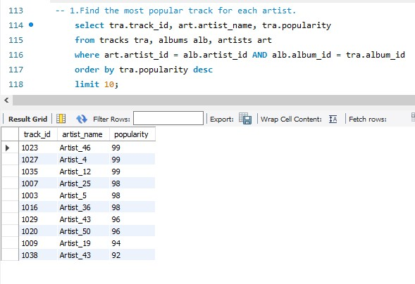
Advanced Queries
1.Most popular track per artist

Slide 16
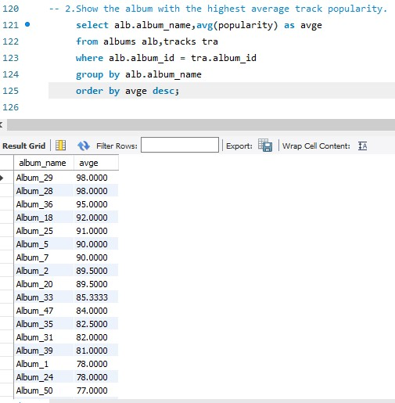
2.Album with highest avg popularity

Slide 17
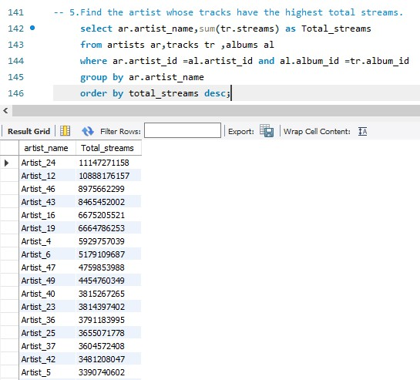
3.Artist tracks with highest Stream

Slide 18
Key Insights
Pop music dominates streams and remains the most popular genre.
Top artists consistently release hit albums that drive billions of streams.
Premium users are concentrated in a few countries (major markets).
Danceability and energy strongly influence track popularity.
Shorter, high-energy songs tend to perform better in streams.
User analysis shows steady growth in Premium subscriptions compared to Free users

Slide 19
Project Benefits
• Improved SQL querying skills.
• Hands-on experience with realistic dataset.
• Business use cases:
- Identify top-performing artists/tracks.
- Analyze subscription trends.

Slide 20
Conclusion
SQL helped transform raw Spotify data into valuable insights.
Identified top artists, most popular tracks, and key user trends.
Showed how energy, danceability, and other features impact popularity.
Highlighted subscription patterns across different countries.
Proved SQL as a powerful tool for analyzing real-world datasets.

Slide 21
Thank You

